Slide 1
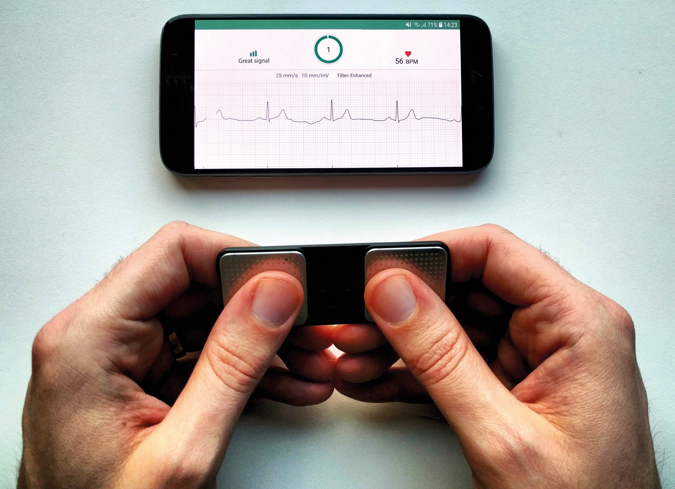
The Research Question
What is the diagnostic accuracy of the Alivecor Kardia 1-lead ECG device for:
Atrial fibrillation (AF)
Any rhythm abnormality
AF, premature beats, etc.
Any conduction abnormality
AV block, bundle branch block
…among consecutive primary care patients?

Slide 2
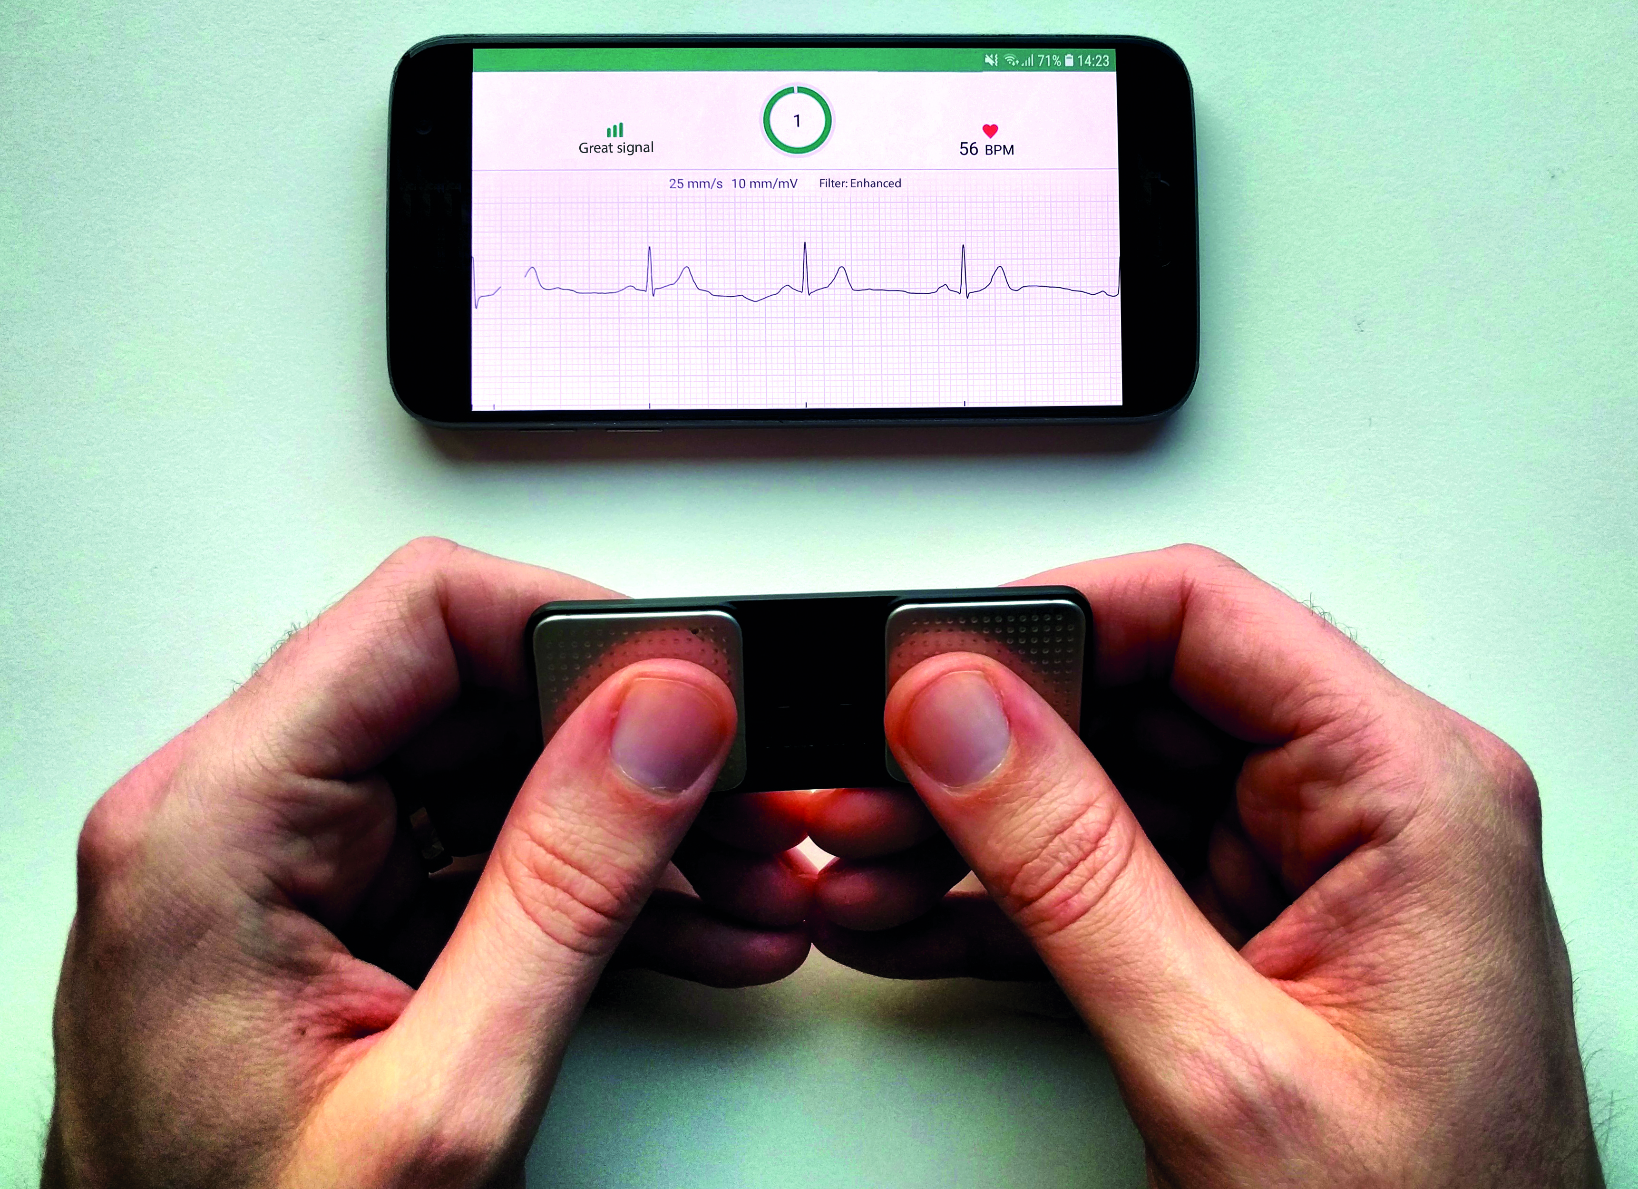
Research Design and Method
23
AF
Routine care
12-lead ECG
44
Any rhythm abnormality
n = 214
consecutive patients
ECG
as indicates by local GP
Cardiologist
Reference standard
Any conduction abnormality
28
10 sec
Index tests
AF
?
Alivecor 1-lead ECG
A
Any rhythm abnormality
?
Cardiologist
Any conduction abnormality
?
30 sec
B
AF
?

Slide 3
What the Research Found
Excellent! sens 100%, spec 100%
Good sens 87%, spec 98%
Sufficient sens 91%, spec 94%
Insufficient sens 46%, spec 100%
AF
Any rhythm abnormality
Any conduction abnormality

Slide 4
What this means for Clinical Practice
Kardia Alivecor can be used to detect and rule out AF in primary care when visually assessed by experienced ECG interpreters (here: cardiologists)
In-built algorithm also has high accuracy for AF, though not perfect
Other rhythm abnormalities (mainly PACs/PVCs) can also be detected with sufficient accuracy
Kardia cannot rule out conduction abnormalities in primary care patients

