Slide 1
Primary Care and COVID-19 Response and Recovery
Robert Graham Center
Notes:
Where will this slide show be presented
AAFP Research segment – cover it all
FMLC – predicting the future of family medicine – discuss telehealth, redeployment, payment
PBRN Conference – COVID response and recovery panel – quick overview

Slide 2
COVID-19 Response and Recovery
Graham Center uses historic data to make future projections.
What has primary care been doing?
What does that mean for today?
How to use what we know to create what we want?
COVID-19 Response -
COVID-19 Recovery –
The rest of primary care

Slide 3
Kerr White and PBRNs

Slide 4
Where do people go for their respiratory illness? Primary care, and hospital care for COVID-Like Illness
Notes:
Congressional Briefing 4.29.2020
Jack Westfall, MD, MPH – Director, Robert Graham Cetner
Thank you for the opportunity to share date from the Robert Graham Center for Policy Studies in Primary Care and HealthLandscape. The need for ambulatory primary care has increased over the past month. Patients with COVID-19 symptoms, illness, and questions are flooding primary care practices. And other illness is not sheltering in place; acute and chronic diseases did not go on holiday.
Primary care has had to dramatically change the way it delivers care. Physical distancing coupled with patient fear and uncertainty are changing the way patients contact their primary care provider. Patients have COVID-19 related symptoms and questions. And patients continue to have the acute, chronic, and preventive health needs they always have, from chest pain to asthma to well child checks and immunizations, primary care has worked hard to balance the need for in-person visits with the opportunity to provide telehealth visits. While facing an increase in patient need, the manner in which the care is delivered has shifted with a significant amount provided by telehealth, with a steady need for in-person care as well. Unfortunately, there has been inadequate support for both in-person visits and telehealth visits. The constant has been that patients continue to need primary care.
While there is urgency at the acute hospital setting, the vast majority of COVID Like Illness is seen out in the community and primary care setting. Last week, just 4.7% of emergency department visits reported to the CDC National Surveillance Program were due to COVID Like Illness (CLI).
Most patients with a respiratory illness receive care in the primary care. For instance. As seen in slide 1, In a given year, 19.5 million patients are seen by primary care for an upper respiratory illness and a URI is part of 64 million primary care visits. 10.7 million patients are seen for bronchitis during 82.5 million PC visits.
Each year, primary care physicians care for 9 million patients with pneumonia
In contrast, just 900,000 patients are hospitalized due to pneumonia.
While trying to balance in-person and virtual patient care, the payment for telehealth has been inadequate and often just missing. For primary care practices that have relied on fee-for-service payment, this shift has been devastating.
In Primary Care (PC)
In a given year, 19.5 million patients are seen by primary care for a URI and 64 million primary care visits include a diagnosis of URI, 10.7 million patients for LRI/bronchitis and 82.5 million PC visits include a diagnosis of LRI/bronchitis and 9 million patients for pneumonia and 38 million PC visits include a diagnosis of pneumonia.
Hospitals
Each year, 263,000 patients are hospitalized for URI, 372,000 are hospitalized for LRI, and 890,000 are hospitalized for pneumonia. 416,000 hospitalizations include the diagnosis of URI, 888,000 include the diagnosis of LRI, and 1.5 million hospitalizations include the diagnosis of pneumonia.

Slide 5
Proportion of encounters amenable to telehealth
Proportion of encounters amenable to telehealth
Telehealth amenable encounters | All Physicians |  | Primary Care Physicians
 | n | % | n | %
Yes | 299,347,453 | 35 | 165,333,984 | 42%
No | 551,348,168 | 65 | 228,884,017 | 58
Total | 850,695,621 | 100 | 394,218,001 | 100
Source: Author’s Analysis of the 2016 National Survey of Ambulatory Medical Care Survey weighted by patient weight.
Notes: Telehealth amenable encounter was coded as `0’ when at least one of the services required physical presence of the physician and `1’ if physical presence was not required.

Slide 6
73%

Slide 7
Proportion of encounters that require in-person visit
Physician Presence Required | All Physicians |  | Primary Care Physicians
 | n | % | n | %
Yes | 580,027,034 | 69 | 258,431,199 | 66%
No | 266,748,176 | 31 | 134,797,218 | 34
Total | 850,695,621 | 100 | 394,218,001 | 100
Source: National Ambulatory Medical Care Survey 2016
Notes:
We used 2016 NAMCS data to examine what proportion of outpatient visits required physician presence
We looked at services provided by all physicians in the data, and the proportion provided by primary care specifically
For both all physicians and primary care specifically a majority of services required in person visits by our estimates

Slide 8
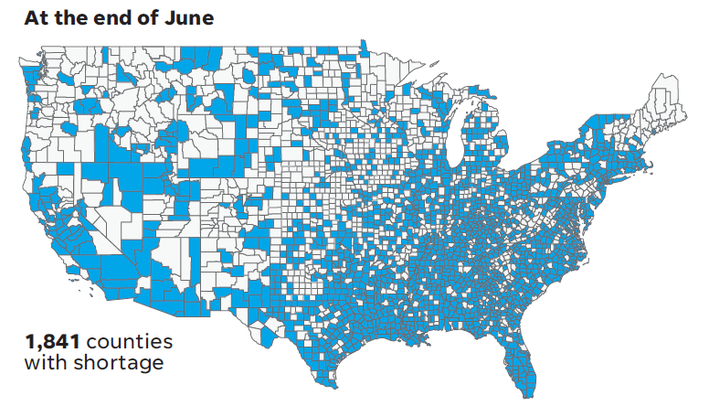
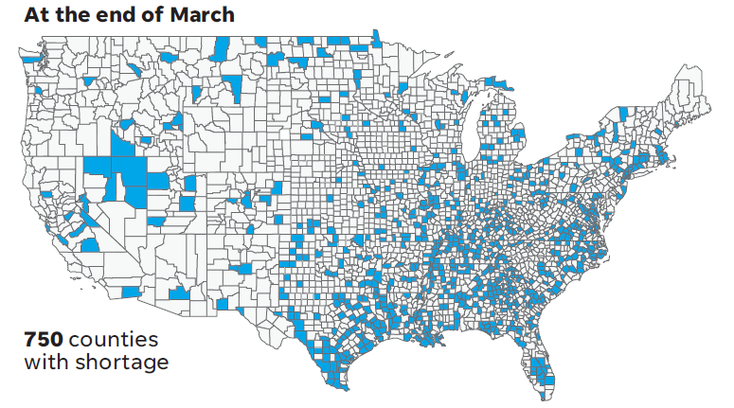
What if no one shows up? Primary care closure and furlough Projections with federal relief
Notes:
In early March, 2020, there were 138,707 family physicians, whose practices supported 1,872,907 jobs, including those of the physicians, for a total of $154 billion in wages and salaries. Based on lost revenue from patient visits, over the next 3 months upwards of 60,000 family physicians may cut back or stop practicing in their current location. The loss of primary care physicians is compounded by the resulting loss of 784,133 medical assistants, nurses, and other staff, and lost wages and salaries of $64 billion. In March of this year, 750 counties had a family physician shortage. Without significant policy changes, this may soar to 1,841 counties with family physician shortage as seen in this slide.
And the impact has been immediate. In late March the U.S. Bureau of Labor Statistics, reported 43,000 lost jobs already in healthcare, chiefly in ambulatory care including 12,000 in physician offices. Thank you for the opportunity to share these findings with you.

Slide 9
Redeployment Capacity Results

Slide 10
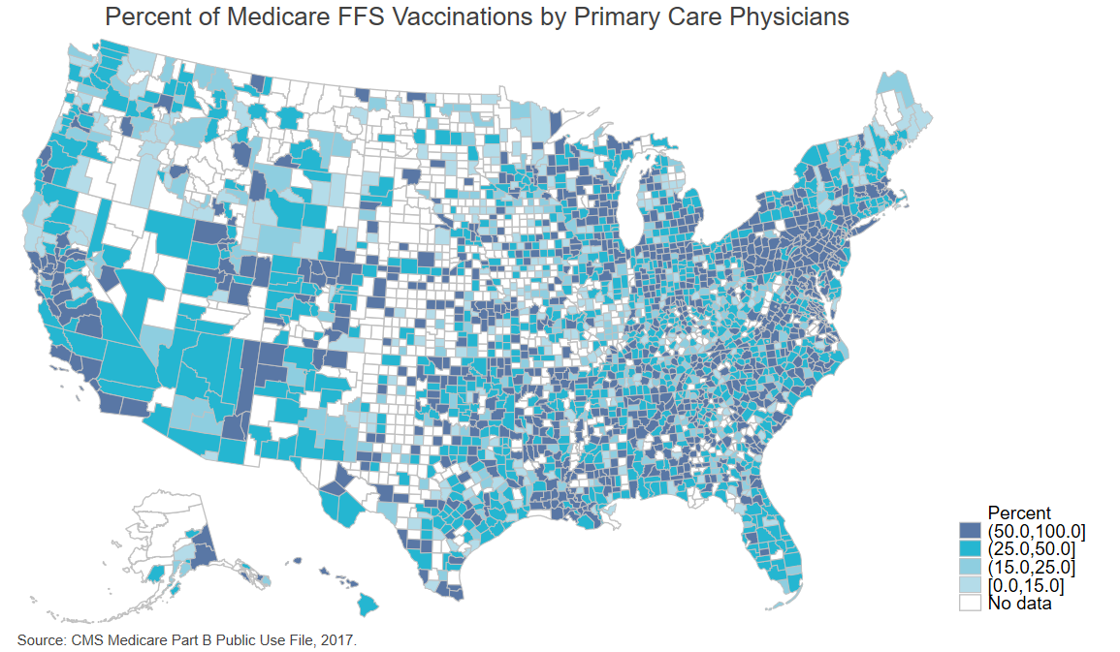
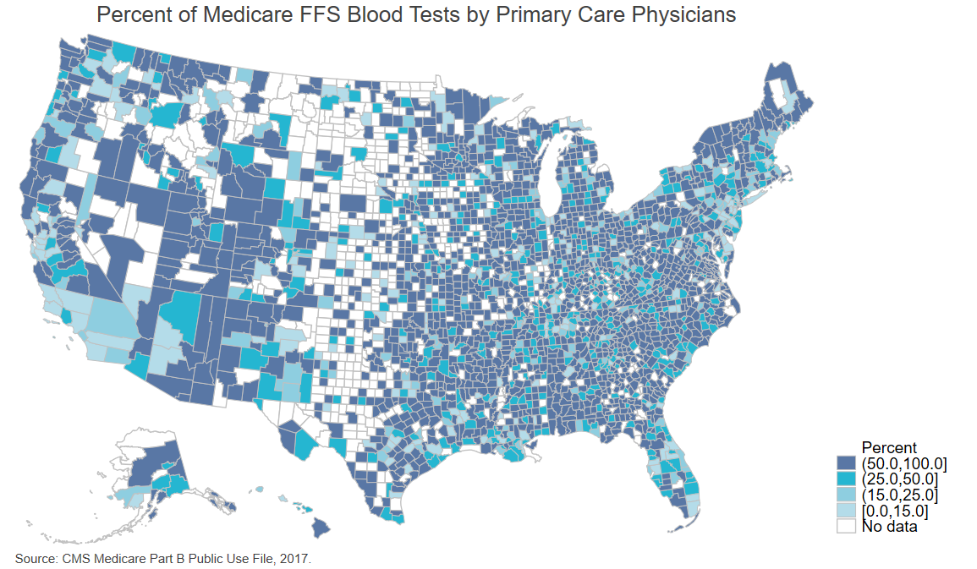
Where are blood test and vaccines done?

Slide 11
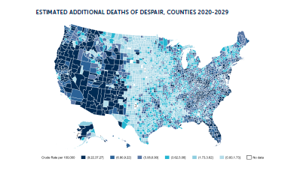

Slide 12
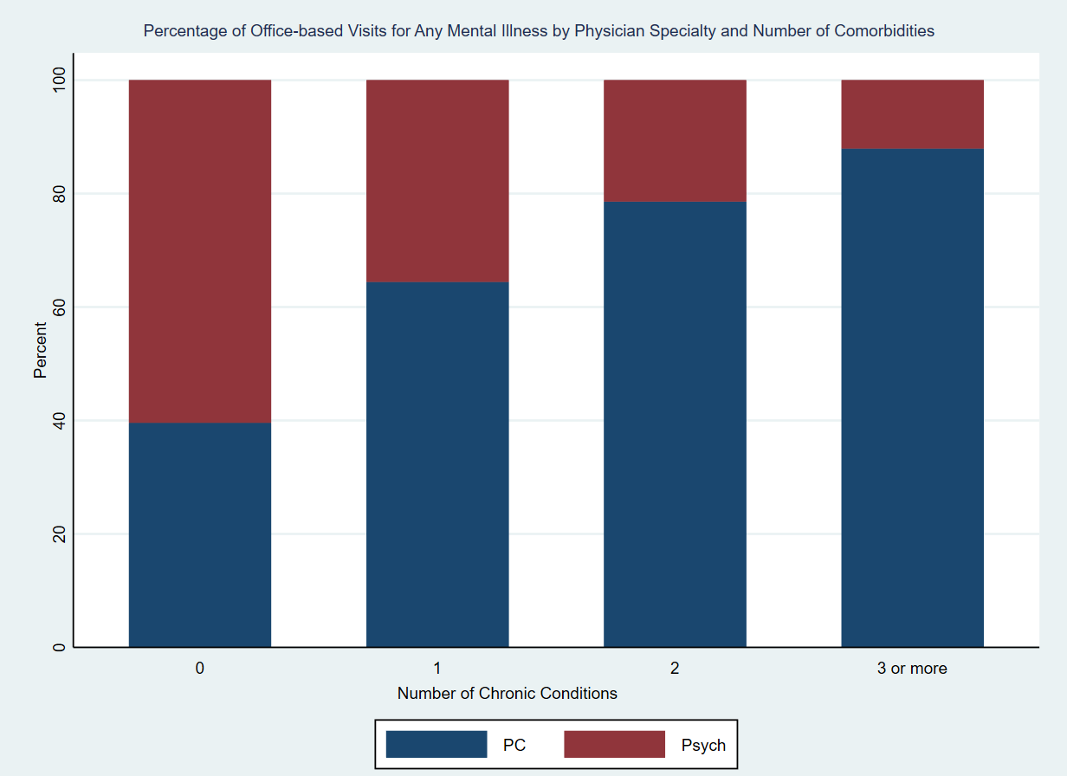

Slide 13
PREVENTION
DIAGNOSIS
SUPPORTIVE CARE
TRIAGE
MANAGEMENT OF SEQUELAE
REDEPLOYMENT

Slide 14
Projections – Reality – COVID-19 2020

