Slide 1
Advancing Primary Health Care for the Public Good

Slide 2
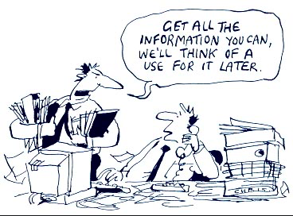
Quick Survey
3 Simple Rules
Data
Data
Data

Slide 3
American Academy of Family Physicians American Academy of Nurse Practitioners American Academy of Pediatrics American Academy of Physician Assistants American Board of Family Medicine American Board of Internal Medicine American College of Clinical Pharmacy American Geriatric Society American College of Physicians Anthem American Osteopathic Association Ariadne Labs Catalyst Health Network Family Medicine Education Consortium Direct Primary Care Alliance Heart of Virginia Health Care Lehigh Valley Health Network Maryland Department of Health Maine Medical Association North American Primary Care Research Group National Committee on Quality Assurance National Research Network Patient First Primary Care for All Oregon Practice-based Research Network Oklahoma Practice-based Research Network Primary Care Centers Round Table Sentara Quality Health Network Society for General Internal Medicine Society for the Teachers of Family Medicine Telligen The Institute for Integrative Health Tidewater Physicians Multispecialty Group University of Missouri School of Medicine University of Colorado Health System Virginia Center for Health Innovation Virginia Council of Nurse Practitioners Virginia Commonwealth University
Quick COVID-19 Primary Care
Survey
The Larry A Green Center
Primary Care Collaborative
3rd Conversation
17,000
Clinicians
18 weeks

Slide 4
The “new normal” – April
Decreased patient volume
Paid for less than half of their work
Furloughed or laid off staff
85%
66%
47%

Slide 5
The “new normal” – August 2020

Slide 6
March pandemic stressors persist

Slide 7
Second public health crisis brewing
Quick COVID-19 Primary Care Survey: July & August

Slide 8
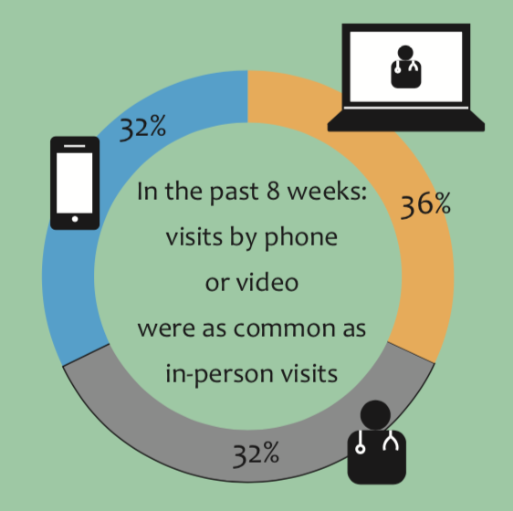
Telehealth boost
Quick COVID-19 Primary Care Survey: June

Slide 9
Telehealth bust
37%
FTF down, contact at all-time high
telehealth billing denied
future insurer
coverage uncertain
clinician pull back on use
13%
56%
52%
Quick COVID-19 Primary Care Survey: June

Slide 10
What happened to the social contract?
Worthy of your trust
Wholeness of your dignity
Patient first
Societal investment in this basic good

Slide 11
Patient surveys: 9,000
COVID patient volume
2019… 42% – at least once
COVID… 53% – 2x in 8 weeks
Possibility of losing their doctor?
32% panic, heartbroken
39% upset, lost

Slide 12
Patient view: Primary care during COVID
Valued Relationship
Clinicians say: 72%
Patients say: 77%
79% being seen ~ feel better
85% helps make sense of things
76% I can ask about anything
82% this is someone I trust
91%
First Contact
85%
Continuity
82%
Coordinated
80%
Comprehensive
Quick COVID-19 Primary Care Survey: June

Slide 13
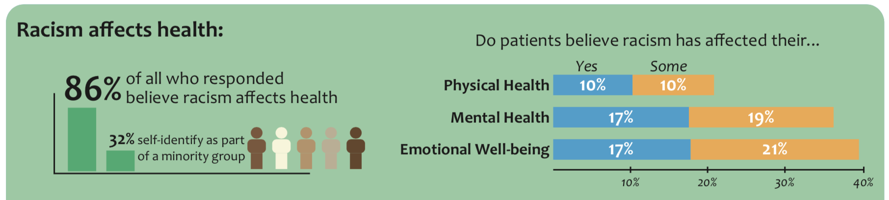
Clinicians said
Patients said
28%
Physical health
Mental health
Primary care helped
31%
Racism impact on patient health
56%
23%

Slide 14
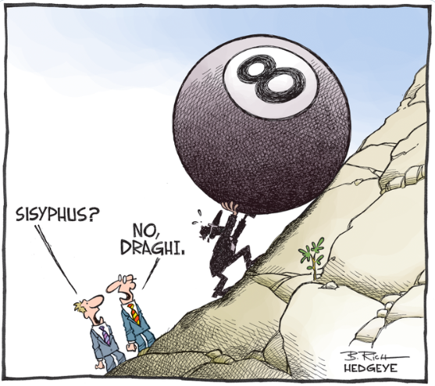
End Result
Professionalism is on the rise
Generalism is being rediscovered
Primary care can grow in the wild
The social contract between medicine and the public is at stake
NO,
PRIMARY
CARE

Slide 15
Questions / Comments
Sincere thanks to our funders
Morris-Singer Foundation
Samueli Foundation
Deep appreciate to the team and advisors
Christine Bechtel, Asaf Bitton, Erin Britton, Brendan Elliott, Martha Gonzalez, Larry Green, Ann Greiner, Lauren Hughes, Tony Kuzel, David Meyers, Will Miller, Jonathan O’Neal, Sarah Reves, Kurt Stange
Rebecca Etz, PhD. www.green-center.org

