Slide 1


Choose Your Own Adventure: PBRNs, Primary Care Learning Health Systems and Everything in Between
Onil Bhattacharyya
Frigon Blau Chair in Family Medicine Research at Women’s College Hospital
Associate Professor, Department of Family and Community Medicine
Notes:
Goal: Advance work of the CPCRN to become a national Primary Care LHS

Slide 2



Challenges in Primary Care
Attachment
Access
Human Resources
6.5 million Canadians are unattached to a primary care team
Of those connected to a primary care team, only 1 in 5 have same- or next-day access
Higher rates of retirement
Fewer med students choosing family medicine
Looking forward…
16% of family physicians are over the age of 65
Burnout continues to be a top contributor for retirement among health care providers
Notes:
Here’s our version of the primary care crisis
Access to primary care is consistently worse than peer countries
The word crisis is possibly a misnomer, because some things might be a bit worse, but really what I see is a growing gap between what is routinely done and what is theoretically possible. There is a failure of the imagination and a failure of ambition that, if we grasp it, could make primary care so much more than it ever was. Let me use an analogy to illustrate how we might adjust our ambitions, and what role PBRNs might play in operationalizing a different approach to primary care.

Slide 3


Notes:
Let me use an analogy to illustrate how we might adjust our ambitions, and what role PBRNs might play in operationalizing a different approach to primary care.

Slide 4

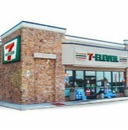

Notes:
Going from improving individual clinics to building networks of clinics that make care better is not particularly easy, but I think we have a sense of how to do it on a small scale. Given the theme of PBRNs past present and future, I would like to explore the range of options to make PBRNs more effective and the paths from PBRNs to building primary care’s role in LHS.
Strong primary care systems are associated with better population health outcomes, but I would say that in most countries they are not configured in a way that optimizes population health, just like convenience stores are not configured to optimize food security at a population level. I will draw mostly on examples from Canada, but every country will have a set of common and distinct choices in our quest to use PBRNs to build better health systems.

Slide 5



Challenges in Research
Relevance
Cumulative
Learning
Scale
Notes:
Priorities for researchers differ from policymakers and patients
Limited engagement between researchers, patients, health care providers, and decision makers contributes to this divide between research, policy and care
Duplication or minor variations research studies limit cumulative learning on top of the small sample sizes
We have enormous variation in Canada, but are unable to learn from it
Sustainability and scale is so infrequent we make a point of noting it
Hard to find funds to sustain project, even harder to scale them

Slide 6
Canadian Primary Care Research Network
Building Capacity
Governance
Increase capacity among researchers, clinicians, policymakers, community members, & Indigenous communities
Nurture a highly coordinated, decentralized network
Practice
Knowledge Translation & Exchange
Engagement
Generate and mobilize knowledge that informs and transforms practice
Create and nurture sustained partnerships with diverse partners
Know-
ledge
Data
Research Projects
Equity Diversity & Inclusion
Scale and spread successful patient-oriented research & innovation
Enrich and support opportunities for Indigenous and equity deserving people to become researchers in primary care
Notes:
Funded by the Canadian Institute for Health Research Strategy for Patient Oriented Research
$10M + $10M match
It is designed to address many of the challenges in Primary Care research
Engages patients, providers and policymakers in grant writing, budget allocation and ongoing governance
¼ of the executive includes patients as voting members
Funds 8 research projects that spread innovations across multiple provinces
Supports consolidation of a Primary Care Information System

Slide 7
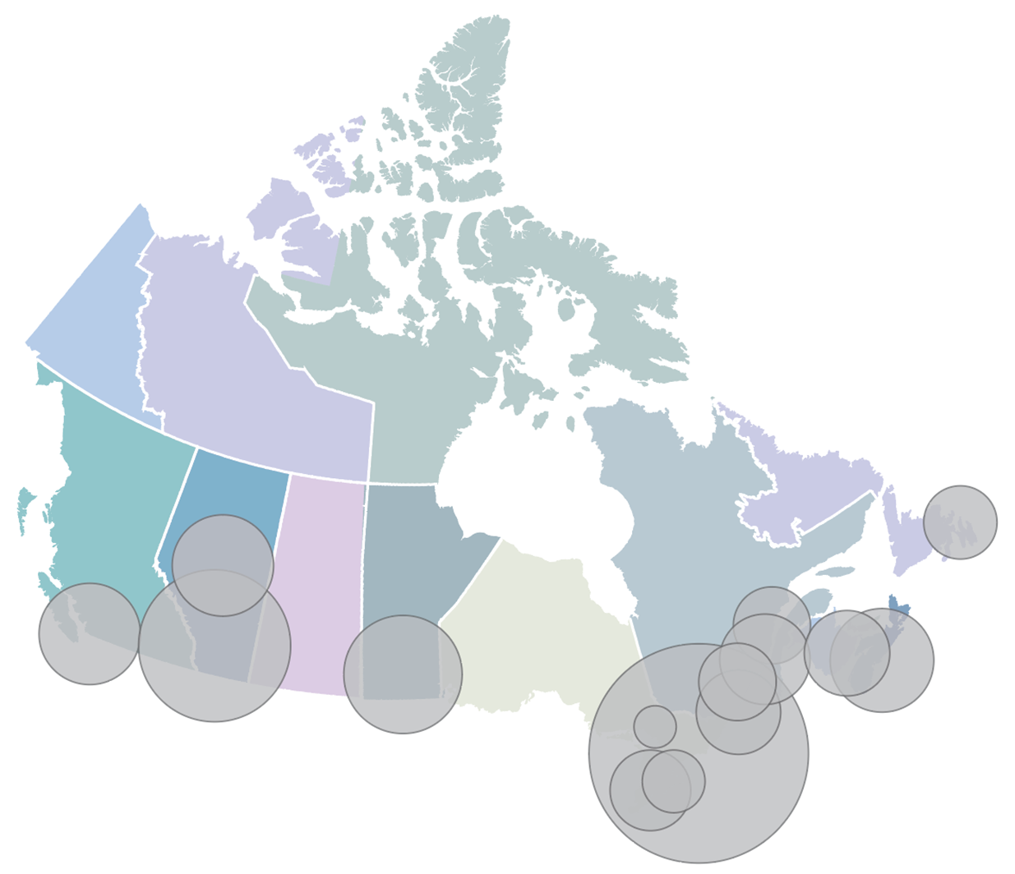
CPCRN Practice Based Research and Learning Networks
British Columbia (101 providers, 133K patients)
BC-PHCRN, Vancouver
Alberta (267 providers, 354K patients)
SAPCReN, Calgary
NAPCReN, Edmonton
Manitoba (249 providers, 267K patients)
MaPCReN, Winnipeg
Saskatchewan, NWT and PEI:
beginning stages
Ontario (719 providers, 1.4M)
DELPHI, London
UP-Learn, Toronto
EON, Kingston
MUSIC, Hamilton
OPEN, Ottawa
NOSM, Northern Ontario
Alliance of Healthier Communities (CHC data), Ontario
Quebec (130 providers, 47K)
RRSPUM-Réseau de recherche en soins
primaires de l'Université de Montréal
Réseau-1 Québec
Nova Scotia and New Brunswick (21 providers, 11K)
MaRNet and BRIC-NS, Halifax
CRIC, St. John
Newfoundland (64 providers, 85K)
APBRN and PRIME, St. John’s
Notes:
We support the development and growth of PBRLNs across the country
We added the “L” to signal that they go beyond research

Slide 8
Re/defining a PBRN
Practice-based research networks (PBRNs) are collaborations of researchers and primary care practitioners who are engaged in conducting health/care research, addressing questions and problems that emerge from daily practice, translating research findings into evidence-based practice, and improving the quality of healthcare.
Cited in Dania et al, JABFM 2021

Slide 9
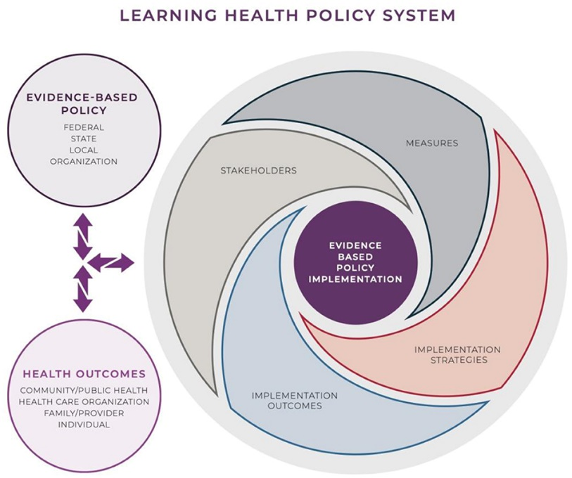



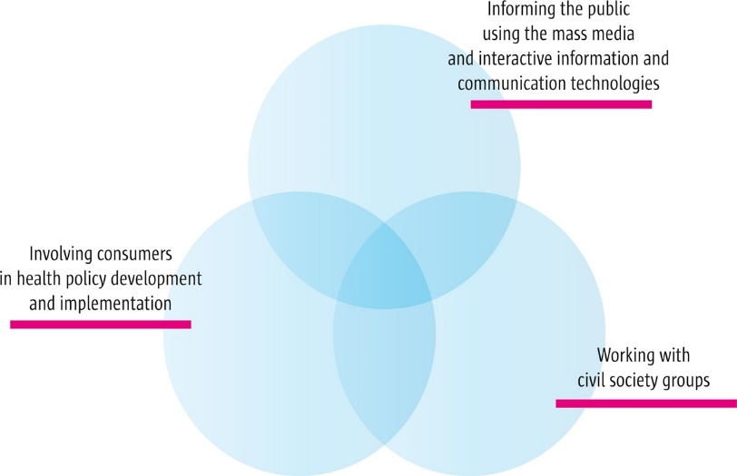
Areas of Focus for PBRNs
Community Engagement
Quality Improvement
Research
Informing Policy

Slide 10


Community Engagement
Notes:
Jack Westfall’s work on the Hight Plains Research Network is perhaps the most emblematic example of this focus
Community is involved in setting the research questions, engage participants and interpret results
Our very own Viv Ramsden, former NAPCRG president, is developing a PBRLN in Saskatchewan that is relationship driven, this involves understanding and knowing about someone through repeated interactions. Relational equity is about co-creating and carefully cultivating the work being undertaken. We hope to build on these relationships in co-creating a PBRLN which would undertake to answer questions that are meaningful to each of the clinics/Residency Training Sites in Saskatchewan.
This strategy not only mitigates potential power imbalances but also boosts the sustainability and quality of healthcare interventions.
They have put Site Scholarship Leads (family physicians) in each of the Residency Training Sites and are working towards having a two-person team of people with lived experience in each of these sites that could support and engage in education/learning, research and practice with the health care providers, researchers, decision-makers and other patients.

Slide 11


Quality Improvement
Notes:
The best example we have of this focus is AoHC, an organization of Community Health Centres in Ontario, where staff are salaried and the focus is on care for specific (and often structurally marginalized) populations.
Jenn Rayner leads the EPIC PBRN (and you can check out her poster at the conference), and as she describes it, the key features are:
Q come from providers and administrators
You collect the minimum quantity of data to act on the results
The studies directly advance organizational goals
The operations are lean but financially sustainable and do not require external grants

Slide 12

Research
Objectives
Tests current and emerging treatments for acute COVID-19
Study whether any acute treatment can prevent long COVID
Build an adaptive platform trial for other respiratory infections and future pandemics
Participants
Adults who tested positive for COVID with symptoms starting within the last 5 days and
aged 18-49 years with one or more chronic condition(s) OR aged 50+ years regardless of health status
546 participants recruited to date
Funded by a $10M grant from 3 federal agencies
Notes:
Research, on the other hand, is often expensive
You ask questions that researchers want to write a grant for and funders will pay for

Slide 13
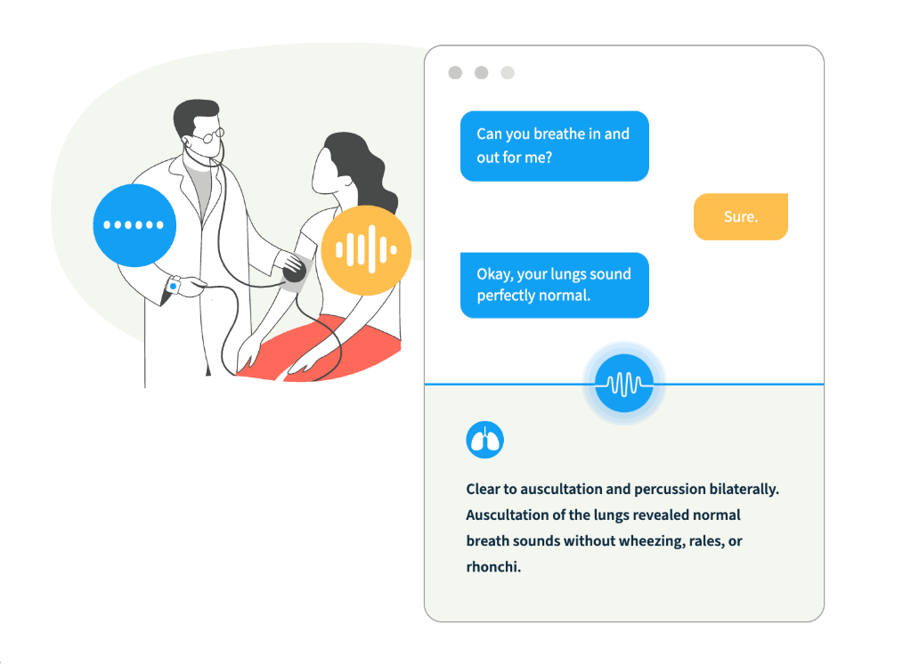

Informing Policy: Administrative Burden and AI
​Artificial intelligence (AI) scribes are software programs that capture and transcribe dialogue between patients and clinicians to automatically generate medical notes.
AI scribes and automation processes have the potential to alleviate administrative burden.
​Aim: To evaluate and describe the potential benefits and/or impacts of AI scribes and automation processes in primary care.
13
Notes:
My own work is based on answering questions for policymakers
They define the topic, the budget and the timeline
And we collaborate on the question and the implications

Slide 14



Research at the Pace of Policy
Phase 1: Discovery
October 2023 – March 2024
Phase 2: Implementation
April – June 2024
Competitive Analysis
Simulated Clinical Encounters
Implementation
Head-to-head comparison of the features, functions, and technical performance of 6 AI scribes in the Ontario market.
Clinical encounter between a
standardized patient and primary care provider using an AI scribe to assess performance and impact in a controlled lab environment.
Implementation of
3 AI scribes among
150 primary care providers across Ontario to understand use in real-life settings.
14

Slide 15



Next Steps
Simulations in Virtual Care Lab at WCH
Network of primary care clinics
Network of clinics is used to implement and evaluate other initiatives
Secure messaging
Digitizing clinical processes
Clinical decision support systems

Slide 16




Practice based research and learning network stages of maturity
FORMATION: Small group of primary care practices, patients and researchers.
GROWTH & EXPANSION: Expanded membership and establishment of basic research processes and governance structures.
KNOWLEDGE TRANSLATION, MOBILIZATION AND INNOVATION: contributes significantly to research and QI in the region; A leader in primary care research, driving innovation in clinical practice and research methods.
SUSTAINABILITY THRU EMBEDDED APPLIED RESEARCH AND EVIDENCE: achieves long-term sustainability and impact on primary care and research; provides system level leadership.
Notes:
Formation: Limited infrastructure, small-scale projects, minimal funding, initial clinician engagement
Growth and Expansion: Increased membership, modest funding, basic data collection, growing interest from clinicians and researchers. There is improved infrastructure, increased funding, involvement in multi-site studies, broader engagement with clinicians and patients.
KTM and Innovation: Well-established infrastructure, strong funding support, involvement in regional/national initiatives, routine dissemination of findings, active engagement of diverse stakeholders. Leading or spearheading research projects, developing novel interventions, contributing to policy development, strong recognition in the research community
Sustainability thru Embedded Applied Research and Evidence: Stable funding sources, ongoing research collaborations, sustained engagement of clinicians and patients, enduring impact on healthcare delivery

Slide 17
PBRN – Internal functions
 | Forming | Growth | KT + Mobilization | Sustainability
Leadership
Staff
Funding
Scientific Expertise
Data

Slide 18
Internal functions – Sample of Canadian PBRNs
 | Forming | Growth | KT + Mobilization | Sustainability | Total
Leadership |  | 5 | 2 | 2 | 9
Staff |  | 3 | 3 | 3 | 9
Funding |  | 3 | 5 | 1 | 9
Scientific Expertise |  | 3 | 5 | 1 | 9
Data |  | 3 | 3 | 3 | 9

Slide 19
External functions
 | Forming | Growth | KT + Mobilization | Sustainability
Learning network
Health workforce engagement
Patient and community engagement
Indigenous and EDG engagement

Slide 20
External functions – Sample of Canadian PBRNs
 | Forming | Growth | KT + Mobilization | Sustainability | Total
Learning network | 2 | 4 | 2 | 1 | 9
Health workforce engagement | 2 | 4 | 2 | 1 | 9
Patient and community engagement | 4 | 4 | 1 |  | 9
Indigenous and EDG engagement | 8 | 1 |  |  | 9

Slide 21

Governance and organizational leadership-120 clinics; Leadership team for improvement, strategy and information management.
Staff: Director of research and policy , Research and Evaluation lead, Policy Analyst , Knowledge Translation Specialist, Quality Improvement and Performance Leads
Funding: Stable funding; dedicated budget, special project funding and research reserve fund
Scientific expertise: Team with expertise in clinical informatics, public health and QI that leads projects
Data & technology: Data warehouse, data support, common metrics and patient experience measures; sends practice reports to clinicians and link data with administrative databases
Patient & community partner engagement: Patient advisory board with involvement in governance, research direction and co-design
Health workforce engagement: projects guided by staff advisory groups (admin, clinicians, team members); free up staff time to participate in research and other learning initiatives
Learning network: hosts communities of practice (e.g. community vaccination, social prescribing) which are open to non-members; 50% of sites have participated over the last 3 LCs

Slide 22
How do we support the growth of PBRNs?
Primary Care Information systems
Trial networks
Linking practice to policy through a living lab

Slide 23



Primary Care Information Systems

Slide 24


Support primary care researchers to design, fund and lead trials
Standardize and share approaches to study design, recruitment, consent, compensation, data collection and analysis
National collaboration and growth: support investigators and organizations, share resources, and promote collaboration
Centre communities: work collaboratively with communities to set research priorities and actively involve them in research processes
primarycaretrials.ca

Slide 25

Objectives
Partner with primary care and emergency departments to identify new viruses and detect future pandemics
Improve patient care and rapid testing for multiple viruses
Accelerate the development of treatments, vaccines and diagnostic tests
Create a system to link patients to ongoing clinical trials
PREPARED was funded by an $18.9M grant from the Canada Biomedical Research Fund (CBRF)
upstreamlab.org/prepared
Notes:
Identify new viruses and detect future pandemics: PREPARED partners with primary care and emergency departments to routinely collect samples from patients with respiratory symptoms and continuously scan electronic medical records.
Improve patient care and rapid testing for multiple viruses: PREPARED implements new, rapid testing systems for multiple viruses such as COVID-19, RSV, adenovirus, and influenza.
Accelerate the development of treatments, vaccines and diagnostic tests: PREPARED helps build healthier communities by engaging with industry partners specializing in the development of treatments, vaccines and diagnostic tests.
Link patients to clinical trials: PREPARED creates a system for referring patients with acute infections to ongoing trials. Accelerating innovation starts with safe and secure data sharing to inform developments, expedite research, reduce costs and improve product access, ultimately giving healthcare solutions back to communities.

Slide 26

30 partner institutions
16 primary care practice-based research networks in Alberta, British Columbia, Manitoba, Newfoundland and Labrador, Ontario, and Québec.
11 industry partners
upstreamlab.org/prepared

Slide 27

Primary care research ecosystem
Artificial setting
Natural setting
Multi-stakeholder
User-centric
Medium to long-term
Multi-methods
Living Lab Infrastructure
Schuurman D, De Marez L, Ballon P. Open innovation processes in living lab innovation systems: Insights from the LeYLab. Technology Innovation Management Review. 2013;3(11).
Notes:
Schuurman D, De Marez L, Ballon P. Open innovation processes in living lab innovation systems: Insights from the LeYLab. Technology Innovation Management Review. 2013;3(11).

Slide 28
CYOA – which path will you choose first?
Community Engagement
Quality Improvement
Research
Informing Policy
Notes:
Who is asking the question?
Who is providing resources?
Who is listening to the answer?

Slide 29
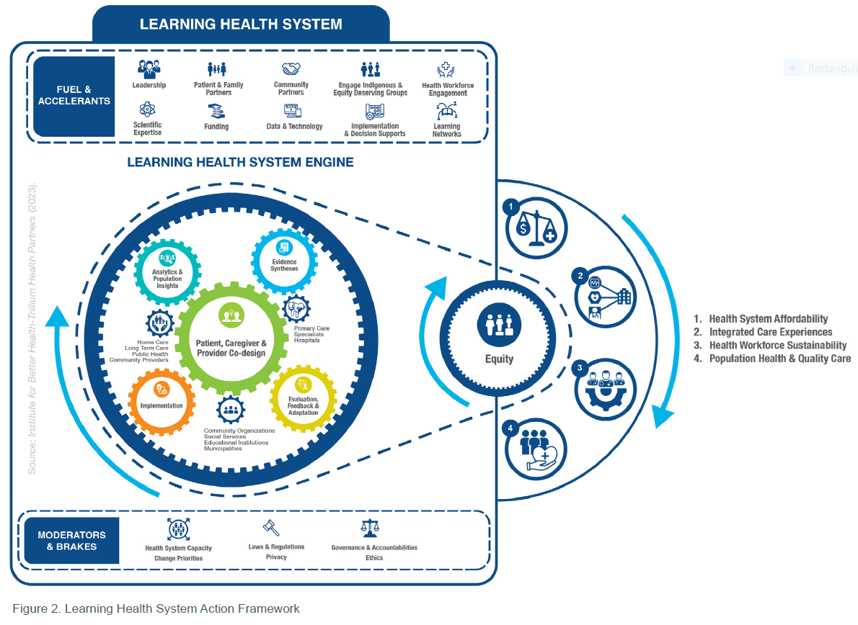
Putting it all together

Slide 30
Brenda Andreas
Co-Chair, Patient Council
Canadian Primary Care Research Network

Slide 31
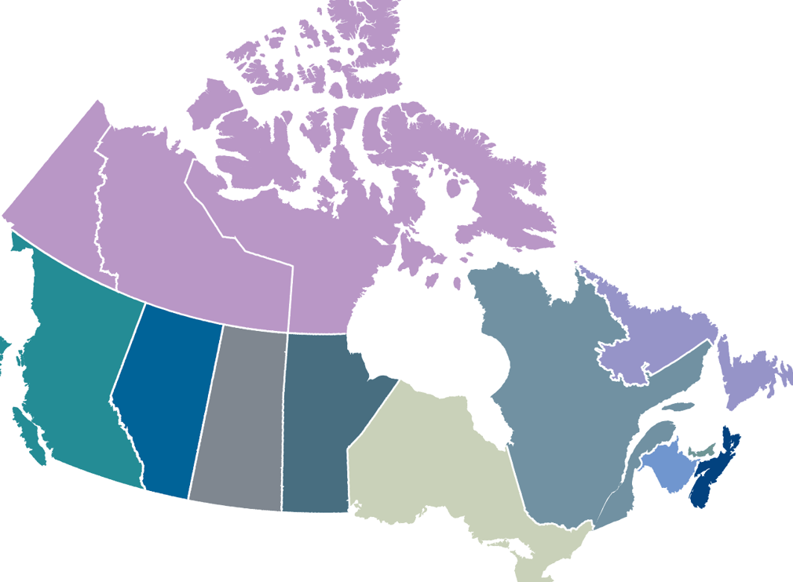








CPCRN Patient Council

Slide 32
CPCRN Members
Network Managers
Charlotte Schwarz, NB
Amy Svotelis, QC
Principal Investigators
Grailing Anthonisen, QC
Sarah Bhatti, ON
Krystal Binns, NB
Shelby Elkes, BC
Hennessey Ford, NWT
Charlotte Jensen, AB
Leanne Kosowan, MB
Jennifer Lawson, ON
Laurie Michael, PEI
Udoka Okpalauwaekwe, SK
Andrea Pike, NL
Onil Bhattacharyya, ON
Shelley Doucet, NB
Kimberly Fairman, NWT
Andreas Gruneir, AB
Gayle Halas, MB
Amanda Hall, NL
Catherine Hudon, QC
Ruth Lavergne, NS
William Montelparle, PEI
Vivian Ramsden, SK
Sabrina Wong, BC
Patient partners
Brenda Andreas, AB
Mpho Begin, MB
Jackie Hanson, SK
Steve Wolinsky, ON
Joanie Cranston, NL
Shaneel Pathak, AB
Ghislaine Rouly, QC
Policymakers
Jillian Paul, ON
Julia McFarlane, BC
Notes:
Introduce CPCRN and Learning Health System approach – what is it and what makes it different from other organizations?
The value is the continuous improvement and quality improvement approach that you bring and scaling it across networks – this is a key differentiator of CPCRN vs other organizations
Briefly explain LHS, how are we different than other initiatives (especially highlight governance, unique infrastructure/assets/expertise)

Slide 34






Subscribe to our newsletter:
upstreamlab.org
upstreamlab@unityhealth.to
@AndrewDPinto
@UpstreamLab
Upstream Lab

