Slide 1
The Research Question
A Comparison of the Male Osteoporosis Risk Estimation Score (MORES) and the FRAX® in Identifying Men at Risk for Osteoporosis
  Alvah R. Cass, MD, SM, Angela J. Shepherd, MD, Rechelle Asirot, MD, Maimoona Nizami, MD & Manju Mahajan, MD
How do the MORES and FRAX® compare in identifying men at risk for osteoporosis?
  FRAX®designed to assess the risk of future fracture with/without DXA scan (11 factors)
  2011 USPSTF endorsed FRAX for screening based on 10-year fracture risk
  MORES developed to identify men at risk of osteoporosis (age, wt, COPD)
  Family physicians are ideally suited to engage men in shared decisions regarding early detection and treatment of osteoporosis
Notes:
BP34 Adherence to Antibiotic Prescribing for LRTI and Association With Recovery (Oral Presentation On Completed Research) Nick Francis, MD, PhD, Cardiff University; David Gillespie; Jacqueline Nuttall; Paul Little; Theo Verheij; Samuel Coenen; Jochen Cals; Kerenza Hood; Herman Goossens; Christopher Butler

Slide 2
What the Researchers Did
Population: 1498 men from the NHANES III dataset, 50 years-of-age and older with a valid DXA scan
Design: Blinded comparisons of the MORES and FRAX® to identify men at risk for osteoporosis
Methods/Intervention:
  DXA scan: reference standard (T-score ≤ -2.5, femoral neck or total hip)
  Sensitivity, specificity, and ROCs for the MORES (positivity criterion ≥ 6 points) and FRAX® (positivity criterion 10-year fracture risk ≥ 9.3%)
  Proportions of men correctly identified for treatment based on National Osteoporosis Foundation (NOF) guidelines
Notes:
aged ≥18 years, consulting with an illness where an acute or worsened cough was the main or dominant symptom, or had a clinical presentation that suggested a lower respiratory tract infection that had been present for ≥28 days.

Slide 3
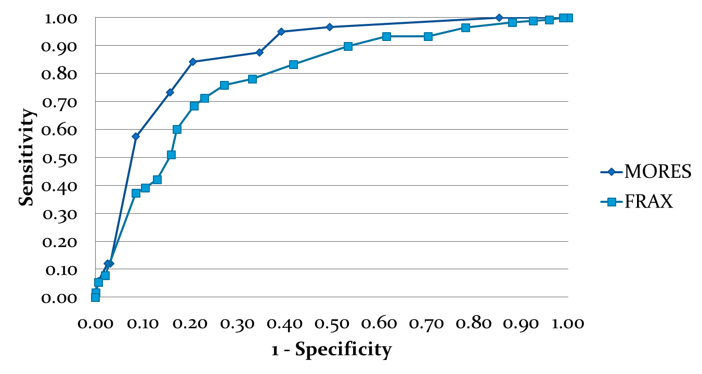
What the Researchers Found
4.5% (n=67) of the men had osteoporosis
11.9% (n=178) of the men were treatment candidates based on NOF guidelines
The MORES was more sensitive (96% v 39%) but less specific (61% v 89%) than the FRAX®
The MORES correctly identified 81.5% (n=145) men who met NOF treatment guidelines compared to only 50% (n=89) for the FRAX®
ROC Analysis
Area Under the Curve
  MORES – 0.87 (0.81, 0.92; 95% CI)
  FRAX® – 0.79 (0.74, 0.85; 95% CI)

Slide 4
What This Means for Clinical Practice
The MORES performed better than the FRAX® (using the USPSTF recommended threshold of 9.3%) to:
  identify men at risk for osteoporosis, and
  identify men most likely to benefit from treatment.
We suggest a two-staged approach for men aged ≥50 who are concerned about osteoporosis,
  1st: The MORES provides a simple clinical approach to identifying men at greatest risk for osteoporosis for whom a DXA scan is reasonable.
  2nd: Given the results of the DXA, the FRAX® provides an excellent approach to estimating 10-year fracture risk and guiding treatment decisions.

