Slide 1
Advancing Primary Care Transformation
Cross-border Perspectives
Robert Reid MD PhD
SVP Science, Trillium Health Partners, Mississauga, Ontario
Professor, Dalla Lana School of Public Health, University of Toronto
Professor, Health Research Methods, Evidence & Impact, McMaster University
March 2, 2017

Slide 2
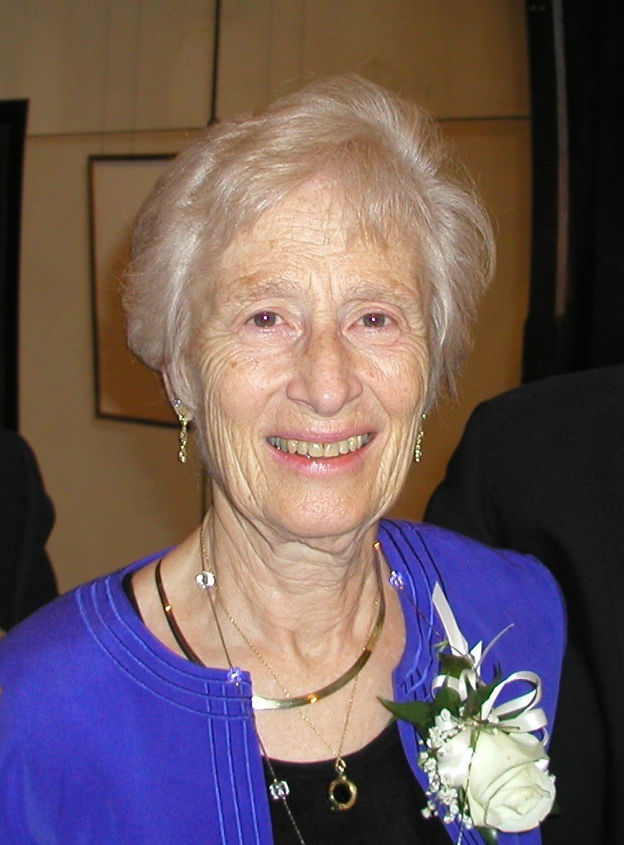
Primary Care Attributes are Universal
Accessibility Ability to get “in the door” for new problems
Continuity LT relationships independent of disease
Comprehensiveness Ability to respond to common issues
Coordination Integration with other care providers/sites
Family Centeredness
Community Orientation
Barbara Starfield MD 1932-2011
(Starfield 1998)

Slide 3
The Importance of Primary Care
Observational evidence is clear that healthcare systems that underscore primary care (access, continuity, comprehensiveness, care coordination) achieve:
  Better Health Outcomes
  Areas with stronger primary care associated with improved population health (YPLL, LE, birth weight, hospitalizations for ACS conditions)
  Attributes of primary care associated with better outcomes
  Lower Costs
    Stronger primary care systems yield fewer hospitalizations, and ED visits
    Areas with higher primary care supply have lower costs
  Better Equity
  Primary care mitigates the adverse health effects that come with social disadvantage
Starfield B et al. Milbank Q 2005
Shi L. Scientifica 2012

Slide 4
The Chronic Care Model
Health System
Health Care Organization
Community
Resources and Policies
Self-
Management
Support
Clinical
Information
Systems
Delivery
System
Design
Decision
Support
Informed,
Activated
Patient
Productive
Interactions
Prepared,
Proactive
Practice Team
Improved Outcomes
Wagner EH, Austin BT, Von Korff M. Improving outcomes in chronic illness. Managed care quarterly. 1996;4(2):12-25.

Slide 5
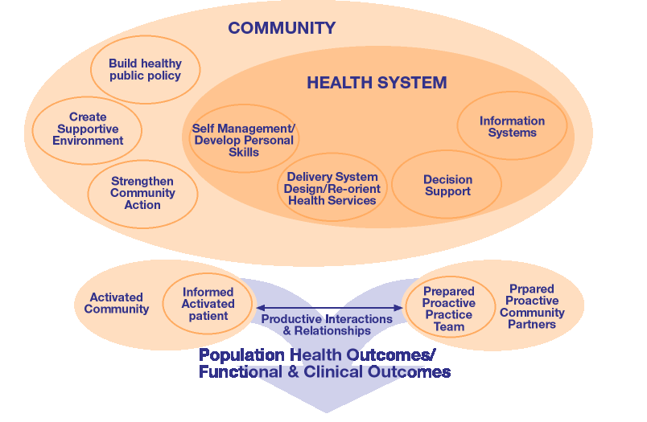
The Expanded Chronic Care Model
Barr VJ et al. Healthcare Q 2003:7(1):73-82.

Slide 6
Our Challenge
To find effective & affordable finding ways to finance organize care that can enable these universal tenets of primary health care & chronic care to
  meet the needs & aspirations across the population diversity
  accommodate for varying personal & community resources
  be reliably adopted & sustained across large populations
What can we learn from each other?

Slide 7


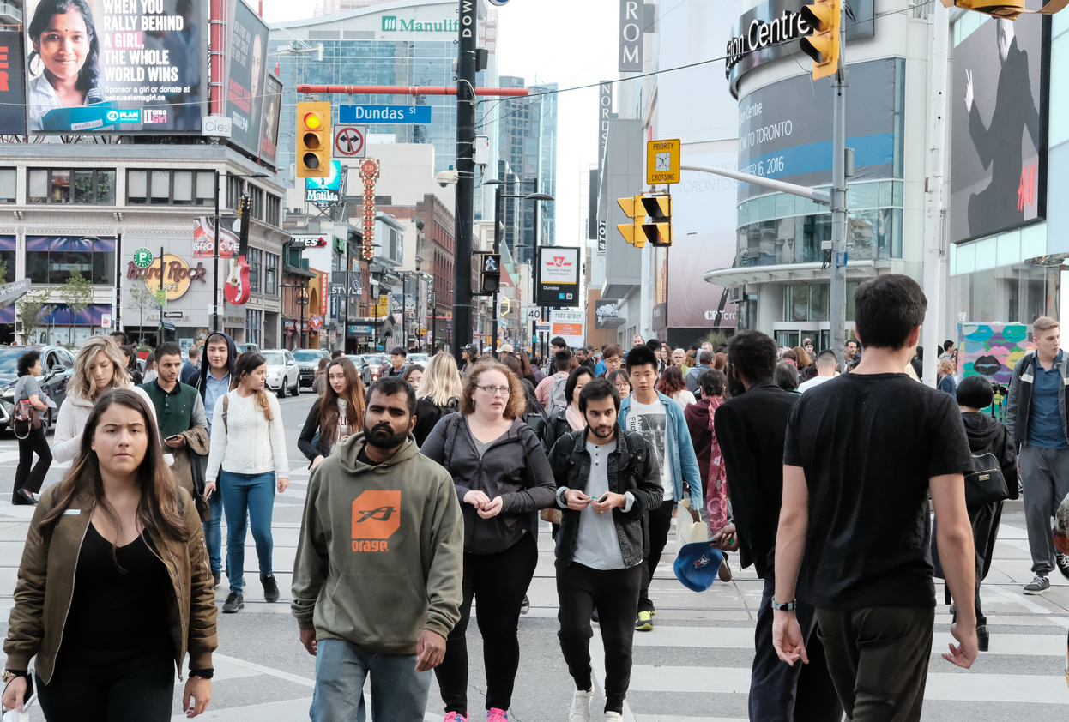

Do Canadians & Americans differ in their needs for primary care?

Slide 8
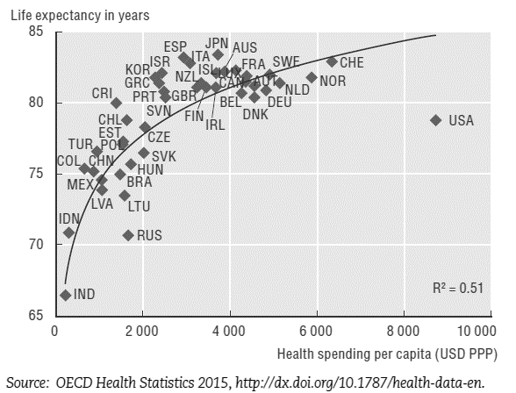
Life expectancy at birth and health spending per capita, OECD countries, 2013
Life Expectancy at Birth (years) | 81.8 | 78.8
Health Spending per capita (PPP) | $4,531 | $8,713
Source: OECD Health Statistics 2015, http://dx.doi.org/10.1787/health-data-en.

Slide 9
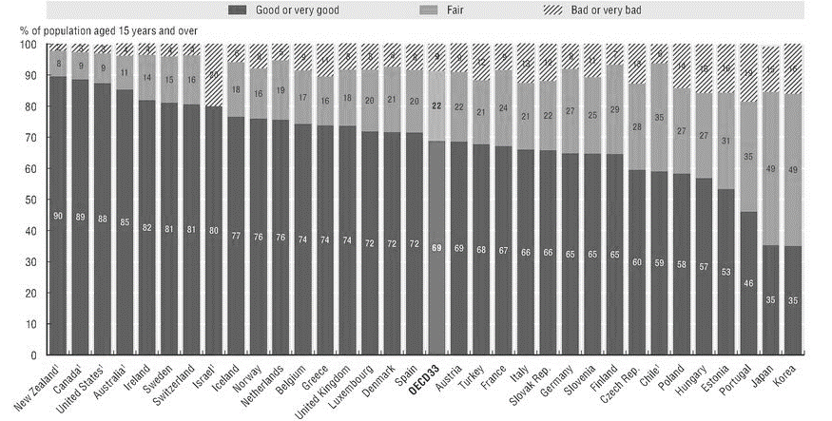
Self-Rated Health Status, OECD, 2013
3
3
9
9
% Good / V Good Health / Excellent | 89% | 88%
% Fair Health | 9% | 9%
% Poor / Health | 3% | 3%
89
88
Source: OECD Health Statistics 2015, http://dx.doi.org/10.1787/health-data-en.

Slide 10
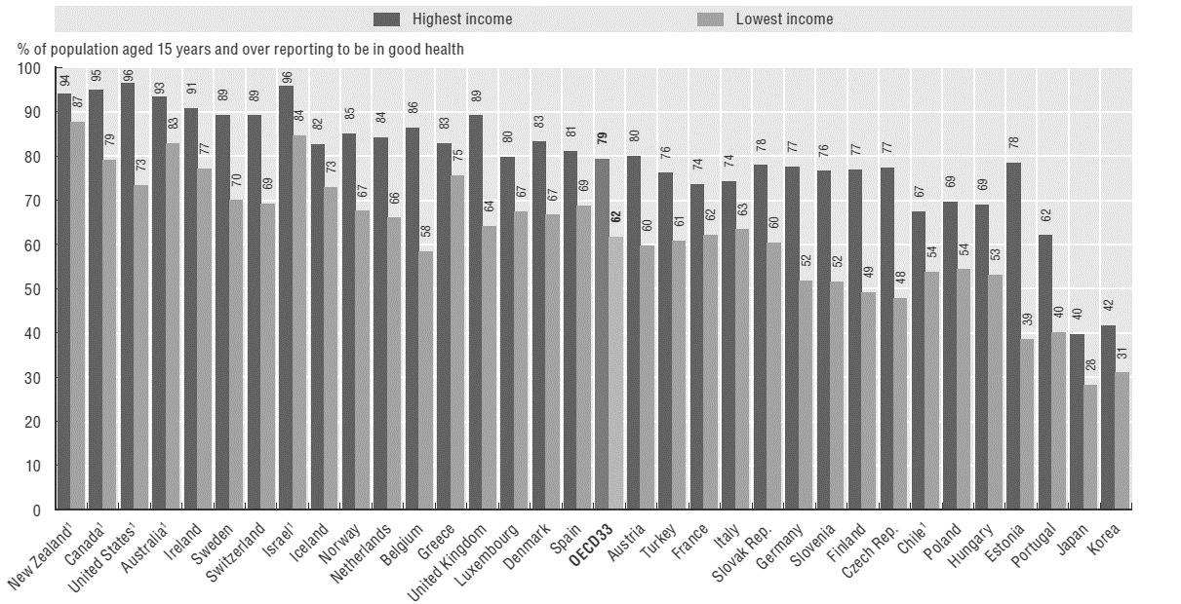
Self-Rated Health Status by Income Level, OECD Countries, 2013
% Good/ V Good Health – Highest Income | 95% | 96%
% Good/ V Good Health – Lowest Income | 79% | 73%
Source: OECD Health Statistics 2015, http://dx.doi.org/10.1787/health-data-en.

Slide 11
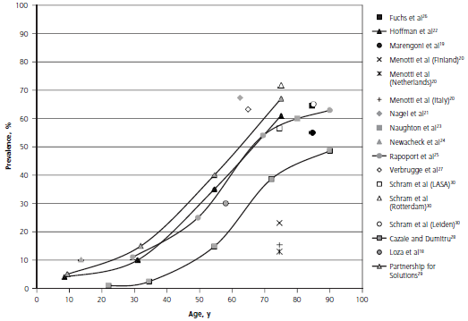
Prevalence of Multi-morbidity (≥2 Chronic Diseases)
Cross National Evidence Synthesis
Source: Fortin M et al Ann Fam Med 2012

Slide 12
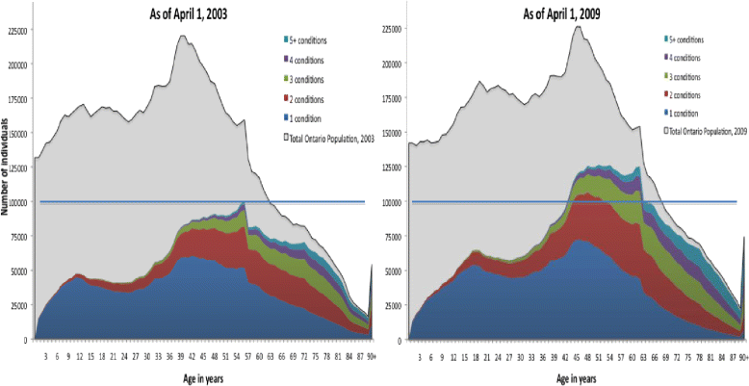
Increasing Burden of Morbidity in Ontario Canada, 2003-2009
Source: Koné Pefoyo et al. BMC Public Health (2015) 15:415

Slide 13

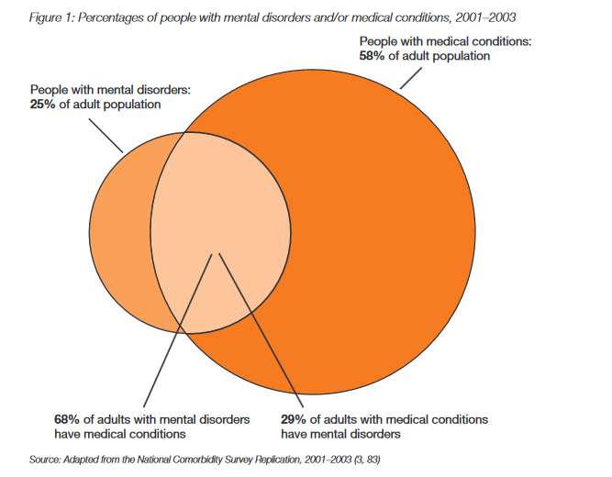
% US Adults with Mental Disorders and/or Medical Conditions, 2001-2003
Source: Druss BG, et al. 2011 Mental disorders and medical comorbidity. Research Synthesis Report no. 21. RWJF.

Slide 14
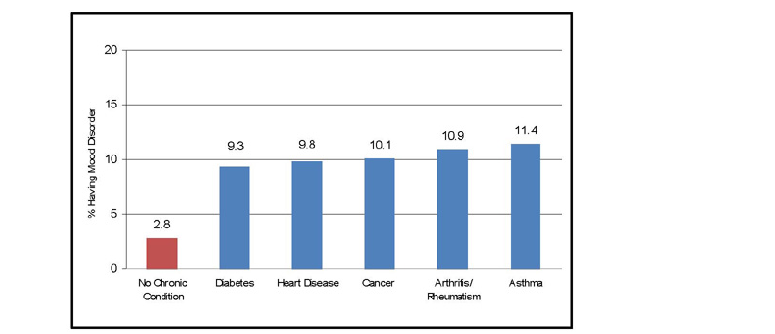
Mood Disorder Rates in Ontario by Chronic Medical Illness
Source: Gadalla T. Chronic Diseases in Canada 2008;28:148-154

Slide 15

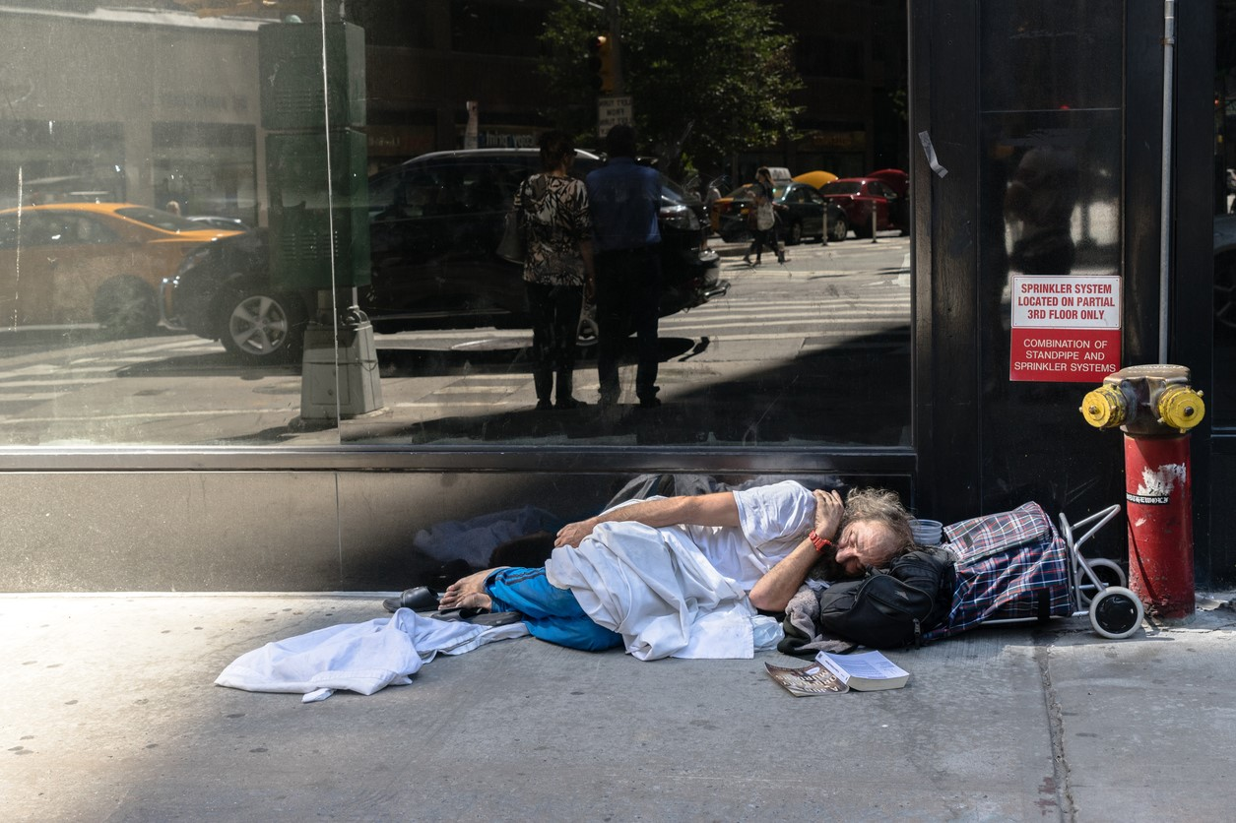
Do Canadians & Americans differ in their capacities & resources?

Slide 16
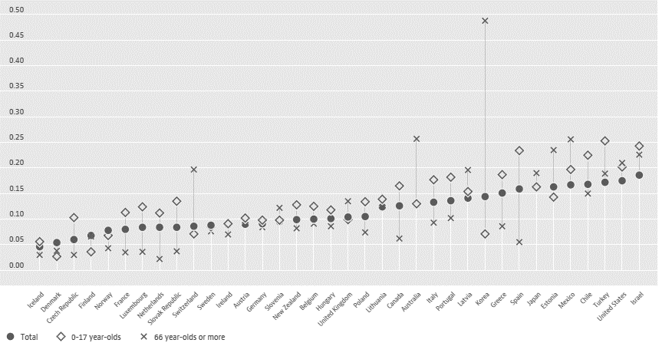
Poverty Rate, Total & by Age Group, OECD Countries, 2014
Total Population | 0.126 | 0.175
0-17 year olds | 0.165 | 0.202
65+ year olds | 0.062 | 0.210
×
Note: Poverty rate is the ratio of the population whose income falls below the poverty line; taken as half the median household income of the total population.
×
Source: OECD (2017), Poverty rate (indicator). 10.1787/0fe1315d-en.

Slide 17
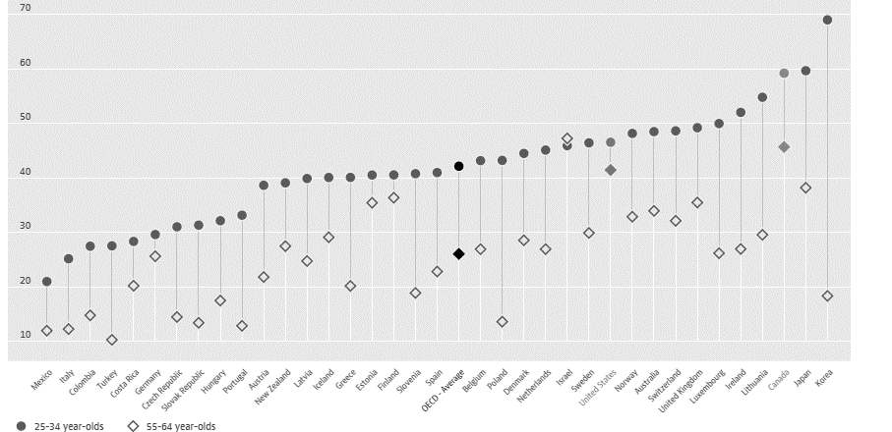
Educational Attainment, OECD Countries, 2014
% with Tertiary Education
25-34 year olds | 59.2% | 46.5%
55-64 year olds | 45.7% | 41.4%
Note: Population with tertiary education is defined as those having completed educational programmes leading to advanced research or high skill professions such as medicine and more vocational programmes leading to the labour market.
Source: OECD (2017), Population with tertiary education (indicator). 10.1787/0b8f90e9-en.

Slide 18
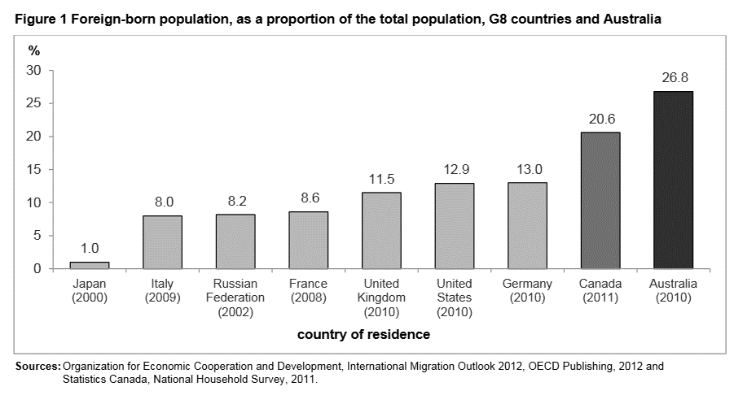
Immigration is characteristic of Canada & USA

Slide 19
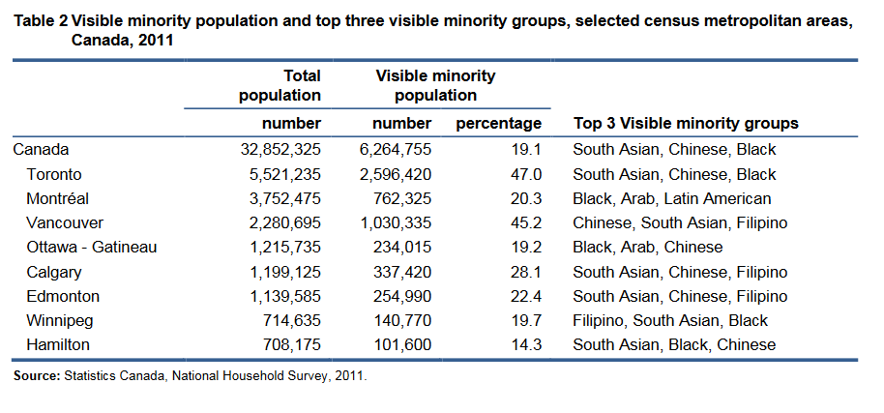

Slide 20

Americans & Canadians are Unevenly Distributed

Slide 21
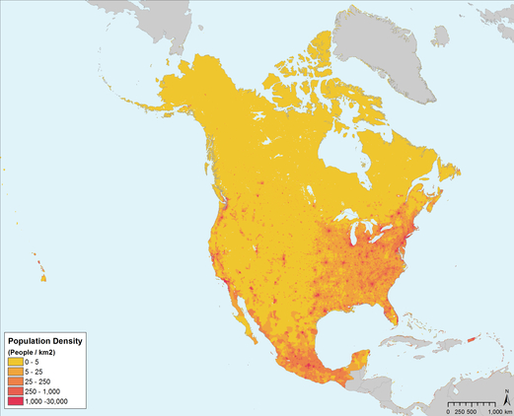
Americans & Canadians are Unevenly Distributed
North American Population Density, 2000
321 million people (2015)
Land area: 9,148k km²
81% live in urban areas
80% within 60 miles of coast
West region has highest urban concentration
36 million people (2015)
Land area: 9,093k km²
80% live in urban areas
90% within 600km of USA
10% spread sporadically across 90% of land mass
Source: Gridded Population of the World, Version 3 (GPWv3). SEDAC, Columbia University. Palisades, NY.

Slide 22
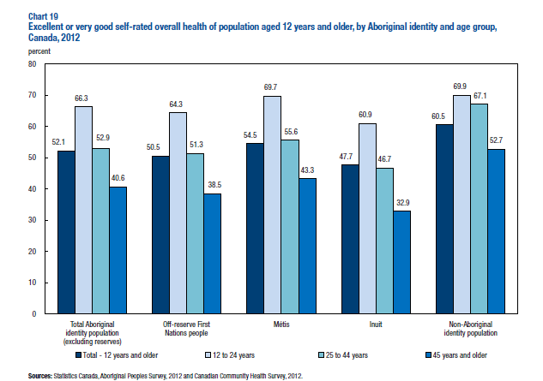
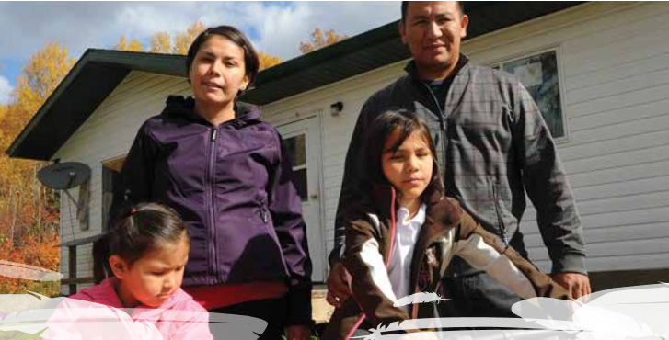
Large Disparities in Health For Aboriginal Canadians
The Report of the Royal Commission on Aboriginal Peoples
“Aboriginal people are at the bottom of almost every available index of socioeconomic well-being, whether [they] are measuring educational levels, employment opportunities, housing conditions, per capita incomes or any of the other conditions that give non-Aboriginal Canadians one of the highest standards of living in the world.”

Slide 23
Myths & Realities of Canadian & American Health Care
Pop Quiz Part 1
True or False?
The Canadian Healthcare System is based out of Ottawa
Almost all healthcare spending comes from public sources
Universal, first-dollar coverage for hospital, MD, & diagnostic serv
Universal benefit for medications, LTC, dental, home, vision care
Most MDs are self-employed
Fee-for-service remains most common payment method in primary care
Most patients are rostered/paneled with a PCP or clinic
FALSE
Healthcare is provincial responsibility
FALSE
~70% of spending is public
TRUE*
No copays/coinsurance for “needed” services
FALSE
Patchwork of programs across country
TRUE
Most self-employed and in private practice
TRUE
FFS dominates, but growth in many
Provinces/regions with alternate payments
FALSE
Most have free choice at point of care

Slide 24
Myths & Realities of Canadian & American Healthcare
Pop Quiz #2
True or False?
Healthcare insurance is a “shared responsibility” between government, employers, and individuals
The US does not have good examples “single payer” healthcare
Most healthcare spending is private (non-government)
Many patients are covered by both public & private insurance
Most primary care physicians are self-employed
Patients have free choice of provider or clinic
TRUE
Highly fragmented insurance system with gaps in insurance coverage
FALSE
Medicare covers all US seniors with defined benefit
TRUE*
52% of US healthcare is privately financed
TRUE
Overlap in insurance is common
TRUE
Yes, but growth in large group practices with salaried physicians
FALSE
Patients are often obliged to choose MDs in a defined network

Slide 25
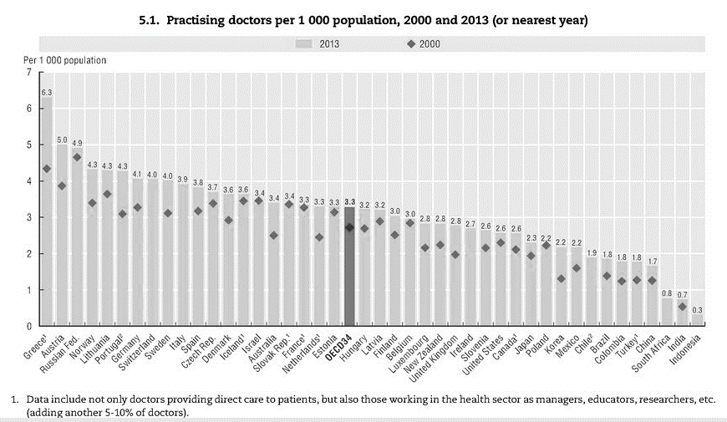
Physician Supply
Physicians per 1,000 pop, OECD Countries, 2000 2013
MDs per 1,000 | 2.6 | 2.6

Slide 26
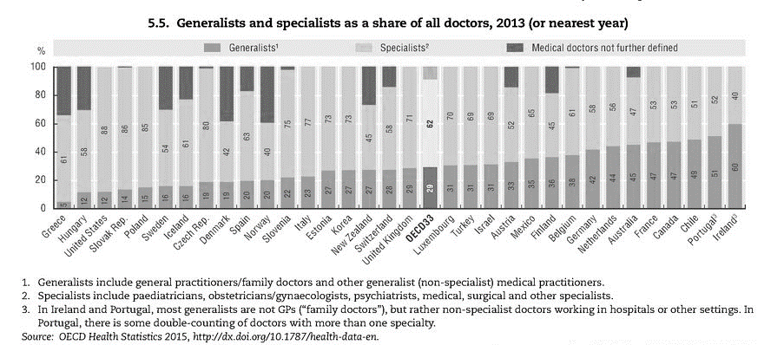
Balance of Primary Care & Specialty Care
Percent Generalist & Specialist Physicians , OECD Countries, 2013
% Generalist MDs | 47% | 12%
% Specialist MDs | 53% | 88%
53
88
47
12
Source: OECD Health Statistics 2015, http://dx.doi.org/10.1787/health-data-en.

Slide 27

Are there gaps in primary care delivery in Canada & USA?

Slide 28

Primary Care: Views of Canadians & Americans
Results From The Commonwealth Fund’s 2016 Survey of Adults in 11 Countries
 | Selected Measures | % of Adults Reporting… |  |  | CMWF Avg
Access | Same- or Next-day Appts | .. getting same/next day appt. last time sick or need medical attn. | 43% | 51% | 75%
 | After-Hours Care | ...getting after hours care very or somewhat easily | 34% | 42% | 43%
 | Avoidable ER Use | … an ER visit that could have been avoided if reg MD was avail | 41% | 47% | 34%
 | Email Access | …emailing practice with a medical question in last 2 years | 4% | 12% | 8%
 | MD Visit Cost Barriers | … not visiting an MD because of cost | 6% | 22% | 9%
 | Rx Cost Barriers | … not filling an Rx or skipping medication because of cost | 10% | 18% | 6%
  Source: CIHI. How Canada Compares: Results From The Commonwealth Fund’s 2016 International Health Policy Survey of Adults in 11 Countries. Ottawa, ON: 2017.

Slide 29
Primary Care: Views of Canadians & Americans
Results From The Commonwealth Fund’s 2016 Survey of Adults in 11 Countries
 | Selected Measures | % of Adults Reporting… |  |  | CMWF Avg
Continuity | Regular Source of Care | …having usual doctor | 85% | 77% | 85%
 | Knowledge of Med Hist | …regular doctor did not “always” or often” know important info | 14% | 16% | --
  Source: CIHI. How Canada Compares: Results From The Commonwealth Fund’s 2016 International Health Policy Survey of Adults in 11 Countries. Ottawa, ON: 2017.

Slide 30
Primary Care: Views of Canadians & Americans
Results From The Commonwealth Fund’s 2016 Survey of Adults in 11 Countries
 | Selected Measures | % of Adults Reporting.. |  |  | CMWF Avg
Coordination | Specialist Waiting Time | …waiting 4+ weeks to see a specialist in past 2 years | 56% | 24% | 36%
 | Information Availability | …specialists not having basic information from regular MD | 13% | 17% | 15%
 |  | …regular MD was not up to date on care received from specialist | 21% | 23% | 19%
  Source: CIHI. How Canada Compares: Results From The Commonwealth Fund’s 2016 International Health Policy Survey of Adults in 11 Countries. Ottawa, ON: 2017.

Slide 31
PRIMARY CARE: VIEWS OF CANADIANS & AMERICANS
Variability across Canada in Patient Reports of Access
While results are below the international average in most parts of the country, some provinces report timelier access to regular care.
 | N.L. | P.E.I. | N.S. | N.B. | Que. | Ont. | Man. | Sask. | Alta. | B.C. | Can. | CMWF avg.
Able to get same- or next-day appointment to see a doctor or a nurse | 34% | 30% | 34% | 33% | 39% | 44% | 47% | 49% | 48% | 44% | 43% | 57%
Very/somewhat easy to get medical care in the evenings, on weekends or on holidays without going to the hospital emergency department | 16% | 25% | 26% | 35% | 27% | 40% | 34% | 32% | 42% | 27% | 34% | 43%
Always/often receive an answer the same day when they contact their regular doctor’s office with a medical concern | 61% | 70% | 64% | 50% | 54% | 62% | 57% | 51% | 58% | 64% | 59% | 72%
Same as average
Below average
  Source: CIHI. How Canada Compares: Results From The Commonwealth Fund’s 2016 International Health Policy Survey of Adults in 11 Countries. Ottawa, ON: 2017.

Slide 32
Primary Care: Views of Canadians & Americans
Percent of adults with a chronic condition who…
  Source: Osborne R, et al. Health Affairs 2016:35:2327-2336.

Slide 33
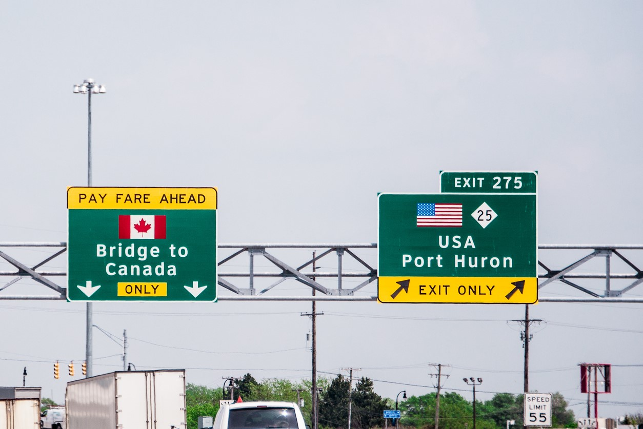
Cross-national comparisons can lead to important learnings

Slide 34
Thank you.
Robert.Reid@thp.org

