Slide 1
Building Bridges to Integrate Care – Incubating New Models for Complex Needs
Onil Bhattacharyya, MD PHD
Frigon Blau Chair in Family Medicine Research
Women’s College Hospital, University of Toronto

Slide 2
Goal of BRIDGES
Use an incubator model to develop, implement, and evaluate innovative models of care for people with complex needs
Family Medicine
Community Care
Medicine
Psychiatry
Primary Care
Hospital
Care
Integrating Across Disciplines
Integrating Across the Continuum
Notes:
BRIDGES is an Ontario Ministry of Health and Long-term Care funded initiative, jointly led by the Departments of Medicine, Psychiatry and Family & Community Medicine at the University of Toronto, to develop and test nine new models of care which link hospitals, primary care clinics and community services to provide comprehensive care to people with complex chronic disease. These models aim to: (i) engage multiple institutions and health care providers to deliver more integrated care, (ii) optimize health outcomes and the use of health care resources, and (iii) have the potential to be replicated across the province. BRIDGES will inform provincial efforts to improve health care transitions by highlighting successful models, providing local evidence of their application, and creating an impetus for health system change.

Slide 3
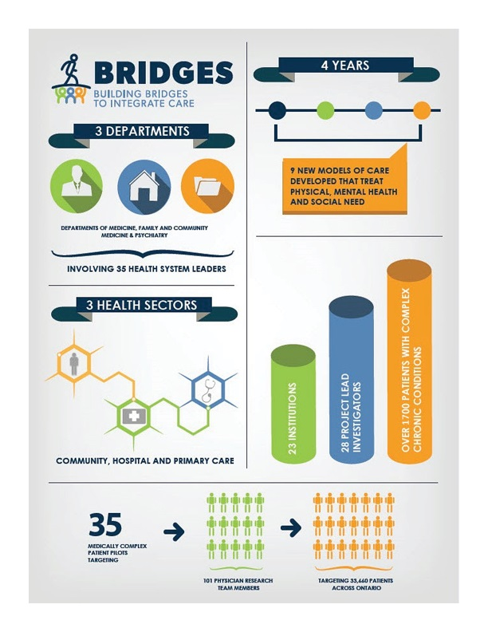

Slide 4
The BRIDGES Process
Solicit
Select
Support
Scale

Slide 5
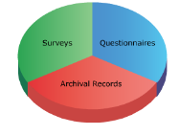


BRIDGES approach
Mixed methods evaluation
Over 2,300 Patients with Complex Chronic Conditions
  Academic and front-line expertise
28 Project Investigators
Front-Line Providers
Academics
23 Institutions

Slide 6
Project | Population | Model
IMPACT Plus | Complex patients | Multidisciplinary team consultation
IHBPC | Homebound elder | Multidisciplinary homecare team
Innovate AFib | Atrial Fibrillation | Nurse coordinator
PIC COPD | COPD | Nurse-led self-management
CATCH-ED | Frequent ED users in Mental Health | Transitional case management
SCOPE | GPs with high user patients | Phone consultation + coordination
H-SOAP | Addictions | Rapid consultation + care
RAPT | Mental Health | Rapid consultation
ICCT | GPs w/ complex older patients | Shared or assumed care
Notes:
Add content from other slide

Slide 7
BRIDGES – Study Designs
Project | Recruitment | Study Design
CATCH ED | 166 | RCT
PIC COPD | 470 | RCT
H-SOAP | 124 | RCT
RAPT | 265 | Propensity matched cohort
SCOPE | 30 PCPs | Propensity matched cohort
IHBPC | 291 | Propensity matched cohort
Innovate Afib | 220 | Time series w/ control sites
IMPACT+ | 78 + 68 | Matched controls w/in site
ICCT | 50 | Implementation Evaluation
All mixed method evaluations - 274 interviews conducted with patients, caregivers, physicians, and team members
Notes:
Update content here

Slide 9
CARE
CO-ORDINATION
CONNECTION

Slide 11
PARTNERS
SERVICE
PROGRAM
SPECIALIST
SERVICE
PROGRAM

Slide 12
Implementation
$7.59 Million over 4 years – funds for evaluation, not operating costs
61 applications, 9 projects selected
All studies implemented
8 out of 9 sustained
4 scaled up beyond initial sites

Slide 13
Quantitative results to date
2 positive trials –
One showed 20% reduction in hospital admissions at 90 days, and 17% reduction at 180 days
One showed increased treatment initiation and retention (82% vs. 27% 1 appt; 50% vs. 17% > 1 appt)
2 negative trials
Consult service for PCPs showed no effect on ED visit rates per physician in matched cohort
Transitional case management - no significant change in symptoms, ED visits or hospitalization in RCT
1 implementation study – improved team climate inventory
4 results pending

Slide 14
Insights from the process
Support teams in asking the right questions at the right time
Support continuous model redesign by evaluating each phase
Need to assess and address system barriers
Implementing and evaluating a new model takes time: 3-6 years
  IRB: > 6 months for ½ the teams
  Data Sharing Agreements: 2-6 months
  Building a functioning inter-institutional team: 12-18 months
  Observe benefit from an intervention: 3-12 months
  Measure impact with administrative data: 9-12 months
Notes:
You need equipoise to do a trial
Easy to figure out it’s not working, hard to figure out if it is
Your model may be restricted by system barriers, but some of these can be modified

Slide 15
Health Service Innovation
Excitement
Peak of Inflated Expectations
Program/
Market Fit
Scale-up
Pre-launch
Pivots
Trough of Disillusionment
Time
Adapted from Paul Graham

Slide 16

Internist
CCAC
Nurse Navigator
Imaging
Create a virtual interdisciplinary team around the primary care practice

Slide 17







How SCOPE Works
Internist
CCAC Care Coordinator
Nurse Navigator
17
ConnectingOntario
Medical Imaging

Slide 18
through a single point of access…
Acute Ambulatory Care Unit (AACU)
Community and home supports
Substance Use Network (SUN)
Radiology consult
Telephone advice
Coordinated Care Planning
Telemedicine IMPACT Plus (TIP)
Selecting the right test
CACE Complex Care Clinic
CHF/COPD telehomecare management
Transitional Pain Service;
Specialty Referrals
Schedule urgent imaging
Virtual Ward
Case management/patient follow up
Mental health/depression urgent psychiatry
Urgent reporting
Atrial Fibrillation Clinic
Palliative supports
RN Health Coach
General navigation

Slide 19

Limitations
Value of SCOPE
Strengths
Urgent advice
Access to specialty care
Strong community of PCPs previously not connected
Can titrate service intensity to patient need
Access to community services
Created a platform for linking services to needs
Access to acute services
Patients often bypass their PCP and go straight to ED
Access to medical imaging services
Lower than expected call volumes
PCPs unable to identify their complex patients

Slide 20

Developing Health Services
Excitement
Peak of Inflated Expectations
Fit b/w Program &
Public need
Platform pivot
Pre-launch
Shift to high volume
Target Patients
Trough of Disillusionment
Time
Adapted from P. Graham
Notes:
In health services, we look for fit between a program and a public need, which is analogous to the product/market fit that startups are looking for.

Slide 21


SCOPE as a Platform
Identify needs in the community
Facilitate information sharing
Connect PCPs and their patients to care
Facilitate creation of new models of care

Slide 22
Evaluating SCOPE as a Platform
Increased uptake of SCOPE services
Increased # of PCPs enrolled
Reduced wait for services
Quickly address PCP needs
Provide value-added services
Efficient cost per call
Increased # of services plugged into SCOPE
Created new services in response to unmet demand
System adapts to new priorities

Slide 23


Insights on Incubation
Choosing promising models
  Good ideas with great teams
  Staged funding
  Evaluate leadership + commitment
Supporting promising models – fitting a program to a public need
  Implementation evaluation resources
  Patient engagement models
  Methodology mentors

Slide 24
Insights on Incubation
Accelerating the learning
  Match evaluation to maturity of intervention
  Simplified ethics review process for service development/Quality improvement
  Streamline multi-site ethics review
  Offer mix of financial, technical and managerial supports
  Outsourcing recruitment and data collection
  Centralizing quantitative/qualitative data collection and analysis

Slide 25
Conclusions
BRIDGES is a unique and timely resource in Canada
It was an early promoter of models of care integration
It created sustained models, many of which are growing
Measuring initial effect is a start, but many models will need to redesign and recombine to be transformative
Incubation is more powerful when there are mechanisms to scale up
The partnership and learning from BRIDGES will outlive its current structure

Slide 26








Acknowledgements
Executive Committee
  Lynn Wilson
  Gillian Hawker/ Wendy Levinson
  Molyn Lecsz/ Trevor Young
  Scientific and Governance Committee leads
  Kaveh Shojania
  Terry Sullivan
  Ed Wagner
  28 Project leads
  Onil Bhattacharyya
  Gary Naglie/ Michael Schull
  Vicky Stergiopoulos
  Fiona Webster
Key Partners:
Ontario Ministry of Health and Long-Term Care – Health Quality Branch/ Primary Care Branch

Slide 27
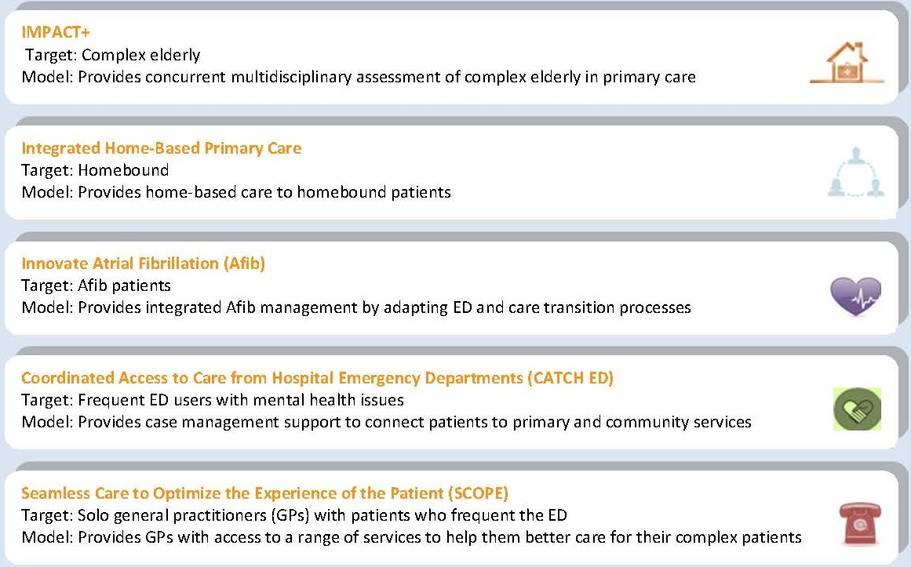
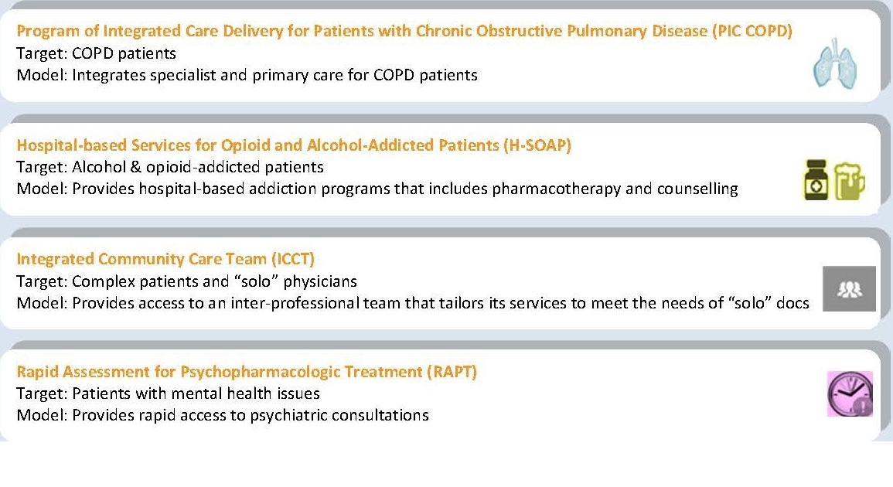
BRIDGES – 9 Projects
(The Integrated Complex Care Clinic)
Notes:
Handout

