Slide 1
Some thoughts on multi-morbidity and complex patient populations
Ross E.G. Upshur BA(Hons.)MA,MD,MSc,CCFP,FRCPC
Head, Division of Clinical Public Health, Dalla Lana School of Public Health
Scientific Director, Bridgepoint Collaboratory for Research and Innovation
Assistant Director, Lunenfeld Tanenbaum Research Institute, Sinai Health System
Professor, Department of Family and Community Medicine and DLSPH
University of Toronto

Slide 2


Slide 3
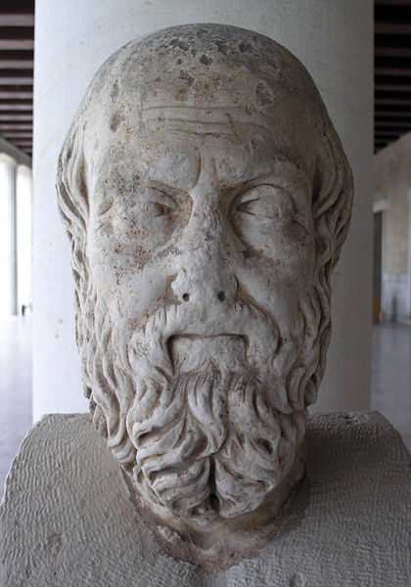

Slide 4
Babylon
Next in ingenuity to the marriage custom is their treatment of disease. They have no doctors, but bring their invalids out into the street, where anyone who comes along offers the sufferer advice on his complaint, either from personal experience or observation of a similar complaint in others…Nobody is allowed to pass a sick person in silence; but everyone must ask him what is the matter.

Slide 5
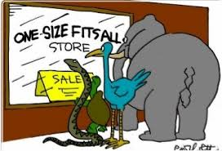


The Challenge

Slide 6
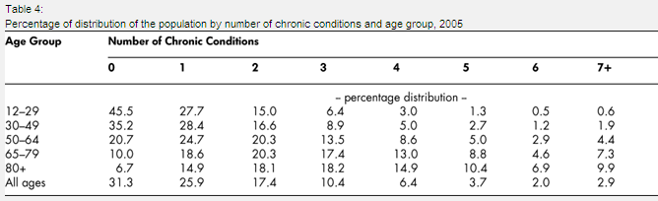
Chronic Health Conditions
Denton and Spencer 2010
Canadian Journal on Aging

Slide 7
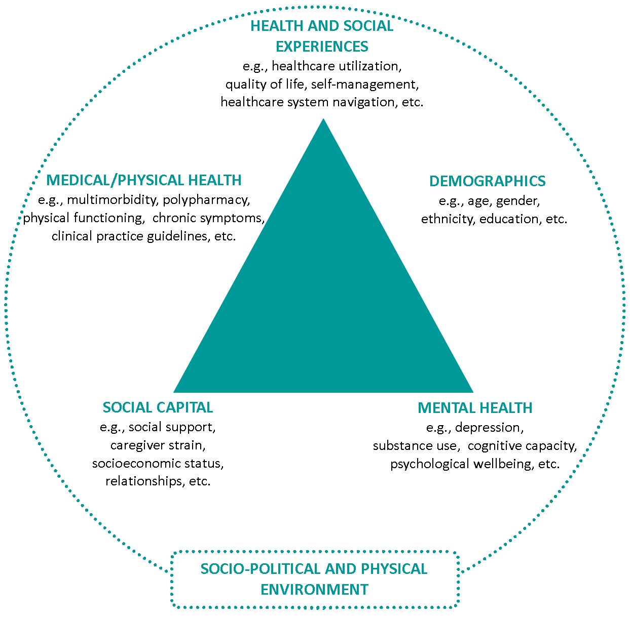
Schaink et al.

Slide 8

Patient Complexity
System Complexity
Specialty Care
Mental Health,
Addiction,
Cognition
Mental Health
LTC
Social Determinants of Health
Social Services
Primary Care
Acute Care
CCAC
Complex Continuing Care
/Rehab
Emergency Department
Multiple Concurrent Complex Conditions ± Aging

Slide 9
Alignment of Treatment Goals
Treatment Goals Aligned
Providers
Patients
Caregivers

Slide 10
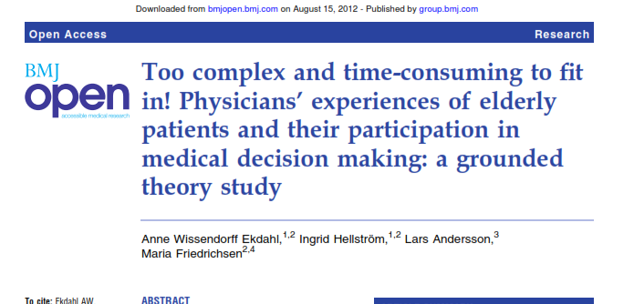

Slide 11
Interprofessional Model of Practice for Aging and Complex Treatments
IMPACT PLUS: a comprehensive model of
  Assessment
  Care Planning
  Mentorship and training
    Interprofessional problem solving model
    Includes PCPs, CCAC worker, pharmacist, RNs, NPs, social workers, physiotherapist, OT, dieticians, trainees
    PLUS
    Psychiatrist & General Internist
Notes:
IMPACT Plus has 3 special features and 3 components that I want to stress.
An assesment tool
A care planning tool
Mentorship and training tool
Three Components:
Simultaneous interprofessional consult
Includes Psychiatrist
Includes internist

Slide 12
IMPACT PLUS
Healthcare Providers Collaborative Problem Solving and Decision Making
Patient and Family
Family Physician
Internist
Psychiatrist
Social Worker
Resident Physician
Pharmacist
Dietitian
PT
OT
Nurse
Homecare Coordinator
Patient and Healthcare Provider Collaborative Problem Solving and Decision Making
Notes:
It brings the interprofessional team, patient, and family together in one place all at the same time.
The basic concept is for the interprofessional team, in real time, to collaboratively assess and develop a care plan with the patient and family. The interprofessional team may vary depending on local circumstances and the session length also varies. Initially, we were taking 2 hours/patient, but as our team skills developed, we have been able to reduce this to 1 or 1.5 hours.
The intention is to prevent this:

Slide 13
Lessons learned
Patients :
  feel cared for and heard, given time to actually surface what is important
  Co-develop care plans that focus on what is achievable given very diverse and complicated treatment burdens
Family caregivers:
  feel supported
  able to give voice to their stress
  feel empowered to continue to deal with difficult and complex situations

Slide 14
Lessons learned
Health Care Providers:
  experience true inter-professional learning,
  Are able to crowd-source solutions to complex problems
  Reduce stress/burnout through group support and validation that creates a “way forward” with complex patients
  increase their willingness to care for a challenging patient population
  Find patients are easier to manage in subsequent primary care visits

Slide 15
Challenges
Innovative projects often not persuasive on their own
Scale and cost considerations
Measures are not necessarily well calibrated to the phenomenon
Systems need to be rethought and reconfigured

