Slide 1
Minnesota Consortium for Practice Facilitation
Carol Lange, MPH
Course Director

Slide 2
Minnesota Consortium for Practice Facilitation (MNCPF)
Goal: To build organizational capacity by promoting and enabling continuous improvement activities through practice facilitation.
Ultimate goal is to support health care delivery and operations leading to enhanced patient experience, lower costs, and better outcomes.
Long-term strategy: Build a network of practice facilitators across the state, region and nationally that collaborate, share and innovate.
Work began in 2015.

Slide 3
MNCPF Consortium
  FIVE ORGANIZATIONS:
  Institute for Clinical Systems Improvement (ICSI)
  Minnesota Department of Health
  Normandale Community College
  Stratis Health
  University of Minnesota Medical School – Department of Family Medicine and Community Health

Slide 4

MNCPF Consortium Members
  Institute for Clinical Systems Improvement (ICSI)
  Mission: champion the cause of health care quality and to accelerate improvement in the value of the health care delivered to the populations served by our medical group members and health plan sponsors.
  More information: www.icsi.org

Slide 5

MNCPF Consortium Members
  Minnesota Department of Health
  SIM grant leadership supported PF role
  Minnesota Immunization Information Connection
  Variety of projects promoting primary care-public health collaboration
Notes:
SIM – State Innovation Model

Slide 6

MNCPF Consortium Members
Normandale Community College
Part of Normandale’s mission of supporting healthcare workforce development.
Partner to program curriculum development, delivery, evaluation, credentialing and financials.
National leader in Health IT training and development
More information: www.normandale.edu/ce

Slide 7

MNCPF Consortium Members
Stratis Health
Works locally to achieve national health care quality goals, through Lake Superior Quality Innovation Network – the Medicare Quality Innovation Network - Quality Improvement Organization (QIN-QIO) which serves Minnesota, Michigan, and Wisconsin.
More information: www.Stratishealth.org

Slide 8

MNCPF Consortium Members
Family Medicine and Community Health
University of Minnesota Medical School
Link to research and researchers
Over 15 years experience using practice facilitation.
Notes:
TRANSLATE Model

Slide 9
Overarching Competency Themes
Systems Thinking
  Analyst/Consultant
  Knowledge, Skills and Attitudes (KSA’s)
  Operating from place of choice
    Pace of change (actions taken that help or hinder movement)
    Change management – beliefs, attitudes – building wisdom through the “why”
Capacity Development
  Leadership
  Relationships
    Communication
    Asking questions/listening
Self-awareness
Notes:
think of the role as the mechanism/liaison that connects the who, what, how and why for an organization to affect change and improvement

Slide 10
Change Management Approach
MNCPF’s approach intersects the work of the people (healthcare workforce), the design and use of the processes and systems and influences behaviors and beliefs of a healthcare organization in a progressive and practical way.
People
Practice Facilitation
Process
Systems

Slide 11
Change Management Approach
Practice Facilitation develops and improves:
People – “Who will do the work?”
Processes – “How should/can they do it?”
Systems – “With What?”
Beliefs – “Why should we do this?”
And focuses on activities that prioritize quality improvement, patient safety, lowering costs, and empowering consumers – all e-Health priorities.

Slide 12
Practice Facilitation Program Structure
Based on AHRQ Curriculum
Two-day in-person session led by faculty from MNCPF Consortium members.
Eleven weekly tele-seminars with discussion, interactivity and case studies.
Practicum: Participants gain real work experience and exposure to practice facilitation activities and concepts.
Upon completion of all components, participants earn PF Certificate.
Notes:
Examples of Practicum: based on individuals past experience and gaps/needs. Assess clinic’s readiness for change, data collection and presentations, investigate and present content such as MOC or Adaptive Leadership

Slide 13
Two day Session Content
Each session includes lecture, small group activities and sharing/report back a summary to the larger group.
Faculty serve as resources to small group activities.
8 faculty presenters from the five consortium organizations and guest industry SMEs.
Notes:
Elevator Speech, pre-readings, case studies

Slide 14
Two day Session Content
Nine Content Sessions:
  Changing Healthcare System
  Practice Facilitation Process
  Assessing Practices
  Using Appreciative Inquiry
  Mapping and Redesigning Workflow
  Relationship Building
  Three Faces of Measurement
  Motivational Interviewing
  Ready, Set, Go: Moving Toward Action
Notes:
Each day begins with an activity (ice breaker, elevator speech), closes with wrap up (re-write elevator speech)

Slide 15
Tele-Seminars
11 weekly seminars
Pre-work, participation and assignments.
Builds on in-person sessions.
Involve graduates as presenters in some sessions.
(Detailed flyer is available at the conference)

Slide 16
Results
Two series completed
25 participants from 14 organizations
Strong collaboration between public health and primary care
  52% of participants are from Public Health Agencies
Participants were from throughout Minnesota

Slide 17
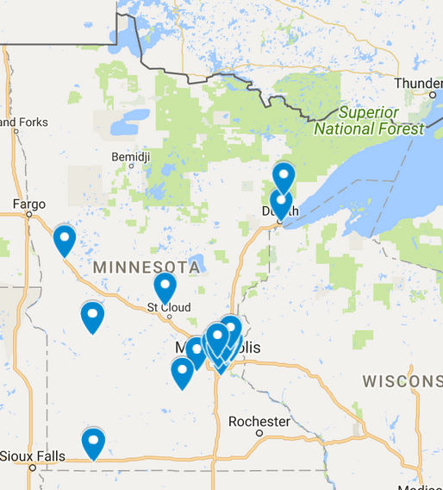
Results – Geographic Mix

Slide 18
Questions?
Contact Information:
  www.normandale.edu/ce/classes
  Carol J Lange: carol.lange@Normandale.edu or lange076@umn.edu

