Slide 1
Systematic Intervention Tracking
H2O’s Electronic Practice Record (EPR)
Meg Heard, MS
Manager, Programs & Initiatives – Oklahoma Clinical and Translational Science Institute (OCTSI)
Program Manager – Healthy Hearts for Oklahoma (H2O)

Slide 2
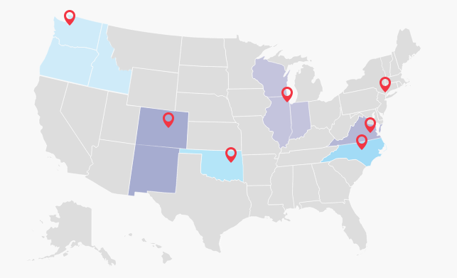

$5 million
3 years
250+ small to medium practices
5,000 practices nation wide

Slide 3
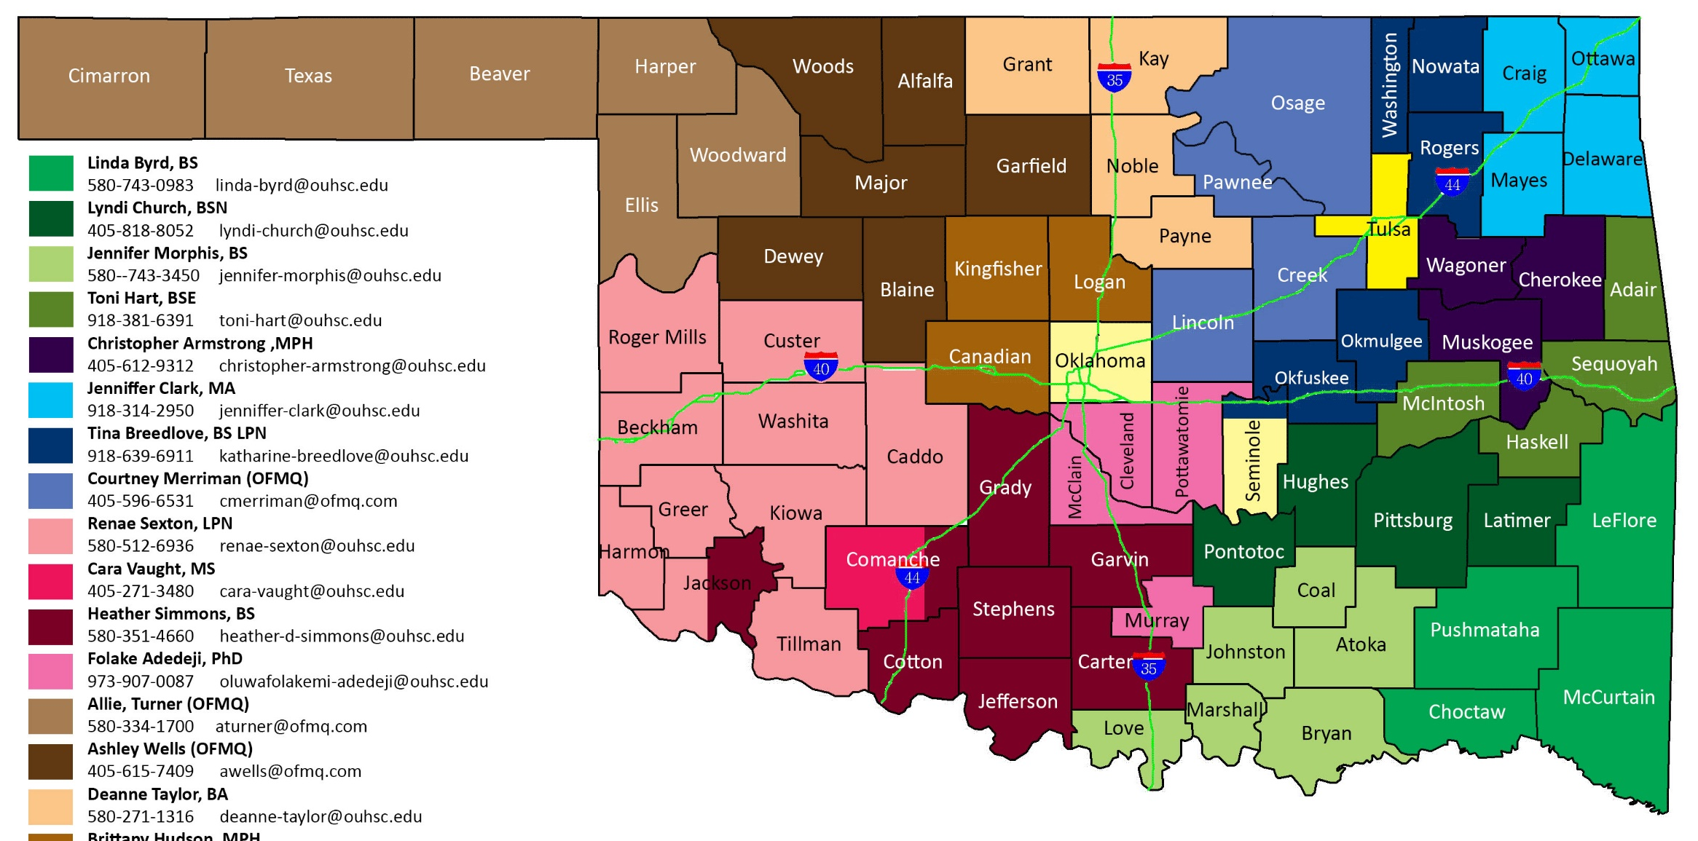
250+ small to medium practices
26 clinic visits per facilitator
4 clinic visits per facilitator coordinator
7800+ facilitation visits

Slide 4
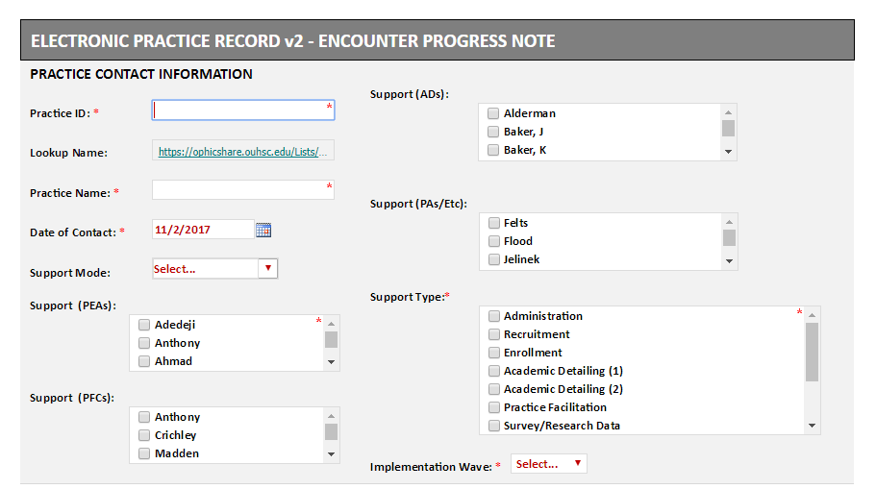
H2O’s Electronic Practice Record Note
Call
Visit
Video
Email
Text
Fax
Also:
EMR Data Extraction
Technology Support
Close-Out Meeting
Other

Slide 5
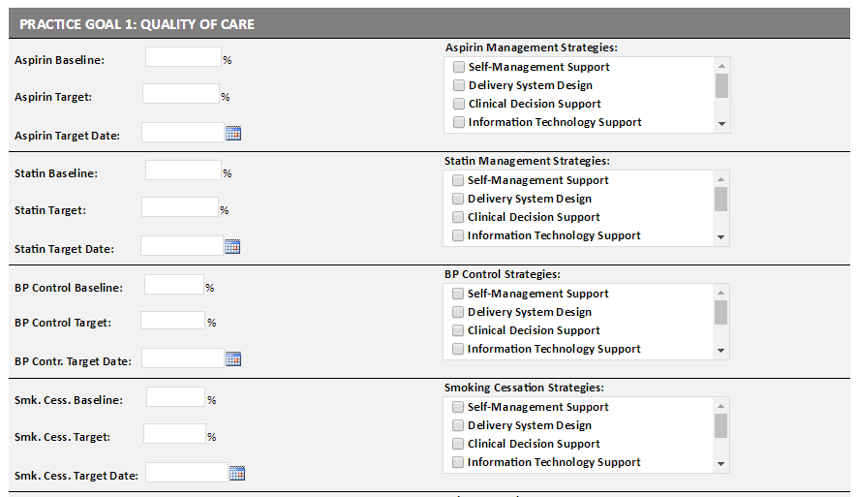
H2O’s Electronic Practice Record Note
Also:
Community Resources / Policy
Get Baseline / More Data

Slide 6
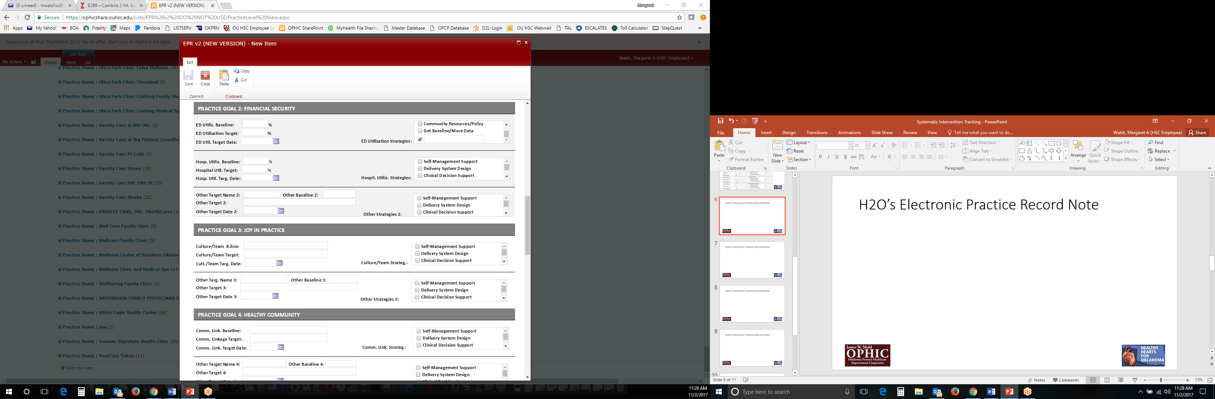
H2O’s Electronic Practice Record Note
Also:
Information Technology Support
Community Resources / Policy
Get Baseline / More Data

Slide 7
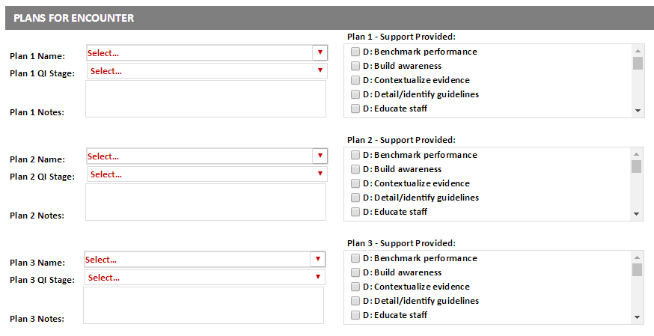
H2O’s Electronic Practice Record Note
Aspirin
Blood Pressure
Cholesterol
Smoking Cessation
ED Utilization
Hospital Utilization
Practice Adaptive Reserve
Community Linkage
Other 1 (Quality)
Other 2 (Financial)
Other 3 (Joy)
Other 4 (Community)
D: Define Opportunity
M: Measure Quality Gaps
A: Analyze Quality Data
I: Improve Processes (PDSA)
C: Control – Keep the Gains

Slide 8
H2O’s Electronic Practice Record Note
DEFINE
D: Benchmark performance
D: Build awareness
D: Contextualize evidence
D: Detail/identify guidelines
D: Educate staff
D: Review county health report
D: Review performance report
MEASURE
M: Administer patient survey
M: Administer practice member survey
M: Administer practice survey
M: Draw a process flowchart
M: Generate Tableau ABCS report
M: Measure work process
M: Observe practice
M: Perform chart review
M: Perform Focus Group – observe/interview
M: Research information
M: Update QI dashboard
ANALYZE
A: Analyze eCQM results
A: Brainstorm improvement ideas
A: Graph QI measures
A: Identify process waste
A: Perform root cause analysis
A: Prioritize ideas
A: Query Tableau
IMPLEMENT
I: 24-hour BP monitoring process
I: Adherence monitoring process
I: Affordable medication process
I: BP measurement process
I: Care coordination billing
I: Care coordination process protocol
I: CHIO participation
I: Clinician protocol
I: Community referral for BP assistance
I: CVD EMR H&P template
I: CVD risk assessment
I: CVD risk calculation
I: Documentation and coding
I: EMR-Attestation for MU
I: EMR-Prompt/reminder
I: EMR-Registry services due
I: EMR-Reporting PQRS
I: Home BP monitoring process
I: Home monitoring log - educate
I: Med reconciliation process
I: Motivational interviewing training for smoking
I: Participation in TSET project
I: Patient action plan
I: Patient activation measure (PAM)
I: Patient education
I: Patient portal
I: Quit smoking med decision algorithm
I: Referral to community lifestyle program
I: Risk stratification process
I: Shared decision tool for statin or ASA
I: Smoking as a vital sign
I: Smoking counseling billing
I: Staff protocols
I: Standing order protocol
I: Standing order protocol (laboratory)
I: Standing order protocol (med adjustment)
I: Standing order protocol referral to quit
I: Team huddle protocol
I: Timely med refill process
I: Tracking flowsheet process
I: Transition of care notification
I: Treatment decision algorithm protocol
CONTROL
C: Define roles/ responsibilities
C: Define standardized process policies
C: Measure adherence
C: Reward adherence
C: Train clinician
C: Train staff

Slide 9
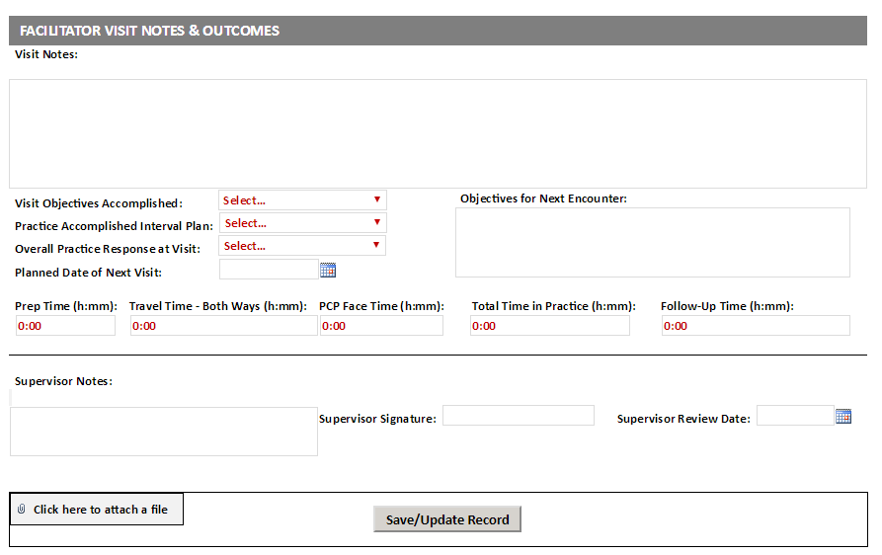
H2O’s Electronic Practice Record Note
Completely
Mostly
Partially
Insufficiently
Not At All
Unknown
Very Unresponsive
Responsive
Minimally Responsive
Unresponsive
Very Unresponsive
Unknown

Slide 10
H2O’s Close-Out Dashboard
Test Family Medicine
Test Family Medicine
Address
City OK ZIP CODE
County Region Quadrant
Name Phone Email

Slide 12
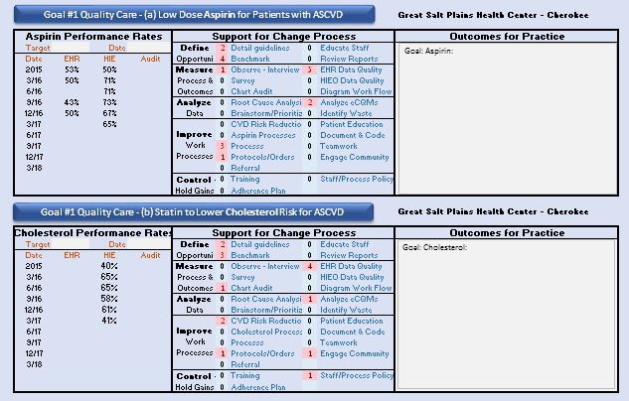

Slide 13
Questions?
Meg Heard, MS
Manager, Programs & Initiatives – Oklahoma Clinical and Translational Science Institute (OCTSI)
Program Manager – Healthy Hearts for Oklahoma (H2O)
Margaret-Walsh@ouhsc.edu

