Slide 1
Building and Supervising a Practice Facilitation Program
Creating the Healthy Hearts for Oklahoma Practice Enhancement Assistant (PEA) Team
Meg Heard, MS
Manager, Programs & Initiatives – Oklahoma Clinical and Translational Science Institute (OCTSI)
Program Manager – Healthy Hearts for Oklahoma (H2O)

Slide 2
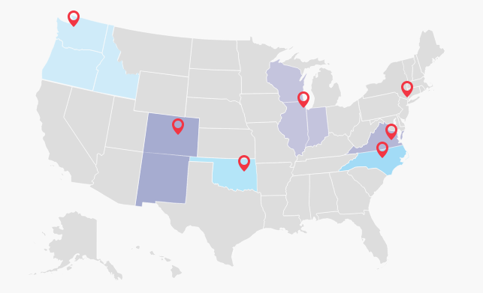

$5 million
3 years
250+ small to medium practices
5,000 practices nation wide

Slide 3
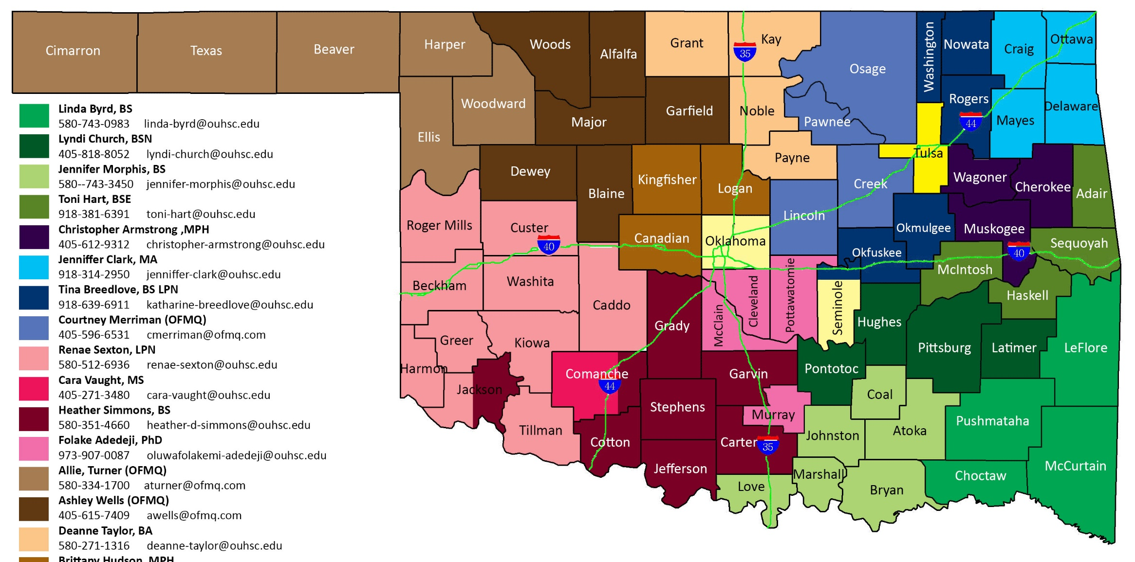
250+ small to medium practices
77 counties
5 regions
20 PEAs
5 PFCs

Slide 4
Personnel Infrastructure
Position Descriptions that Existed
  Project Assistant
  Research Technician
  Research Associate
  Program Coordinator
  Research Coordinator
  Trainer
  Administrative Specialist
Practice Facilitation
  Administrative Work
  Marketing
  Recruiting
  Teaching
  Interviewing
  Relationship Management
PFCs: Manager of Community Network Project
PEAs: Clinical Quality Improvement Coordinator

Slide 5
Three-faceted Training
Conceptual
  What is Practice Facilitation?
    Practice facilitation certificate program at the University of Buffalo
Local
  What is the history of Facilitation in Oklahoma?
    Institutional knowledge and previous projects
Project-Specific
  What will Facilitators be doing for H2O?
    Granular level training

Slide 6
Support / Continuing Education / Communication
Regional Team Meeting
(Weekly)
Program Manager & PFC Meeting
(Weekly)
PEA Q&A Session
(Weekly)
IT Support Meeting
(Monthly)

Slide 7

Sustainability
Different P.I.s
Variety of Research Topics
Different Funding Sources
Overlapping Timelines
Geographic Differences
Ranging Personnel Requirements

Slide 8
Conclusion
Infrastructure
Training
Support
Continuing Education
Communication
Sustainability

Slide 9
Questions?

Slide 10
Group Work
Use the cards at your table to create a PF Team
Discuss how you would overcome obstacle
H2O PEA will act as your scribe

