Slide 1
Welcome
2017 NAPCRG PBRN Conference

Slide 2
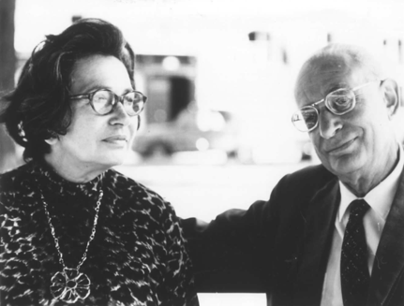

Slide 3
    “At the center of medicine there is always a human relationship between a patient and a doctor.”
    -Michael Balint
Notes:
On of Balint’s core assumptions is that

Slide 7
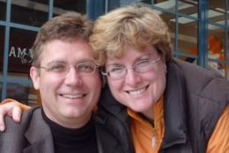

Slide 8
    “At the center of PBRN research there is always a human relationship.”
Notes:
On of Balint’s core assumptions is that

