Slide 1
Evaluation Of A National D&I Initiative To Enhance Primary Care Practice Capacity And Improve Cardiovascular Disease Care
Practice-based Research Network Conference
Deborah Cohen, PhD
June, 2017

Slide 2
Background
Opportunities
Strategies
Notes:
NEED TO BE IN PRESENTATION MODE

Slide 3
Background
Opportunities
Strategies
Foundational Ideas
Evaluation Methods
EvidenceNOW Practices
Notes:
THIS WILL LOOK STRANGE WHEN NOT IN PRESENTATION MODE

Slide 4
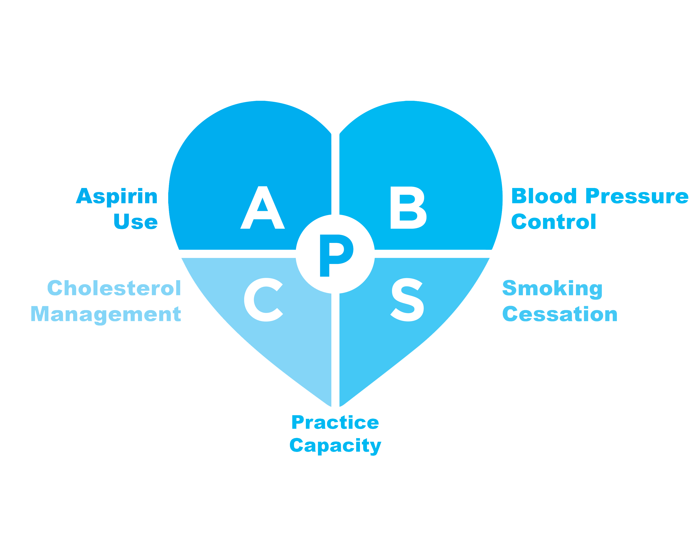
ABCS |
Foundational Ideas

Slide 5
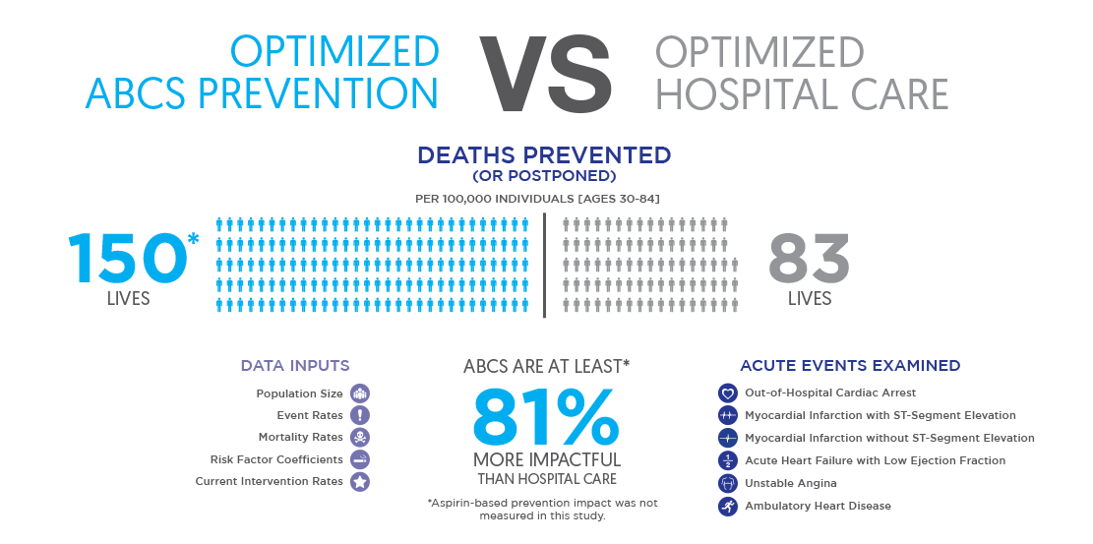

Slide 6
Background
Foundational Ideas
Evaluation Methods
EvidenceNOW Practices
Notes:
THIS WILL LOOK STRANGE WHEN NOT IN PRESENTATION MODE

Slide 7
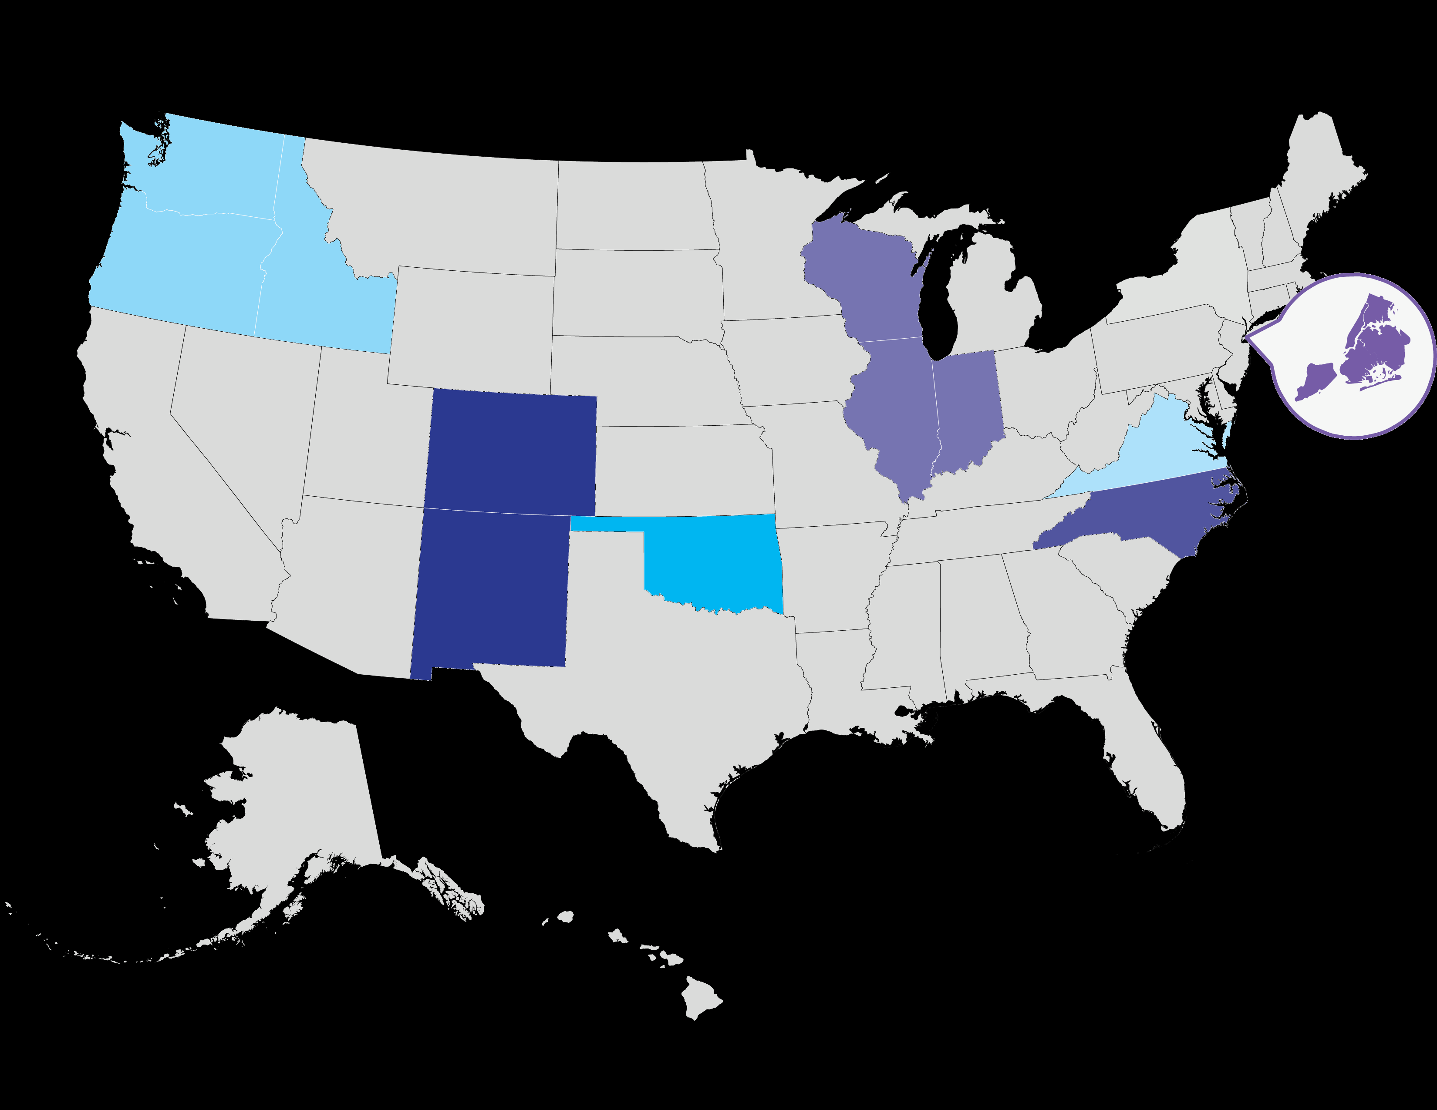
EvidenceNOW Cooperatives |
Regional Map

Slide 8





ESCALATES |
Scale

Slide 9
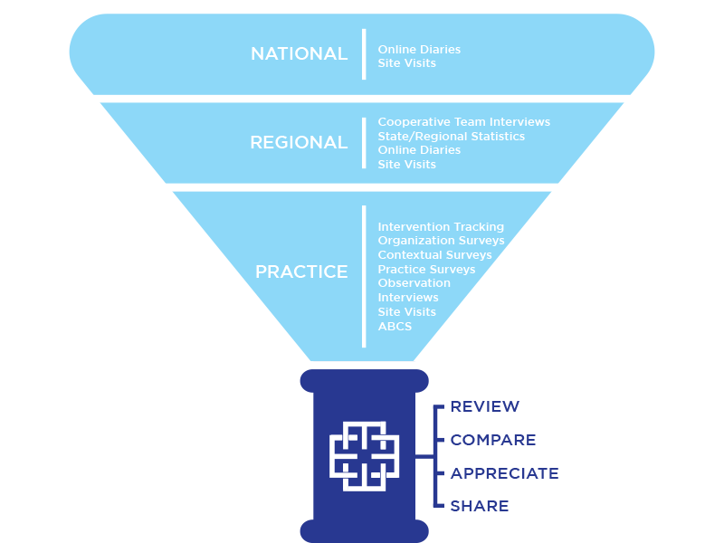
Leverage similarities across Cooperatives to
Assess ABCS at baseline
Assess practice capacity
Conduct a prospective observational analysis of the most effective combinations of interventions, practice and contextual factors
Use qualitative methods to understand how and why those combinations are effective
Rapidly disseminate

Slide 10
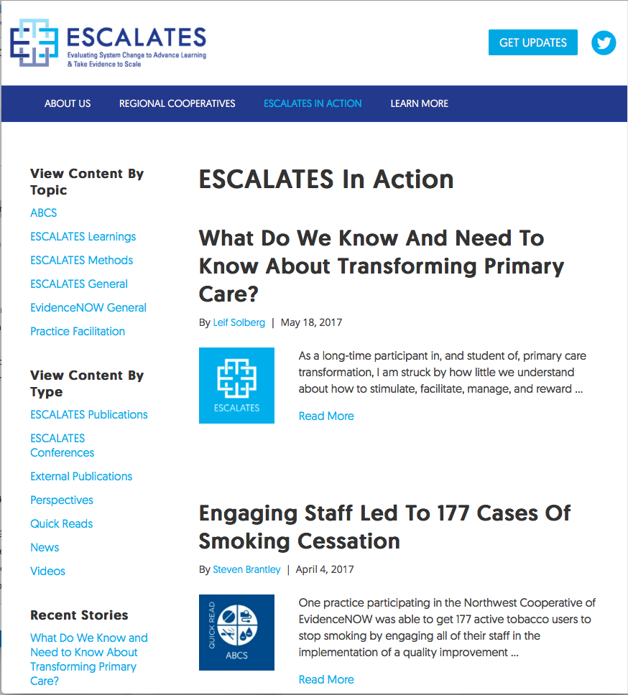
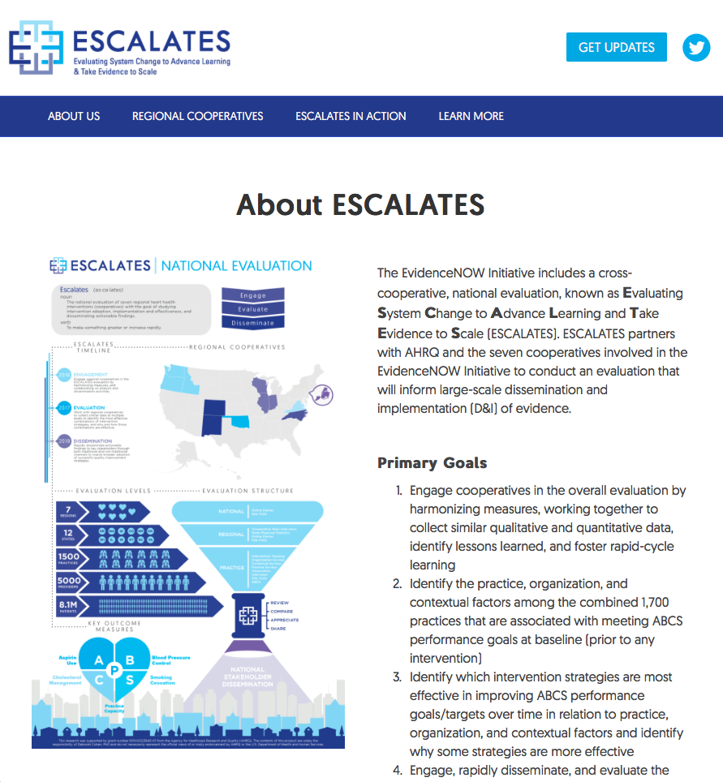
ESCALATES.org |
Rapid Dissemination

Slide 11
ABCS |
Measures
Aspirin | CMS 164 NQF 0068 - Percentage of patients 18 years of age and older who were discharged alive for acute myocardial infarction (AMI), coronary artery bypass graft (CABG) or percutaneous coronary interventions (PCI) in the 12 months prior to the measurement period, or who had an active diagnosis of ischemic vascular disease (IVD) during the measurement period, and who had documentation of use of aspirin or another antithrombotic during the measurement period.
Blood Pressure | CMS 165 NQF 0018 - Percentage of patients 18-85 years of age who had a diagnosis of hypertension and whose blood pressure was adequately controlled (<140/90mmHg) during the measurement period.
Cholesterol | CMS 347 - Percentage of high-risk adult patients aged >= 21 years who were previously diagnosed with or currently have an active diagnosis of clinical atherosclerotic cardiovascular disease (ASCVD); OR adult patients aged >=21 years with a fasting or direct Low-Density Lipoprotein Cholesterol (LDL-C) level >= 190 mg/dL; OR patients aged 40-75 years with a diagnosis of diabetes with a fasting or direct LDL-C level of 70-189 mg/dL; who were prescribed or are already on statin medication therapy during the measurement year.
Smoking | CMS138 NQF008 - Percentage of patients aged 18 years and older who were screened for tobacco use one or more times within 24 months AND who received cessation counseling intervention if identified as a tobacco user

Slide 12








*
Context Assessment

Slide 13
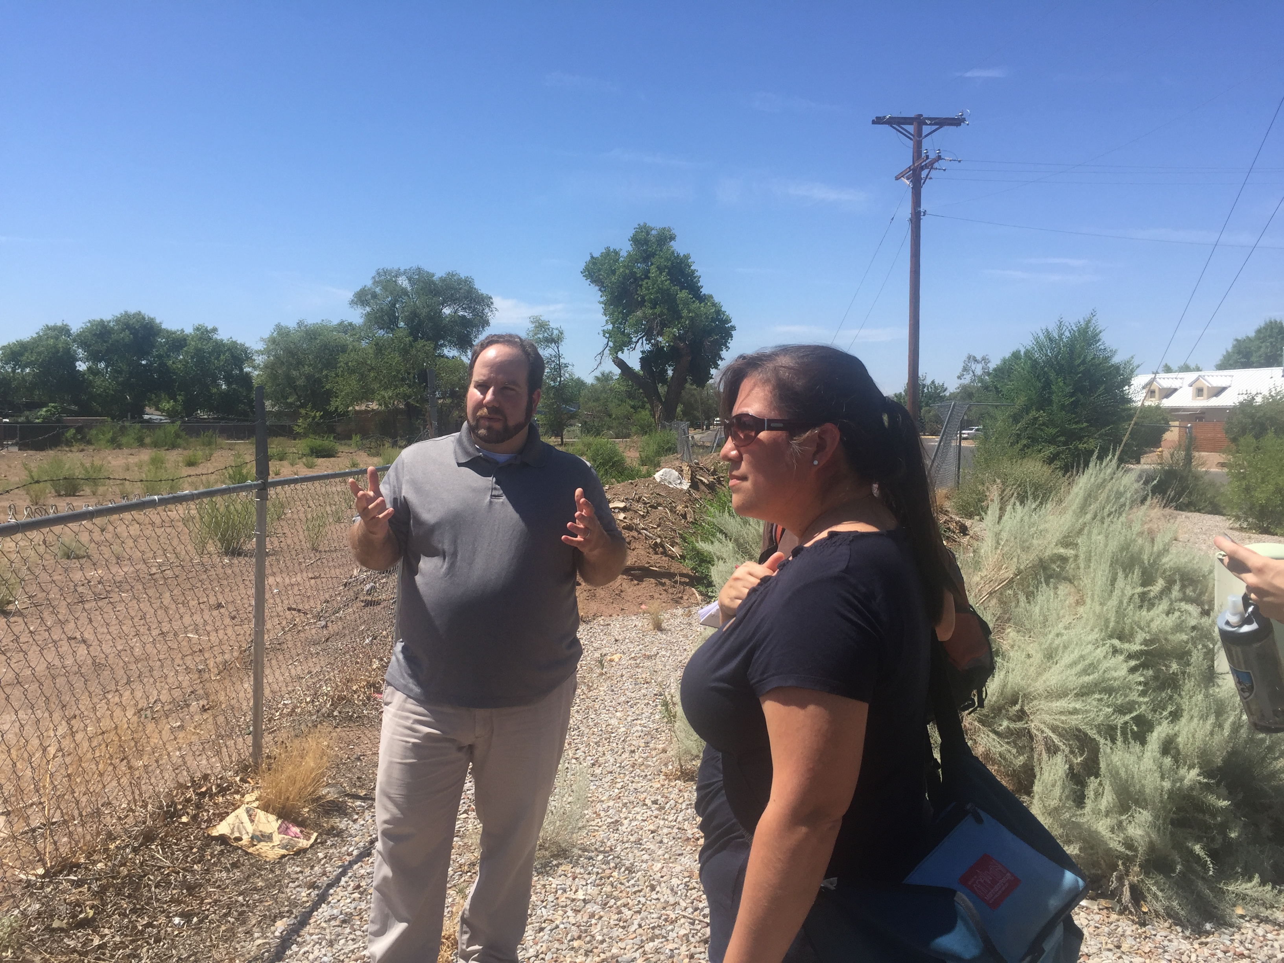

Slide 14
Background
Foundational Ideas
Evaluation Methods
EvidenceNOW Practices
Notes:
THIS WILL LOOK STRANGE WHEN NOT IN PRESENTATION MODE

Slide 15
Characteristics Of EvidenceNOW Practices
Characteristic, n(%) | N=1,509 | Cooperative Range (%)
Practice location
Urban | 1024 (68.1) | 47.7-100
Rural | 286 (19.0) | 0.0-30.9
Suburban | 169 (11.2) | 0.0-26.4
Classified as Medically Underserved Area | 485 (32.2) | 11.6-40.8
Practice size
Solo practice | 353 (23.5) | 6.7-51.6
2 to 5 clinicians (MD, DO, NP, PA) | 686 (45.6) | 15.3-59.0
6 to 10 clinicians | 204 (13.6) | 5.8-17.2
11 or more clinicians | 155 (10.3) | 2.1-23.4
Practice ownership
Clinician | 598 (39.8) | 27.8-72.1
Hospital / health system / HMO | 337 (22.4) | 1.6-52.8
Government clinics (FQHC, RHC, IHS) | 298 (19.8) | 4.2-39.5
Academic | 19 (1.3) | 0.0-5.9
Other / None | 165 (11.0) | 0.5-38.3
Notes:
Emphasize variation for each characteristic across cooperatives
Predominantly urban practices but with good representation of rural practices as well (as high as a third of practices in one cooperative)
A third are classified as located in a Medically underserved area
In terms of size, practices with 2-5 clinicians most represented in the overall sample, but in one cooperative 52% of the practice are solo
Clinician-owned practices most represented in the overall sample, but again significant variation across cooperatives, where 41% of one cooperative’s practices are health system owned

Slide 16
Background
Opportunities
Strategies
Notes:
NEED TO BE IN PRESENTATION MODE

Slide 17
Background
Opportunities
Strategies
Quality (ABCS)
Capacity building
Data infrastructure
Notes:
NEED TO BE IN PRESENTATION MODE

Slide 18
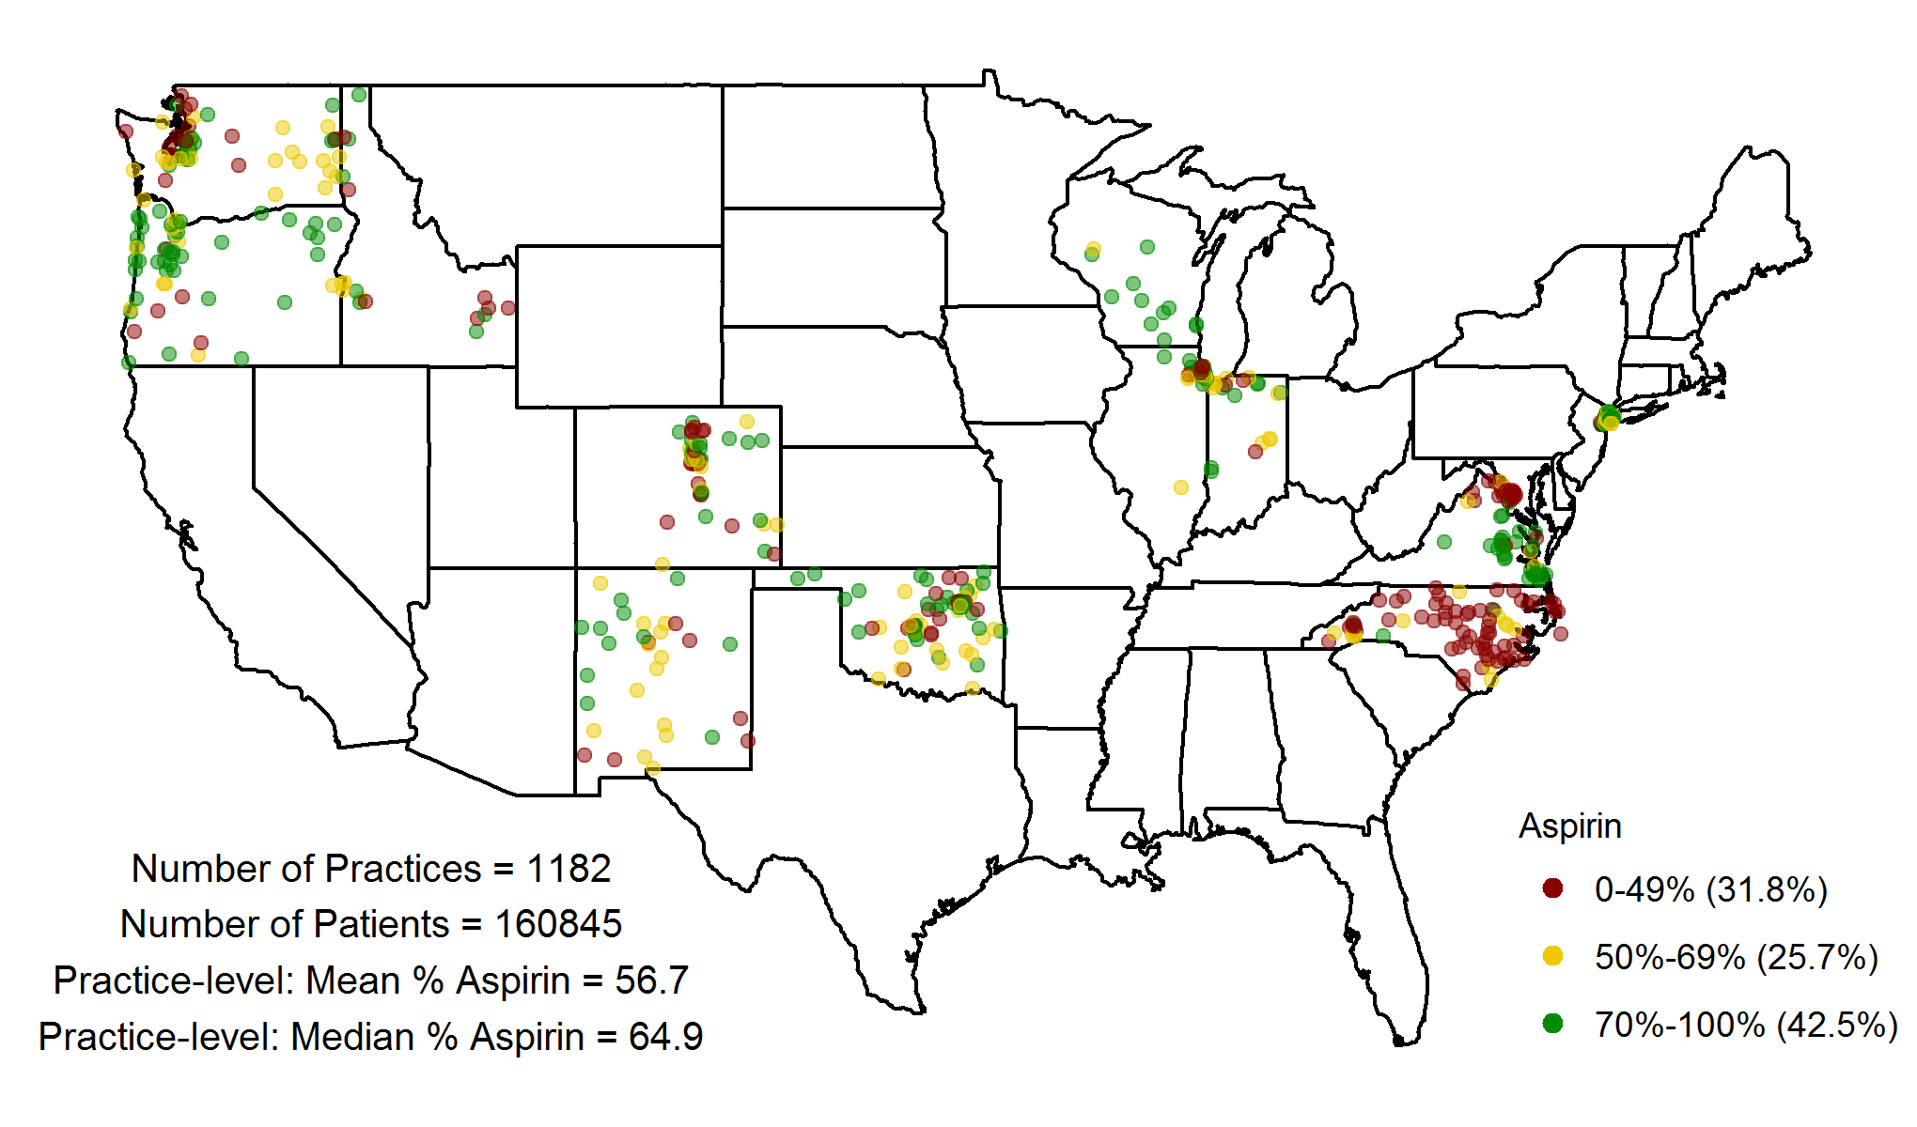
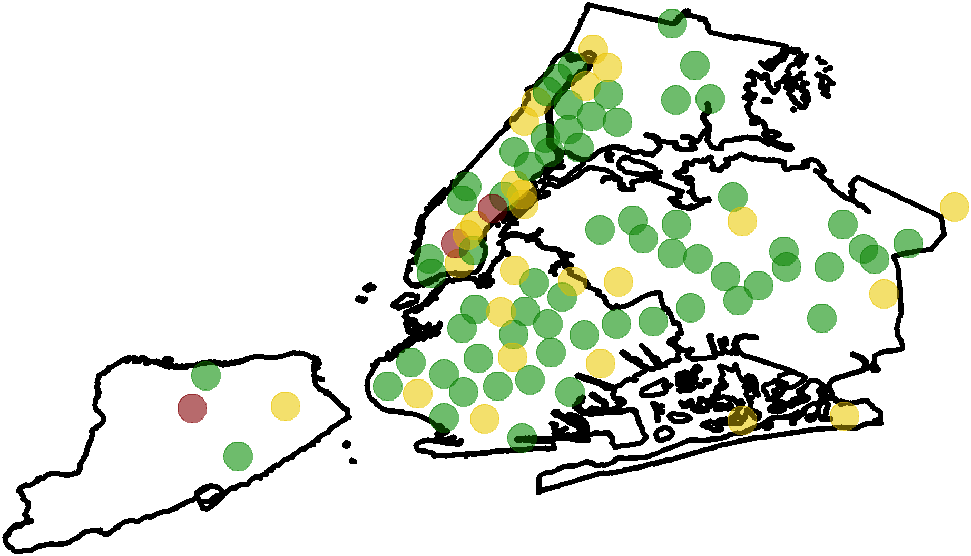

Baseline ABCS Distribution | Aspirin by Zip Code
Number of Practices = 1182
Number of Patients = 160,845
Practice-level: Mean % Aspirin = 56.7
Practice-level: Median % Aspirin = 64.9

Slide 19
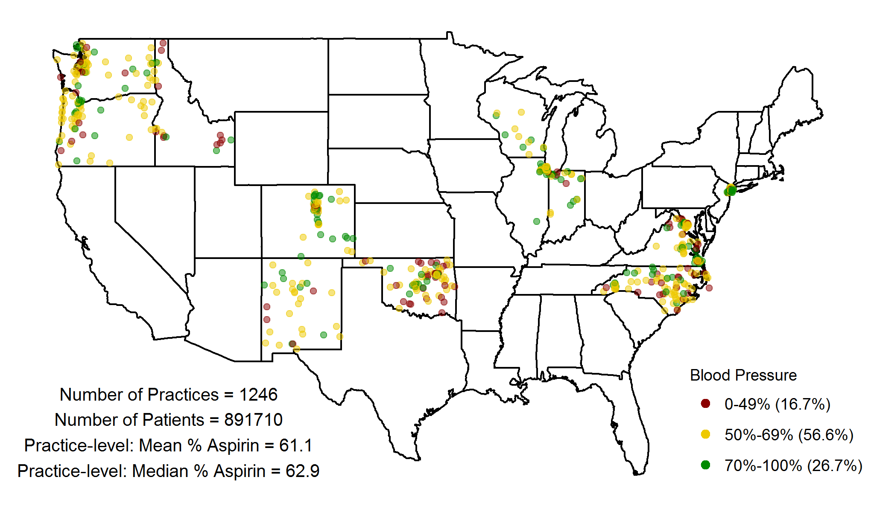
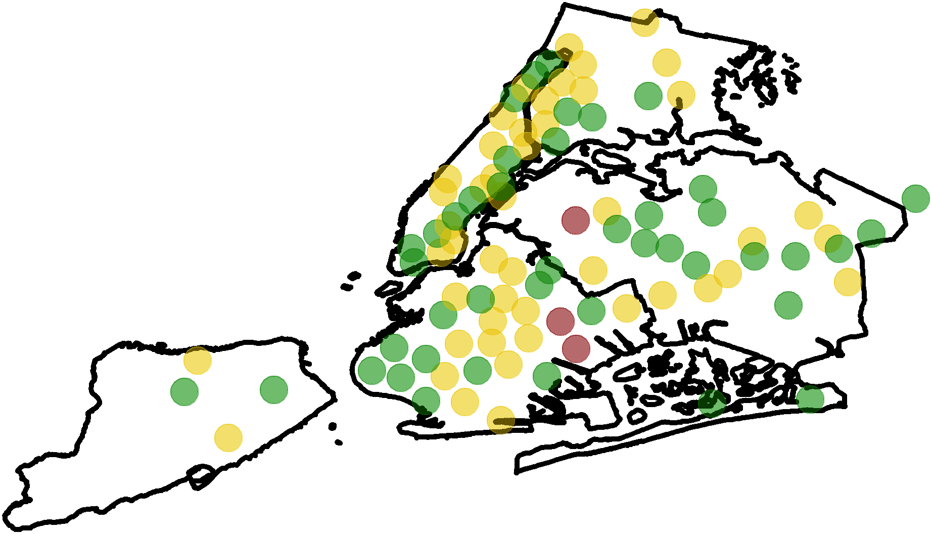
Baseline ABCS Distribution | Blood Pressure by Zip Code
Number of Practices = 1246
Number of Patients = 891,710
Practice-level: Mean % BP = 61.1
Practice-level: Median % BP = 62.9

Slide 20
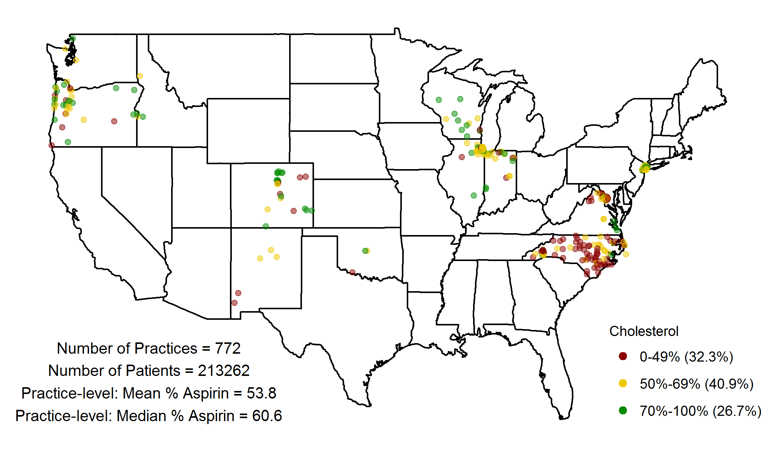
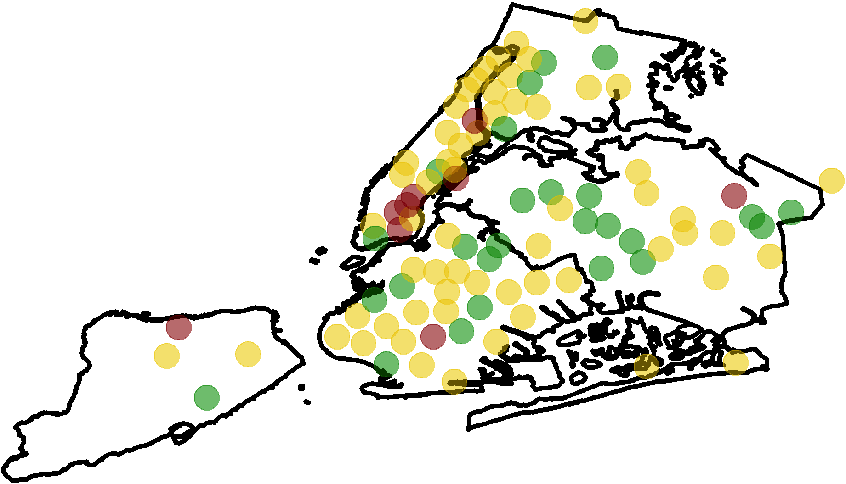
Baseline ABCS Distribution | Cholesterol by Zip Code
Number of Practices = 772
Number of Patients = 312,262
Practice-level: Mean % Cholesterol = 53.8
Practice-level: Median % Cholesterol = 60.6

Slide 21
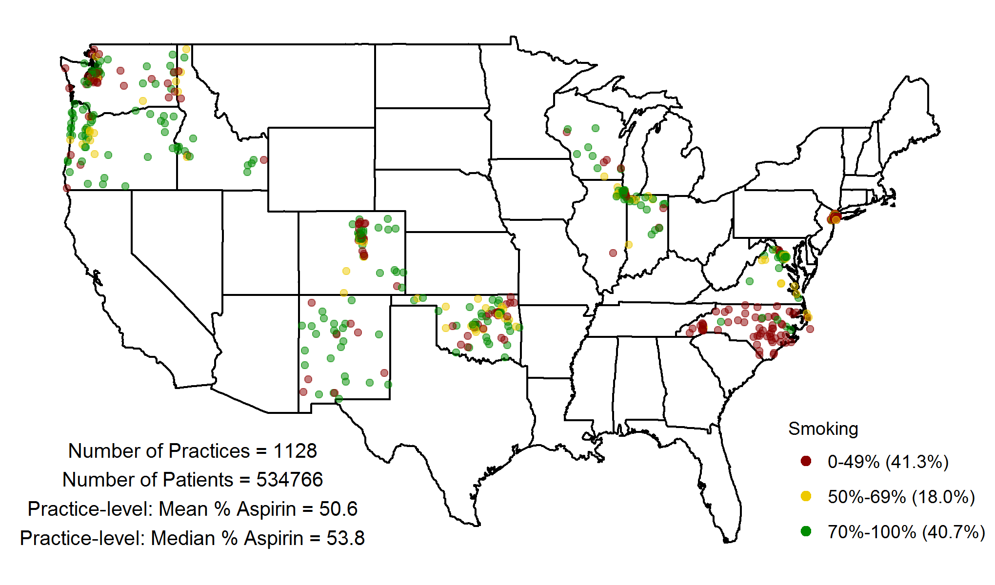
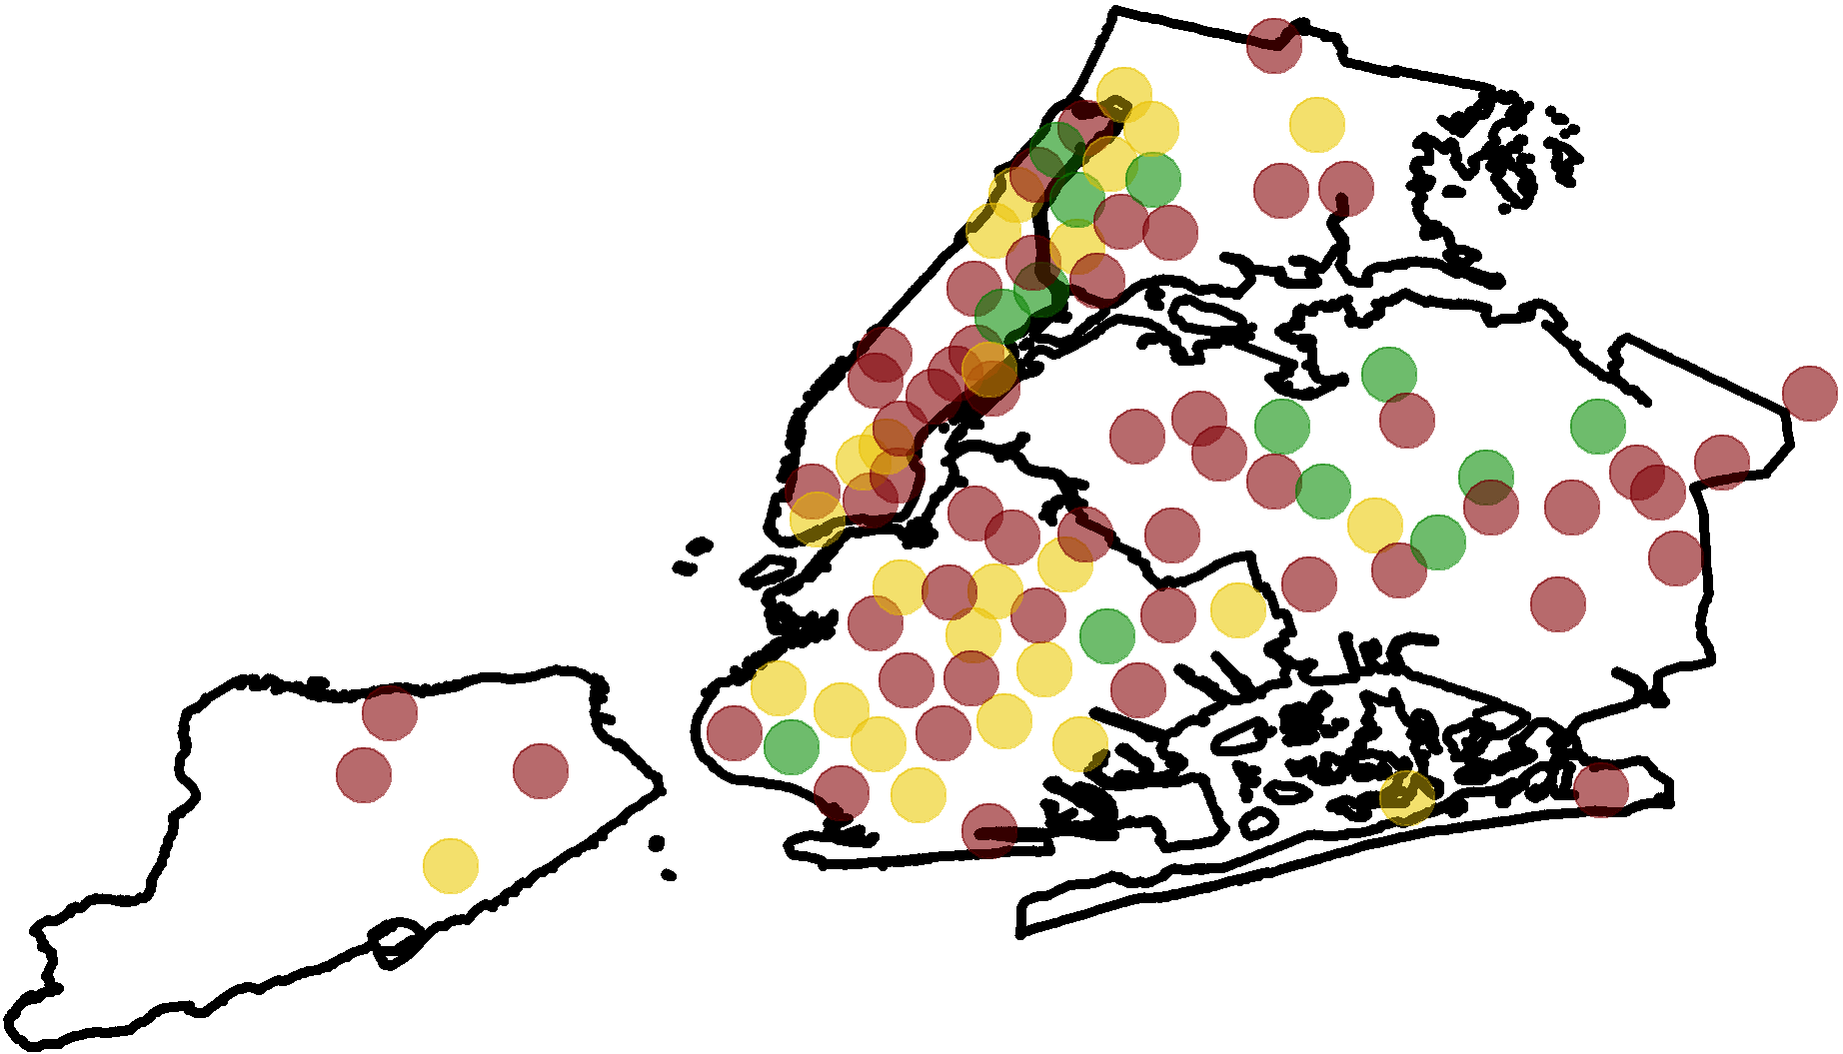
Baseline ABCS Distribution | Smoking by Zip Code
Number of Practices = 1128
Number of Patients = 534,766
Practice-level: Mean % Smoking = 50.6
Practice-level: Median % Smoking = 53.8

Slide 22
Opportunities
Quality (ABCS)
Capacity building
Data infrastructure
Notes:
NEED TO BE IN PRESENTATION MODE

Slide 23
Four Different Ways Of Thinking About Practice Capacity
Capacity for change
Capacity for doing quality improvement
Degree disruption
Team member burnout

Slide 24
Capacity for Change and
for quality improvement

Slide 25
Baseline Practice Capacity Distribution
20
15
10
5
0
CPCQ STRATEGIES
Number of Practices = 1183
CPCQ Mean (SD) = 9.2 (12.1)
Relative Frequency (%)
-28 -24 -20 -16 -12 -8 -4 0 4 8 12 16 20 24 28
CPCQ Strategies Score (Range = -28 to +28)
20
15
10
5
0
ADAPTIVE RESERVE
Number of Practices = 1266
AR Mean (SD) = 0.71 (0.1)
Relative Frequency (%)
0.00 0.10 0.20 0.30 0.40 0.50 0.60 0.70 0.80 0.90 1.00
Adaptive Reserve Score (Range = 0 to 1)

Slide 26
Disruptive Events

Slide 27
Disruptive Change in Practices
Characteristic, n(%) | N=1,509 | Cooperative Range (%)
Disruptive change in last 12 months
One change | 506 (33.5) | 16.3-47.7
Multiple changes | 284 (18.8) | 5.8-32.8
No changes | 586 (38.8) | 23.1-61.2
*≥15% missing data

Slide 28
Factors Associated with Use of QI Strategies
20
15
10
5
0
CPCQ Strategies Score (Range = -28 to +28)
Relative Frequency (%)
-28 -24 -20 -16 -12 -8 -4 0 4 8 12 16 20 24 28
  Practices that experienced multiple major disruptions

Slide 29
Burnout

Slide 30
Burnout
“Overall, based on your definition of burnout, how would you rate your level of burnout?”
1 = “I enjoy my work. I have no symptoms of burnout”
2 = “Occasionally I am under stress, and I don’t always have as much energy as I once did, but I don’t feel burned out”
3 = “I am definitely burning out and have one or more symptoms of burnout, such as physical and emotional exhaustion;”
4 = “The symptoms of burnout that I’m experiencing won’t go away. I think about frustration at work a lot”
5 = “I feel completely burned out and often wonder if I can go on. I am at the point where I may need some changes or may need to seek some sort of help.”
No
Burnout
Burnout
Williams et al. Health Serv Res 2002; 37(1);119-141; Schmoldt et al. HMO Practice 1994 8 (2): 58–63

Slide 31
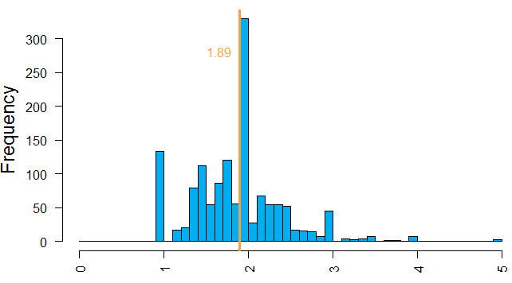
Burnout Distribution
Frequency
Average Burnout Score at Practice
Cross-Cooperative Range: 1.7-2.1

Slide 32
Practice Members Reporting Burnout

Slide 33
Opportunities to Identify and Help with Burnout
People working in non-solo practices
People working in non-clinician owned practice
People with an excessive workload
People who may see a misalignment between incentives the meaning of their work (e.g., MU, ACO efforts)

Slide 34
Opportunities
Quality (ABCS)
Capacity building
Data infrastructure
Notes:
NEED TO BE IN PRESENTATION MODE

Slide 35
Data Infrastructure
Characteristic, n(%) | N=1,509 | Cooperative Range (%)
Number of EHR systems, n | 68 | 4-32
Most common systems, n(%)
eClinicalWorks | 338 (22.4) | 5.5-90.4
EPIC | 296 (19.6) | 0.3-45.1
NextGen | 125 (8.3) | 0.0-28.2
ONC certified EHR, n (%) | 1432 (94.9) | 91.7-100.0
Meaningful Use status, n(%)
None | 276 (18.3) | 9.3-25.9
Stage 1 only | 213 (14.5) | 5.8-27.2
Stage 1 and Stage 2 | 1020 (67.6) | 46.3-84.9
Ability to Create Quality Reports from EHRs
No capacity | 380 (25.2) | 15.9-47.2
In-practice capacity | 475 (31.5) | 18.3-40.2
Use outside resource | 652 (43.2) | 134-56.6
Notes:
Most practices had ONC-certified EHRs and over half participated in both Stage 1 and Stage 2 MU

Slide 36
Data Infrastructure |
Data Requirements for QI
The CQMs for EHRs must reflect current guidelines
Practices must be able to generate credible reports for CQMs
  Report measurement periods must be customizable
  Reports must be adaptable to the level of:
    Practice
    Clinical team
    Clinician, and
    Patient level
Comparability of data across EHRs / practices

Slide 37
Data Infrastructure |
Challenges & Opportunities
Pace and quality of measure specifications
ONC-certified EHRs lack customizable measurement periods
Excessive fees for customization and upgrades required for basic reporting functionality
Unresponsiveness to practice requests when report problems emerge
Limited technical capacity and skill set at practice
EHR system design, documenting behavior, EHR programming
Lack of comparability within and across EHR systems

Slide 38
Background
Opportunities
Strategies
Notes:
NEED TO BE IN PRESENTATION MODE

Slide 39
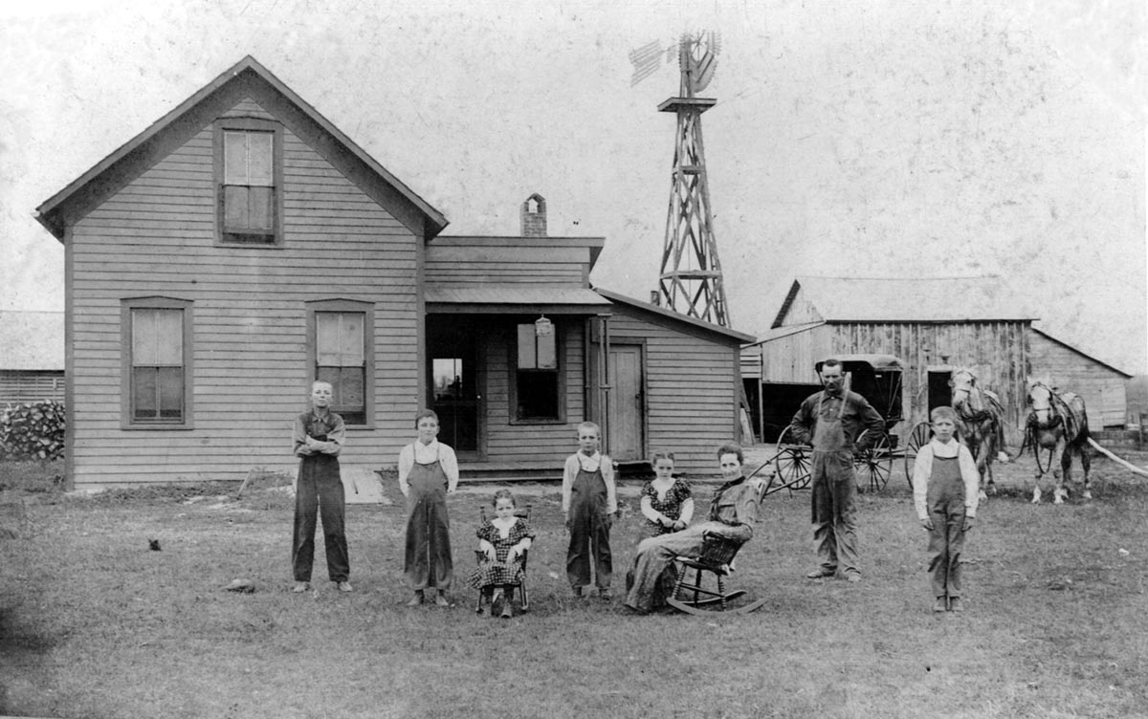
Notes:
You have a pretty grim view of farming life. (-; Please it, it will make for a good giggle.

Slide 40
Practice Extensions |
Analogous Models
Regional organizations develop infrastructure to build relationships in their region with the purpose of learning about needs
Regional organizations support practices in sustaining themselves and providing excellent care to the patients they serve
The practice extension was approved by an unfunded mandate of the US legislature
Practice extensions are built on the shoulders of PBRNs

Slide 41
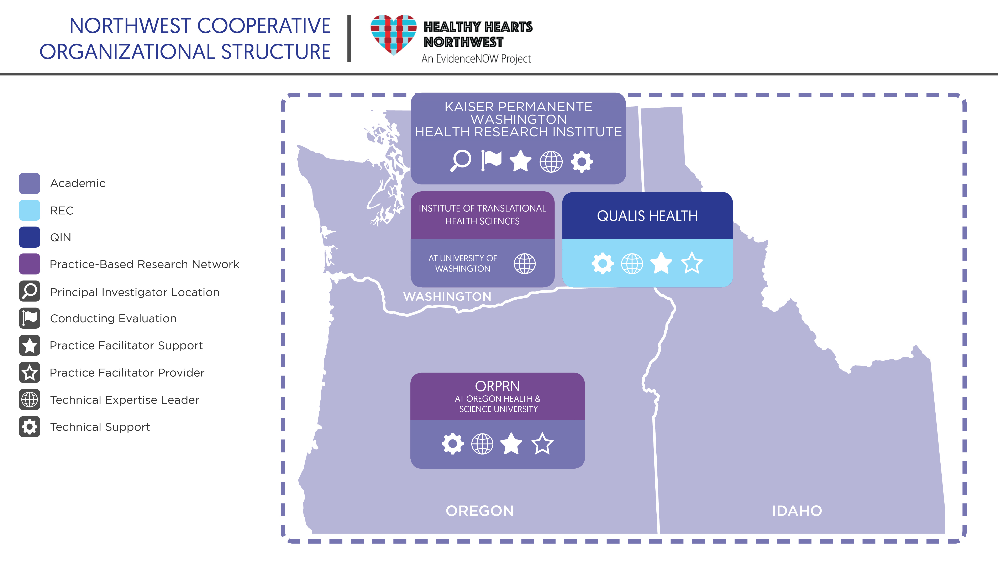

Slide 42
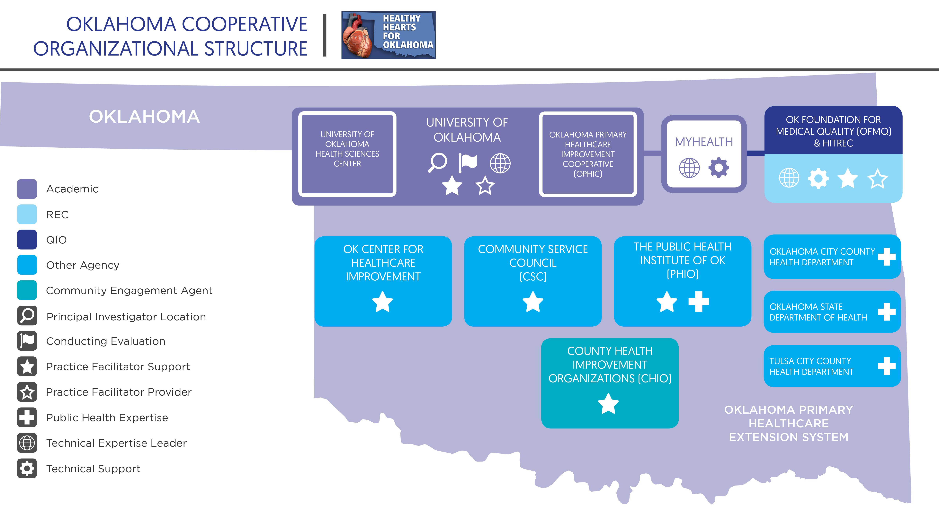

Slide 43
Practice Extensions |
What Are They Doing To Help Practices?
  Providing data infrastructure and health IT expertise
  Providing practice facilitation or coaching to help with quality improvement
  Offering expert consultation
  Offering online learning opportunities
  Creating learning collaboratives
  Creating peer-to-peer learning opportunities
  Engaging communities and patients
  Cooperatives are also creating content delivered through these modes of connecting and learning

Slide 44
Background
Opportunities
Strategies
Notes:
NEED TO BE IN PRESENTATION MODE

Slide 45
Background
Opportunities
Strategies
Health Information Technology
Practice Facilitation
Notes:
NEED TO BE IN PRESENTATION MODE

Slide 46
Data Infrastructure |
Data Hub & Warehouse
Network of independent practices
Practice
Practice
Practice
Practice
Practice
Practice
Practice
Hub / Data warehouse
Query/Alert building
Policy distribution
Result reporting
Provider messaging
Data Request

Slide 47
Data Infrastructure |
Health Information Exchange
Family Doctor
Specialty Doctor
Public Health
Hospital
Lab
Health System
Health Information Exchange (HIE)
Pharmacy
Data Request

Slide 48
Data Infrastructure |
Native EHR Functionality
Primary Care Practice
Single EHR
Data pull / use of native reporting functional / manual chart audit

Slide 49
Data Infrastructure |
Strategies
Invested time and money to develop partnerships with Health IT experts
  Work with vendors
  Write programs to extract batch CCDs or back-end data from EHRS
  Design and program dashboards and reporting functionality for practices
  Work directly with practices
Health IT support is a critical element of the primary care practice extension

Slide 50
Strategies
Health Information Technology
Practice Facilitation
Notes:
NEED TO BE IN PRESENTATION MODE

Slide 51
External Support |
Practice Facilitation Infrastructure
Elements of developing regional infrastructure for practice facilitation:
Professional workforce of trained practice facilitators
Reach distant practices
Tools and guides to support facilitator work
Strategies for quality assurance
  Tracking facilitator work with practices
  Observing facilitators
  Peer-to-peer learning
PBRN role was critical

Slide 52
External Support |
Practice Facilitation Activities
Facilitators work to improve practice capacity and ABCS by:
Pulling patient lists and teaching practices how to do this
Planning PDSA cycles
Holding practices accountable to making the changes
Educating practice staff
Sharing approaches and ideas across practices
Connecting peers across practices

Slide 53
External Support |
Practice Facilitation Activities
Observing and helping with workflow changes
Explaining how measures are calculated and why documentation of certain types is important
Working behind the scenes to help build staff leadership and QI capacity
Helping with EHR problems
Helping practices address other systems issues indirectly related to ABCS

Slide 54

The Work of Practice Facilitators and Health IT Experts

Slide 55
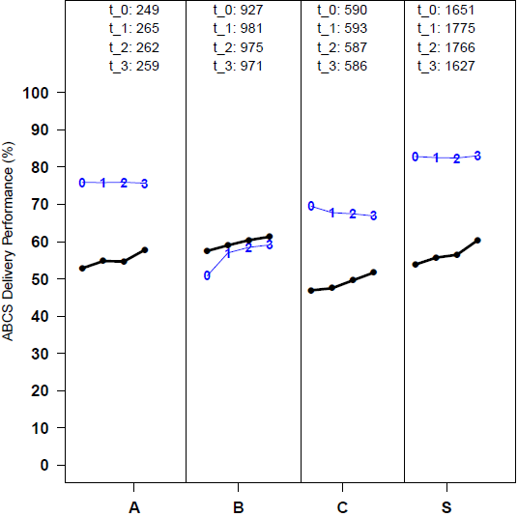
Longitudinal ABCS Trajectories

Slide 56
Future Opportunities for PBRNs
Background
Opportunities
Strategies
Notes:
NEED TO BE IN PRESENTATION MODE

Slide 57
PBRNs |
Questions For The Road Ahead
What are the impacts on practices of physician/clinician and staff turnover and other disruptive events?
What’s really going on with burnout?
What are strategies for accessing and reporting data now and for the future? What role can PBRNs play in helping practices with this?
How are practices using or not using all the data they now have available about their practice performance and why?
How do practices adapt to becoming an employed practice? And, what role or new role might PBRN play with these practices?
What is the importance of culture and its intentional development at the practice-level in both adaptability and in ability to achieve performance excellence?

Slide 58

The Team
Notes:
Claire – create slide

Slide 59
Thank You
escalates@ohsu.edu escalates.org @ESCALATESorg

