Slide 1

Practice-Based Research Networks Add Value to Evidence-Based Quality Improvement
Karen M. Goldstein, MD MSPH
Research Associate, Durham VAMC Center for HSR&D in Primary Care
Assistant Professor, Duke University School of Medicine
Presenter:
Susan Frayne MD, MPH
Director, VA Women‘s Health Practice-Based Research Network, VA Palo Alto Health Care System
Professor, Stanford University School of Medicine
Authors: KM Goldstein, D Vogt (Study PI), A Hamilton, S Frayne, J Gierisch, J Blakeney,
A Sadler, B Bean-Mayberry, D Carney, B DiLeone, A Fox-Galalis, R Klap, E Yee (Study Co-PI),
Y Romodan, H Strehlow, J Yosef,, E Yano
July 2016 NAPCRG Conference

Slide 2

Bench to Bedside?

Slide 3
Evidence-Based Quality Improvement (EBQI)
What is EBQI?
  A systematic approach to fostering the multilevel research-clinical partnerships necessary for effective implementation
  Integrates evidence through existing structures
  Tailors evidence to local contexts
EBQI has not been tested in PBRNs
  PBRNs are potentially an ideal setting for applying EBQI: PBRNs provide real-world infrastructure for clinician-researcher collaboration
  PBRNs emphasize fostering practice-based change

Slide 4


EBQI at a Single Site
Research
Clinicians
Local Site
EBQI Activities

Slide 5
EBQI in PBRN Context
Research
Clinicians
Research
Clinicians
Local Site
EBQI Activities
Local Site
EBQI Activities

Slide 6
EBQI in PBRN Context
Ongoing Local
Partnership
Ongoing Local
Partnership
Research
Clinicians
Research
Clinicians
Local Site
EBQI Activities
Local Site
EBQI Activities

Slide 7
EBQI in PBRN Context
Ongoing Local
Partnership
Ongoing Local
Partnership
Research
Clinicians
Research
Clinicians
Local Site
EBQI Activities
Local Site
EBQI Activities

Slide 8
EBQI in PBRN Context
Ongoing Local
Partnership
Ongoing Local
Partnership
Research
Clinicians
Research
Clinicians
Local Site
EBQI Activities
Local Site
EBQI Activities
National PBRN Community
PBRN Coordinating Center support

Slide 9
Our Objective
We evaluated EBQI implementation in a PBRN setting:
To what extent does the PBRN infrastructure add value to EBQI implementation of an evidence-based curriculum, “Caring for Women Veterans”?

Slide 10
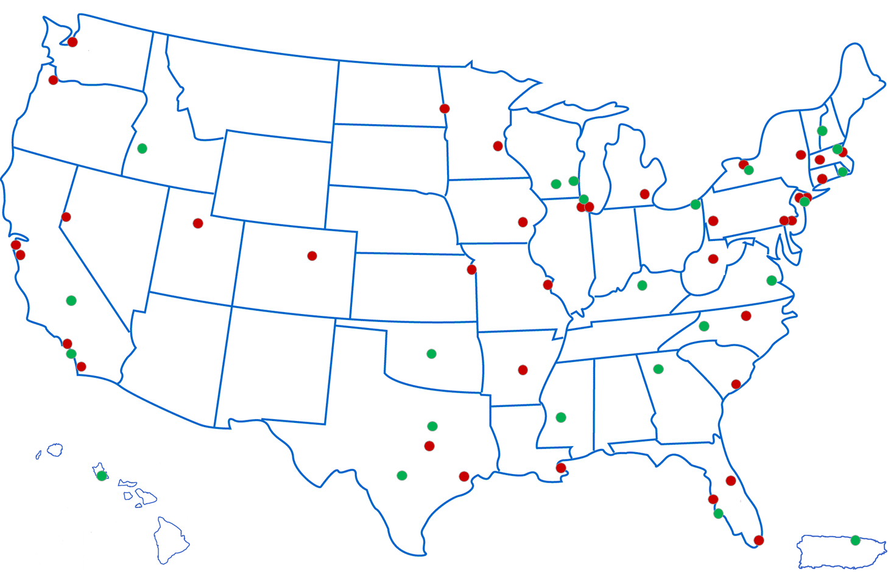
Methods: PBRN Context
VA Women’s Health PBRN (WH-PBRN)
  Fosters inclusion of women Veterans in research
  Promotes partnerships between women’s health clinicians and women’s health researchers in VA
  Established in 2010 with four inaugural sites
    2,600-5,000 women Veterans at the 4 sites; rural 10-53%; racial/ethnic minority 10-57%
    Cross-site similarities in administrative and clinical structures
60 sites as of 2015

Slide 11
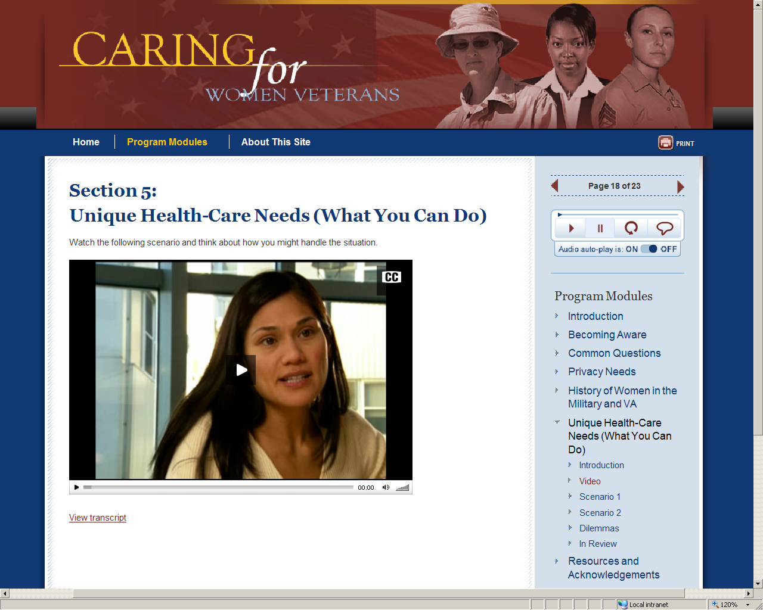
Methods: CWV Project as a case study
Caring for Women Veterans (CWV)
  Evidence-based gender awareness curriculum for VA staff
  At 4 inaugural WH-PBRN sites, conducted a cluster randomized trial:
    Evaluate an EBQI approach to tailoring the CWV training to the needs of local sites
  Clinical workgroups
    Expert Panel at each site identified clinical workgroups that would benefit from the training (e.g., Emergency Department, specialty clinics, community-based VA primary care clinics)
    Workgroups randomized to EBQI vs “training as usual”

Slide 12
Examples of EBQI Tailoring for Implementation of Caring for Women Veterans
Training Setting | Holding the training individually vs. in a group setting
Clinical Environment | Reviewing pictures displayed in clinical settings and change to create a more gender aware environment
Participation incentive | Mandatory vs. optional training
Action Plans | Option for employees to create a specific action plan including specific gender-awareness goals
Marketing | Option to create locally-produced media to encourage gender awareness among staff and patients

Slide 13
Analysis
Site teams identified impacts of the PBRN context on EBQI processes using:
  A formal review of project call minutes
  Structured site team input
  Post-project debriefing calls
Mapped PBRN site feedback to the four Replicating Effective Programs (REP) implementation phases:
  Pre-condition
  Pre-implementation
  Implementation
  Maintenance/evolution
  Kilbourne 2007 Implementation Science: REP

Slide 14
Results: Barriers to and Facilitators of Successful Multi-Site Implementation within the VA WH-PBRN
REP Domains | Barriers | Facilitators
Pre-Condition | Schedule coordination across sites due to competing time demands | Minimal local content tailoring due to similar site audiences Alignment of project/site goals
Pre-Implementation | Multi-level training needs across sites | Open communication across sites at all levels for rapid sharing of trouble-shooting strategies
Implementation | Variations in logistic needs across sites due to local tailoring choices | Support from study PI and PBRN coordinating center
Maintenance/ Evolution | Additional effort needed to create sustainment plans for multiple sites | Site leadership commitment to PBRN activities

Slide 15
Recommendations for EBQI projects within a PBRN
Pre-Condition | *Build on areas of common mission between PBRN sites leads, facility leadership, and project objectives
Pre-Implementation | *Capitalize on PBRN commonalities in multi-site process strategies and preparations for local intervention tailoring *Plan for coordination/tracking of multi-level training to support fidelity of implementation across sites
Implementation | *Share implementation strategy challenges/successes real-time across sites for benefit of partner sites
Maintenance/ Evolution | *Share dissemination materials across sites to amplify local site effort, capitalizing upon existing clinician-researcher partnerships at the local PBRN site

Slide 16
Conclusions
PBRN involvement strengthened EBQI activities across all phases of this multi-site implementation project
  PBRN’s existing researcher-clinician partnerships facilitated implementation planning activities
  Built on the efficiencies of site commonalities for multi-site project tools and scalable communication strategies
PBRNs contribute to the uptake of evidence into everyday practice
  Can serve as an important component of the future implementation of evidence-based initiatives using EBQI approaches

Slide 17

We would like to acknowledge and thank all of those who participated in this EBQI project at the four sites and without whom this project would not have been possible
This project was supported by: VA HSRD SDR 10-012 (PIs: Yano /Frayne); National Center for PTSD; HSRD Research Career Development Award #05-195 (Yano); NIMH/VA QUERI R25 MH080916 (Hamilton); HSRD Durham VAMC.
The views expressed are those of the authors and do not necessarily reflect the position or policy of the Department of Veterans Affairs or the United States government

Slide 18
Selected References
Kilbourne AM, Neumann MS, Pincus HA, Bauer MS, Stall R. Implementing evidence-based interventions in health care: application of the replicating effective programs framework. Implement Sci. 2007;2:42.
Frayne SM, Carney DV, Bastian L, Bean-Mayberry B, Sadler A, Klap R et al. The VA Women's Health Practice-Based Research Network: amplifying women veterans' voices in VA research. J Gen Intern Med. 2013;28 Suppl 2:S504-9.
Vogt DS, Barry AA, King LA. Toward gender-aware health care: evaluation of an intervention to enhance care for female patients in the VA setting. J Health Psychol. 2008;13(5):624-38.

