Slide 1
People travel but data do not:
How we compared PBRN data across three countries
NAPCRG PBRN conference
June 2018
Michelle Greiver, MD; Sumeet Kalia, MSc;
Simon de Lusignan, MD; Frank Sullivan, MD;
Amanda Cheng, MPH; Dena Moftah;
Jonathan N. Tobin, PhD

Slide 2
Background
PBRNs have large electronic data holdings
  Electronic Medical Records (EMRs)
  Clinical studies
Individual level patient data often cannot easily travel across borders because of privacy and regulatory requirements
Comparisons between countries may be valuable, due to different
  Population characteristics
  Healthcare delivery and Payment systems
  Social context
  Availability of different data elements

Slide 3
Objective
To describe a research collaboration among PBRNs in three countries
  Canada (UTOPIAN)
  UK (Royal College of General Practitioners Surveillance and Research Centre database)
  USA (Clinical Directors Network, Inc. (CDN))
All of the research networks have a shared interest in studying and improving cardiovascular health outcomes and have key common data elements

Slide 4

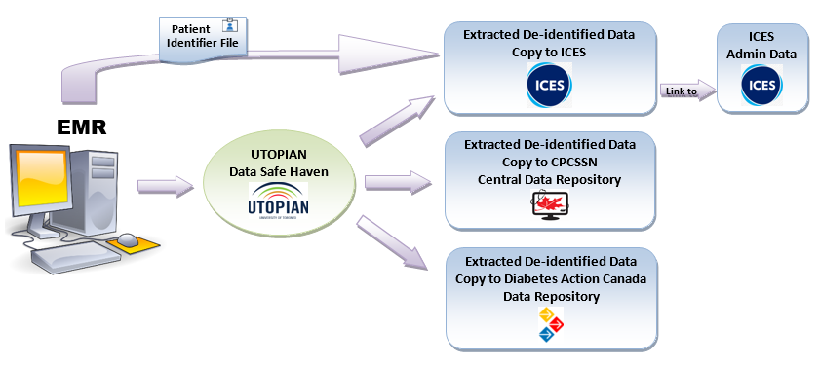
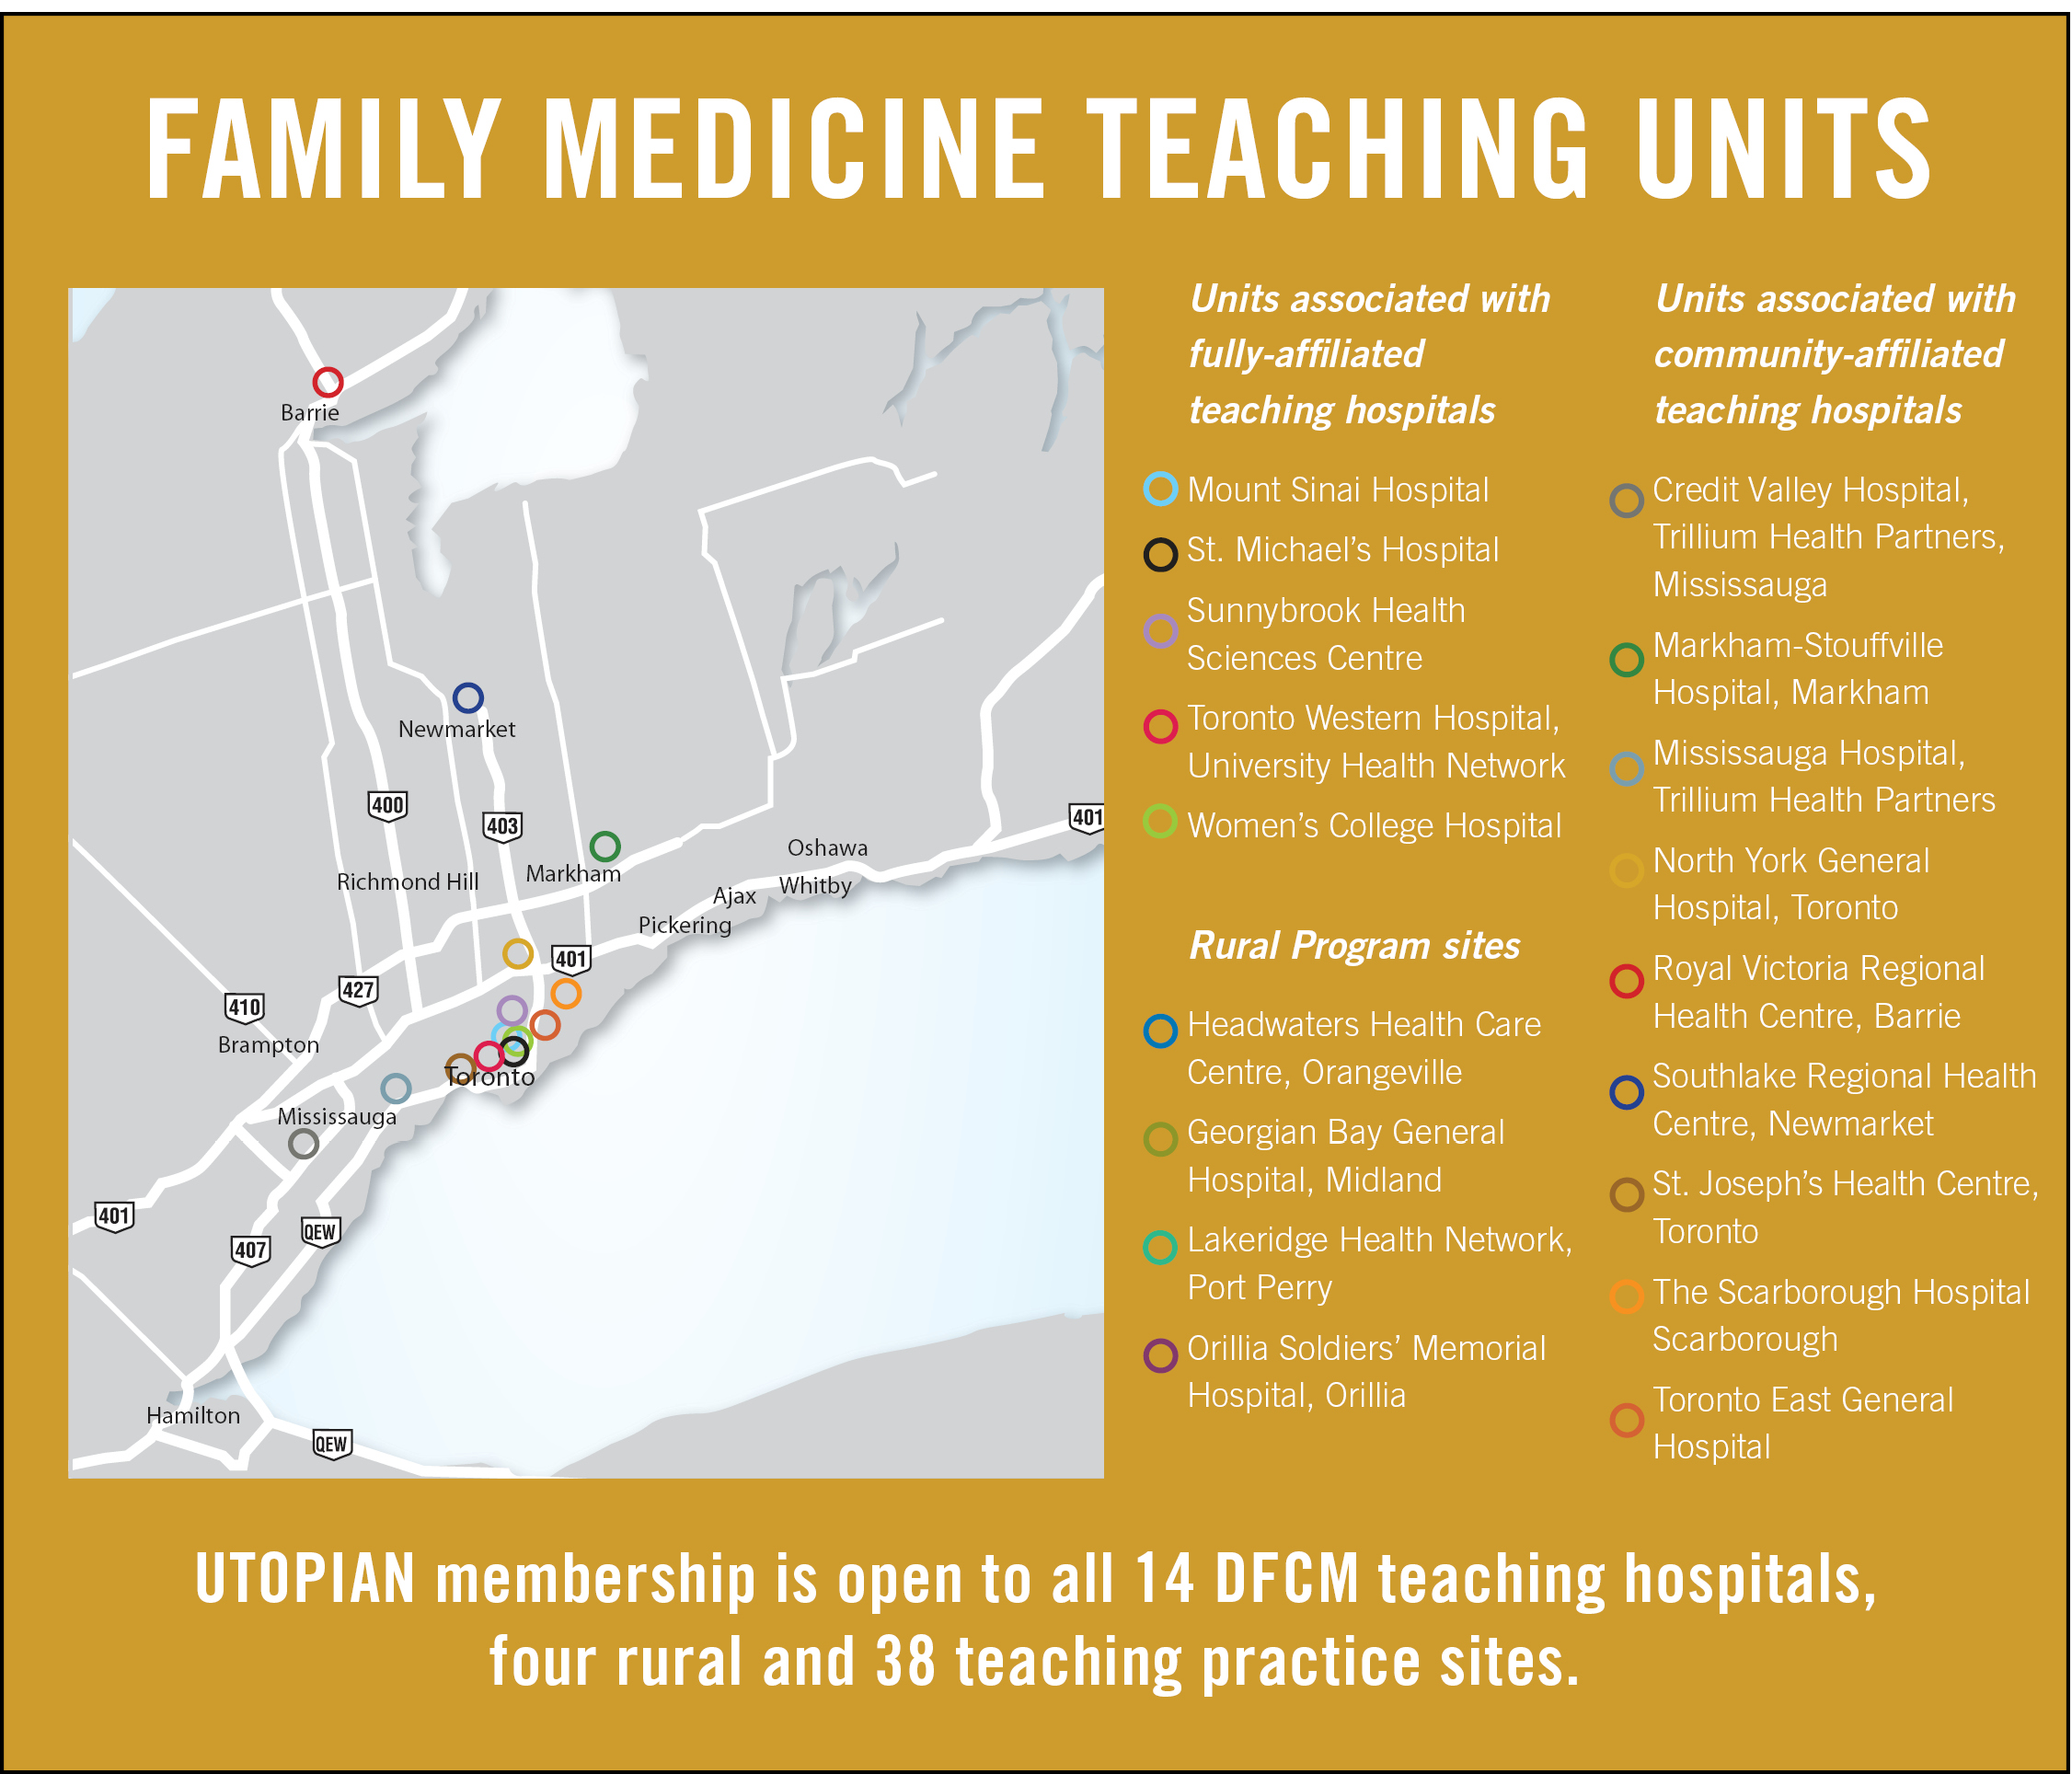



14 teaching units, ~400 practices, ~1,500 faculty, ~1M patients
Providing support for primary care research (practice facilitators, data management and analysis, courses on research methods/writing)
Primary care EMR database (>550k+ patient records in 2017.Q4)

Slide 5

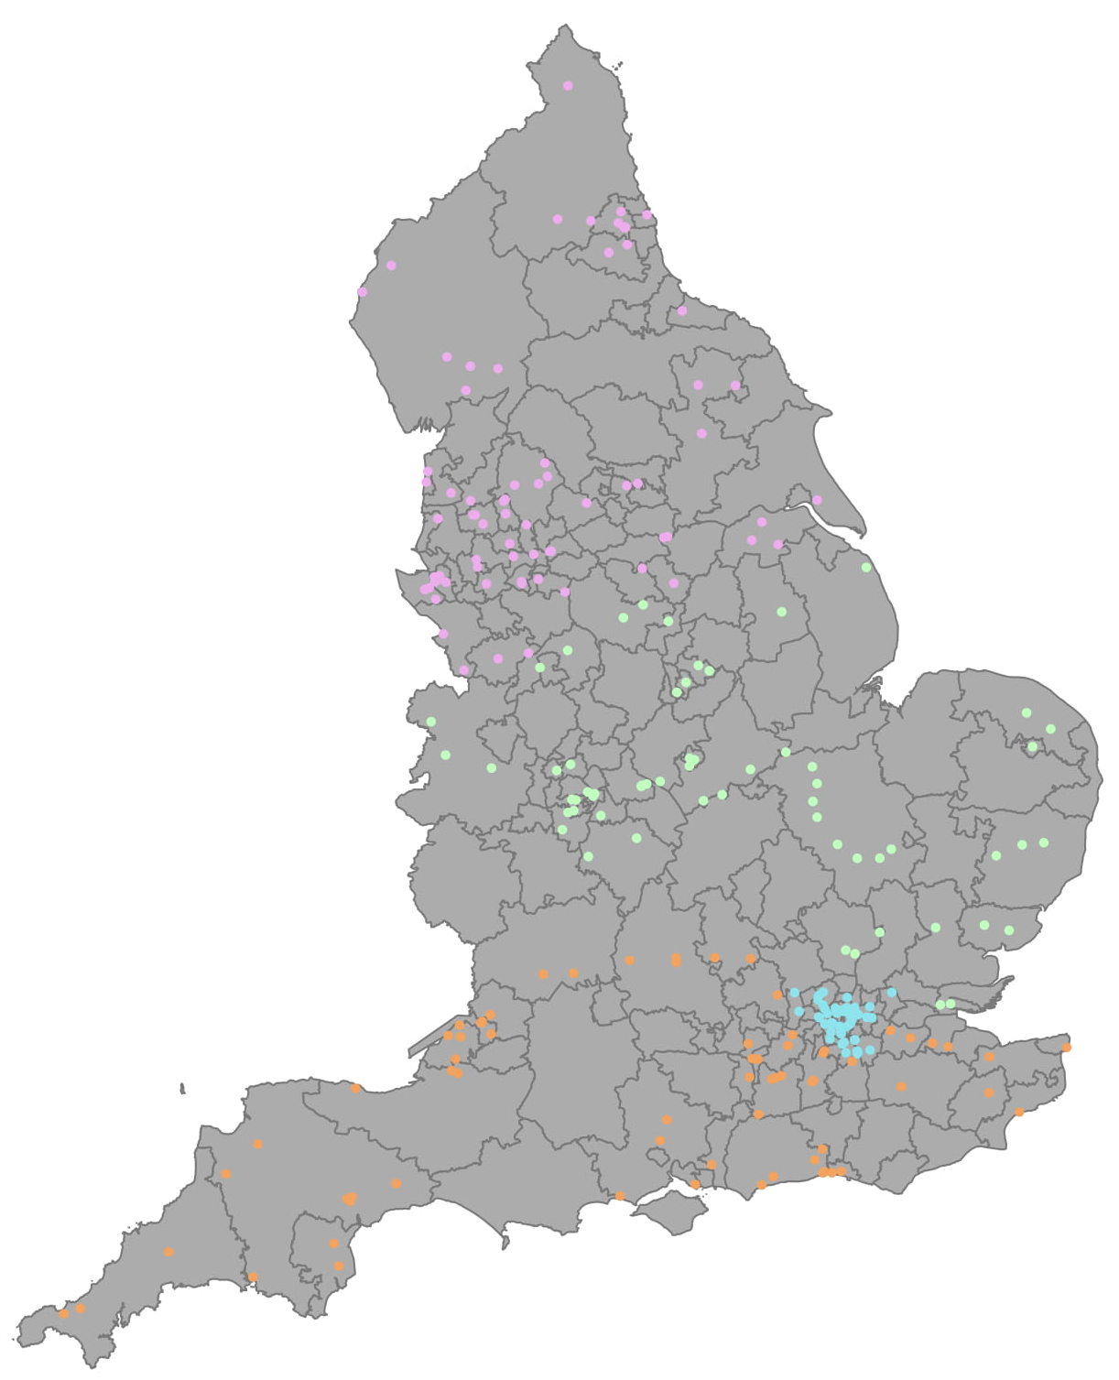
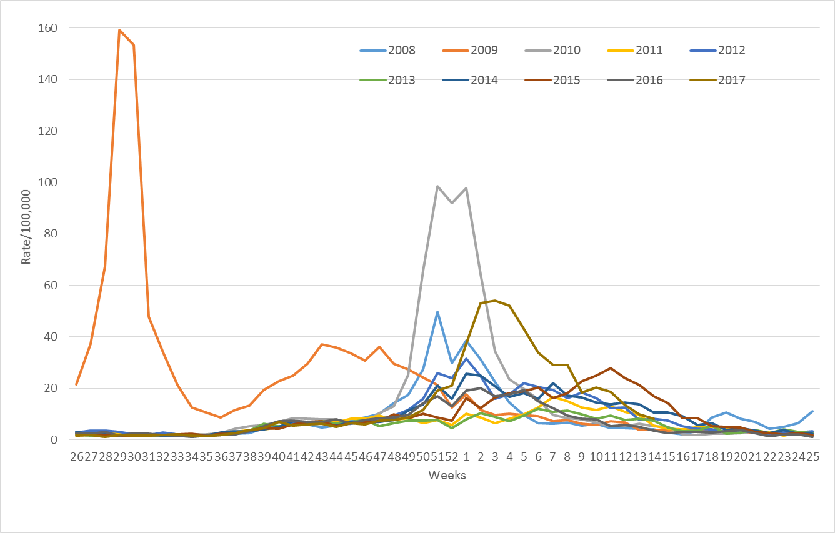
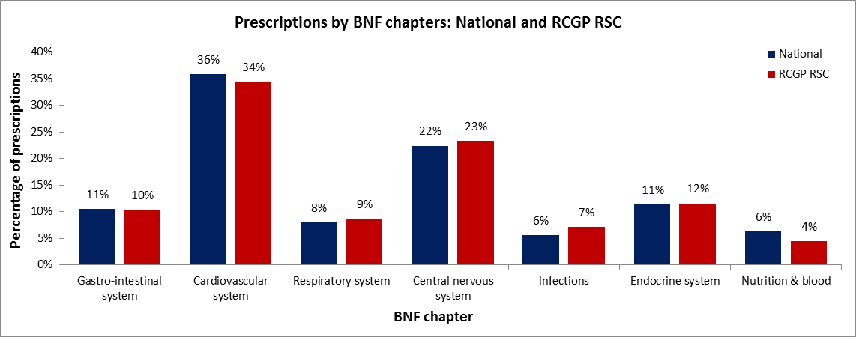
RCGP RSC
Royal College of General Practitioners – Research & Surveillance Centre
One of Europe’s oldest sentinel system
  First data collections in 1957
  National distribution of practices
  >250 practice members
  uploading >2 million patient records each week
  Data available for research, surveillance
Surveillance of influenza, infections & respiratory illness
  National surveillance system for influenza, etc. since 1967
  Important role in spotting the 2009 pandemic
Nationally representative growing database:
  UK has a registration-based system – one patient – one GP
  National linkable unique ID – NHS number
  Nationally representative of chronic disease and prescribing
  Cardiovascular outcomes well recorded (e.g. BMJ. 2018 Feb 14;360:k342. doi: 10.1136/bmj.k342)
Plentiful recording of BP
  >1.4 billion “encounter”/consultation records
  >31 million BP recordings in our network database
Data & analytics hub @ University of Surrey
  Since March 2015 – Director: Prof Simon de Lusignan
  www.rcgp.org.uk/rsc
Representative
distribution of
practices >>
Spotted 2009 influenza out of season pandemic
<<
Representative prescribing by drug type

Slide 6

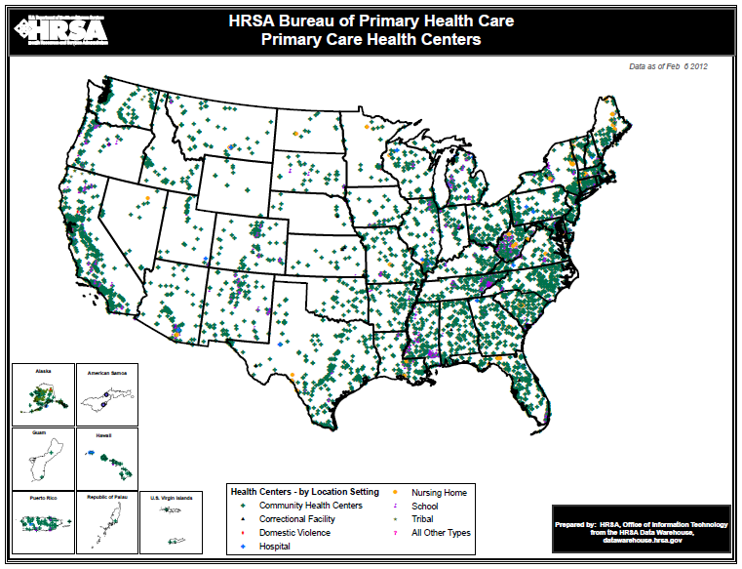
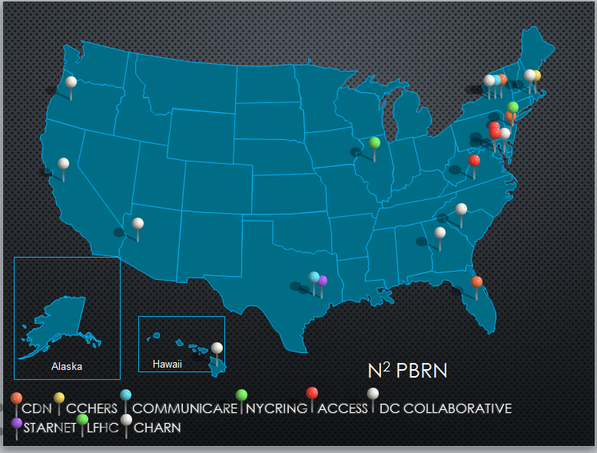

CDN has built a scalable research infrastructure to serve the needs of the clinicians who practice in the health care safety-net by building on existing infrastructure, creating new relationships, providing external practice facilitators (onsite, online), and dissemination channels
  CDN N² –PBRN: Building a Network of Safety Net PBRNs
CDN is A Practice-based Research Network (PBRN) that works with Federally Qualified Health Centers (FQHCs) and other Primary Health Care Safety-net Practices
DHHS – HRSA: The Primary Health Care Safety-Net
CDN N2-PBRN
PBRN Partners
  Access Community Health Network (ACCESS)
  Alliance of Chicago (ALLIANCE)
  Association of Asian Pacific Community Health Organization (AAPCHO)
  Center for Community Health Education Research and Service (CCHERS)
  Clinical Directors Network (CDN) [LEAD PBRN]
  Community Health Applied Research Network (CHARN)
  Fenway Institute (FENWAY)
  New York City Research and Improvement Group (NYCRING)
  Oregon Community Health Information Network (OCHIN)
  South Texas Ambulatory Research Network (STARNet)
  Southeast Regional Clinicians Network (SERCN)
  Florida Clinical Research Consortium (One Florida)
9,000 sites, 22 million patients
9 PBRNs,
600 sites,
4.5 million patients
CDN is an
AHRQ Center of
Excellence for
Practice-based
Research
and Learning
Funded by AHRQ Grant: P30HS021667
PI: Jonathan N. Tobin, PhD (CDN)

Slide 7
The study: End digit preference for BP
Manual BP and AOBP are associated with different patterns of data for BP in both routine care and RCTs
  50% to 60% of manual BPs end in zero (example, 140/90)
    de Lusignan S, Belsey J, Hague N, Dzregah B. End-digit preference in blood pressure recordings of patients with ischaemic heart disease in primary care. J Hum Hypertens. 2004 Apr;18(4):261-5.
  Clinical care is driven by manual and AOBP readings taken in office-based settings
  Inaccurate readings may be:
    Rounded down → leading to undertreatment
    Rounded up → leading to overtreatment
Does adoption of AOBP result in less EDP?
Does this make a difference to patient outcomes?

Slide 8
Methods:
Working across borders
Computable phenotypes and analytic codes were shared across US border
Results were analyzed separately
Aggregate results were shared and integrated

Slide 9
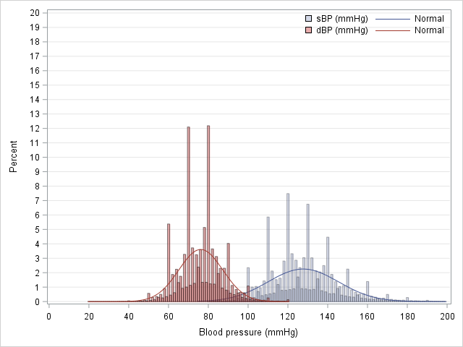
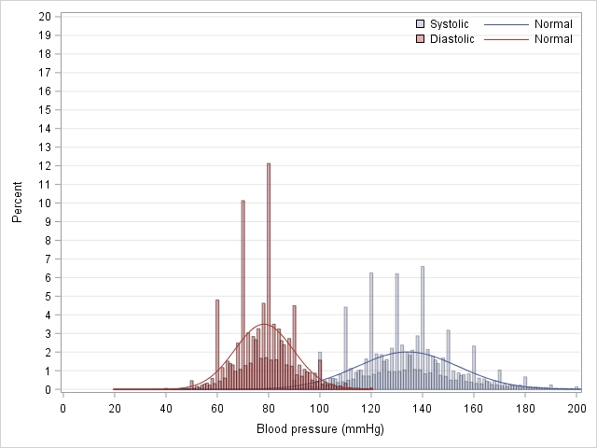
Systolic and diastolic BPs in UK and Canadian EMR databases
Canadian blood pressures
UK blood pressures

Slide 10
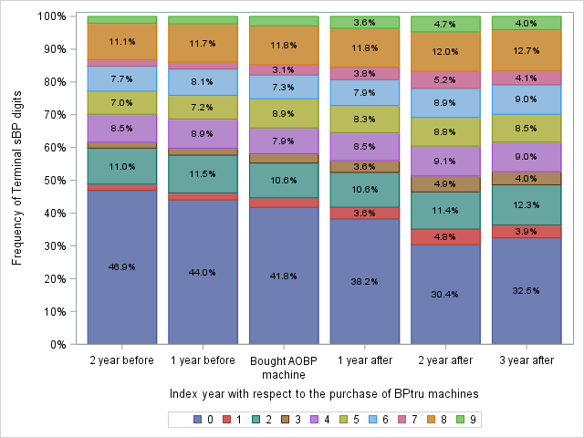
Canada: Impact of adoption of AOBP machine on end digit preference: Linked survey result and EMR data

Slide 11
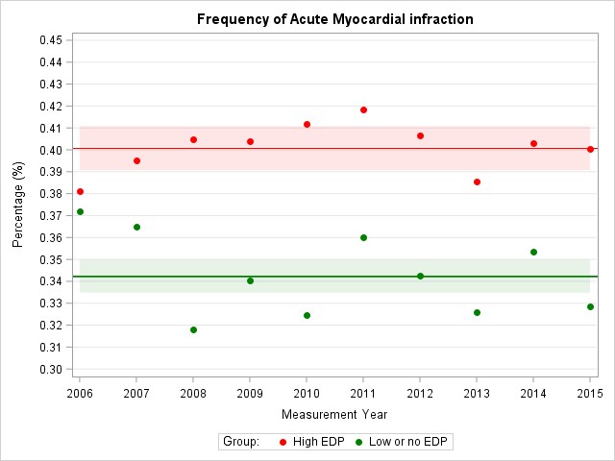
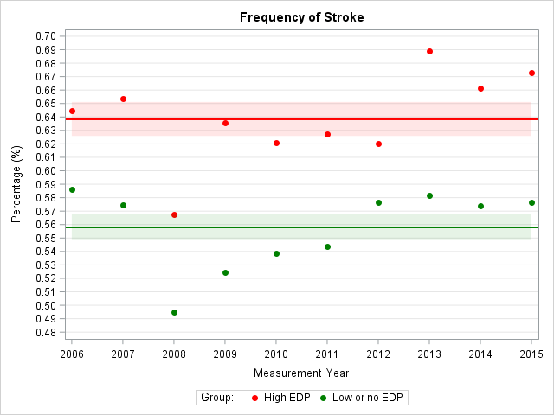
UK: Association between EDP and Cardiovascular outcomes
Myocardial Infarcts
Standardized morbidity ratio: 1.16
95% CI 1.14-1.19
Strokes
Standardized morbidity ratio: 1.15
95% CI 1.12-1.17

Slide 12

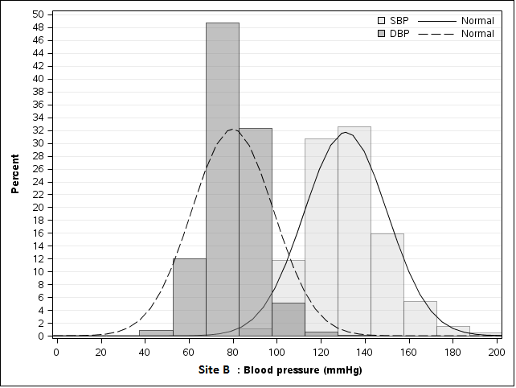
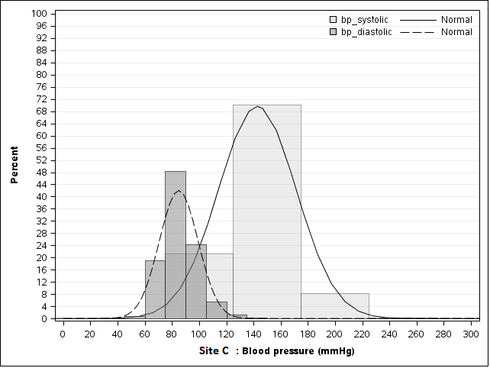


Blood Pressure Visit Intensification for Successful Improvement of Treatment (BP Visit)
Funded by NIH-NHLBI Grant #:1R18HL117801) PI: K. Fiscella, MD, University of Rochester and J.N. Tobin, PhD, Clinical Directors Network, Inc (CDN).
Results: BPVisit
SUMMARY
The BPVisit Study is a Quality Improvement intervention designed to improve care for patients with uncontrolled blood pressure. It’s overarching aim is to determine whether implementing multimodal QI strategies will result in clinician implementation of the JNC guidelines for monthly visits for patients with uncontrolled blood pressure who are patients at FQHCs in the New York Metropolitan area
Fiscella, K., Ogedegbe, G., He, H., Carroll, J., Cassells, A., Sanders, M., Khalida, C., D’Orazio, B.M., Tobin, J.N., “Blood Pressure Visit Intensification in Treatment (BP-Visit) Study: Trial Design” American Heart Journal 170(6):1202-10, 2015. PMID: 26678642

Slide 13
Conclusions about
Blood Pressure Research
BP End Digit Preference (EDP) may be a global phenomenon with important public health implications:
  There appears to be systematic rounding down of BP associated with higher rates of EDP, and presumably more use of manual BP measurement
  Higher rates of EDP were associated with a higher frequency of adverse cardiovascular outcomes

Slide 14
Conclusions about multinational PBRN Collaborations
Analyses by PBRNs conducted in parallel can be combined
Data were similar, but each country and PBRN can contribute unique elements
Federated analyses using aggregated data appear to be feasible:
  “To perform linear regression analyses on a continuous aggregate outcome we need only 2 parameters: the mean and the standard deviation (SD), within strata of a set of categorical predictors. The frequencies (counts) of the combinations of the predictors can be used as weights.”
        Moineddin R, Uruquia ML. Epidemiol, Nov 2014: 25(6)
Data for observational studies and for planning and conducting cross border PBRN studies are valuable and can be combined without posing any regulatory risks to patient privacy

Slide 15
Connections
Visit from UTOPIAN Deputy Director to Surrey, UK, to discuss Canadian results
Visit from UTOPIAN Analyst to Surrey to learn about RCGP RSC database
Poster at NAPCRG PBRN 2017
Visit to poster and interest from President/CEO of CDN (USA)
Several teleconferences among USA, Canada, and UK Research Teams

Slide 16



Obesity and Adolescent Pregnancy:
Building a De-Identified Electronic Clinical Database to Examine the Biological and Social Determinants of Nutritional Status, Pregnancy and Birth Outcomes
SUMMARY
This community-academic partnership involves the creation of a multisite de-identified Electronic Health Records (EHR) database that will demonstrate the feasibility of using available measures conducted as part of routine clinical care to explore associations and identify targets for future interventions that address adolescent nutritional and pregnancy outcomes.
This “Big Data” EHR-based study addresses the disproportionate health burdens experienced by overweight and obese adolescents and their infants up to the age of 24 months.

Slide 17
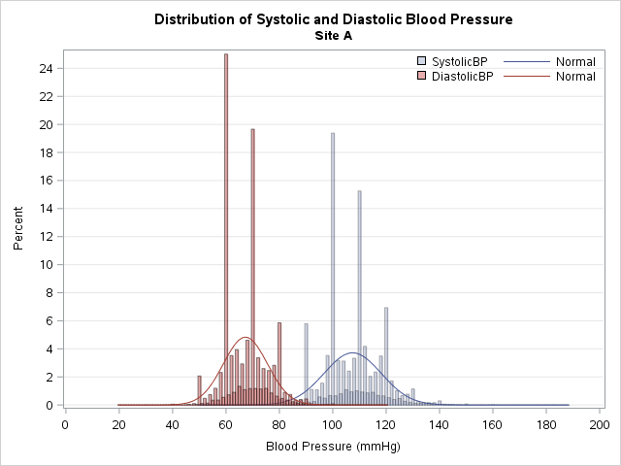
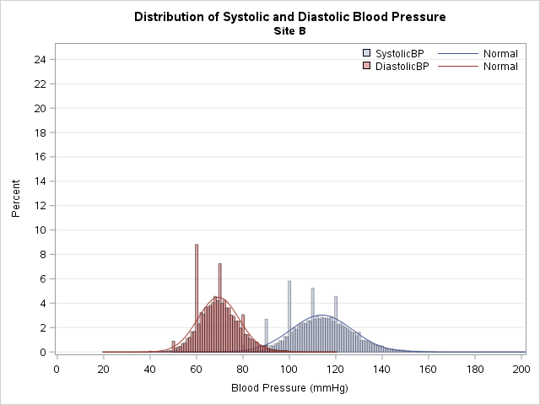
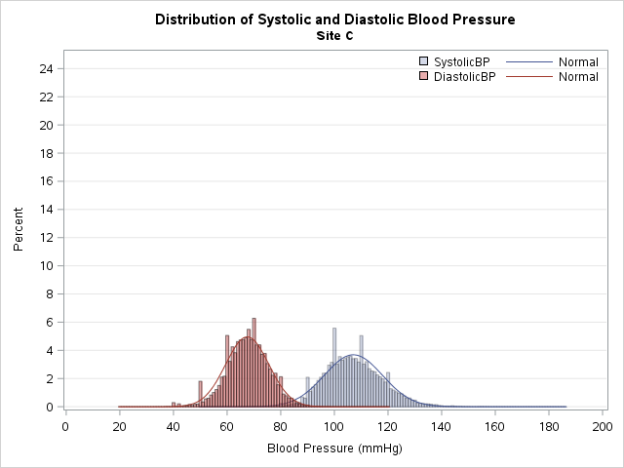
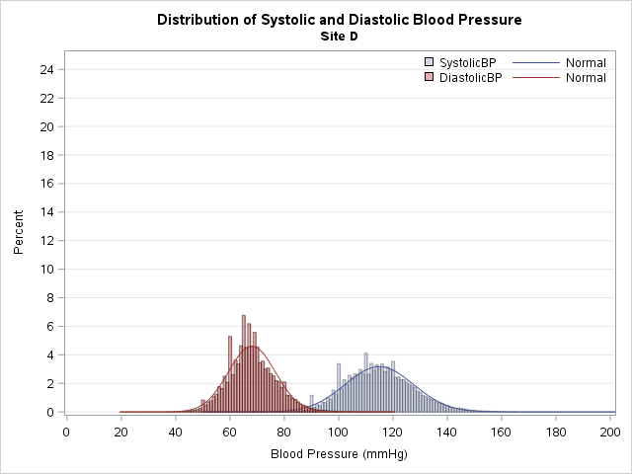
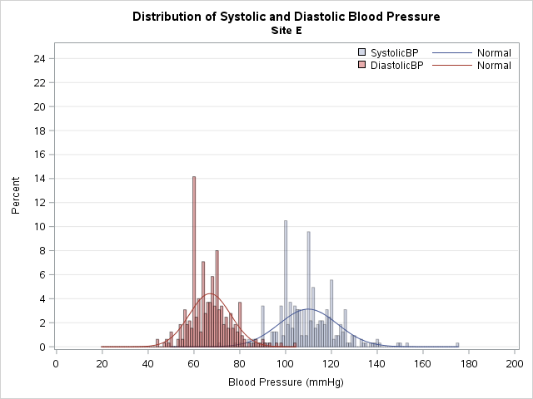
Sackler Study:
Blood pressure distribution by site

Slide 18
Thank you. Questions?

