Slide 1
Parent Perceptions and Preferences for Pain Management During Child Vaccinations
Stacey Engster, MD, MS, Carrie Fascetti, LSW, Alexandra Mykita, MA, Evelyn Cohen Reis, MD
June 24, 2019
Notes:
Add CTSI logo and funding

Slide 2
Outline
Pediatric PBRN Information
Background
Goal and Objective
Methods
Results
Conclusions
Implications

Slide 3

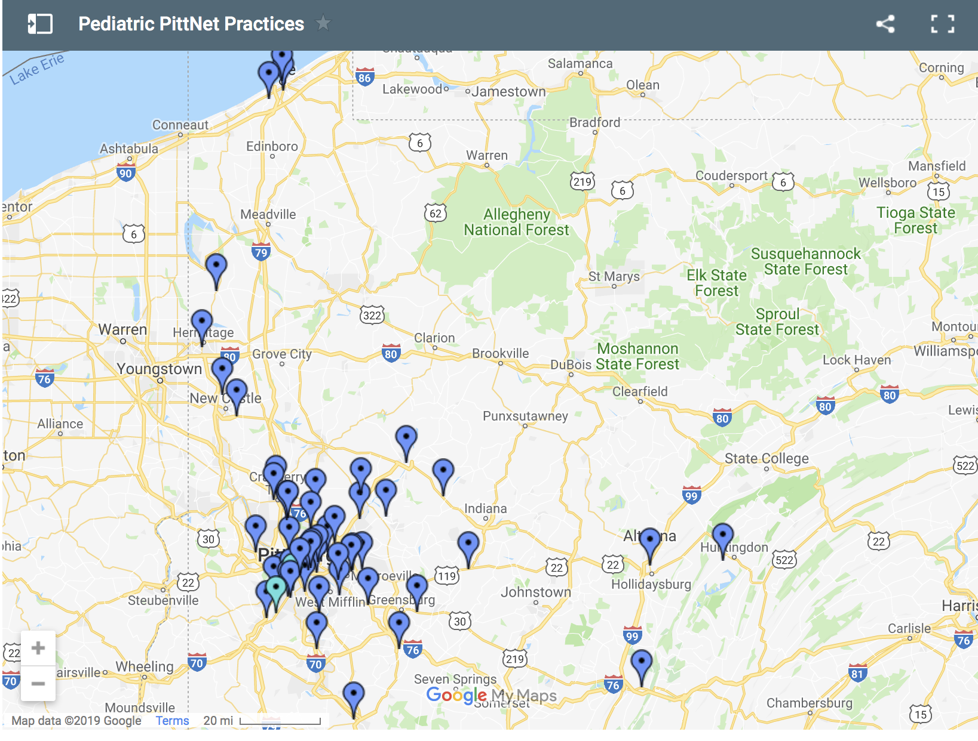
35 practices
57 offices
13 counties
Notes:
Add separate slide
Supported by
Launched in 2007, 32 practices, 54 offices, 13 counties, 275+ providers; over 5600 participants in over 200 research studies with behavioral/physical health concerns; over 100 investigators
Add number of patients

Slide 4

280 providers serving over 266,000 privately and publicly insured patients in urban, suburban, and rural settings
Over 5600 research participants in over 200 studies by over 100 investigators including physical and behavioral health
Notes:
35 practices with 57 office sites in 13 counties in Western Pennsylvania. We have approximately 280 primary care providers serving over 266,000 privately and publicly insured patients, aged birth to 21 years, in urban, suburban and rural settings.

Slide 5
Background
Pediatric immunizations are the most common source of procedure-related pain and distress in children
Several evidence-based pain management strategies are available and recommended^{1,2}
Despite availability, few pediatric practices routinely use pain management strategies³
Shah V, Taddio A, Rieder MJ, HELPinKIDS Team. Clin Ther. 2009; 31 Suppl 2: S104-51.
Shah V, Taddio A, McMurtry M, et al. Clin J Pain. Oct 2015; 31 (10):S38-63.
Taddio A, Manley J, Potash L, et al. Pediatrics. 2007;120:e637–e643.
Notes:
Add shotblocker pic!
Sweet ease
ShotBlocker® works through a novel application of the gate control theory of pain management. It is a plastic, C-shaped device with small bumps on its back. When pressed firmly against the skin at the injection site, ShotBlocker® saturates the sensory nerves and distracts the patient from pain signals caused by the needle poke. The device is both simple and easy to use, bringing comfort to users of all ages

Slide 6
Goal
To enhance the care of children and to improve clinical practice within our network regarding pain management during routine vaccinations

Slide 7
Objectives
To understand how parents perceive their children’s experiences with routine immunizations
To determine parent preferences for pain management among various ages of children

Slide 8
Methods
Cross-sectional online survey of parents regarding their perceptions of their children’s discomfort with vaccinations and their preferences for pain management
Brief, anonymous survey consisting of 22 questions
Average time to complete was 8 minutes via Qualtrics
Option to enter a random drawing to win $25
Notes:
Drawing online
Registry
Irb approved

Slide 9
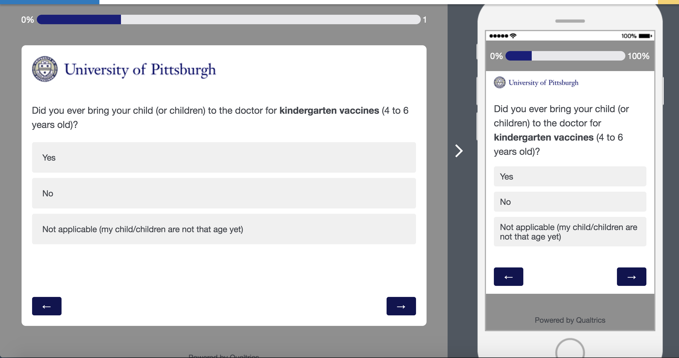
Methods
Notes:
Drawing online
Registry
Irb approved

Slide 10
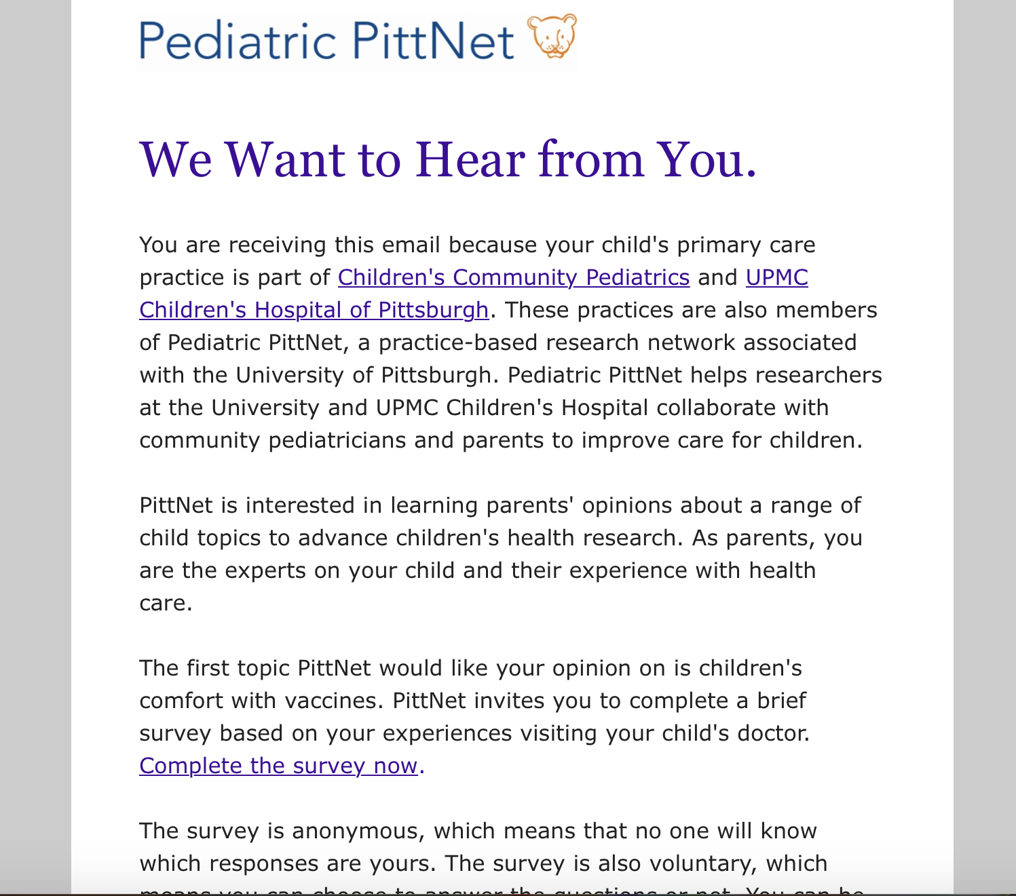
Methods - Recruitment

Slide 11
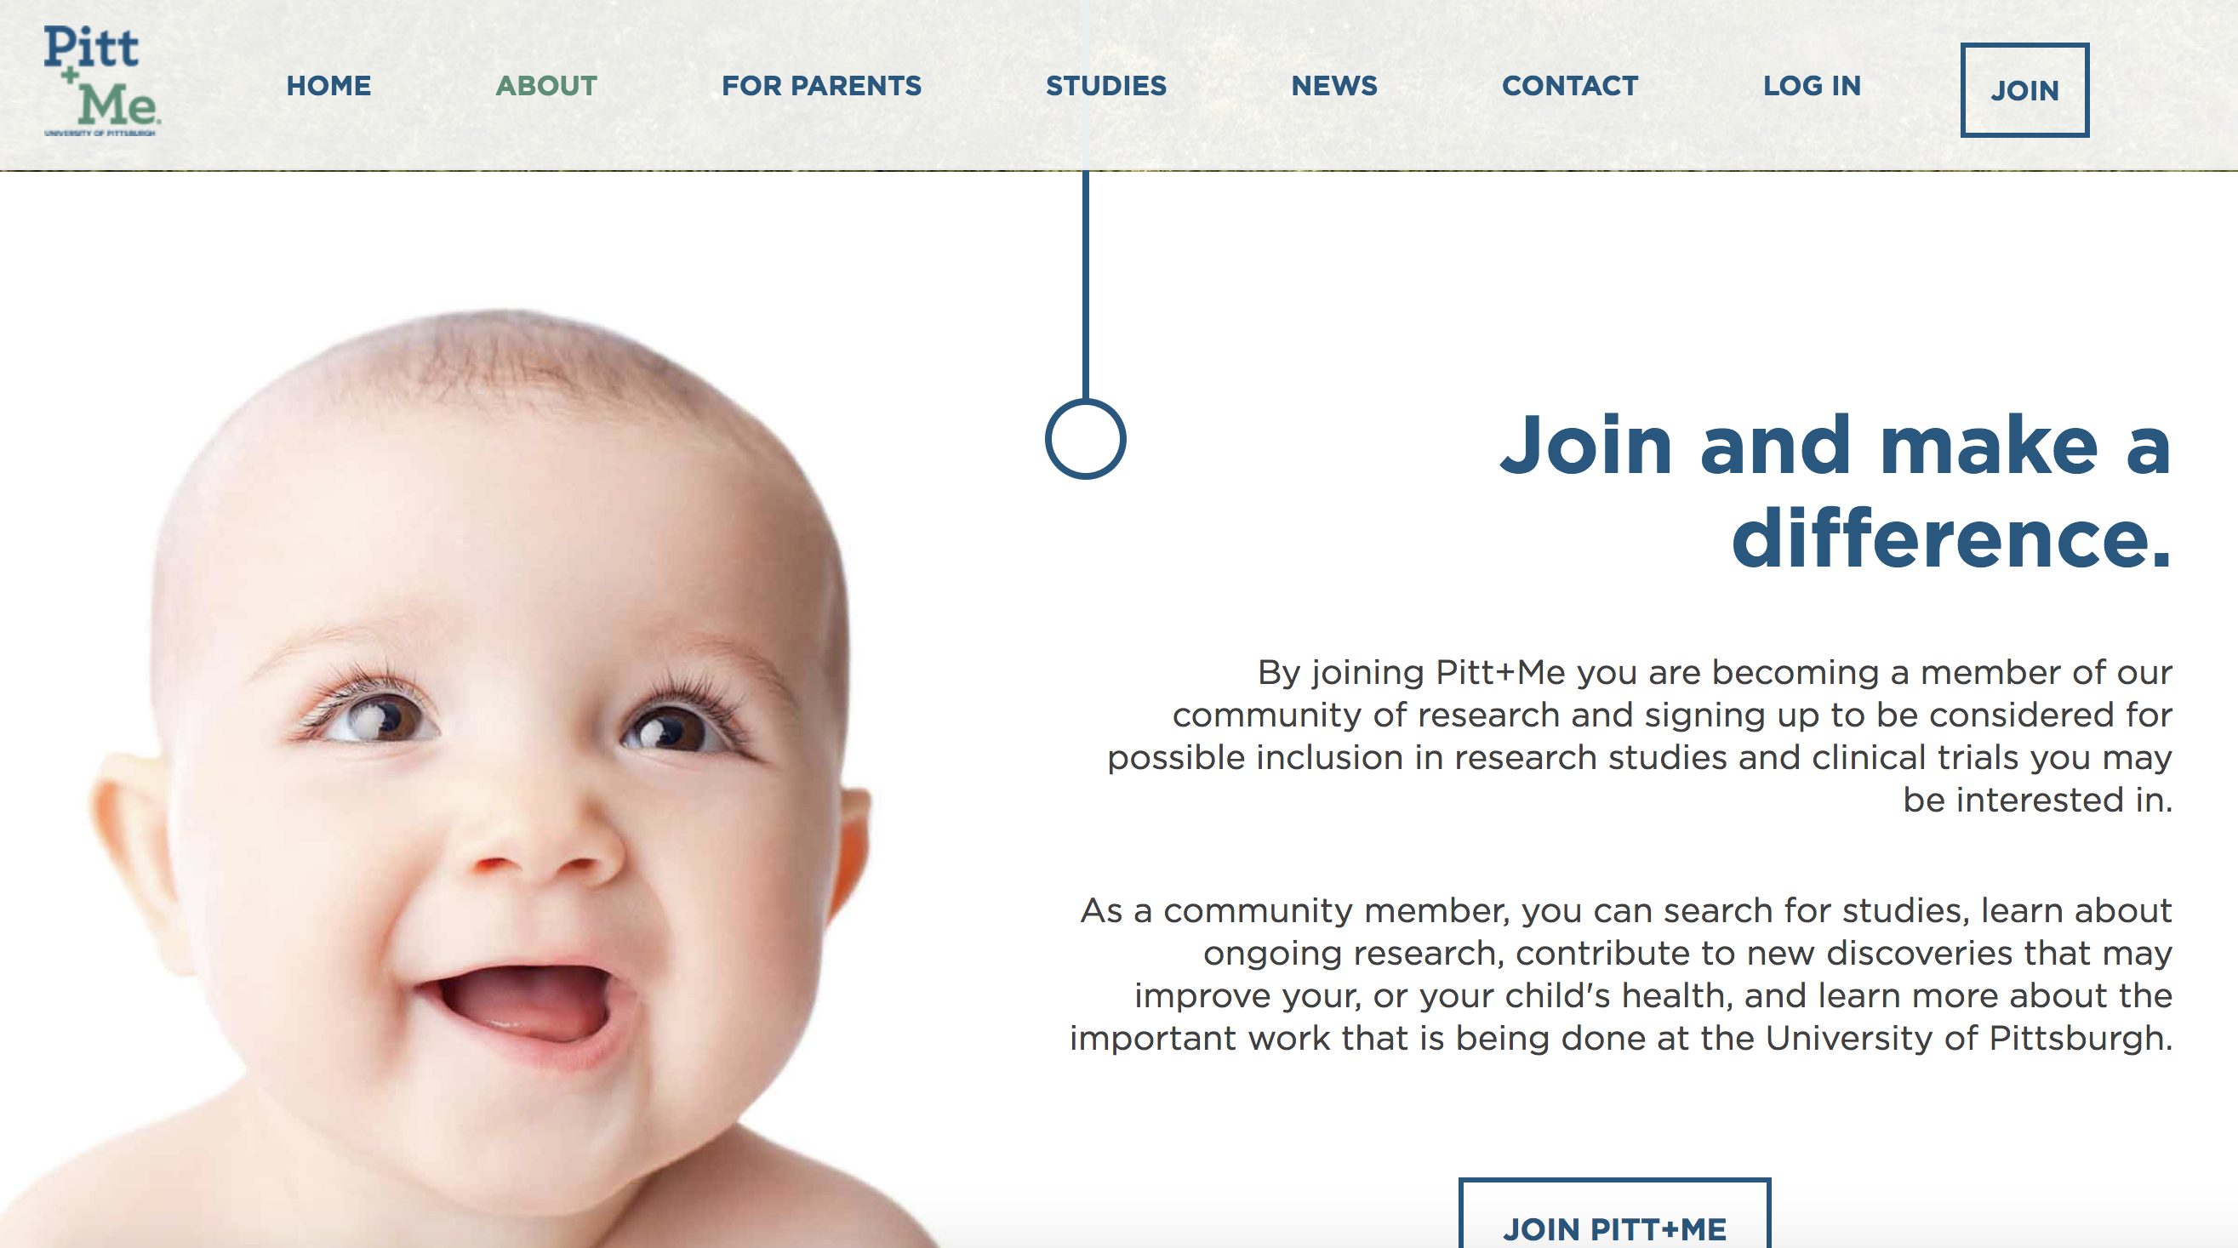
Methods - Recruitment

Slide 12
Methods – Inclusion/Exclusion Criteria
Convenience sample of eligible participants:
  Parents aged 18 years and older
  Accompanied their child to a pediatric primary care office to receive routine vaccinations
Participants (3%) were excluded if they didn’t answer any question on the survey

Slide 13
Results – Demographic Information
From October 2018 through May 2019, 370 participants started the survey and 359 completed it
91% of parents were female, about half aged 30-39 years, from 141 different zip codes
Over 51 different pediatric primary care offices; about 94% within our pediatric PBRN
Parents on averaged had 2 children (SD=1.08)
Notes:
Parent Vaccine Survey
Started: Oct. 17 (33 weeks)
Completed : 356*
Gift Card Entries: 293
Interested in Parent Panel through survey: 200
Follow-up Responses (YES confirmed via email): 106
No Response after 2 week follow-up:
Pitt+Me Referrals: 176
*Includes surveys submitted that were only partially completed
Weekly Avg of Completed Surveys: 11
Surveys completed this week: 5

Slide 14
Results – Demographic Information
Notes:
11 surveys a week
About half pitt+me

Slide 15
Results – Parent Perceptions
When asked about perceived child discomfort, many parents said their child was uncomfortable with vaccinations during infancy (86%), young childhood (67%), and young adolescence (20%)
For infants, most parents (85%) were asked to hold their baby during vaccinations and most (98%) were allowed to hold their infant if they wanted

Slide 16
Results – Kindergarten Vaccines
Notes:
For children receiving kindergarten vaccines, most parents preferred several pain management options including distraction such as singing a song or blowing on a pinwheel (37%), a topical cooling spray (vapocoolant) (39%), and a ShotBlocker® which is a C-shaped device with small bumps (30%).
Parents reported a smaller percentage of their children received these pain management options: 12% distraction, 4% vapocoolant spray, 2% ShotBlocker®.
About 50% of parents said their child was offered no pain management options.
On average, parents chose 1.8 preferences (SD 0.82), OR of 65% of parents that answered this question: 44% chose 1 option, 33% chose 2, 22% chose 3 strategies

Slide 17
Results – Teenage Vaccines
Notes:
most parents preferred similar pain management strategies, including distraction like listening to music (14%), vapocoolant spray (15%), and ShotBlocker® (12%), while a smaller percentage of adolescents received these pain management options: 2% distraction, 2% vapocoolant spray, and 1% ShotBlocker®. About 20% of parents said no pain management options were offered to their child for teenage vaccines.
Mean of 1.3 preferences with 1.01309 SD; OR of % of people that reported preferences: 40% chose 1 option, 20% chose 2, 17% chose 3 answers

Slide 18
Results – Parent Ideas for Improvement
Allowing mothers to breastfeed during vaccine administration
Providing consistent enthusiasm from office staff to aid distraction
Adjusting the timing and office location of vaccine administration during preventative visits
Providing educational materials, including videos and age-appropriate cartoons, to help prepare children
Referring to the vaccine schedule regularly so parents are also prepared

Slide 19
Conclusions
Most parents perceived discomfort when vaccines were administered to their infants, young children, and teens
Parents preferred several pain management options be offered during vaccination, including distraction techniques, vapocoolant spray, and the ShotBlocker®, yet few of these options were actually utilized for their children
PBRNs could enhance patient and parent experiences during routine pediatric immunizations by promoting pain management strategies

Slide 20

Implications
Provide feedback to practices as a network and individually
Improve clinical care for children by changing current practice to include several pain management strategies during routine vaccinations
Create a Parent Panel for our PBRN

Slide 21
Acknowledgements
Funding through NIH/CTSA Grant UL1TR001857

Slide 22
References
Shah V, Taddio A, Rieder MJ, HELPinKIDS Team. Effectiveness and tolerability of pharmacologic and combined interventions for reducing injection pain during routine childhood immunizations: systematic review and meta-analysis. Clin Ther. 2009; 31 Suppl 2: S104-51.
Shah V, Taddio A, McMurtry M, et al. Pharmacological and Combine Interventions to Reduce Vaccine Injection Pain in Children and Adults: Systematic Review and Meta-Analysis. Clin J Pain. Oct 2015; 31 (10):S38-63.
Taddio A, Manley J, Potash L, et al. Routine immunization practices: use of topical anesthetics and oral analgesics. Pediatrics. 2007;120:e637–e643.

Slide 23
Questions?

