Slide 1
Limitations of electronic health records in identifying study participants for
pragmatic asthma studies
Michelle L. Hernandez MD, Kathleen M. Mottus PhD, Michelle C Hayes BA, Jennifer Rees RN CPF CRN, Tamera Coyne-Beasley MD
North Carolina Network Consortium
North Carolina Translational and Clinical Sciences (NC TraCS) Institute
June 24, 2019

Slide 2
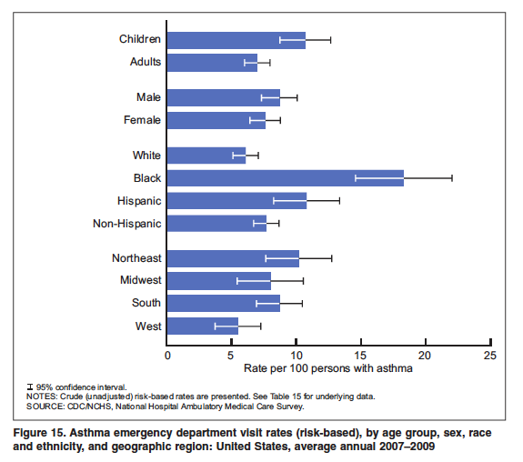
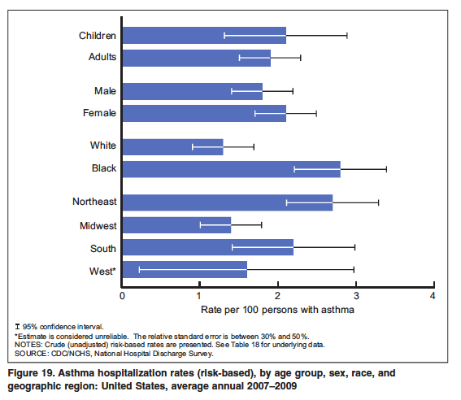
Blacks and Hispanics have a disproportionately higher asthma burden (2007-2009)
4.5x more likely to visit ED
3x more likely to be hospitalized
Higher mortality: 3x more likely to die from asthma-related causes
CDC National Surveillance of Asthma: US, 2001-2010

Slide 3
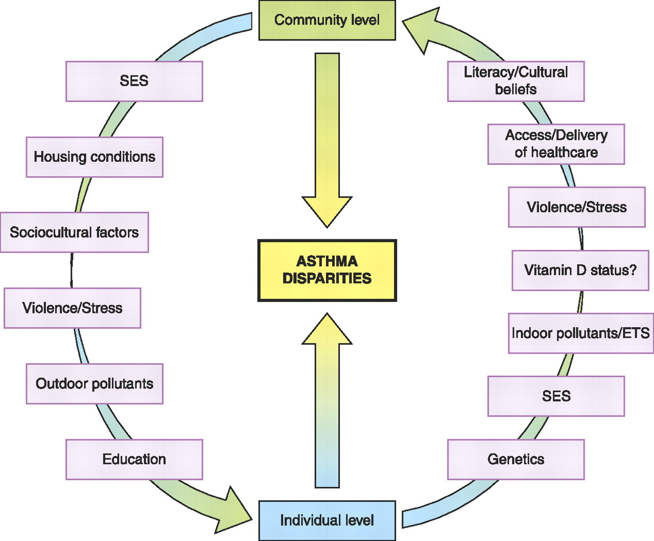
Reasons for this disparity?
Lack of education and/or understanding that controller meds need to be used even when symptoms NOT present
PeRson EmPowered Asthma RElief (PREPARE) Study
Pragmatic comparative effectiveness trial in Blacks & Hispanics with
poorly controlled asthma on a daily inhaled corticosteroid (ICS) therapy
Erick Forno; Published in: Juan C. Celedón; Am J Respir Crit Care Med 2012
Notes:
Bigger font

Slide 4
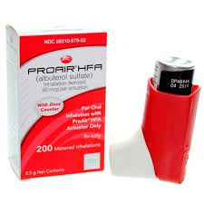
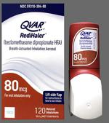
PREPARE Study Design
AA or H/L adults at risk for asthma exacerbations
PARTICS
+
1 study visit: video consent , baseline data, inhaler video
Or
15 Monthly Surveys
Standard of Care
Primary Endpoint: Asthma exacerbations
Treatment with systemic corticosteroid therapy
Patient-Activated Reliever-Triggered Inhaled CorticoSteroid (PARTICS)

Slide 5
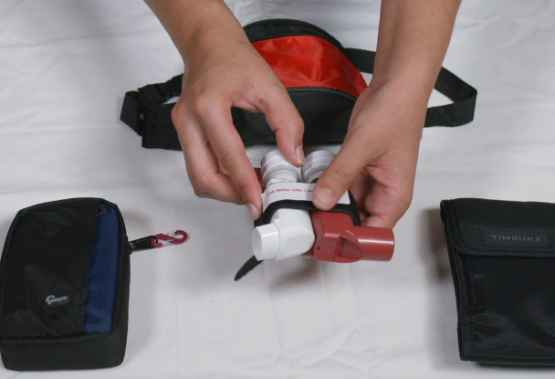

Slide 6
PREPARE identified participants using Electronic Health Records (EHRs)
Queries of EHRs are being heavily leveraged as a potential cost-effective method for participant identification
In previous studies using a minority population
  Blacks and Exacerbations on LABA v. Tiotropium (BELT)] (Wechsler et al, JAMA 2015)
  Study sites recruited ~14% of EHR-identified patients (1100/~8000)
PREPARE study assumptions used the BELT EHR experience
  EHRs can identify patients taking the required medications
    Assume 80% of those identified will qualify when screened
UNC Chapel Hill is one of 18 participating sites
  UNC’s first pragmatic asthma clinical trial

Slide 7
4-Part Identification Strategy
Potential Patients Identified (Data Warehouse)
Step 1: Carolina Data Warehouse (CDW) submission
Asthma in the problem list
Ages 18-74
Alive
Hispanic/Latino, Black/African-American
Chart Review
Made Contact
Screened Patients
Seen for asthma diagnosis in the past year
On a daily ICS or ICS/LABA therapy
Does not have another chronic lung disease other than asthma
Scheduled and Enrolled

Slide 8
4-Part Identification Strategy
Potential Patients Identified (Data Warehouse)
Step 2: CDW refinement
From CDW identified patients:
Review from clinics whose providers have agreed to have their patients contacted
&
Who reviewed the Asthma IQ guidelines
Chart Review
Made Contact
1038 patients
Screened Patients
Time?
Processing Data Warehouse
3 hours per quarter
Scheduled and Enrolled

Slide 9
4-Part Identification Strategy
Potential Patients Identified (Data Warehouse)
Step 3 Review the EHR (clinical notes, med list, & PFTs)
Confirm current medication
PFT values
ACT scores
Chart Review
1038 Patients
479 eligible after chart review
46% sensitivity
Made Contact
Screened Patients
Time?
30 minutes/chart x 1038 charts
239 hours to identify eligible participants
288 hours to exclude ineligible participants
Scheduled and Enrolled

Slide 10
4-Part Identification Strategy
Potential Patients Identified (Data Warehouse)
Step 4 Contact potential participants
Review recent exacerbations & updated ACT
411 eligible after phone screen
Sensitivity: 39.5%
Chart Review
Made Contact
Time?
30 minutes/phone call x 479
205 hours to identify eligible participants
34 hours to exclude ineligible participants
Screened Patients
Time?
Study visit: 2 hours
Scheduled and Enrolled

Slide 11
Phone Interview for Pre-Eligible
Study Participants

Slide 12
Most commonly identified reasons for ineligibility
10%
348 patients’ medications were not correctly captured
51.5% of ineligible participants

Slide 13
Conclusions
Our EHR had low sensitivity for identifying participants for a pragmatic asthma clinical trial
UNC PREPARE: 46% qualified after chart review; 39.5% after phone screen
  Significant research coordinator time spent reviewing EHRs from ineligible participants
  Based on data input to the data warehouse
BELT study: 80% qualified after screen
EHR use intended to promote cost savings for pragmatic trials
  322 hours of coordinator time on excluding ineligible participants
UNC one of 18 sites
  Will need to investigate EHR performance characteristics at other study sites

Slide 14

Conclusions
Reasons?
Current problem list/medications not updated regularly by providers/clinical staff
  Time problem!
Heterogeneity in asthma care among providers & patient education
More complexity to inclusion criteria than other asthma trials
  Distinction between daily OCS v. exacerbations
  Change in inclusion criteria

Slide 15

Conclusions
Lessons learned
Prior to study start, identify parameters for the best computable phenotype
  Proper balance of sensitivity & specificity
Allocate budgeted time
  EHR data analysts to refine computable phenotype
  Still need research coordinators to review charts
Goal
Better estimate of cost/patient enrolled
Increased willingness to participate in pragmatic trials
Improved patient outcomes

Slide 16





Acknowledgements & Questions?

