Slide 1
Development of a Hub & Spoke Model of Medication Assisted Treatment (MAT) in Rural Communities of Western Colorado for Patients with Opioid Use Disorder (OUD)
Ann Cox, DNP, FNP-BC, PMHNP-BC
Notes:
Introduction

Slide 2
Who am I?
APN dual board certified as a Family Nurse Practitioner and Psychiatric Mental Health Nurse Practitioner
Work as an Assistant Professor of Nursing at Colorado Mesa University in the Doctorate of Nursing Practice Program
Work as a Psychiatric Mental Health Nurse Practitioner in a Community Based Mental Health Clinic in the largest city of Western Colorado
Career goal: Reduce number of opioid overdose related deaths in rural Western Colorado through MAT implementing a Hub & Spoke Model

Slide 3
Conflict of Interest
I have no conflict of interest to report
Notes:
I have no conflict of interest

Slide 4
Definitions
MAT: Medication Assisted Treatment with the use of buprenorphine/naloxone for patients with OUD
OUD: Opioid Use Disorder as per the DSM V criteria

Slide 5
Hub & Spoke Model
Model of providing MAT for clients with OUD
Vermont Hub-and-Spoke Model of Care For Opioid Use Disorder
  An approach to expand access to MAT in order to reduce opioid overdose deaths
  Incorporated this model for treatment in rural western Colorado
Notes:
Vermont Hub-and-Spoke Model modified for a Rural setting. Mind Springs Health covers the entire western Slope

Slide 6
Colorado and Opioid Use Disorder
Overdose is common
Opioid Use Crisis has severely impacted Western Colorado and other rural regions of the United States
Statistics show Mesa County impacted to a greater degree than other areas in Colorado
Notes:
Explain geography of Western Colorado, length of time between clinics and inclement weather issues

Slide 7
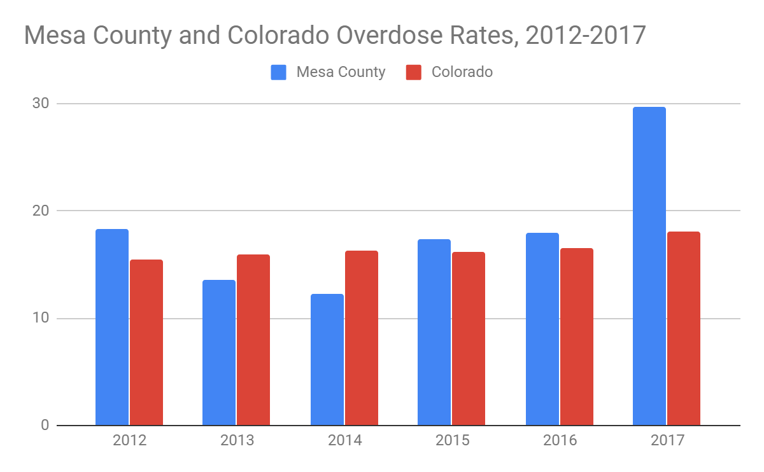
Notes:
From 2012 to 2016 overdose rates are higher overall but in 2017 there was a huge spike

Slide 8
2018 Report
Coroner’s Report for 2018 shows decrease in opioid deaths in Mesa County
Thought to be due to starting MAT with the Hub and Spoke Model
Notes:
Recent report shows that there has been a decrease for the first time. Likely thought to be a result of what we are doing in the local area.

Slide 9
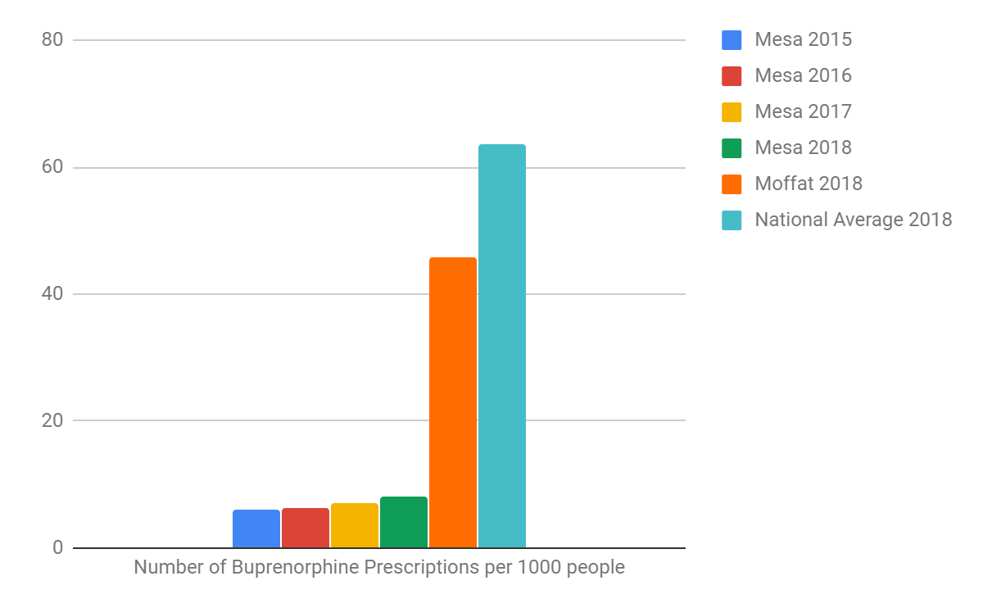
Notes:
With the high rate of overdose rates in Mesa County we are behind the national average for buprenorphine prescriptions. Moffat County is much higher than Mesa with regard to this but they are even behind the national average. Indication that we have a lot of work to do.

Slide 10
Setting Up MAT
MSH (Community Mental Health Center) met with local public health and primary care communities to develop strategies for treating individuals with OUD late 2017
Harm Reduction Strategy
”Hub & Spoke” Model chosen for MAT
  “Hub”: Community Based Mental Health Clinic
  “Spoke”: PCP offices, outlying rural communities and jails
Notes:
Initial work for setting up a MAT clinic. Harm reduction vs Abstinence with MAT. Other strategies for treatment not working. Hub and Spoke was thought to be a perfect model. Mobile bus not feasible.

Slide 11
Methods & Results
Community Stakeholders meet to discuss Hub and Spoke process
MAT team developed
February 2018 MAT clinic opens
APN has “X” waiver and able to prescribe Buprenorphine
  Reached initial 30 patients by November 2018
  Application for additional patients to total 100 approved by SAMHSA November 2018
Two PCP offices
  actively working as “Spokes” by Fall 2018
Notes:
Grand Junction has been exemplary for being able to have various health care entities cooperate with the community leaders. This may have helped make this a smooth process.

Slide 12
MAT Team “Hub”
APN with “X” waiver
MD consultant specializing in addiction medicine
Therapist (CAC III)
Medical Office Assistant
Case Manager (CAC III)
Peer Specialist

Slide 13
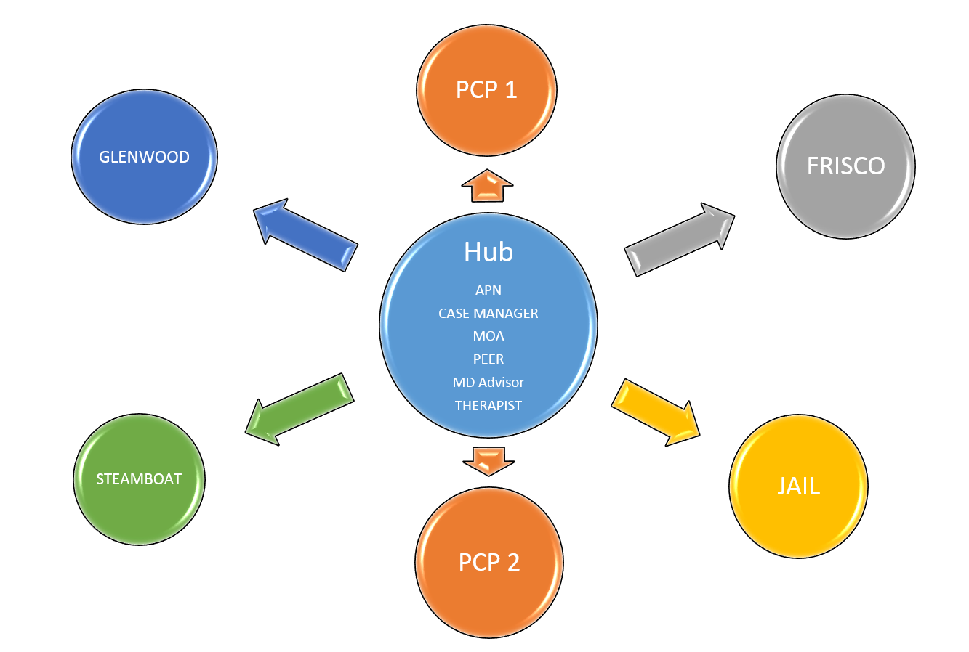
Hub & Spoke Model: Rural Western Colorado
Notes:
The hub and spoke model that we currently have in place involves the team working at the Hub and the spokes which include rural clinics that are part of mind springs and two PCP offices. We are working with community leaders in steamboat for expansion to the jail and the mesa county jail. I will go into the differences of the two jails in later slides

Slide 14
Intake Process for Induction
Clients referred for intake
  Self referred or Referred from PCP
Intake Appointment
  Meet with Peer or Case Manager
  MAT contract at time of intake; Sign ROI
  Obtain Labs (LFTs & UDS) prior to first appointment with APN
Induction at “Hub”
  Clients who are in active withdrawal
  Client must have UDS identifying that they are appropriate for induction
  Client ideally has COWS score of 6
  Client has tapered off opiates—individually recommended
Notes:
Clients come to us by referral. Either self or through a PCP. They are informed that we will be communicating with their PCP and they sign a release of information. We work to help them establish a PCP if they have not been established with one.

Slide 15
Maintenance and Follow Up
Maintenance
  Clients who have already started buprenorphine at our clinic or elsewhere
    Some have been started at another clinic and have moved to the area
    Some have been getting “off the streets”
    Some have been getting at another clinic locally but are wanting to transfer care to MSH
  All clients are scheduled for diagnostic evaluation with the APN
  Prescription given the day of the evaluation
Follow up
  Clients are seen weekly for a minimum of 4 weeks
  Moved to less frequent visits based on their individual progress
Notes:
Maintenance client is defined as someone already receiving buprenorphine through our clinic or transferred from another client. All new clients will have a full diagnostic evaluation for appropriateness in our program. Either dosed and return the following day or given a 7 day prescription

Slide 16
Spokes
PCP offices
  Clients receiving primary care in the two “Spoke” PCP offices are referred back to their PCP after 4 weeks unless not stable
  Clients who do not have a PCP are evaluated by the PCP offices who are functioning as “Spokes” for the MAT treatment, for acceptance into these offices for their primary care and ongoing MAT
  Clients who are needing a higher level of care for their early recovery are referred back to the ”Hub” by the PCP offices
  Note: The “Hub” is able to manage patients who need a higher level of care from the Team specializing in behavioral health as well as primary care. Clients will go back and forth between the “Hub” and the “Spokes”

Slide 17
Rural Clinics
Rural Areas of Western Colorado
  Frisco—3/2019
  Granby—5/2019
  Steamboat—7/2019
  Glenwood—Summer/Fall 2019
Staff in rural clinics trained
  MAT contract
  Urine Drug Screens/Lab (LFT)
  Huddle--phone conference
  Set up appointments via Telemedicine
  PDMP (Colorado Prescription Drug Monitoring Program)
Notes:
Once we had a solid process in Grand Junction, clinics established in rural areas. Staff had to be trained in these areas.

Slide 18
Telemedicine Appointments
Process:
  Diagnostic Evaluation via Telemedicine--Maintenance
  Diagnostic Evaluation at the Hub if Induction
  MAT prescribed electronically to the rural pharmacy
  Follow up visits via Telemedicine
Notes:
It was felt that it is an exception to have the patient not come to the hub for induction. However some new clients did not require an induction. In this case they could be seen for initial evaluation via telemedicine

Slide 19
Jail Expansion
Mesa County Jail
  Clients come to hub immediate after release from jail
Steamboat Springs Jail
  Telemedicine for MAT while in Jail
Notes:
Mesa county jail wanted to do the inductions themselves and then refer the patients to Mind Springs. Steamboat jail asked for our assistance with the entire process.

Slide 20
Jail Expansion, cont’d
Why?
  >10 million persons/year pass through US jails
    >65% have SUD
  Addiction, withdrawal in custody poses safety issues for staff, traumatizing for inmate
  People are over 40 times more likely to overdose fatally when they leave jail without treatment
  Treatment in jail: >50% decrease in return to custody
  Jail accreditation requires some form of treatment
                Credit: JK Costello, MD

Slide 21
References
Brookland, Sigmand Vermont Hub-and-Spoke Model of Care For Opioid Use
Di Chiara and Imperato, PNAS 1988
Disorder: Development, Implementation, and Impact
DSM V
JK Costello, MD, Rocky Mountain Health Plans

