Slide 1
Person- (and Practice-)
Centered Research
James W. Mold, MD, MPH
Emeritus Professor of Family and Preventive Medicine
University of Oklahoma

Slide 2
Objectives
After participating in this forum, you will be able to...
Explain key differences between person-centered care and problem-oriented care
Identify some of the information needs and research questions raised by person-centered care
Discuss the implications of person-centered care for research methods (study populations, interventions, and outcomes)
Explain how the same principles can be applied to research and QI initiatives with practices.

Slide 3
Disclosures
No conflicts of interest
Work History:
1977-1978: 6 months as a general physician in Ghana, W. Africa
1978-1984: Private family practice, Hillsborough, NC
1984-1988: Univ. of OK, Fam. Med. Undergrad, Med. Educ.
1988-1993: Univ. of OK, Fam. Med. Geriatrics
1993-1994: Univ. of Louisville, Fam. Med. Geriatrics
1994-2014: Univ. of OK, Fam. Med. Practice-Based Research
2014-present: Retired, independent contractor Univ. of OK, and UNC
Notes:
Since medical school I have been on a mission to humanize health care.

Slide 4
Outline
Features that distinguish (true) person-centered care from problem-oriented care (20 min. + 10 min. discussion)
New research questions raised by person-centered care (20 min. + 10 min. discussion)
Methodologic issues raised by person-centered care (20 min. + 10 min. discussion)
Please interrupt at any time if you are confused or have a clarifying question.
Notes:
At the end of my comments in each section I will mention the implications for research and QI with practices.

Slide 5
PART ONE
Person-Centered Care

Slide 6
Definition of Patient-Centered Care
“Providing care that is respectful of, and responsive to, individual patient preferences, needs, and values, and ensuring that patient values guide all clinical decisions.” (National Academy of Medicine, 2015)
Very broad, encompassing several different typologies*:
Whole person, problem-oriented care (biopsychosocial model)
  Holistic care (whole patient rather than parts of patient)
Shared decision-making (EBM, value-based purchasing, PCORI)
  Collaborative care (rather than paternalistic care)
System improvements (care coordination, navigators, PCMH, ACOs)
  Guided care (rather than having to navigate a complex, fragmented system)
Person-centered care (narrative medicine, relationship-based care, goal-directed care)
  Promoting the fulfillment of the person’s life project
*Tanenbaum SJ. What is patient-centered care? A typology of models and missions. Health Care Anal (2015) 23:272-287.
Notes:
I plan to focus primarily on person-centered care, and I will use the example of goal-directed care because I am most familiar with it and because it can most comfortably embrace the other two models as well as medical science.

Slide 7
Patient-Centered vs. Person-Centered
Starfield B. Is patient-centered care different from person-focused care? Perm J, 2011; 15(2): 63-69.
Both patient-centered and person-focused care are important, but they are different. In contrast to patient-centered care (at least as described in the current literature with assessments that are visit-based), person-focused care is based on accumulated knowledge of people, which provides the basis for better recognition of health problems and needs over time and facilitates appropriate care for these needs in the context of other needs. That is, it specifically focuses on the whole person. Proposed enhancements and innovations to primary care do not appear to address person-focused care.
Eklund JH, et al. “Same same or different?” A review of reviews of person-centered and patient-centered care. Patient Educ. Counselling. 2019; 102(1): 3-11.
The analysis revealed that the goal of person-centered care is a meaningful life while the goal of patient-centered care is a functional life.
Notes:
Comments?

Slide 8
Forces Driving Implementation of Person-Centered Care
Rising cost of health care (rationing vs. prioritization)
Continued increase in fragmentation of care through carve-outs
  Palliative care, multi-problem patients, seriously ill patients, athletes, the elderly, women
Patients’ desire for greater involvement in decision-making
Increasing importance of prevention
Increased awareness of the behavioral, social, and environmental determinants of health
Increasing need for interdisciplinary teamwork
Physician frustration with corporatization/industrialization of medicine; reduced joy in practice; burnout
Genetic testing and genomic medicine
Notes:
Once we all have our DNA mapped at birth, we will realize that we are all complex, multi-problem patients.

Slide 9
Primary Care
Defined by processes (access, coordination, continuity, comprehensiveness, partnership with patients, etc.) not pathology
Cradle to grave (lifespan orientation)
Relationship-based
Whole person within family and social context
In sickness and health (normal life events, health promotion, prevention)
Goal-directed (meaningful outcomes)
The mission of primary care is to help each person experience a full, meaningful, and rewarding life (i.e., person-centered care).
Because of the circumstances of our evolution, we never developed and implemented a conceptual model compatible with that mission.
Notes:
Primary care is qualitatively different from subspecialty care. Many of the failures of primary care can be attributed to the passive adoption of a disease-oriented model of care.

Slide 10
A man walks into a bar with a frog on his head, and the bartender asks him, “Where did you get that?”
The frog answers, “I’m not sure. It started as a tiny pimple on my butt.”
Notes:
Person-centered care involves shifting the focus from problems to patients, not patients with problems, but patients.

Slide 11
Care Plan Structures
Person-Centered Care
Problem-Oriented Care*
Goals | Obstacles | Plan
Prevent premature death | High CAD Risk; HTN; High LDL | Aerobic activities; SMART Diet; ramipril; statin trial; colonoscopy
Play basketball | Tendonitis, Statin concerns | Comprehensive home exercise program; PT
Minimize end-of-life burden on family | Advance directives out of date; Children out of country | Update directives; review with kids; update Will; unload junk
Problems | Goals | Plan
HTN | BP<140/90 | ACEI, etc.
Hyperlipidemia | LDL<100 | Diet; statin
Rotator Cuff Tendonitis | Resolve tendonitis | Ortho, PT, etc.
Allergic rhinitis | Control symptoms | Zyrtec
HPDP | Complete services | Colonoscopy
*Assumes that correcting problems will result in longer, better life, so no need to explore goals.
Notes:
Health problems are viewed as potential obstacle or challenges to achievement of personal goals. Think financial planning or educational counseling. Problem solving is just one of many potentially useful strategies, depending upon the goal.

Slide 12
Personal Health Goals
There are four personal goals to which primary care clinicians’ knowledge and skills often apply:
Prevention of premature death and/or disability
Maintenance and/or improvement in quality of life (includes activities, relationships, meaning/purpose, etc.)
Optimization of person growth and development
Increasing the probability of a good death
Notes:
Goals are desired outcomes for which it makes little sense to ask why or …so that?

Slide 13
Adrian Metcalf
12 y.o. AA boy being raised by single mother; below median household income; urban, high-crime neighborhood; loaded, unlocked gun in house; rides bike without helmet; unhealthy diet; BMI 65%tile; little physical activity; fam. hx of HTN, CVA, DM; UTD on immunizations.
Goal: Prevent premature death:
Estimated life expectancy: 67
Could gain 4.2 additional years of life by:*
Increasing physical activity (2.5 years)
Firearm safety measures (1.2 years)
Eating a healthier diet (0.5 years)
Note: I was not able to accurately estimate impact of moving to safer neighborhood.
The estimated impacts of other preventive strategies are negligible.
*Calculated using a predictive model developed by Zsolt Nagykaldi
Nagykaldi Z, et al. Applied Clin Informatics 2013; 4(1): 75-87.
Notes:
Person-centered care would focus first and most heavily on the preventive measures that would probably have the largest impact (physical activity and firearm safety).

Slide 14
Jeremy Scott
33-y.o. with chronic shoulder pain from an HS sports-related rotator cuff tear. Has seen a primary care doctor, an orthopedic surgeon, and a physical therapist. Tried rest, heat, and ice, a variety of exercises, an injection, anti-inflammatory medications. Was offered surgery but with difficult recovery and no guarantees.
Goal: Improve QOL (ability to participate in meaningful activities):
When asked what he would like to be able to do that he couldn’t because of the shoulder problem, he said he would like to be able to go bow hunting with his brothers. It then occurred to him that he might be able to use a crossbow with a physician’s note.
Note written
Notes:
Person-centered care focuses in the outcomes of importance to each person. That doesn’t always require achieving normalcy.

Slide 15
Mary and Sarah Treadwell
40-y.o. F and her 70-year-old mother, a long-time patient. Since the death of father when 14, daughter had lived with mother. When tried to become more independent — get a job, go on dates, etc. — mother’s symptoms (headaches, dizziness, stomach pain, fatigue) became worse. Once I began seeing the daughter, the nature of the dance became clear.
Goal: Enhance personal growth and development:
Some time at each visit spent teaching/encouraging each of them to contribute to the other’s psychological growth.
Focusing on personal development as a goal helped the daughter find the courage to get a job, move out, and get married (the identity and intimacy tasks) and the mother to proudly let her do so (the generativity and ego identity tasks).
Notes:
The growth and development goal is generally assumed, and the clinician’s role is often covert.

Slide 16
Mrs. Lively
75-y.o. widow. Daughter brought her in with concerns about short-term memory loss, a concern shared by her mother. Cognitive testing confirmed; judgement and decision-making abilities still intact.
Goal: Increase the probability of a good death:
Discussed probability that her thinking difficulties might get worse over time, and asked her if there would be a point at which she would no longer want to her life to be prolonged. She said if she was no longer able to recognize family members.
Two years from that encounter, daughter called to tell me that her mother no longer recognized her. Life-prolonging medications were stopped, and she died peacefully a few weeks later.
Notes:
Viewing a good death as a goal assures that everyone has been advised and helped to communicate advance directives.

Slide 17
Common Misconceptions
Patients are entirely responsible for determining goals
Identifying goals is difficult, time-consuming
  Much can be assumed
  Requires different set of questions
Only useful with complex patients
  Though it is more useful in these patients
Will result in errors of omission
Can’t happen/too many systems obstacles

Slide 18
Practice #103
Common practice goals??
Provide best possible care to individual patients
Ensure financial viability for the practice
Increase joy in practice for clinicians and staff
Improve community health outcomes
2-MD peds practice enrolled in asthma QI project. Office manager, receptionist, billing clerk, and two MAs. Hispanic patient population. Stressful work environment.
Goal: Increase joy in practice
Facilitator interviewed MDs and staff. Office manager doing most of the work; didn’t trust the other staff members to do it well. Facilitator helped staff update job descriptions, training schedules, and metrics. Office manger began allowing staff to do their jobs. Everyone’s spirits improved.
Notes:
Essentially the quadruple aim since patient experience of care is a major component of financial viability.

Slide 19
Discussion Questions
What questions to you have about Tanenbaum’s typology of “patient-centered care?”
Does person-centered care exist in nature?
What concerns do you have about goal-oriented care as a model of person-centered care?
What additional information and skills would you need before you would try to implement person-centered health care in your setting?
In your experience, what are the most common goals of clinicians/practices?
What additional questions do you have about how the model might apply to dissemination/implementation research in practices?
www.goaldirectedhealthcare.org www.patientprioritiescare.org
https://www.narrativemedicine.org/about-narrative-medicine/
https://www.uclahealth.org/nursing/relationship-based-care

Slide 20
PART TWO
Research Questions

Slide 21
Overarching Questions
Does a person-centered approach to care result in better outcomes than the current problem-oriented approach?
If so, which outcomes for which patients, how, and why?
And what will it take to disseminate and implement it?

Slide 22
Literature Reviews
Rathert C, et al. Patient-centered care and outcomes: A systematic review of the literature. Med Care Res Rev 2012; 70(4): 351-379
“Overall, the literature on PCC processes and outcomes portrays generally positive empirical relationships between PCC and intermediate as well as some distal outcomes. Although the randomized studies found mixed results for long-term clinical outcomes, some of these studies did find positive relationships. Almost all studies, regardless of methodology, found positive relationships between PCC processes and patient satisfaction and well-being. Surprisingly, none of the PCC studies in this review examined involvement of family.”

Slide 23
Recent Literature Reviews
Kogan AC, et al. Person-centered care for older adults with chronic conditions and functional impairments: A systematic literature review. JAGS 2016; 64: c1-c7.
“Fifteen descriptions of PCC were identified, addressing 17 central principles or values. The six most-prominent domains of PCC were holistic or whole-person care, respect and value, choice, dignity, self-determination, and purposeful living. Although multiple definitions and elements of PCC abound—with many commonalities and some overlap—the field would benefit from a consensus definition and list of essential elements to clarify how to operationalize a PCC approach to health care and services for older adults.”

Slide 24
Recent Literature Reviews
Delaney LJ. Patient-centered care as an approach to improving health care in Australia. Collegian 2018; 25(1): 119-123.
Higher rates of adherence; self-management; goal achievement
Greater patient satisfaction
Reduced need for dx testing, subspecialty care, hospitalization
Higher likelihood of end-of-life preferences being followed
More accurate clinical information; better patient-clinician communication
Improved patient safety
However, most studies cited were conducted in hospitals and long-term care settings.

Slide 25
“How to Keep Prevention on the Table in the Face of Disease Management Incentives”
When disease management is used to prevent premature death and disability, it is prevention.
In person-centered care, diseases are viewed as risk factors for premature death and disability. A person-centered approach eliminates the conflict.
New questions raised by this re-conceptualization include:
Do we need to reconceptualize continuous risk factors (next slide), and does that require a new terminology?
How can we analyze increasingly complex risk/resiliency profiles in order to prioritize preventive strategies?
How can we track progress (life extension) over time in a way that is meaningful for patients and clinicians?
Notes:
(The theme of this conference.) The challenge then becomes prioritization based upon each person’s risk/asset profile. Not everyone benefits from reduction in BP. Said in another way, ideal BP is probably different for each person.

Slide 26
Impact of BP Reduction on Risk of CVA and MI
Hypertension
Normotension
From Archimedes (David Eddy)
Notes:
For an individual, the benefit of BP reduction depends upon how high their BP is. Instead of telling people they have or do not have HTN, should we simply tell them whether and how much they might benefit from lowering their BP?

Slide 27
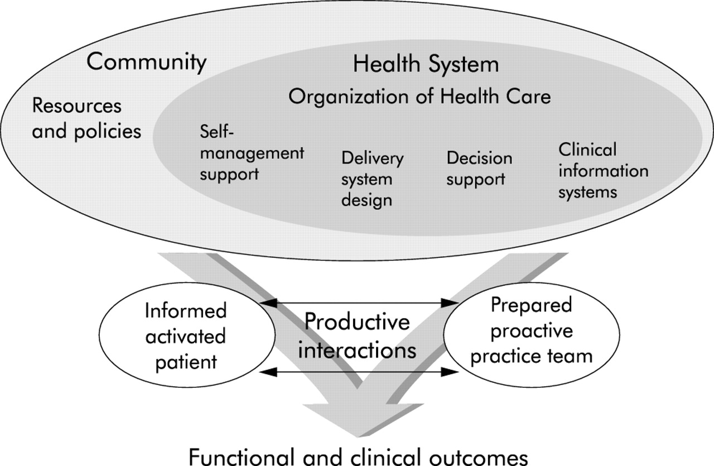
Chronic Care Model

Slide 28
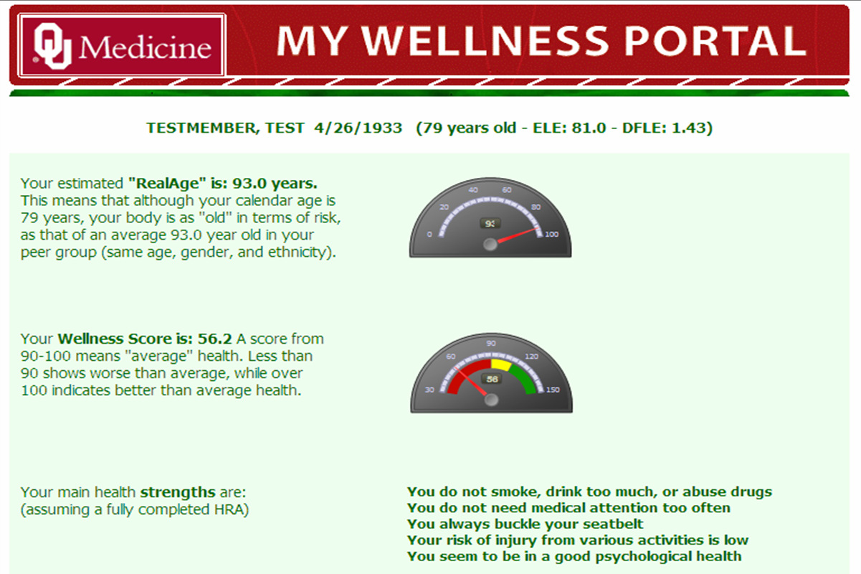
From the Wellness Portal/Health Planner (Zsolt Nagykaldi)
//

Slide 29
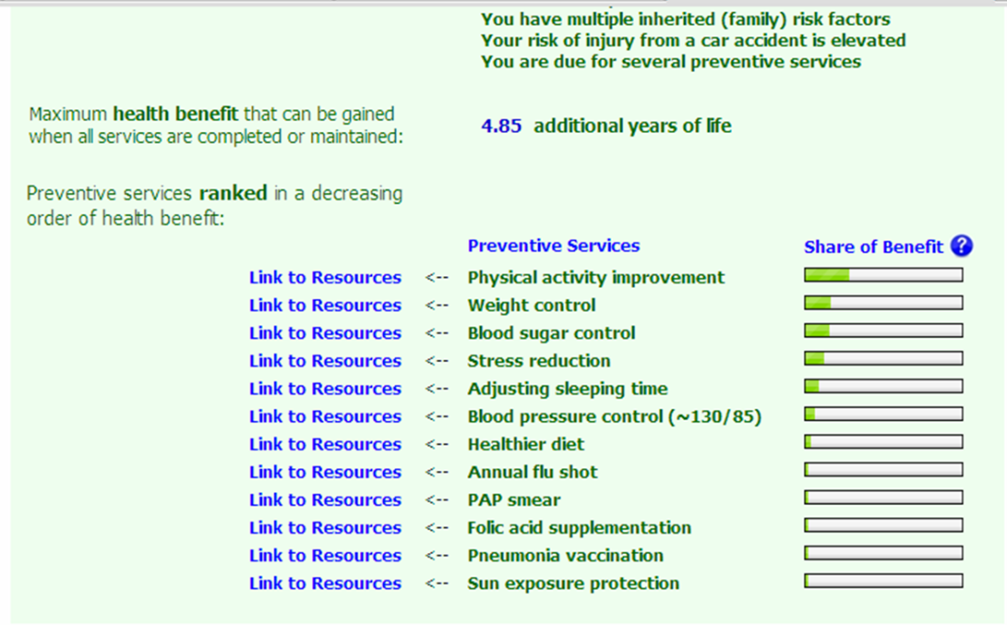
Notes:
Prioritizing preventive strategies means focusing on those strategies likely to yield the greatest ratio of benefits to risk. In this patient’s case, the potential hazards of taking BP medicine my not be worth the relatively small benefit in terms of increased life expectancy, particularly when compared to increasing physical activity and losing weight.

Slide 30
Improving Current Quality of Life (QOL)
QOL can be defined as being able to do the things that make life worth living, that produce pleasure, satisfaction, meaning, and growth.
Everyone defines QOL differently. That creates challenges for researchers.
We need to know:
How can clinicians help patients clarify and prioritize their QOL priorities?
How can we systematically elicit and consider functional requirements, obstacles, opportunities, adaptations, and alternatives in order to provide the best assistance?
How can we arrive at an effective plan of care and how and when should it be reevaluated and adjusted as lessons are learned?
Notes:
QOL is the top priority for patients most of the time. When clinicians emphasize prevention, it creates a balanced view.

Slide 31
Supporting Personal Growth and Development
G&D is an important focus of pediatric and end-of-life care but often neglected in adolescents and adults.
Includes physical, psychological, and spiritual components
Research questions:
What is the best way to assess and track the various components of personal growth and development across the lifespan and to recognize and respond when obstacles and challenges arise?
How can we help patients of all ages and their families negotiate developmental challenges?
How can we help patients and families become progressively more resilient, both physically and psychologically?
Notes:
Includes delaying antibiotic treatment for otitis media., etc. to allow immune system to respond and become more resilient.

Slide 32
Increasing the Probability of a Good Death
In problem-oriented care, death tends to be viewed as failure or defeat. Neither patient nor clinician wants to think or talk about it until it is imminent. In a goal-directed approach death is viewed as an inevitable life event for which it makes sense to plan ahead.
Research questions:
What are the best ways to clarify in advance, document, and communicate when life prolonging measures should be stopped (e.g., conditions worse than death)?
How should we identify, document, and periodically update end-of-life values and preferences?
How and when should we include family members and significant others in development of end-of-life directives?
How can we make sure that current advance directives are available at all points of care, activated when necessary, and followed?

Slide 33
Helping Practices Achieve their Goals
To date, most D&I research and QI initiatives have been directed at increasing practice adherence to guidelines (problem-oriented). A practice-centric, goal-directed approach would require additional information about:
What, in fact, are the most common practice goals?
How can peer advisors and facilitators help practices clarify their goals, objectives, and priorities?
What is the best way to arrive at a feasible plan and to adjust it based upon lessons learned during implementation?
What metrics make sense for common practice goals? Should each practice develop its own metrics?
When helping practices achieve their goals, how much of what kinds of help are most helpful?
Notes:
My list of practice goal types was purely speculative.

Slide 34
Discussion Questions
Did you understand what I proposed regarding viewing “diseases” as risk factors and how that leads to the idea of de-dichotomization?
What kinds of additional/better data would we need to be able to more accurately prioritized preventive strategies?
Quality of life is obviously complex. Can you envision a way to help patients define what it means for them?
Do you think primary care clinicians should focus more on personal growth and development or is this mission creep?
How would you design an electronic record for person-centered care?
What metrics would be appropriate for measuring the quality of person-centered care?

Slide 35
PART THREE
Research Methods
Study Populations
Interventions
Outcomes
Notes:
I’m only going to focus on study populations, interventions and outcomes. I won’t address research designs though that is an interesting topic.

Slide 36
Overarching Research Questions
Does a person-centered approach result in better outcomes than the current problem-oriented approach?
If so, what is the best way to provide it?
Who will benefit most?
And how should we define “better outcomes?”

Slide 37
Possible Study Populations
All primary care patients?
Patients Who Would Probably Benefit the Most?
Older patients
Children
Patients with multiple risk factors
Patients at risk for overdiagnosis and treatment
Patients with disabilities
Patients whose likely cause of death is clear or near
Patients who require an interdisciplinary team approach
Notes:
Other populations?

Slide 38
Developing and Studying Processes
Because interventions for each patient will be different, we will need to study the processes used to arrive at individual care plans.
Challenges include:
Processes usually include several critical steps/components.
  Often more than the sum of their parts (can’t be deconstructed).
  Steps/components may have different values requirements (accuracy, efficiency, effectiveness, safety, patient satisfaction, etc.)
  May require an implementation strategy
Relational, interactional, and psychodynamic aspects are probably key but hard to measure.
  Suggests direct observation or videotaping, qualitative interviews
Some individualization will always be necessary.
  Must clarify critical vs. optional elements
Individual processes affect all other processes within practices.
Patients should be involved in the development and testing of processes of care.

Slide 39
Discovering/Developing/Studying Processes
Processes are typically composed of:
  Principles
  Developing a prioritized prevention plan is sufficiently different from episodic care that the two should be separated in time/space
  Primary, secondary, and tertiary preventive strategies should be considered collectively when devising a prioritized prevention plan
  Techniques
  Annual wellness visits during patients’ month of birth
  Comprehensive risk assessment completed by patient and analyzed by computer using HRA tool
  Scripts
  Real age, wellness score
  Typical day. Good day.
  What would you like to see happen before you die?
Notes:
There are many ways to characterize processes. In our work with practices, this framework has been useful.
In cardiology, heart age was found to be the best way to communicate the seriousness of a heart disease.

Slide 40
Prevention of Premature Death
If PCPs and patients know the potential impact of available preventive measures on their life expectancies, will they implement more impactful preventive services and achieve greater increases in estimated life expectancy?
Population: Consecutive adult primary care patients
Design: 1-year, cluster RCT (clinicians randomized)
Intervention:
Patient-completed risk assessment annually
Clinician and patient receive a computer-generated list of recommended preventive measures including impact of each on ELE
Wellness visit informed by results
Comparison Group: Patients complete the risk assessments baseline and at 1 year; neither they nor their clinician receive the results; wellness visit.
Outcome: Change in ELE after one year
Notes:
The process was developed in a series of steps involving clinicians and patients, technology development, and field tests. The study has been completed as a pilot. The results were dramatic (6 mo. Greater increase in LE). Can’t get funding for a larger study because “too many moving parts.”

Slide 41
Improving Health-Related Quality of Life
If patients communicate their QOL priorities to their physicians, will it impact clinical decision-making and plans of care?
Population: Consecutive adult primary care patients
Design: clinician cross-over RCT; videotaped encounters
Intervention: Patients asked to answer 3 questions about their QOL priorities on printed pre-visit questionnaire
Comparison Group: Patients asked to list current symptoms on pre-visit questionnaire
Outcomes (from videotaped encounters):
Patient QOL concerns acknowledged/mentioned by physician (yes/no)
Inclusion of QOL priorities in clinical decision-making discussion and/or plan of care (yes/no)
Components of encounter based upon modified Flanders criteria
Notes:
This is an example of a simple, one-step process. The study has been done. Results showed no effect on physician behavior (ignored the prompts) and fewer empathic responses. Should this step be abandoned or should we add additional components?

Slide 42
Outcomes:
Prevention of Premature Death and Disability
Estimated life expectancy
Estimated health expectancy (disability-free years remaining)
Real age
Wellness score
Preventive measures chosen
  % of all indicated
  % of those with highest impact (e.g., top three on relative impact list or those providing estimated 1 month of more of additional life)
Notes:
Now let’s consider some possible outcome measures. In studies of patients with cardiovascular challenges, heart age was the measure preferred by patients.

Slide 43
Individualized QOL Instruments
Patient-Specific Index (PASI)
Individual QOL Interview (IQOLI)
Flanagan QOL Scale (QOLS)
Subjective QOL Profile (SQLP)
Quality of Life Index (QLI)
QOL Systemic Inventory (QLSI)
Schedule for the Evaluation of Individual QOL (SEIQoL and SEIQoL-DW)
Patient Generated Index (PGI)
Goal Attainment Scaling (GAS)
Notes:
These instruments tend to take at least 30 minutes to complete and require a trained facilitator. All but the SQLP produce a numerical score. Computerized versions are being developed.

Slide 44
Goal Attainment Scaling
Used primarily in rehab and mental health settings.
Requires assistance of a trained person
Specify any number of goals/objectives prior to intervention
Stipulate possible outcomes (-2, -1, 0, +1, +2) for each objective
Rank the objectives in order of priority
Following intervention, calculate an attainment score by summing the values of the actual outcomes, then adjust for priorities
  App and spreadsheets are available.
Turner-Stokes L. Goal attainment scaling (GAS) in rehabilitation: A practical guide. Clin Rehab 2009; 23: 362-370
Notes:
Each of these instruments allows patients to specify areas of importance or concern. Most result in a calculatable QOL score. While there are many conceptual and methodological issues of potential interest with these instruments, clinically it is the process of working toward a shared goal that matters more than its achievement.

Slide 45
Growth and Development
Body composition (weight, height, BMI, waist circumference, etc.)
Strength, flexibility, balance
Cardiorespiratory fitness
Structural and physiological defense mechanisms
Developmental milestones
Psychological requirements (relationship, autonomy, competence)
Health literacy; understanding of risk factors and vulnerabilities
Psychological resilience
Level of moral development
Notes:
Others?

Slide 46
Good Death
Discussion/documentation of conditions worse than death
Discussion/documentation of end-of-life values/preferences
Completion/documentation/dissemination of living Will
Specification/documentation of surrogate decision-maker
Completion/documentation/dissemination of DPOA
Communication of end-of-life preferences to family including funeral and organ donation/autopsy/burial/cremation preferences
End-of-life financial planning/arrangements (Will, etc.)
Family notified regarding location of important documents, etc.

Slide 47
General
Individualization of care plans based upon patient priorities, resources, and challenges
  Greater variation in management of BP, BS, etc.?
  Justification of recommendations based upon goals?
Adherence to agreed upon plan of care
  Lifestyle changes
  Medications
  F/u primary care and referral appointments
Referrals
  Rehabilitation therapists (OT, PT, ST, nutritionists, etc.)
  Mental health professionals
  Non-medical (lawyers, financial planners, ministers, etc.)
Notes:
There are also a number of possible less specific outcomes. Adherence, with all its challenges, may be one of the best possible measures of patient-centeredness. It also happens to be predictive of better health outcomes.

Slide 48
General (cont.)
Perceived person-centeredness
  Patient Perception of Patient-Centeredness
  Consultation Care Measure
  Questions from CAHPS, PRA, PICS, CPCI, PCAS, IPC, etc.
Support for psychological needs (self determination theory)
  Basic Psychological Need Satisfaction and Frustration Scales, etc.
Neurophysiological responses
  Stress responses?
Post-visit contemplation; idea generation
Post-visit discussions with family
Post-visit self-directed learning

Slide 49
Practice-Centered Outcome Measures
Quality of Care
Delivery of evidence-based care
Measures of key primary care processes (access, continuity, coordination, comprehensiveness, etc.)
AHRQ measures of quality (safe, effective, patient-centered, timely, efficient, and equitable)
Financial Stability
Revenue, revenue/time spent, overhead, profit margin
Joy in Practice
Various scales available (Net Promoter Score, Hackman and Oldham Job Characteristics Model to Job Satisfaction)
Clinician and staff turnover
Community Health Outcomes
Clinician and staff engagement in community wellness initiatives
?? Preventable ED, hospitalization rates
Notes:
Metrics should be determined by the practice.

Slide 50
Discussion Questions
Which populations of patients would you study?
What additional thoughts do you have about development and assessment of processes of care?
What are some other outcome measures we should consider?
How will you use the information discussed in this forum?

Slide 51
Objectives
You should now be able to...
Explain key differences between person-centered care and problem-oriented care
Identify some of the information needs and research questions raised by person-centered care
Discuss the implications of person-centered care for research methods (study populations, interventions, and outcomes)
Explain how the same principles can be applied to research and QI initiatives with practices.

Slide 52
Goal-Oriented Medical Care Collaborative
Several NAPCRG members from the U.S., Canada, and Belgium are launching an International Learning Collaborative on Goal-Oriented Care to bring together clinicians, researchers, managers, patients, and families to help us better understand and adopt goal-oriented care, develop a research agenda to further our knowledge of the model, and create a network to share knowledge and practice and build new partnerships.
As part of this launch we are planning two activities for 2019:
  1. A survey of potential members to help co-design the vision of the Learning Collaborative
  2. A pre-NAPCRG 2019 meeting held in Toronto to start to further the vision and establish a research and practice agenda.
If you are interested in joining our collaborative please leave your contact information on the sheet at the back of the room.

