Slide 1
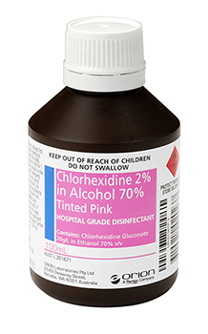
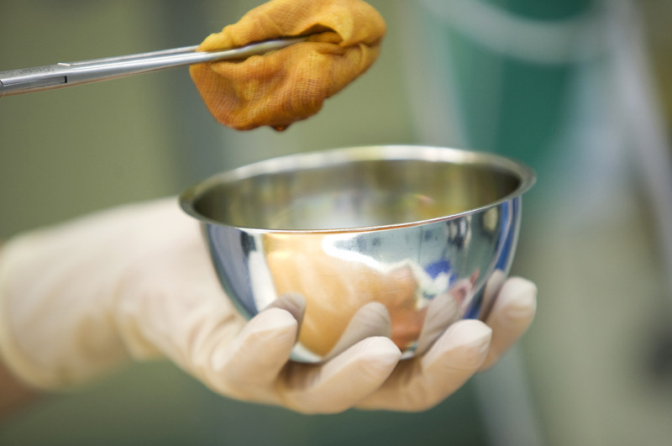
Aqueous v Alcoholic Chlorhexidine for skin antisepsis
Professor Clare Heal and Dr Daniel Charles

Slide 2
The Research Question
Is the use of alcoholic chlorhexidine for skin antisepsis superior to aqueous chlorhexidine in preventing SSI after minor skin excisions in general practice?

Slide 3

Research Design and Method
4 general practices in North Queensland, Australia
Prospective multicentre randomised controlled trial
Consecutive patients ‘minor skin excisions’
Intervention: 0.5% CHG in 70% alcohol
Control: 0.5% CHG aqueous solution

Slide 4
What the Research Found
Overall incidence infection 6.3% (57/909)
5.8% (26/451)(95%CI 3.4-7.6) alcoholic
6.8% (31/458) (95%CI 4.2-9.1) aqueous
No significant difference in SSI p= 0.652
Absolute risk difference -0.9% [-0.021 to +0.039]
NNT 112

Slide 5
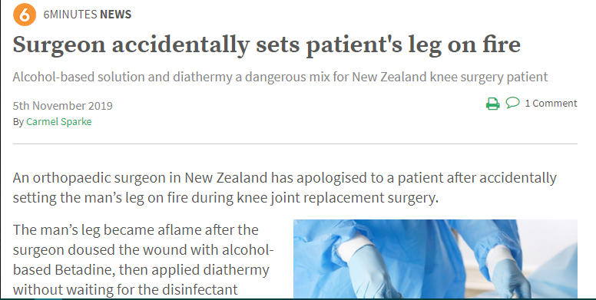
What this means for Clinical Practice
GPs can safely use aqueous chlorhexidine for skin antisepsis
Aqueous has some advantages over alcoholic chlorhexidine
Lower risk of:
Mucosal irritation
Dissolving surgical pen markings
Operating room fires!

