Slide 1
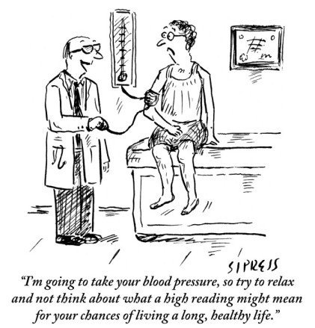
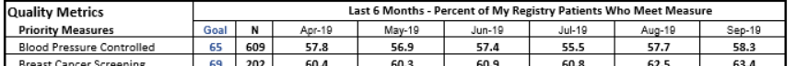


The Research Question
Good quality research indicates home blood pressures (BP) are more accurate than single clinic blood pressures.
Physicians and patients are hesitant to add medications if they doubt the accuracy of a single elevated clinic BP. However, physicians’ BP control rates are calculated and ranked based on the last documented single clinic BP.
Research Question: Does checking home BPs after an elevated clinic BP reading improve physician’s BP control rates while avoiding unnecessary medications in patients when physicians or patients are uncertain about adding medications?
KL2 TR002346

Slide 2


Research Design and Method
Maybe better to avoid adding medications at this time
Average Home BP high
Clinic BP high and no change in BP management done by physician (Recruited participants)
Physician or patient uncertain if clinic BP is high due to:
Stress? Or Sickness? Or Improper measurement? Or Medication adherence issues? Or Patients’ personal situation?
Or BP is truly high???
Physician responses to average home BP measurements checked and physicians’ BP control rates recalculated using average home BP measurement.
Check Home BP for
2 weeks and send average home BP to physician
Average Home BP normal
Patient surveyed for their opinions on home BP monitoring and recommendations for clinical practices after participation in study

Slide 3
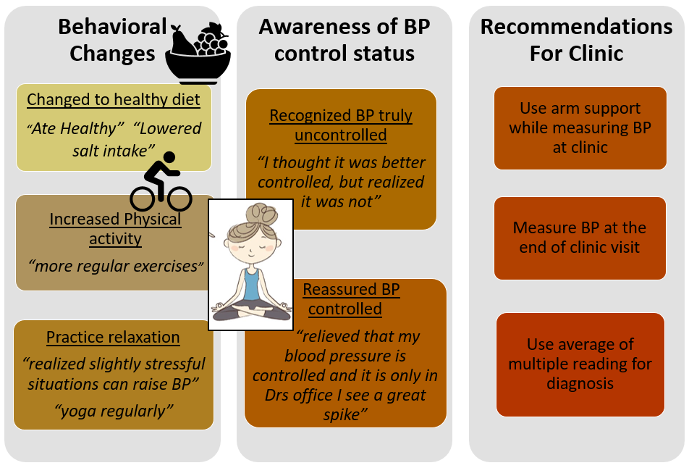
What the Research Found
Clinic BP was falsely high in 2/3rd of patients where physicians did not change BP management and only 16% of these patients needed medications. Inactions for initial high clinic BP were appropriate cautiousness
Patients stated monitoring BP at home helped make healthier and informed choices
Physicians’ hypertension control rates increased by 3-5% when clinic BP was replaced by average home BP for recruited patients. Hypertension control rates of our department would increase from 58 to 86% if we extrapolate our results to all patients in departments’ hypertension registry

Slide 4
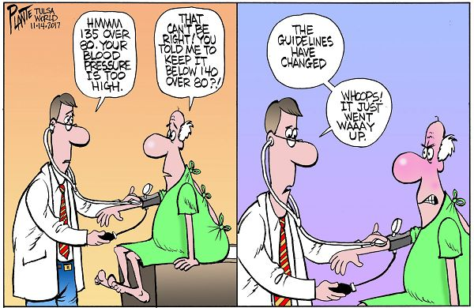
What this means for Clinical Practice
Physicians’ BP management decisions reflect appropriate inactions based on BP trustworthiness and individualized treatment goals.
Patients improve health behaviors and better understand their BP control with home BP monitoring.
Average Home BPs should be used for making BP treatment decisions and estimating BP control rates.
Patil SJ, Wareg NK, Hodges KL, Smith JB, Kaiser MS, LeFevre ML. Home Blood Pressure monitoring in cases of clinical uncertainty to differentiate appropriate inaction from therapeutic inertia. Ann Fam Med January/February 2020 18:50-58; doi:10.1370/afm.2491

