Slide 1
Advancing Implementation Science: An NCI Perspective
David Chambers, DPhil
Deputy Director for Implementation Science,
Division of Cancer Control & Population Sciences (DCCPS)

Slide 2
Session Outline
What is Implementation Science and How Does it Relate to Health Care?
Key IS Activities/Resources
Challenging basic assumptions
Questions and Discussion

Slide 3
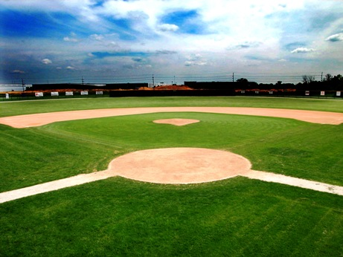

“As I approached the field, carefully laid out according to the specifications of the International Sporting Society, I noted the pristine markings, the carefully attended hills, the manicured zones of grandeur. It was assumed that the mass populace would flock to such a scene, but nary a soul had visited this magical wonderland before me. It was clearly not just the construction, but the demand for its utilization that would ultimately determine its societal impact.” –Lord Harry Henry
IF YOU BUILD IT, THEY MAY NOT COME
”Not exactly what I was looking for”
Chambers, Vinson, & Norton, Advancing the Science of Implementation across the Cancer Continuum, 2018

Slide 4
An Evidence-Based Health Intervention
Is only so good as how and whether. . .
  It is adopted?
  Providers are trained to deliver it?
  Trained providers choose to deliver it?
  Eligible people receive?
If we assume 50% threshold for each step. . .
(even w/perfect access/adherence/dosage/maintenance)
Impact: .5*.5*.5*.5=6% benefit
Adapted from Glasgow, RE-AIM

Slide 5
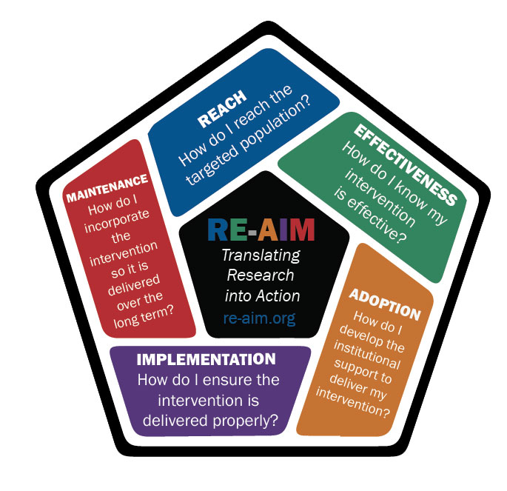
More than Efficacy/Effectiveness
Glasgow, Vogt, & Boles (1999)

Slide 6
Key Terms
Implementation Science is the study of methods to promote the integration of research findings and evidence into healthcare policy and practice.
Dissemination research is the scientific study of targeted distribution of information and intervention materials to a specific public health or clinical practice audience. The intent is to understand how best to spread and sustain knowledge and the associated evidence-based interventions.
Implementation research is the scientific study of the use of strategies to adopt and integrate evidence-based health interventions into clinical and community settings in order to improve patient outcomes and benefit population health.

Slide 7
A big tent of terms (and Circles)*
Health (and Community) Services
Health Services Research
Implementation Science
Dissemination Research
Implementation Research
Health Communication Research
Quality Improvement Science
QI
* The terms according to D.A.C.
Mitchell and Chambers, Journal of Oncology Practice, 2017

Slide 8

Example: Collaborative Care for Depression
Sample IS Challenges:
Is Depression a priority?
How to reach all patients who could benefit
Fit with practice workflow
Implementing the model across varied practices
How to bill for it?
Workforce capacity/training needs

Slide 9
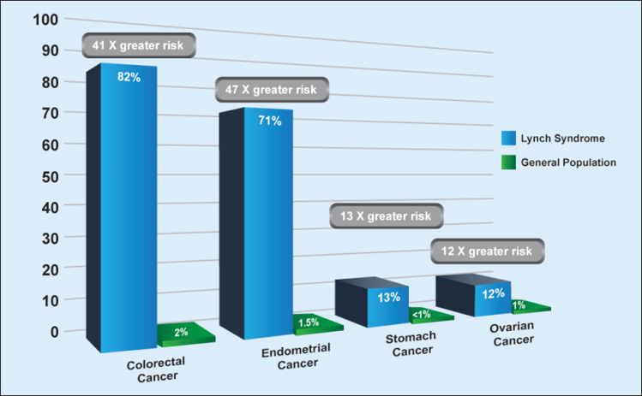
Example Two: Lynch Syndrome
Sample IS Challenges:
ID of Lynch Syndrome within CRC pop
Family member scale-up
Implementing screening/ monitoring/
Workforce capacity/training needs
Payment Policies

Slide 10
The Importance of What…
What is the intervention that needs to be implemented?
Genetic/genomic tests
Information Dissemination/educational intervention
Monitoring and Follow-up
Preventive Care
Treatment
All of the above?

Slide 11
The fish-bicycle conundrum…
Ref: Paraphrased from Irina Dunn, 1970

Slide 12
Dissemination Research
How the “evidence” is created?
Packaging
Transmitting
Receiving
Turning Information into Action
Many of our early efforts in “translating research into practice” jumped over these steps.

Slide 13
Studying Implementation
THE CORE OF
IMPLEMENTATION RESEARCH
Implementation Outcomes
Feasibility
Fidelity
Penetration
Acceptability
Sustainability
Uptake
Costs
Service
Outcomes*
Efficiency
Safety
Effectiveness
Equity
Patient-
centeredness
Timeliness
Health Outcomes
Satisfaction
Function
Health status/
symptoms
What?
How?
THE USUAL
QIs
Implementation
ESTs
Strategies
*IOM Standards of Care
Implementation Research Methods
Proctor et al 2009 Admin. & Pol. in Mental Health & Mental Health Services Research
Notes:
Features important for conceptual models:
Consistent language
Clearly defined constructs for which measures can be located or developed
Analytic model hypothesizing links between measured constructs
Distinguishes processes and outcomes
Two process technologies:
EST’s
Implementation strategies
Outcome distinctions
Implementation outcomes versus service & client outcomes
Types of implementation outcomes
Distinguishes processes and outcomes
Two process technologies:
EST’s
Implementation strategies
Outcome distinctions
Implementation outcomes versus service & client outcomes
Types of implementation outcomes
“Ultimate” outcomes: reason for our healthcare improvement efforts
Can be measured at varying levels:
population level
Patient group
Individuals

Slide 14
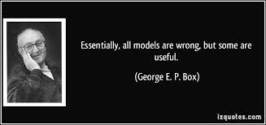
Model Examples

Slide 15
Tabak et al. review of Implementation Science Models
Identified 109 models
Exclusions
  26 focus on practitioners
  12 not applicable to local level dissemination
  8 end of grant knowledge translation
  2 duplicates
Included 61 models
Across Construct Flexibility, SEF, D/I
See http://www.dissemination-implementation.org
Tabak, Khoong, Chambers, Brownson, AJPM, 2012

Slide 16
Roger’s Diffusion of Innovations
Characteristics of the intervention
Organizational characteristics
Adoption decision
Effective implementation
Outcomes
Environmental context
CIPRS: Stetler & Damschroder Theoretical Frameworks
Krein SL, Olmsted RN, Hofer TP, Kowalski C, Forman J, Banaszak-Holl J, et al. Translating infection prevention evidence into practice using quantitative and qualitative research. Am. J. Infect. Control 2006;34(8):507-12.

Slide 17
Aarons, G.A., Hurlburt, M. & Horwitz, S.M. (2011). Advancing a Conceptual Model of Evidence-Based Practice Implementation in Public Service Sectors. Administration and Policy in Mental Health and Mental Health Services Research.38, 4-23.
EXPLORATION
OUTER CONTEXT
Sociopolitical Context
Legislation
Policies
Monitoring and review
Funding
Service grants
Research grants
Foundation grants
Continuity of funding
Client Advocacy
Consumer organizations
Interorganizational networks
Direct networking
Indirect networking
Professional organizations
Clearinghouses
Technical assistance centers
INNER CONTEXT
Organizational characteristics
Absorptive capacity
Knowledge/skills
Readiness for change
Receptive context
Culture
Climate
Leadership
Individual adopter characteristics
Values
Goals
Social Networks
Perceived need for change
ADOPTION DECISION /
PREPARATION
OUTER CONTEXT
Sociopolitical
Federal legislation
Local enactment
Definitions of “evidence”
Funding
Support tied to federal and
state policies
Client advocacy
National advocacy
Class action lawsuits
Interorganizational networks
Organizational linkages
Leadership ties
Information transmission
Formal
Informal
INNER CONTEXT
Organizational characteristics
Size
Role specialization
Knowledge/skills/expertise
Values
Leadership
Culture embedding
Championing adoption
ACTIVE IMPLEMENTATION
OUTER CONTEXT
Sociopolitical
Legislative priorities
Administrative costs
Funding
Training
Sustained fiscal support
Contracting arrangements
Community based organizations.
Interorganizational networks
Professional associations
Cross-sector
Contractor associations
Information sharing
Cross discipline translation
Intervention developers
Engagement in implementation
Leadership
Cross level congruence
Effective leadership practices
INNER CONTEXT
Organizational Characteristics
Structure
Priorities/goals
Readiness for change
Receptive context
Culture/climate
Innovation-values fit
EBP structural fit
EBP ideological fit
Individual adopter characteristics
Demographics
Adaptability
Attitudes toward EBP
SUSTAINMENT
OUTER CONTEXT
Sociopolitical
Leadership
Policies
Federal initiatives
State initiatives
Local service system
Consent decrees
Funding
Fit with existing service funds
Cost absorptive capacity
Workforce stability impacts
Public-academic collaboration
Ongoing positive relationships
Valuing multiple perspectives
INNER CONTEXT
Organizational characteristics
Leadership
Embedded EBP culture
Critical mass of EBP provision
Social network support
Fidelity monitoring/support
EBP Role clarity
Fidelity support system
Supportive coaching
Staffing
Staff selection criteria
Validated selection procedures

Slide 18
Current Funding Announcements
NIH: PAR-19-274; 19-275;19-276 (R01, R21, R03)
NCI leads (21 ICOs total, including FIC, NIMH, NHLBI, NHGRI, as well as OBSSR, ORWH and ODP)
Organizes the D&I research agenda across NIH
>200 grants funded through NIH since 2006
2010 CSR standing review committee
Open to investigators and projects worldwide
Program staff (contacts) happy to review concept papers, specific aims, answer questions at any time
Notes:
Add Fogarty?

Slide 19
Areas Ripe for Exploration
Sustainability of EBPs in a changing context
Adaptability/Evolution of EBPs over time
Implementation of a set of ITVs
Impact of dissemination strategies on practice
Scaling up practices across health plans, systems, networks, and nations
De-Implementation/Exnovation
Adaptive designs (implementation as a step-wise approach)

Slide 20

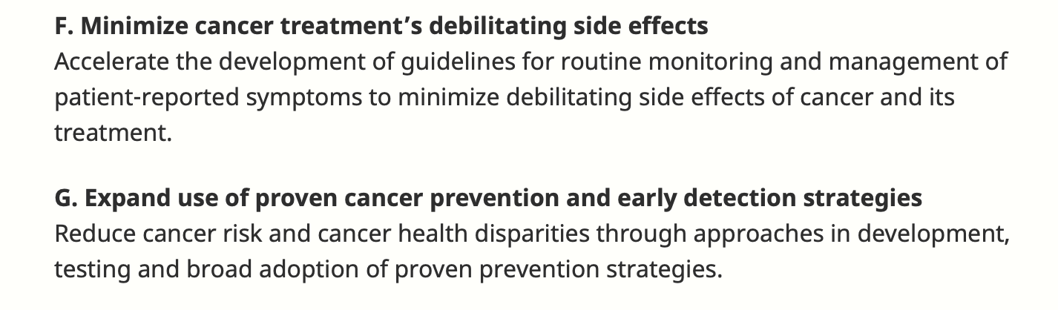
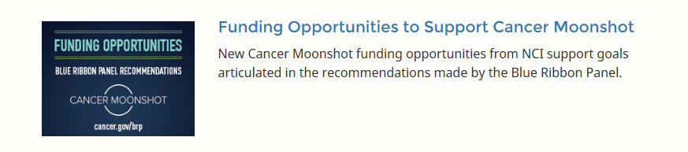
BRP Implementation Science Working Group
Two Recommendations:
Three Research Areas/CMITs(2017-2019):
    Minimize Cancer Treatment’s Debilitating Side Effects
    Prevention and Early Detection of Hereditary Cancers
    Expand Use of Proven Cancer Prevention and Early Detection Strategies

Slide 21
Symptom Management
Hereditary Cancers
IMPACT
Tolerability RFA
Hereditary Cancer Testing & Follow-Up
cGVHD Project
PRO Translation Project
Communication and Decision-Making
Survivorship RFAs
Implementation of Evidence-Based Cancer Prevention and Screening
Cancer Center Cessation Initiative
ACCSIS 1/2
Implementation Science Centers
Cervical Cancer Control
AI/AN CRC Project

Slide 22
Current Needs for Scaling Up Implementation Science
“Natural Laboratories” for rapid studies in health and community systems
Methods and Measurement Development
Filling in gaps in portfolio (e.g. de-implementation, scale-up, value)
Improved Data Aggregation across Providers and Settings
Increasing the Investigator Pipeline

Slide 23
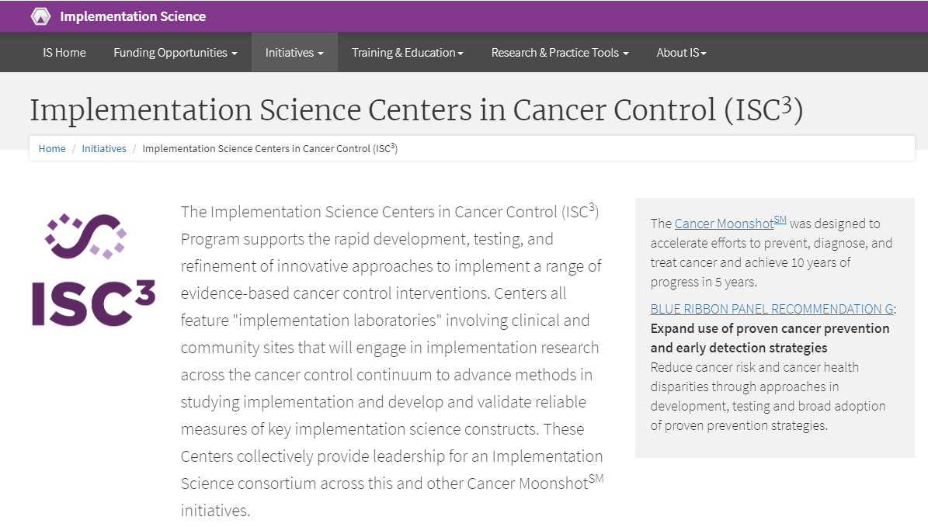
https://cancercontrol.cancer.gov/IS/initiatives/ISC3.html
Notes:
The Implementation Science Centers in Cancer Control were developed in response to the Cancer Moonshot which called for more implementation science. This page provides an overview of the goal of the centers.

Slide 24
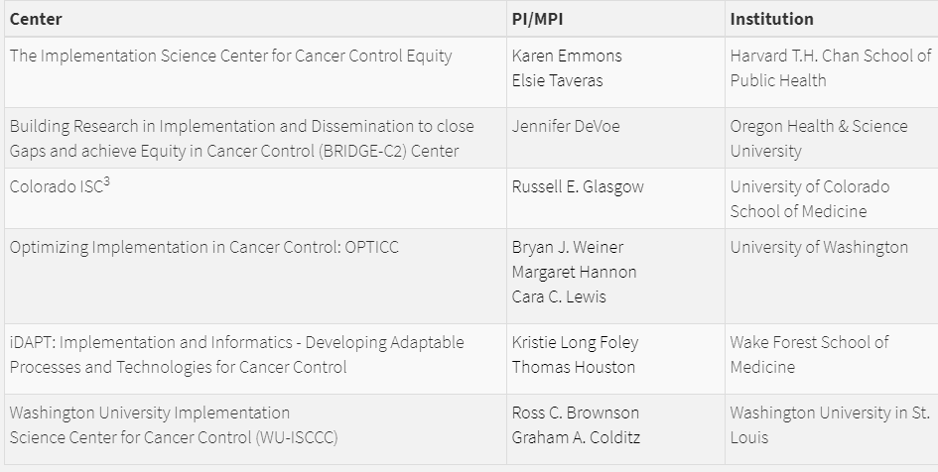
Implementation Science Centers in Cancer Control (ISC³)
Face-to-Face Meeting (ish): September, hosted by Wake Forest (right before 2nd annual
Implementation Science Consortium in Cancer Meeting
Notes:
While some centers may not have explicit pilots focused on CRC in the first year, all have indicated that future pilots could include CRC.
Details for each center are on the next slides

Slide 25
ACCSIS
HPV CC Supps
IMPACT
Prospective trials of Implementation Strategies to improve CRC screening & f/u
Prospective trials of programs to test and improve symptom mgmt
Field-Wide
Consortium
ISCCC
Measurement Development
Implementation Laboratories
D&I PARs
NCORP
Hereditary Cancers
Rapid Pilot Implementation Studies
Patient Engagement
Prospective trials of approaches to improve cascade screening for genetic risk markers
Approaches to improve engagement in clinical trials and other research studies
Smoking Cessation CC Supps

Slide 26
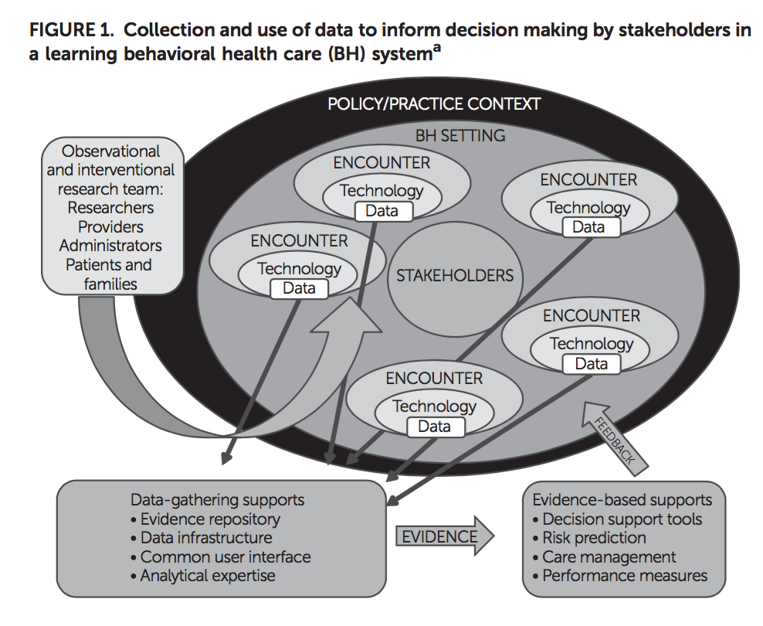
Implementation Labs = Learning HC Systems?
Stein, Adams, Chambers. Psychiatric Services, 2016.

Slide 27

Moving beyond traditional assumptions

Slide 28
Traditional Assumptions
Evidence-based Interventions are static
System is static
Implementation proceeds one practice or test at a time
Consumers/Patients are homogeneous
Choosing to not implement is irrational

Slide 29
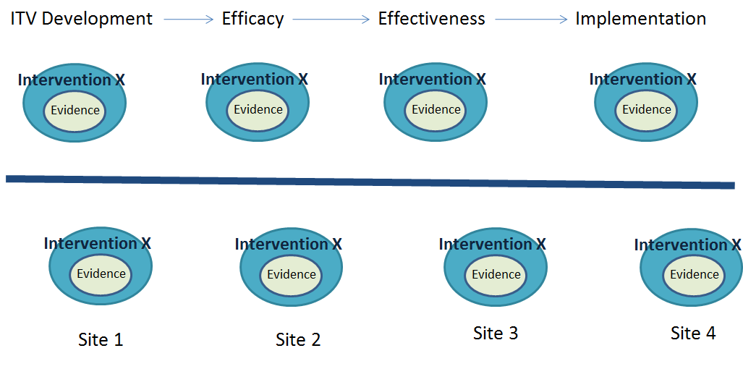
Valuing Consistency
Notes:
We typically in science value consistency of the intervention, across the stages of ITV development and testing (with discrete phases for adaptation seldom occurring). We also consider the “one size fits all” approach, where it is assumed that the ITV should be delivered the same way across diverse sites.

Slide 30
Chambers, Glasgow, Stange (2013), The Dynamic Sustainability Framework. Implementation Science
Expected
Effect
“Voltage Drop” of an intervention as it moves through stages of development
Intervention X
Evidence
Relevance
Impact
Intervention X
Relevance
Evidence
Impact
Intervention X
Evidence
0
Time
Efficacy
Trial
Effectiveness
Trial
D and I
Trial
Notes:
One assumption is that of Voltage Drop, where we fully expect the impact of an intervention to decrease directly with the stage of research. It is considered inevitable that the ITV will not perform as well from efficacy to effectiveness and again in D&I studies, where the “noise” is assumed to get in the way of the expected effect.

Slide 31
“Program Drift” of a fielded intervention (ITV) over time, with expected decrease of effect
ITV
Effect
Intervention X
Intervention X
Evidence
Evidence
Optimal Effect
Program Drift
Unintentional shift
Intervention X’
Evidence
Expected Effect
I0 I1 I2 I3
Time
Chambers, Glasgow, Stange (2013), The Dynamic Sustainability Framework. Implementation Science
Notes:
Similarly, we assume that over time, as practitioners deviate from original manuals defining the intervention, that the expect effect of the ITV will go down. This is often referred to as “Program Drift.”

Slide 32
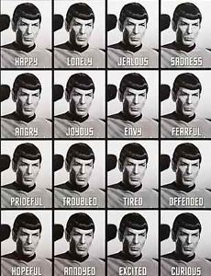
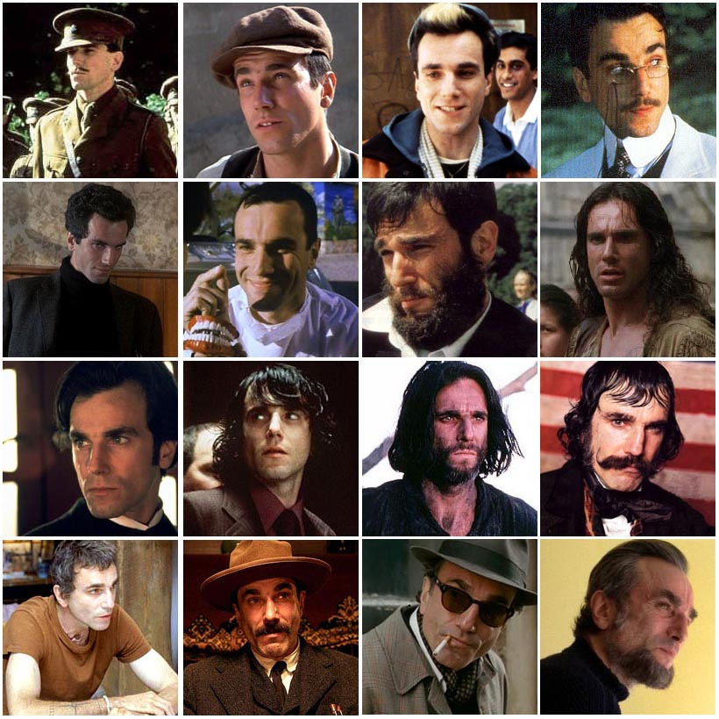
Fidelity vs Adaptation?
Variable use for variable populations, settings, and purposes…

Slide 33
ITV_{b}
ITV_{d}
“Positive Deviance”
+
ITV_{a}
ITV_{c}
ITV
Time and Space
Impact
ITV_{f}
-
“Program Drift”
ITV_{e}
ITV_{g}
KEY: ITV = Intervention, Time and Space = variability of intervention characteristics over time and setting

Slide 34
Embracing Dynamism
More

Slide 35
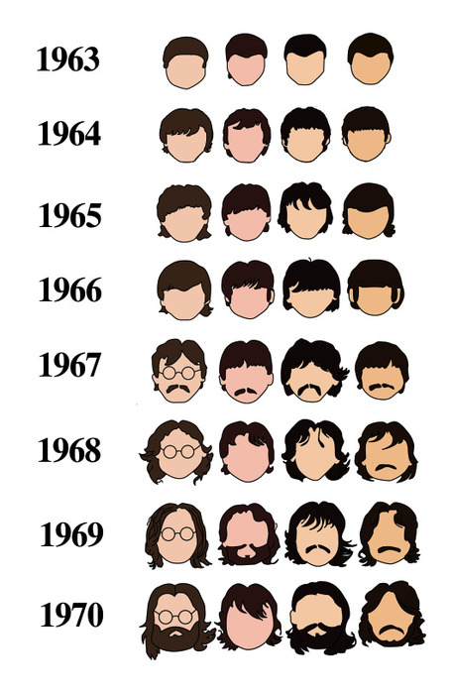
Sustainability or Evolution?
IF MEDICINE CONTINUES TO EVOLVE, SHOULD EXISTING INTERVENTIONS BE SUSTAINED IN THE SAME FORM THAT WE’VE CREATED THEM?
HOW DOES THE SYSTEM COPE WITH A DYNAMIC FIELD THAT IS CONSTANTLY CHANGING?
WHERE DO WE GO FROM HERE?
http://www.thestrut.com/2012/12/19/the-evolution-of-the-beatles-hair/

Slide 36
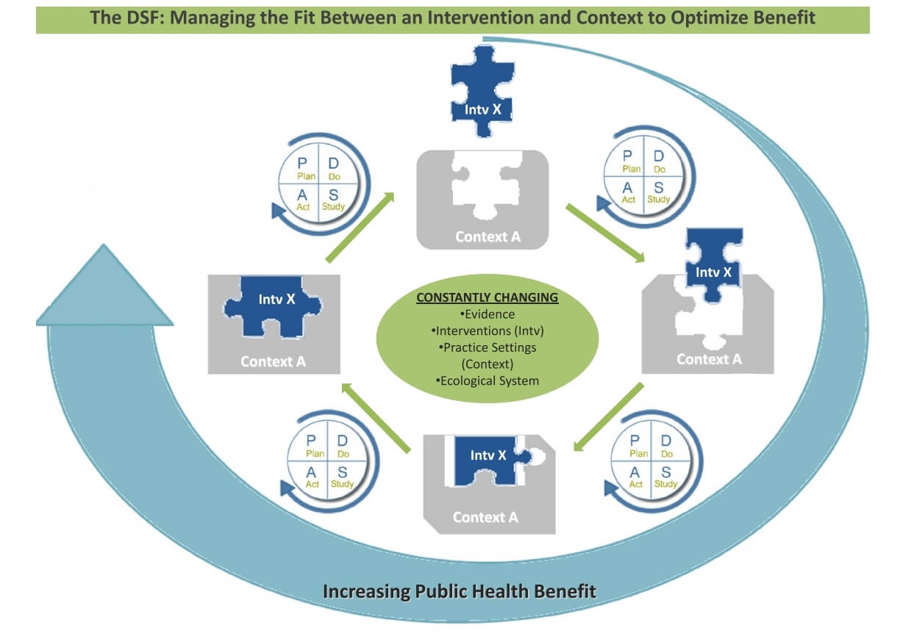
A Dynamic Approach to Sustainability…
Chambers, Stange, & Glasgow, Implementation Science, 2013

Slide 37
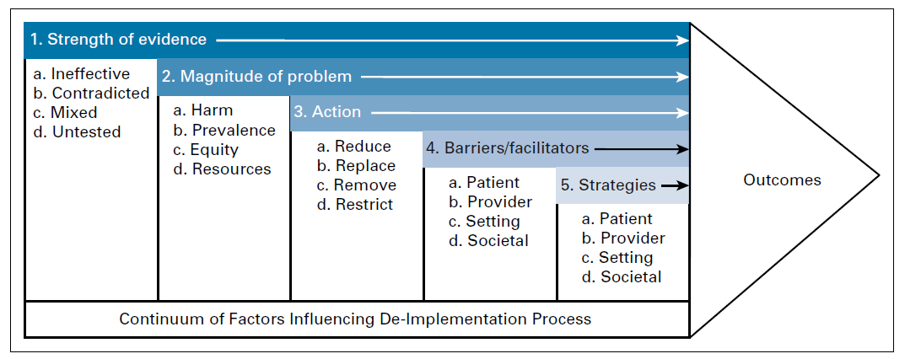
Advancing De-Implementation
Norton, Chambers, & Kramer, JCO, 2018

Slide 38
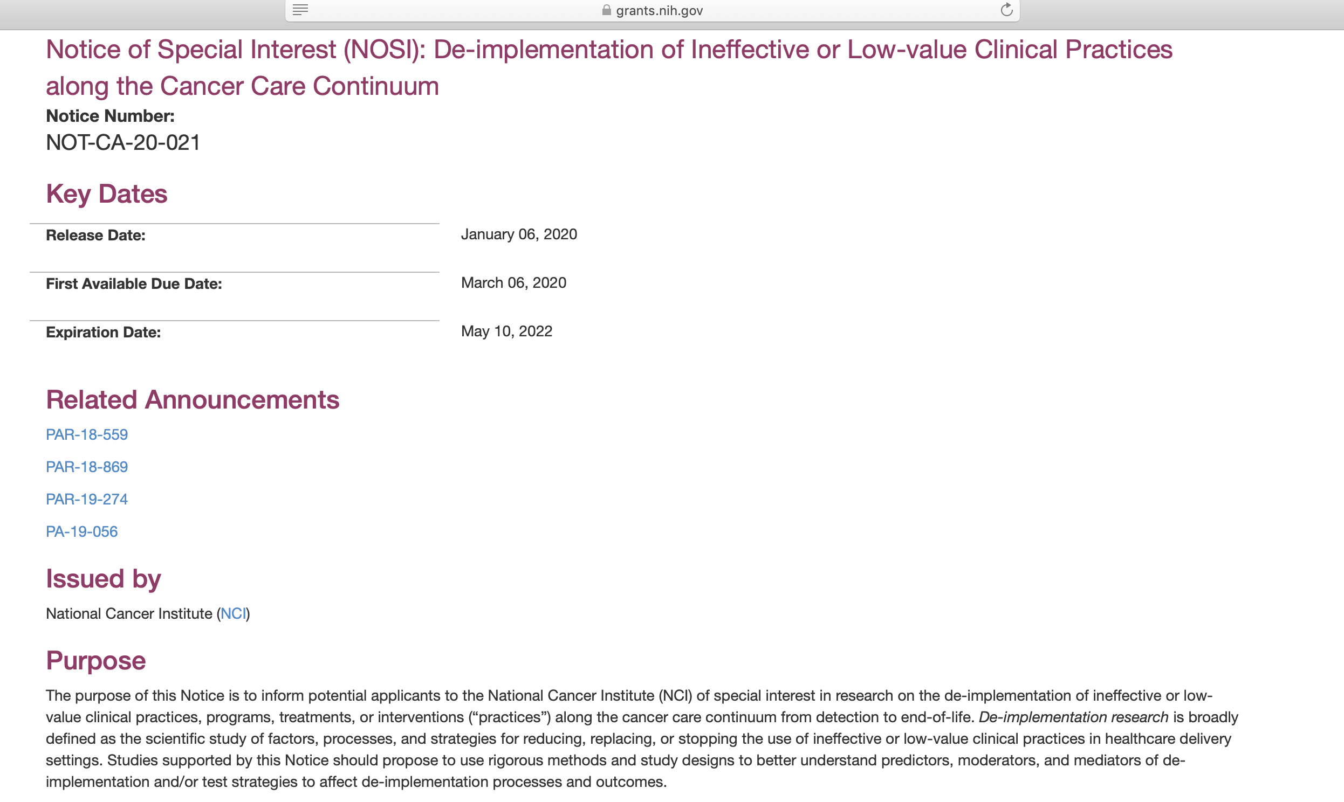
Relatively fresh off the presses…

Slide 39


Slide 40
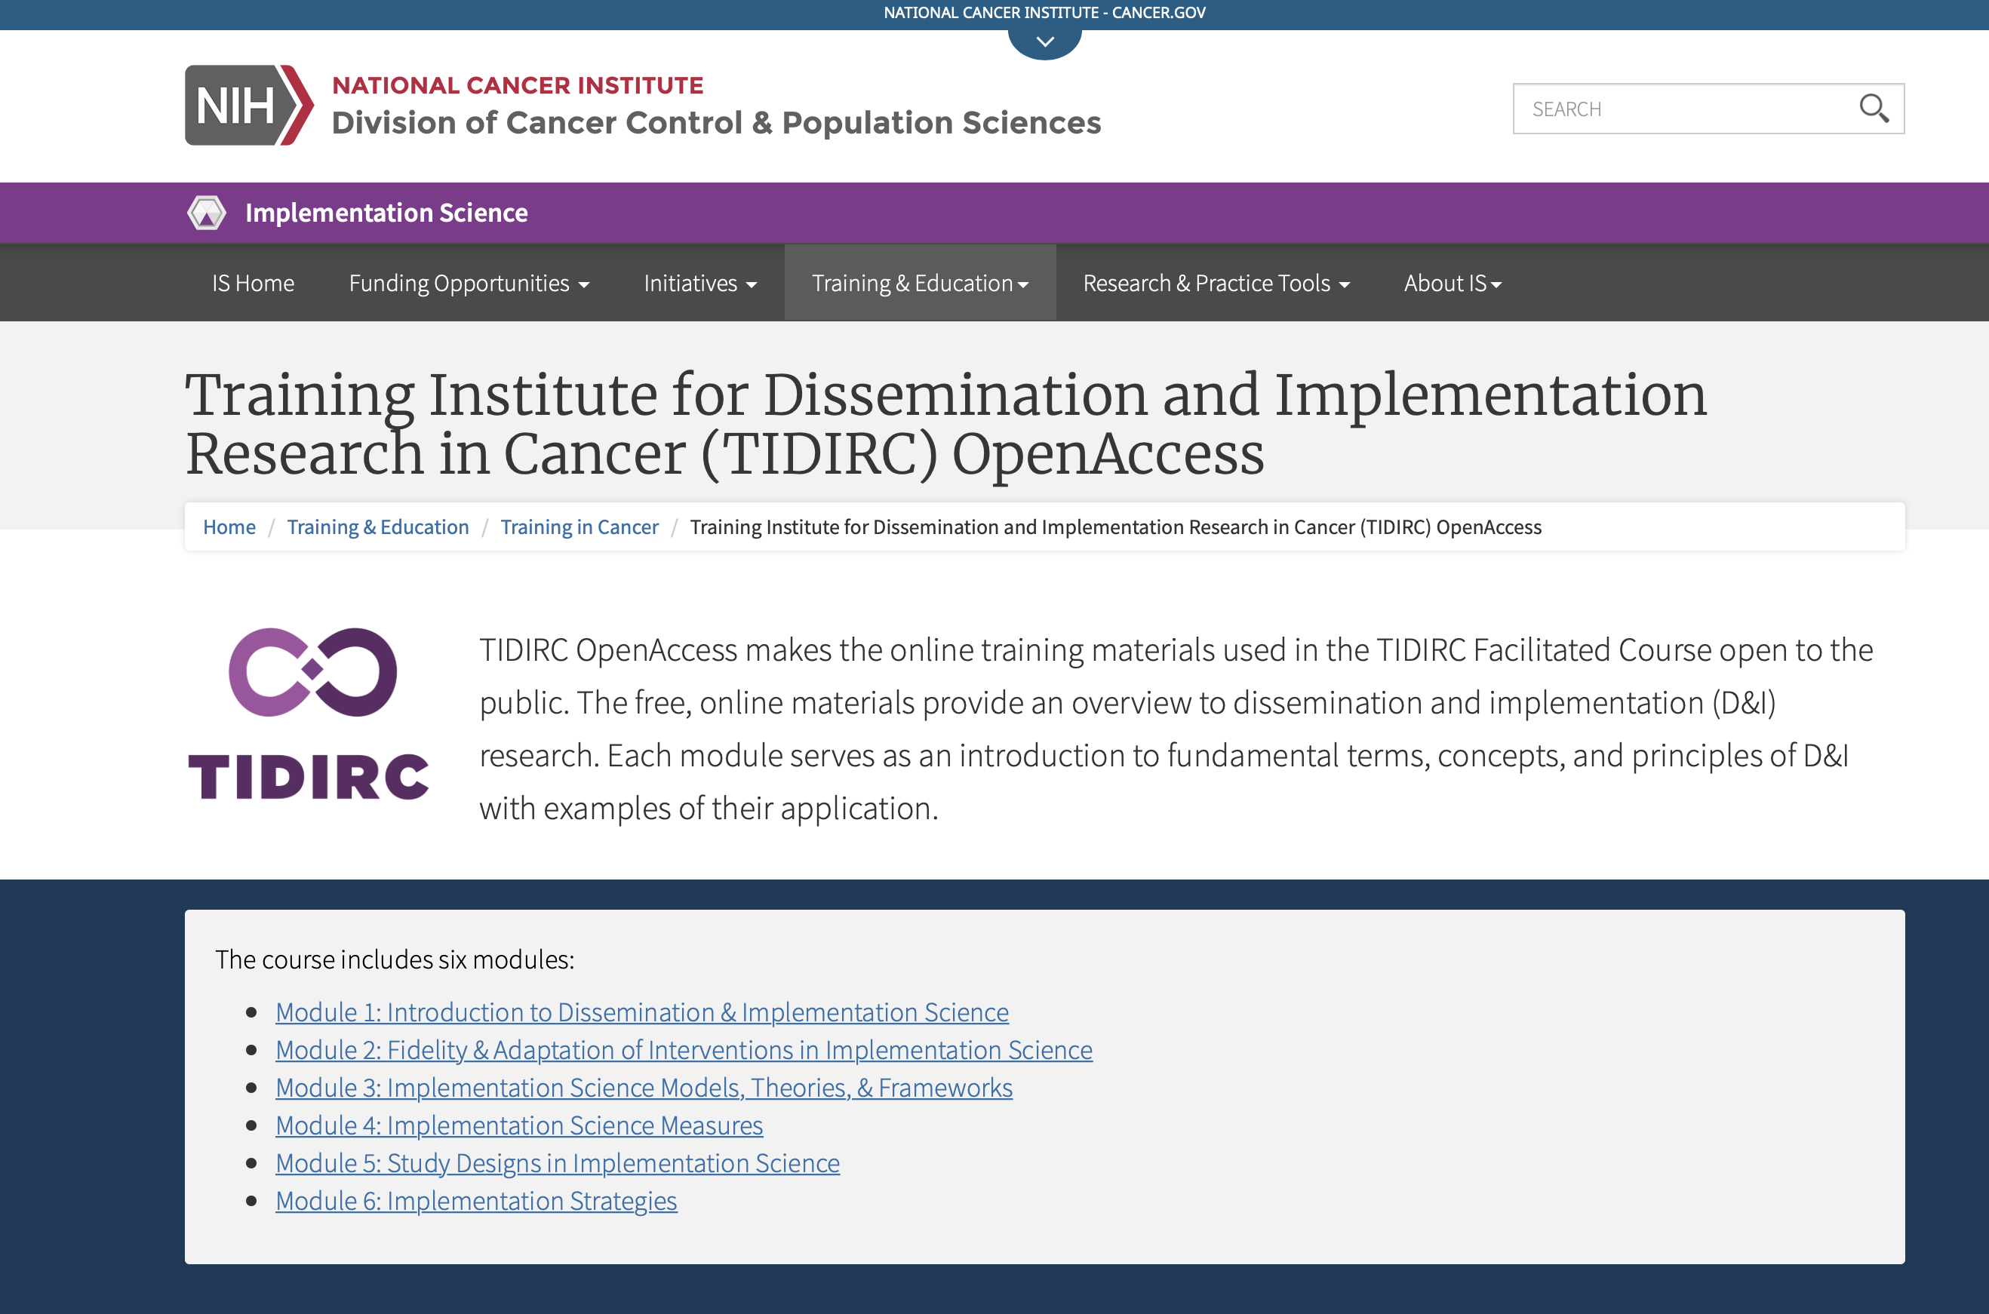
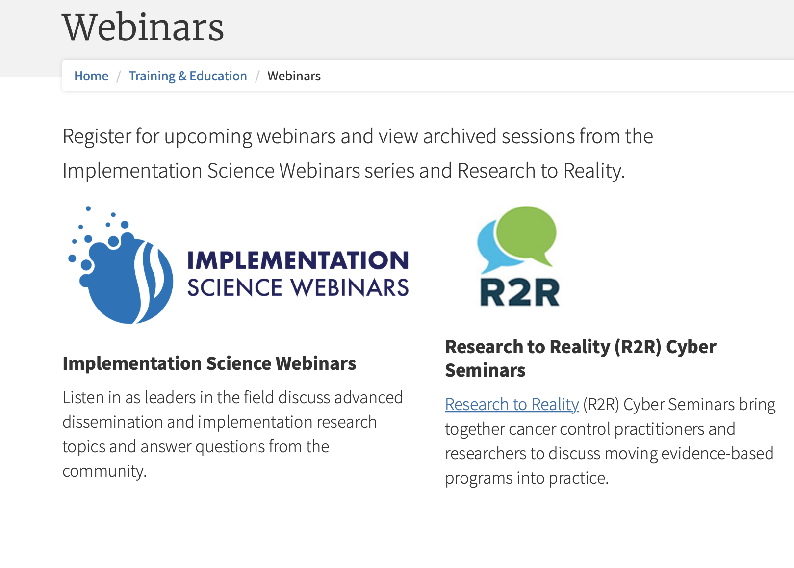
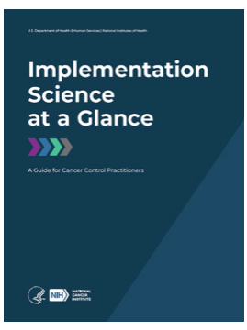

Implementation Science Resources

Slide 41


Future Directions in Implementation Research
December 2017
November 2018

Slide 42
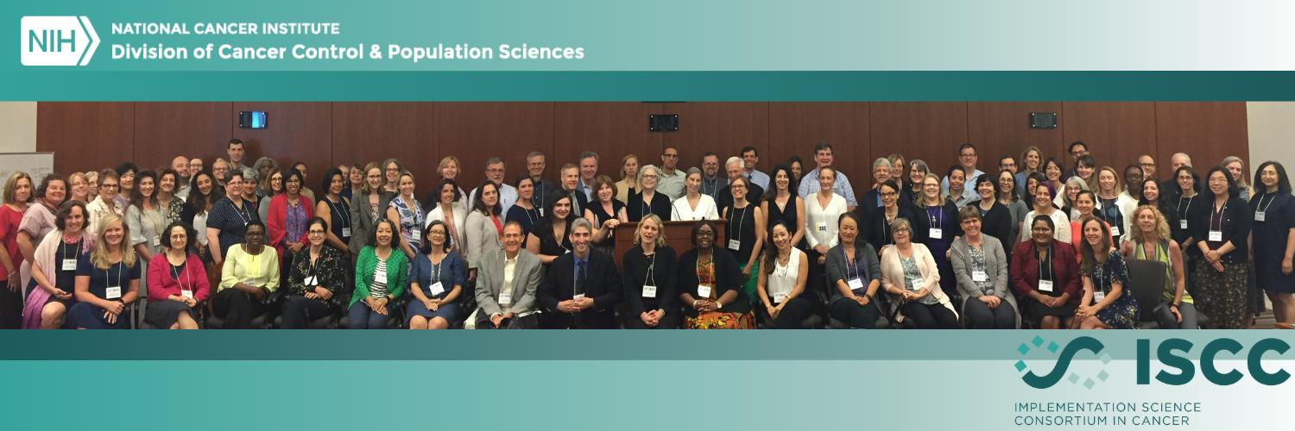
Implementation Science Consortium in Cancer launched July 10-12, 2019
  107 in-person attendees representing 72 institutions
  136 unique on-line attendees representing 102 institutions
Goals identified by participants:
  Advance IS
  Build Capacity
  Collaboration
  Articulate and create a vision for IS
2020 Meeting – Hosted in late-September by Wake Forest University
  Registration Open!
Notes:
As part of this funding announcement, each center will host the Implementaiton Science Consortium in Cancer one time during the funding cycle. NCI kicked off the ISCCC in July 2018 to set the stage that the Consortium is the “big tent” where everyone interested in implementation science in cancer control can participate in moving the field forward and while the funded centers will host the meetings, they are open to the entire community.

Slide 43

dchamber@mail.nih.gov
240-276-5090
@NCIDAChambers

