Slide 1
PBRNs: Potential
Living Laboratories for Disparities Research
NAPCRG Practice Based
Research Network Conference
Eliseo J. Pérez-Stable, M.D.
Director, National Institute on
Minority Health and Health Disparities
eliseo.perez-stable@nih.gov
August 13, 2020

Slide 2
Health Disparity Populations
•Racial/ethnic minorities defined by OMB
•Less privileged socio-economic status
•Underserved rural residents
•Sexual gender minorities
•A health outcome that is worse in these populations compared to a reference group defines a health disparity
Social disadvantage results in part from being subject to discrimination, and being underserved in health care

Slide 3
Race/Ethnicity and Socioeconomic Status Affect Health Outcomes
Fundamental importance in human research
Race/ethnicity predict life expectancy and mortality that are not fully explained
African Americans have more strokes when compared to Whites for same SBP level
Black persons with hypertension have less heart attacks and more cardiomyopathy
Among persons with diabetes, all race/ethnic minorities have less heart disease and more ESRD when compared to Whites

Slide 4
Relative Risk of All-Cause Mortality by US Annual Household Income Level in 2016
Wyatt R, et al., Achieving health equity: A guide for health care organizations. IHI White Paper. Institute for Healthcare Improvement, 2016

Slide 5
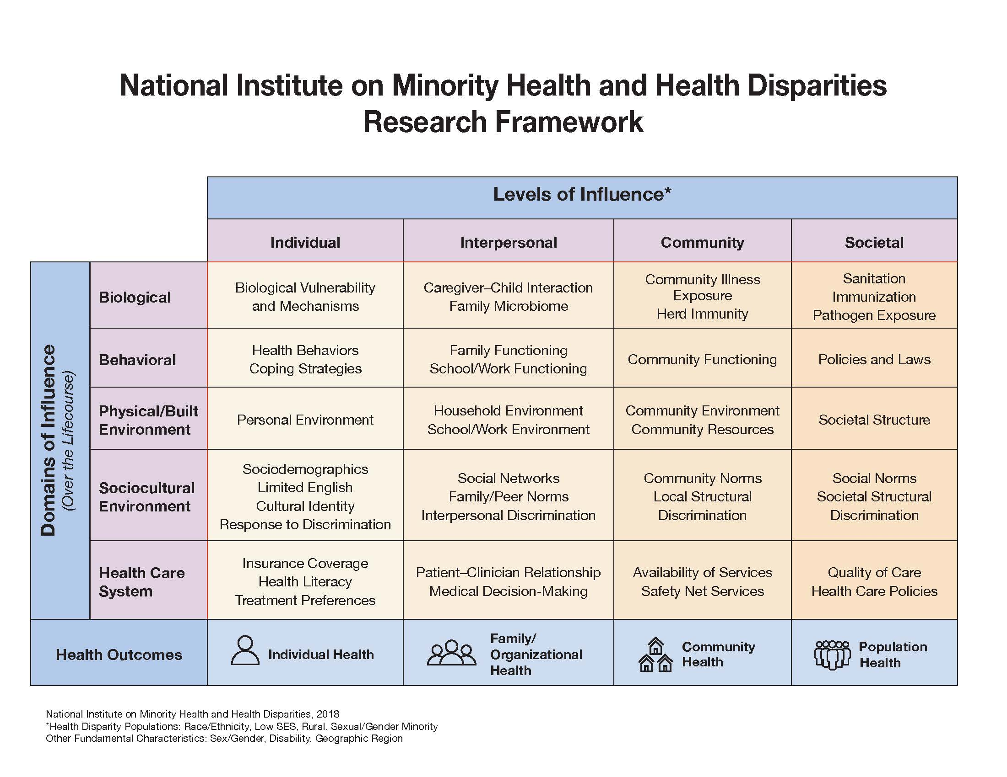

Slide 6
Social Determinants of Health
• Demographics including family background
• Urban or rural residence or geographic region
• Cultural identity, religiosity, spirituality
• Language proficiency, Literacy, numeracy
• Structural determinants: housing, green space, broadband, economic opportunity, transportation, schools, healthy food access, public safety
• PhenX Toolkit on Social Determinants of Health: https://www.phenxtoolkit.org/collections/view/6
Notes:
2

Slide 7
Perception of Unfair Treatment: 2015
In past 30 days were you treated unfairly because of racial or ethnic background in store, work, entertainment place, dealing with police, or getting healthcare?
 | Percent Agree
 | All | Health
Latinos | 36% | 14%
African Americans | 53% | 12%
Whites | 15% | 5%
Trust in clinician/institution? Role of Unconscious Bias?
Kaiser Family Foundation Survey of Americans on Race, November 2015.

Slide 8
Racism as Research Construct
Interpersonal: Most work done, good measures developed, associations established, most common
Structural: History, culture, institutions, and codified practices that perpetuate inequity; how do we incorporate into research?
Internalized: How discrimination (as above) effects individuals who are not aware or sublimate; accept cultural or biological inferiority
Perceived societal and second-hand effects

Slide 9
Practice-based Research to Reduce Health Disparities: What is Needed?
Shift models of care to population health with standardized measurement of social determinants of health
Address patient-clinician communication
What do concordant relationships do?
Leverage health IT to reduce disparities and promote health equity
Recognize and manage structural and interpersonal discrimination

Slide 10
NIMHD Grants Addressing Practice-Based Research
Health Information Technology to improve hypertension control, cancer screening
Incorporation of SDOH in clinical care
National health service corps impact
FQHCs, dual eligible patients and preventable hospitalizations
mHealth interventions to improve CV health in African Americans
14 research grants or K-awards funded

Slide 11
Future Research Directions
Multi-level interventions needed to address health disparities and improve minority health
Discovery science: biological pathways, social determinants, individual behavior, environment, health system….
Assess specific communication strategies between patients-clinicians to maximize trust
Implement structural change to modify individual and group behaviors

Slide 12

Special Issue of AJPH: New Perspectives to Advance Minority Health and Health Disparities Research
Supplement 1, 2019, Vol 109, No S1
Editor’s choice by NIMHD Director Dr. Eliseo J. Pérez-Stable and NIH Director Dr. Francis S. Collins
Definitions for minority health, health disparities, and NIMHD Research Framework
30 research strategies in methods, measurement, etiology, and interventions
Multi-year process with more than 100 authors, including NIH program officers and academic scientists

Slide 13

Connect With NIMHD

