Slide 1
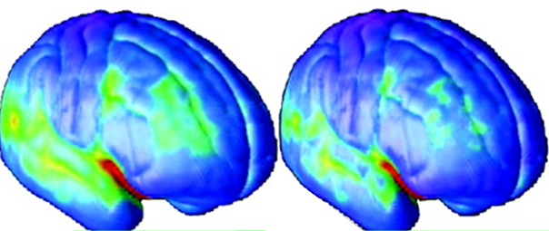
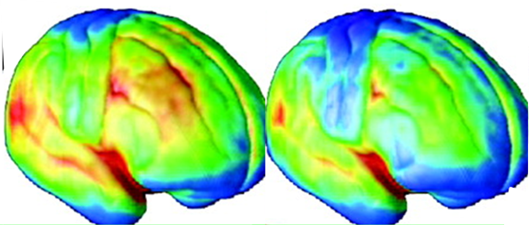


Drug Addiction Science
Age
Biology
Genes/Development
Environment
DRUG/ALCOHOL
Age
Brain Mechanisms
Addiction
Wilson M. Compton, M.D., M.P.E.
Deputy Director
National Institute on Drug Abuse
Advancing Addiction Science

Slide 2
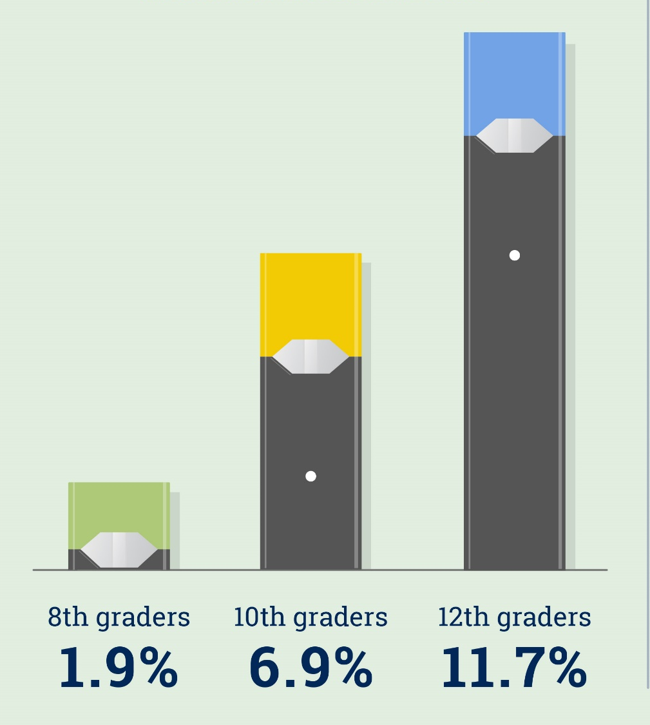

Teen Nicotine Vaping Climbs Significantly (and threatens progress in tobacco control)
Daily Nicotine Vaping
Measured for the
first time in 2019
Past Month Nicotine Vaping
Past month
nicotine vaping
Equates to:
1 in 10‒8th graders
1 in 5‒10th graders
1 in 4‒12th graders
2019 Monitoring the Future Survey

Slide 3
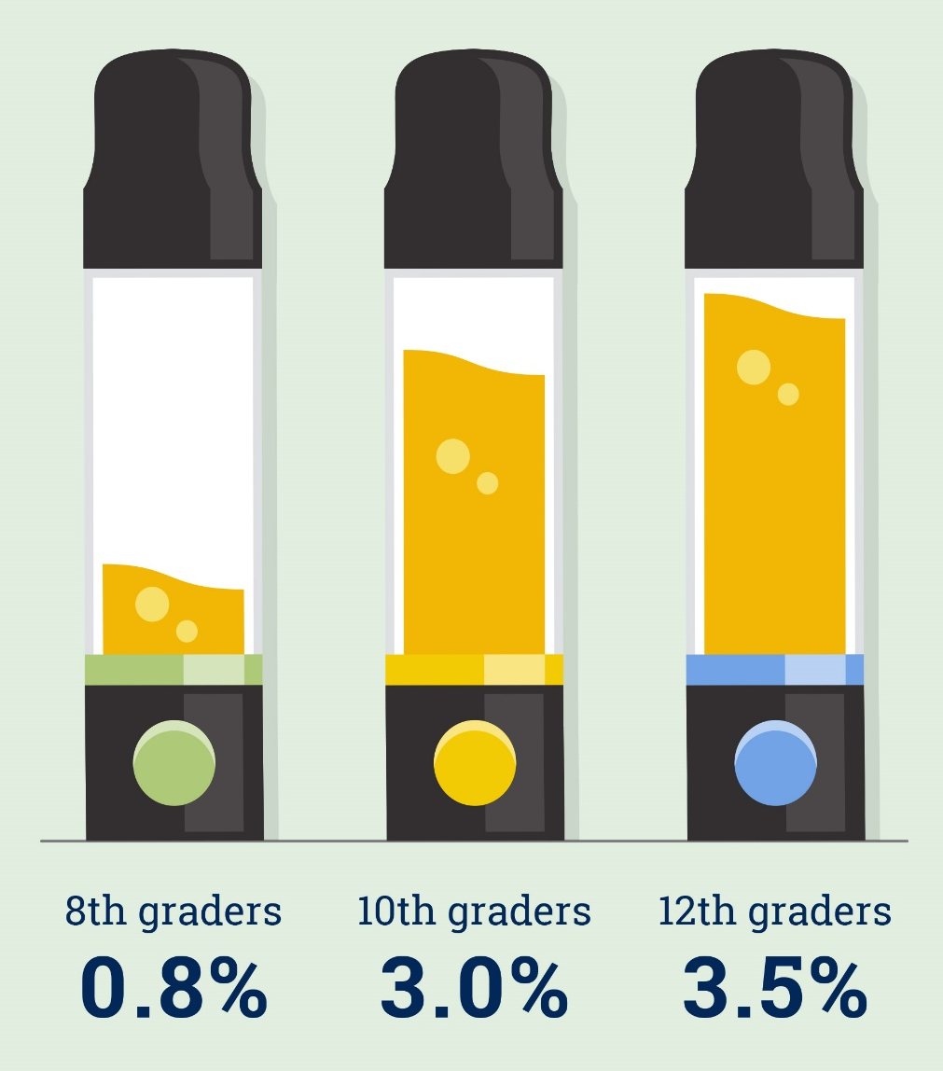

Teen Marijuana Vaping Climbs Significantly
Daily Marijuana Vaping
Measured for the
first time in 2019
Past Month Marijuana Vaping
The 2018-2019 increase is the second largest 1-year jump ever tracked for any substance in the 45-year survey.
2019 Monitoring the Future Survey
Miech, et al. JAMA. Dec 17, 2019.

Slide 4
Evolution of Drivers of Overdose Deaths:
Analgesics
Heroin
“Fentanyl”
Stimulants
31,335“Fentanyl”
67,367 Deaths in 2018
25,877 Stimulants
(e.g. cocaine & methamphetamines)
46,802 from Opioids (Prescription and Illicit)
14,975 Prescribed
14,996 Heroin
See: Compton WM & Jones CM, Ann NY Acad Sci, 2019;
Updated for 2018 from WONDER Database and Hedegaard et al. NCHS Data Brief, no 356. January, 2020

Slide 5
Additional Consequences of Addiction
Drug use while pregnant or parenting has led to increases in rates of neonatal abstinence syndrome and removal of children into the foster care system.
Increased rates of injection drug use have led to increases in acute cases of Hepatitis C and outbreaks of HIV
U.S. Foster Care Removals for Infants < 1 Y.O.
Acute Cases of HCV in USA
Overall
Parental Substance Use
2011
2012
2013
2014
2015
2016
2017
Source: Patrick SW, Frank RG, et al. Hospital Pediatrics, 2019.
Zibbell et al. Am J Public Heath 2018;108:175-181

Slide 6
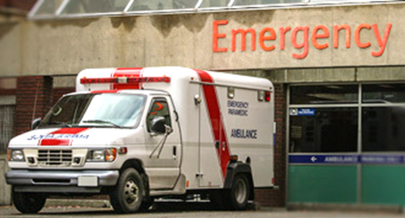
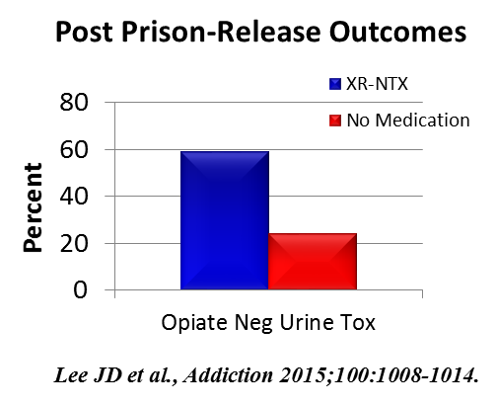
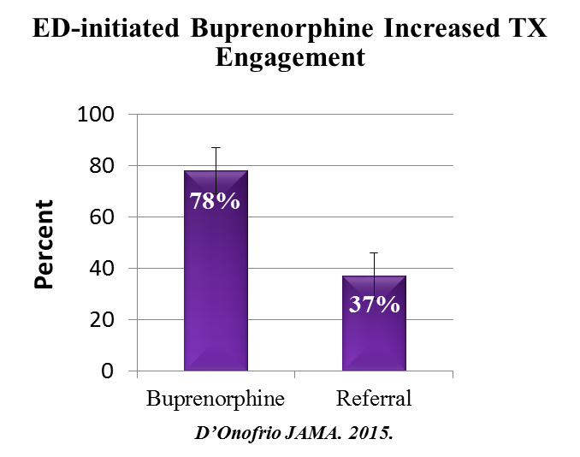
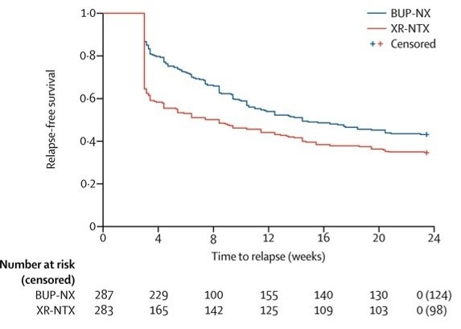
Science = Solutions: Improving Addiction Treatment
Initiating buprenorphine treatment in the emergency department improves treatment engagement and reduces illicit opioid use
Extended release naltrexone initiated in criminal justice settings lowers relapse rates and overdoses
BUP-Nx more effective the XR-Naltrexone overall but appear equally safe and effective after induction
Nasal naloxone for opioid overdose approved by FDA November, 2015 and Lofexidine for opioid withdrawal approved May, 2018
Relapse-free survival
Lee JD, et al., Addiction 2015;100:1005-1014
and New Eng J Med 2016;374:1232-1242
Lee JD et al., The Lancet Nov. 14, 2017

Slide 7
Developing an intervention is only one part of translating research into practice: Implementation Science
Access
and Engagement
Organization Structure and Climate
Intervention
Provider knowledge and behavior
External Environment (stigma, financing)

Slide 8
And…De-Implementation is sometimes needed:
De-Implementation Research
What are some of the multi-level drivers of overuse of low-value clinical practices?
What multi-level strategies can help reduce or stop the use of ineffective practices?
A HEAL-supported study is testing clinical decision support tools for de-implementation of opioid use following dental extractions
(Grant DE027441, PI: Brad Rindal, “De-Implementing Opioid Use and Implementing Optimal Pain Management Following Dental Extractions”)
Notes:
https://projectreporter.nih.gov/project_info_description.cfm?aid=9775669&icde=0

Slide 9
Exploration, Preparation, Implementation, Sustainment (EPIS) Framework
Moullin, et al. Implementation Science 2019;14:1

Slide 10
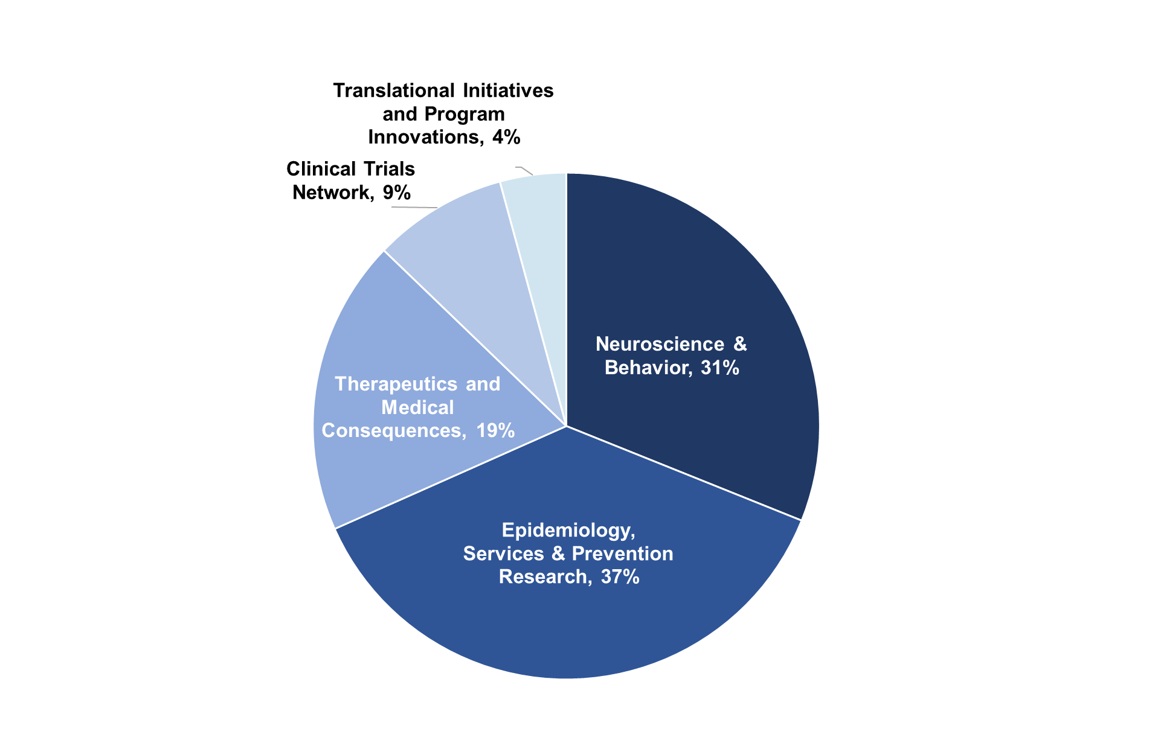
NIDA FY 19 Extramural Research Funding*
Select Program Announcements:
Basic Science (NOSI DAT18-04: Effects of Cannabis Use and Cannabinoids on the Developing Brain)
HIV (RFA-DA-20-022: Assessing the Effects of Cannabinoids on HIV-Induced Inflammation)
Medication Development: (RFA-DA-18-020: Translational Avant-Garde Award for Development of Medication to Treat SUD)
Services (NOSI NOT-DA-19-037: Health Services and Economic Research on the Treatment of Drug, Alcohol, and Tobacco Use Disorders)
*Includes HEAL 1-year funds provided in FY 19 and balance of HEAL 2-year funds provided in FY 18
Advancing Addiction Science

Slide 11

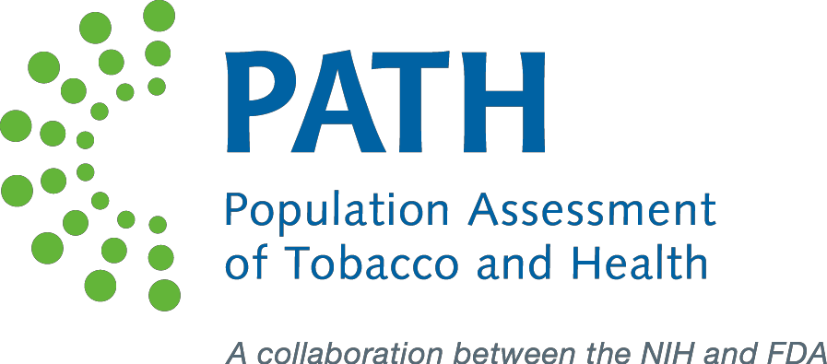
An NIH Collaboration: NIDA, NIAAA, NCI, NIMH, NIMHD, NICHD, NINDS, OBSSR
More than 5 years of data collection, starting with 45,971 adults and youth participants (ages 12 and up)
Data access at http://www.icpsr.umich.edu/icpsrweb/NAHDAP/series/606
Baseline data collection complete—11,878 children ages 9-10
Longitudinal Data—in process
Easy data access.
See abcdstudy.org

Slide 12

HEAL Initiative Research Overview
Pre-Clinical Research in Pain Management
Enhancing Pain Management
Improving Treatments for Misuse and Addiction
Clinical Research in Pain Management
Scientific solutions to the opioids crisis
$500M/year effort
  > $945M obligated in FY2019
  40+ funding opportunity announcements
  41 states
  400 Investigators
  12 NIH Institute and Centers
Expand Therapeutic Options
Enhance Treatments for Affected Newborns
Develop New/ Improved Prevention & Treatment Strategies
Optimize Effective Treatments
Advancing Addiction Science

Slide 13
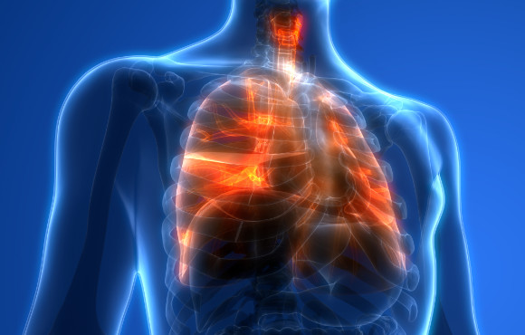
Acute and Chronic Pharmacological Effects:
Drug Impacts on COVID-19 Infections and Outcomes
Nicotine Patch
RCT (n=1900) to be done by Changeux and colleagues who found in a study that smokers are less likely to
contract COVID-19
Tobacco Smoking
Vaping
(Nicotine and/or THC)
Opiate Use
Psychostimulant use
Cannabis
Worse COVID outcomes among smokers

Slide 14
Social Challenges to SUD During COVID-19
Housing instability/homelessness
Increased risk for disease
transmission in homeless shelters
Incarceration
More than half of U.S prisoners have SUD
Prison populations are at greatest risk
for disease transmission during epidemics

Slide 15
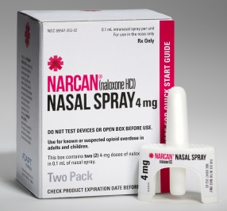
Structural Challenges for SUD During COVID-19
Stress
Stigma
Access to medications for OUD
Limited access to peer-support groups or other sources of social connection
Social distancing increases likelihood of opioid overdoses happening with no observers who can administer naloxone
Buffalo NY Methadone Clinic March 2020

Slide 16
Addiction System Changes in Response to COVID-19:
Potential for Research Evaluation
Increased use of telemedicine
Establishment of mental health hot lines
Deployment of virtual support meetings
Expansion of take-home medicines for MOUD
Buprenorphine prescribing via Telehealth
Release of non-violent offenders with SUD from jails and prisons, which might improve their long-term outcomes
Development of web-based educational material that can be used to help in rehabilitation

Slide 17
Summary:
Complex biological, developmental and social aspects of substance use and addiction suggest multipronged responses.
The severity of the opioid crisis demands urgent action.
Implementation research is essential to improving public health
Addiction
www.drugabuse.gov
Science = Solutions
Advancing Addiction Science

