Slide 1
The Research Question
Brief background:
Black women experience higher rates of infant mortality and adverse birth outcomes as compared with white women, and tend to have lower rates of prenatal care utilization
In Kalamazoo County, black mothers report regular experiences of discrimination and are more likely to have inadequate prenatal care
Research questions:
In the Kalamazoo area, what are the expectations and experiences of women, especially women of color, with their prenatal and postpartum care?
How do women of color interact with the current health care system and how do they respond to their experiences?

Slide 2
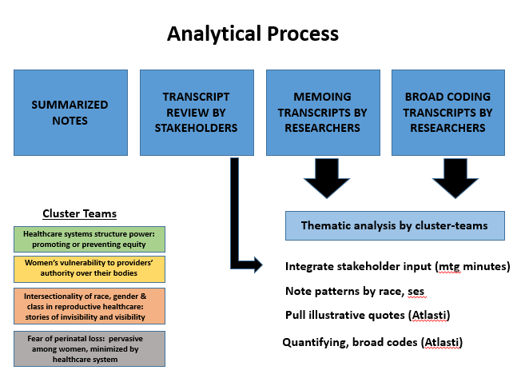
Research Design and Method
Qualitative study
Semi-structured group interviews
Women were pre-recruited from the Mom’s Health Experience Survey
12 CVP focus groups were conducted with a total of 57 women
A quarter of focus groups consisted solely of women of color (WOC), including being led by at least one woman of color
All focus groups were recorded, transcribed, and consensus coded for themes

Slide 3
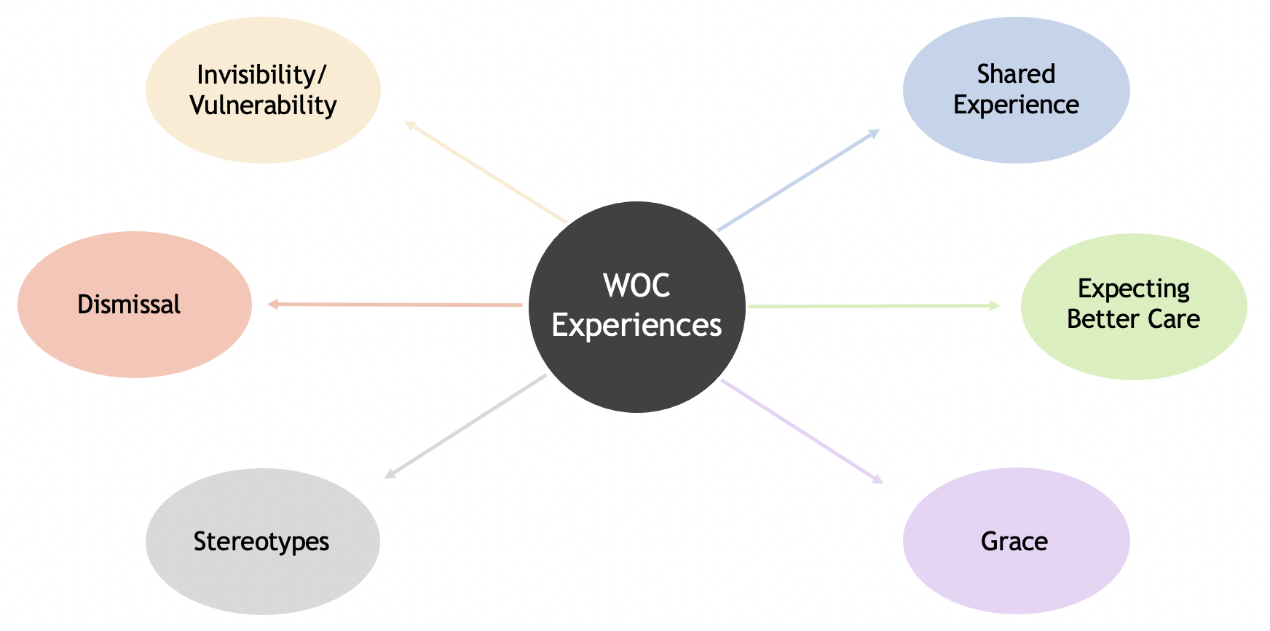
What the Research Found
Focusing on conversations among women of color specifically, certain themes and concepts arose:
Themes of invisibility and vulnerability were
prominent
Felt their experiences were diminished,
ignored, and minimized
Had to battle assumptions and stereotypes
Valued having a sense of shared
understanding and background
Desires don’t align with current ideas of
individualized care – want a shared/relational approach to their care
Displayed grace, or tolerance, for their experiences and for the system

Slide 4
What this means for Clinical Practice
The experiences and suggestions uncovered by this project are a call to providers to challenge their current methods in order to improve experiences and health outcomes
Women’s leading recommendations to community providers include
  More respect and time
  Continuity of care
  Resource-first delivery
  Strategic follow ups
  Increased provider diversity and representation
ALL Women
Women of Color

