Slide 1
The Impact of COVID-19 on Screening Rates for
Colorectal, Breast and Cervical Cancer:
Practice Feedback from a
Quality Improvement Project in Primary Care
Laura A. Schad MPH, Christopher P. Morley PhD, MA – SUNY Upstate Medical University, Syracuse NY
Laura A. Brady PhD, Laurene M. Tumiel Berhalter PhD, Alexandrea Bentham BS - University @ Buffalo, Buffalo, NY
Karen Vitale MSEd, Gary Noronha MD, Carlos Swanger MD – University of Rochester Medical Center, Rochester, NY
Amanda Norton MSW – A.Mandatory, Inc., Ithaca, NY
Supported by Cooperative Agreements NU58DP6102, NU58DP006309, U58DP002029 and U58DP003879, funded by the Centers for Disease Control and Prevention. Its contents are solely the responsibility of the authors and do not necessarily represent the official views of the Centers for Disease Control and Prevention or the Department of Health and Human Services, Health Research, Inc. or the NYS Department of Health.

Slide 2
The Research Question
Did the COVID-19 pandemic impact colorectal, breast & cervical cancer screening in safety-net primary care practices?
  7-year Quality Improvement (QI) Project (2013-2020) aimed at increasing breast, cervical & colorectal (CRC) cancer screening rates through:
    Academic Detailing: tailored education on specific health topics to providers in their own setting
      One session
    Practice Facilitation: trained professionals assist practices in QI
      6 months/year
  Participants: Safety-net primary care practices (PCPs) involved with practice-based research networks (PBRNs) in Central & Western New York State
  Year 7: Spring 2020 COVID-19 Pandemic; PCPs forced to stop/reduce in-person activities & furlough/limit staff onsite
In early project years, breast and CRC improved; cervical was always a challenge
We expected to see drop in all screening rates due to COVID-19
Team realized: It was important to note responses to the pandemic in real-time

Slide 3
Research Design and Method
Longitudinal QI Project utilizing three regional PBRNs in upstate New York State
Slate of evaluation processes each year
  Pre/Post Comparison of rates
  Qualitative interviews
Spring 2020 (final project year) interviews included questions on impact of COVID-19 on screening
  Practice facilitators interviewed practice staff/stakeholders/key informants
  Coded without identifying information
Responses from all practices assessed via content analysis
  Led by one team member, cross-validated by a second
  Initial themes discussed with broader team
    Second analytic, interpretive step
    Team included physicians, health service/public health researchers, practice improvement experts, social scientists
Project determined to be QI (not research) by the Upstate Medical University IRB

Slide 4
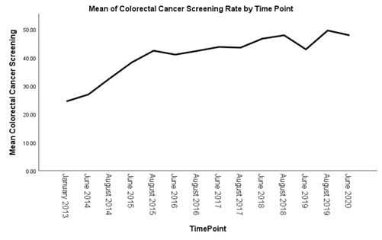
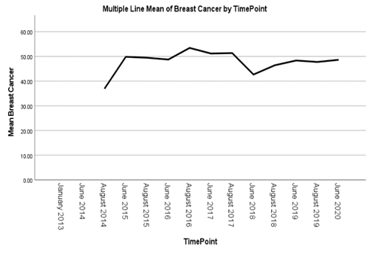
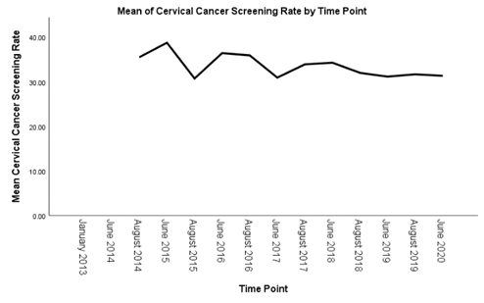
What the Research Found
Screening Rates did not sharply decline – PCPs found ways to maintain rates
Overarching Theme: Practices continued pre-COVID-19 processes
  New emphasis on Telemedicine – many PCPs used what they knew, or developed new competency
  With fewer/no patient visits, PCPs focused on data clean up of records & registries, were able to identify & follow-up with patients in need of screening through telemedicine
  Many responses indicated shift of focus from preventive visits to care for sick patients
CRC cancer: relatively unchanged by the pandemic
  Re-emphasis on at-home testing (e.g. FIT testing)
  PCPs were already mailing test kits to patients – an existing strength
  PCPs had time to follow-up with patients who had a positive FIT kit before the pandemic
Breast cancer: many PCPs use mobile mammography vans – an existing strength
  Mobile screening units were repurposed for COVID-19 testing, a potential barrier; however
  Once the height of the pandemic settled, some regained access to mobile mammography
Cervical cancer: hard to target/track pre-COVID-19 since many seek this at OB-GYN facilities
  OB-GYN clinics closed & fewer staff available to monitor patient data between sites

Slide 5
What this means for Clinical Practice
Telemedicine was extremely useful for practices during this time
  Many PCPs used the time to improve telemedicine services
  BUT presented issues when patients did not have the means to access the technology
  May have continued practice revenue when in-person visits were not possible
  Takeaway: PCPs should develop telemedicine skills and capacity
Some used the decrease in patient visits as time to improve
  Cleaning up patient records/data, filming screening tutorials
  Some have new appreciation for effective data management strategies
  “Downtime” used to better identify patients in need of screening
  Takeaway: data management processes helped maintain screening rates, which has been a consistent theme throughout our project; especially important during pandemic

