Slide 1
Funding Agency Efforts to Promote Diversity, Equity, and Inclusion in Health & Healthcare
Perspectives from the National Heart, Lung, and Blood Institute
George A. Mensah, MD, FACC, FAHA
Presented at the North American Primary Care Research Group Practice-Based Research Networks Meeting
June 25, 2021

Slide 2

Disclaimer and Disclosure Statements
I have no conflicts of interest to disclose.
The contents of this presentation should not be construed as representing an official position of the NIH or the United States Department of Health and Human Services.
Center for Translation Research and Implementation Science (CTRIS)

Slide 3

NHLBI Efforts to Promote Diversity, Equity, and Inclusion in Health and Healthcare: Presentation Outline
Institute-Initiated Research Efforts
Investigator-Initiated Research Efforts
Advancing Inclusive Excellence in the Workforce
Empowering Practice-Based Research Networks
Special thanks to:
Dr. Arlene Bierman, Director, Center for Evidence Based Programs, AHRQ
Bob McNellis, Senior Advisor for Primary Care, National Center for Excellence in Primary Care Research, AHRQ
Rebecca Roper, Program Director, CTRIS, NHLBI
Center for Translation Research and Implementation Science (CTRIS)

Slide 4

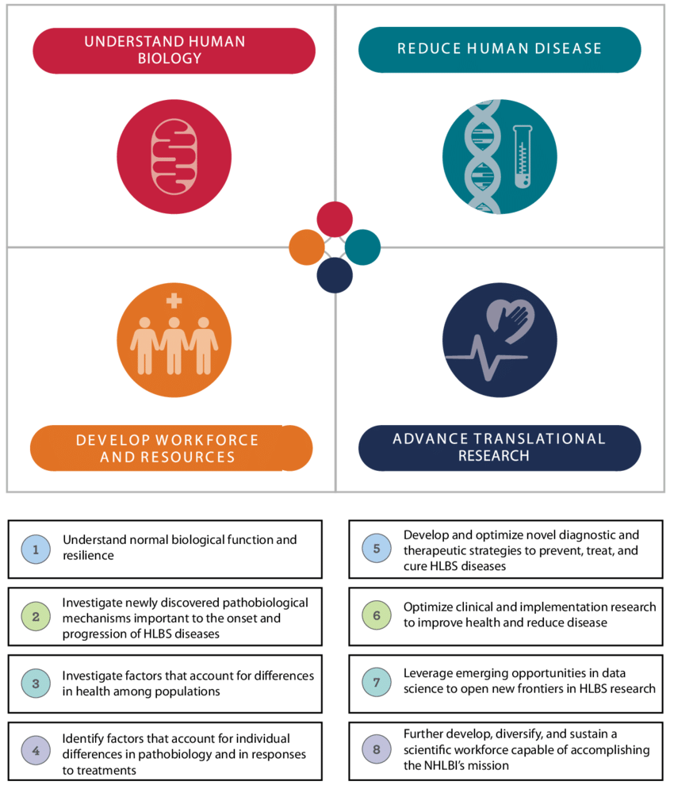
Eliminating Disparities is a Priority at NHLBI
https://www.nhlbi.nih.gov/about/documents/strategic-vision

Slide 5
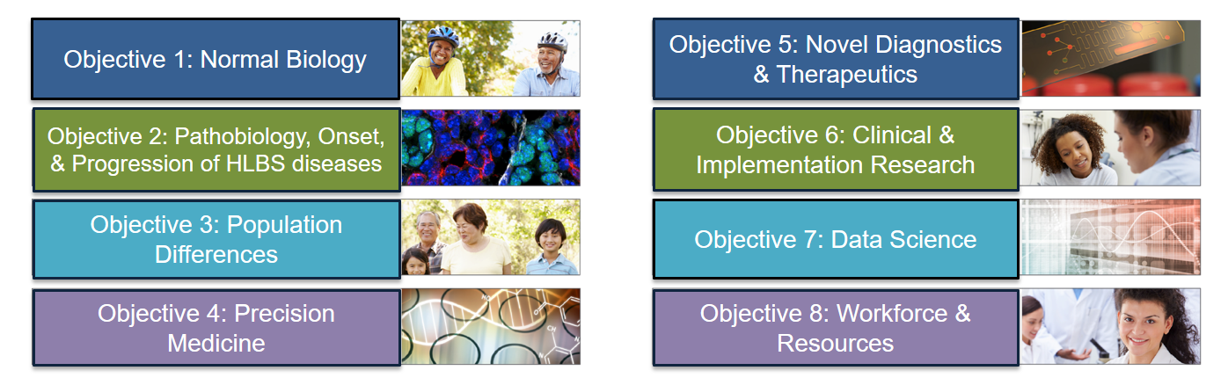

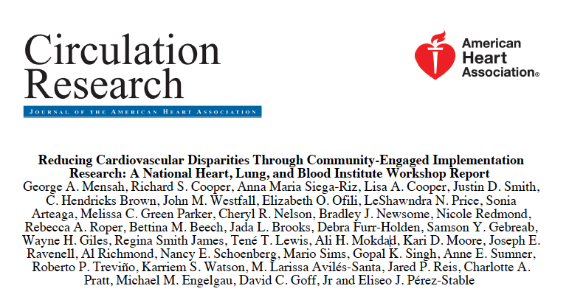
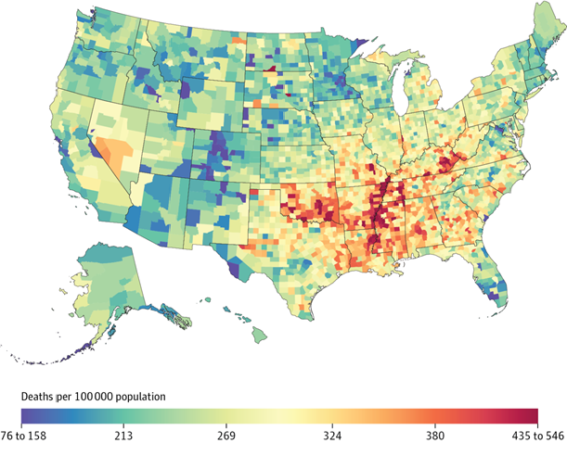
Reducing Health Disparities through Community-Engaged Implementation Research: The DECIPHeR Initiative
Cardiovascular Mortality Differences —
Place Matters
George A. Mensah, David C. Goff, Gary H. Gibbons
JAMA. 2017;317(19):1955-1957.
  DECIPHeR: Community-engaged participatory research to reduce disparities in heart, lung, blood, and sleep disorders.
Mensah, Goff, Gibbons. JAMA. 2017 May 16;317(19):1955-1957.
Mensah, Cooper, Siega-Riz, et al. Circ Res. 2018 Jan 19;122(2):213-230

Slide 6
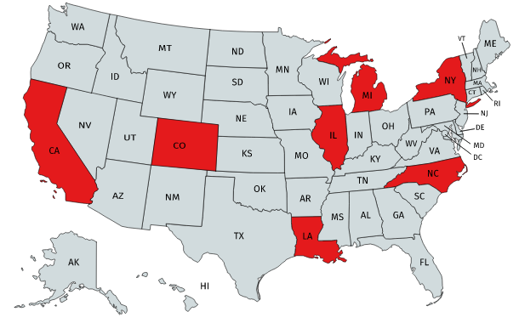

NHLBI DECIPHeR Alliance and Grantees
DECIPHeR Grantees
UCLA, CA
University of Colorado Denver, CO
University of Illinois at Chicago, IL
University of Michigan, MI
Northwestern Univ. at Chicago, IL
NYU School of Medicine, NY
Tulane University, LA
UNC, NC (Coordinating Center)
POC: Dr. Paul Cotton
NIH, NHLBI. RFA-HL-20-003 and RFA-HL-20-004
Mensah GA, Cooper RS, Siega-Riz AM, et al. Circ Res. 2018;122(2):213-230.

Slide 7
NIH CEAL:
Community Engagement Alliance Against COVID-19 Disparities
7

Slide 8
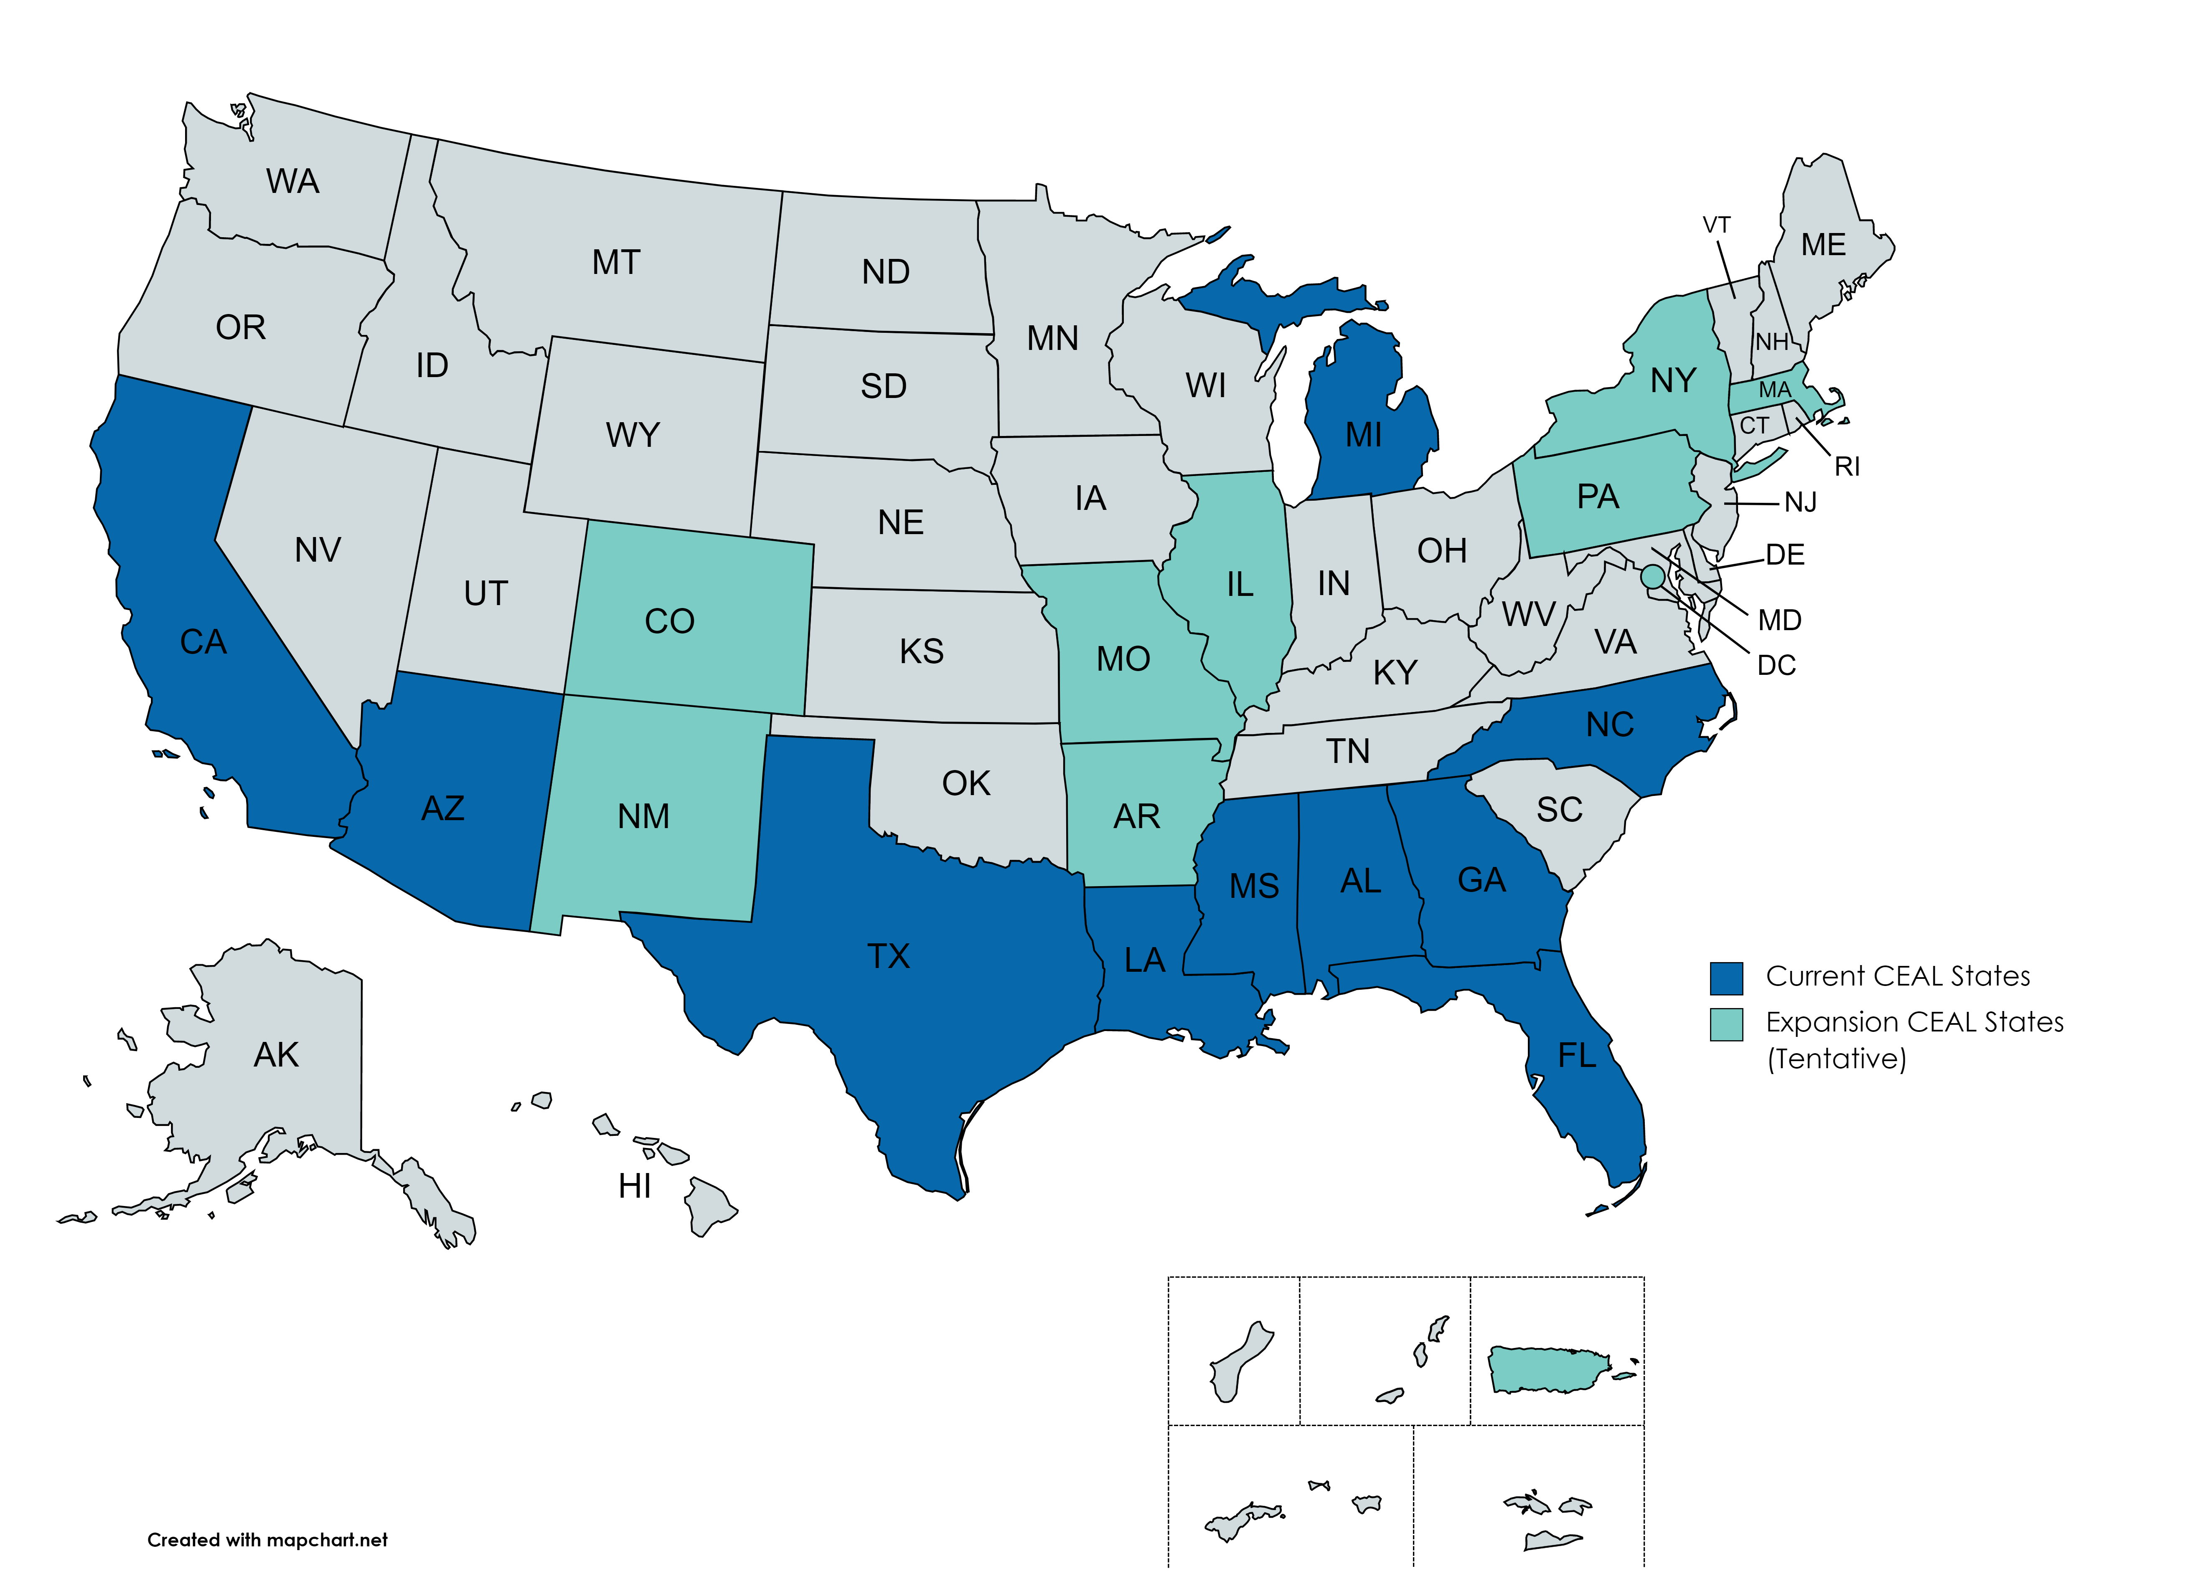






Community Engagement Alliance (CEAL)
Against COVID-19 Disparities
A trans-NIH initiative leading outreach, engagement, and inclusive participation efforts in ethnic and racial minority communities disproportionately affected by the COVID-19 pandemic.
Academic Partners
Community-Based Organizations
Healthcare Centers & Providers
Faith-Based Organizations
Current CEAL States
PR
State & Local Government Agencies
New CEAL Sites
CEAL teams PBRN partnerships:
AL, CO, IL, NY
Pharmacy Networks
8

Slide 9








NHLBI Landmark Cohort Studies
  Multi-Ethnic Study of Atherosclerosis (MESA)
  Jackson Heart Study (JHS)
  Hispanic Community Health Study/Study of Latinos (SOL)
  Women’s Health Initiative
  Cardiovascular Health Study (CHS)
  Atherosclerosis Risk in Communities (ARIC)
  Strong Heart Study (SHS
  Coronary Artery Risk Development in Young Adults Study (CARDIA)
Center for Translation Research and Implementation Science (CTRIS)

Slide 10
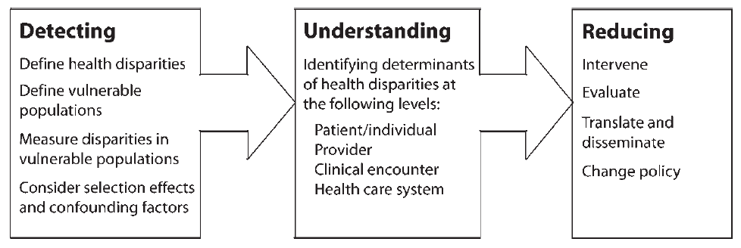
The 3 Phases of the Disparities Research Agenda
PHASE 1
PHASE 2
PHASE 3
Modified from Kilbourne et al. Am J Public Health. 2006;96:2113–2121

Slide 11
Specific Research Funding Opportunities
RFA-RM-21-021: Transformative Research to Address Health Disparities and Advance Health Equity (U01 Clinical Trial Allowed)
RFA-RM-21-022: Transformative Research to Address Health Disparities and Advance Health Equity at Minority Serving Institutions (U01 Clinical Trial Allowed)
RFA-MD-21-004: Understanding and Addressing the Impact of Structural Racism and Discrimination on Minority Health and Health Disparities (R01 Clinical Trial Optional)
RFA-MD-21-008: NIMHD Multiple Chronic Disease Disparities Research Coordinating Center (RCC) (U24 Clinical Trial Not Allowed)
https://grants.nih.gov/grants/oer.htm

Slide 12
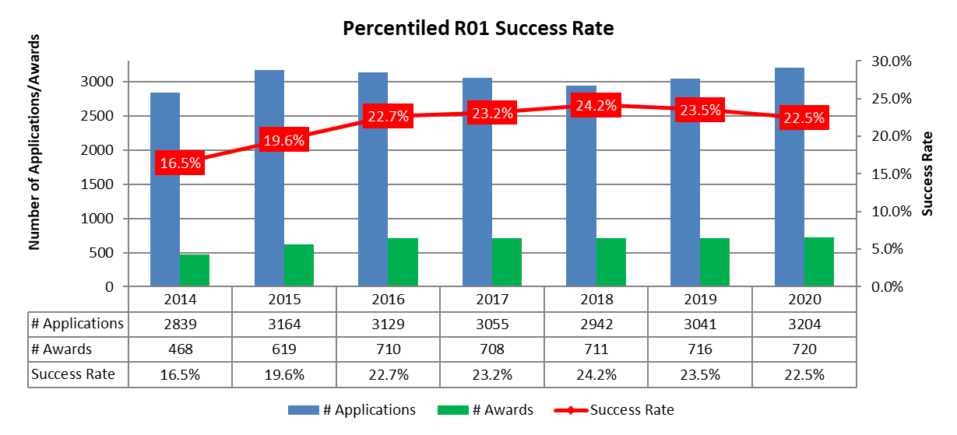
Prioritized Investments in Investigator-Initiated Research
Grant Program | FY19 Paylines | FY19 # Awards (Success Rate) | FY20 Paylines | FY20 # Awards (Success Rate)
R01 | 16%ile | 716 (23.5%) | 16%ile | 720 (22.5%)
ESI | 26%ile | 159 (29.2%) | 26%ile | 145 (28.6%)
K Awards | P.S. 32 | 188 (42.2%) | P.S. 32 | 192 (37.4%)
22.7%
23.2%
24.2%
23.5%
22.5%
19.6%
16.5%
Only non-AIDS applications and awards are included.
Source: Office of the Director, NHLBI.

Slide 13
Preparing Competitive Grant Applications
Notice of Special Interests (NOSI), for example:
  Predictive Analytics for Implementation Research, NOT-HL-20-018
  Behavioral Economics for Implementation Research, NOT-HL-21-010
Conduct technical assistance calls with CTRIS Program Officers (PO)
Monitor NHLBI Workshop Summaries, https://www.nhlbi.nih.gov/events
Search https://report.nih.gov/ for comparable successfully funded projects
Review considerations:
  Early Stage Investigators (ESI) : 10-point bump for some review groups
  Center for Scientific Review group : Request review group?
Center for Translation Research and Implementation Science (CTRIS)

Slide 14








Stepping Stones to Success: Mechanisms to Support Developing a Diverse Biomedical Workforce
Trans-NIH Biomedical Workforce Support
High School and College
Medical and Graduate School
Post-doctoral fellowship
Early Career
Established Investigator
PRIDE R25
Career Development Awards
ESI Grants
Fellowship Grants
Diversity Supplements
BUILD
Fellowship and Training Grants
NIGMS MOSAIC
Maximizing Opportunities for Scientific and Academic Independent Careers
Summer Internships
Helena O. Mishoe Fellowships for Underrepresented Groups
Summer Research Education (R25)
Institutional Award to promote diversity
  Focused on research-intense institutions
K99/R00 Awards to promote diversity
https://www.training.nih.gov/programs/sip
https://www.nigms.nih.gov/
ESI: Early-Stage Investigator
14
Notes:
https://loop.nigms.nih.gov/2019/08/new-maximizing-opportunities-for-scientific-and-academic-independent-careers-mosaic-programs-announced/
Maximizing Opportunities for Scientific and Academic Independent Careers (MOSAIC) funding opportunity announcements have been published. MOSAIC is designed to facilitate the transition of promising postdoctoral researchers from diverse backgrounds, such as individuals from groups underrepresented in the biomedical research workforce at the faculty level, into independent faculty careers at research-intensive institutions. The program has two components:
MOSAIC Institutionally-Focused Research Education Cooperative Agreement to Promote Diversity (UE5)
PAR-19-342
Supports independent organizations (e.g., scientific societies) of biomedical scientists who conduct research within the NIGMS mission. Awardees will provide skills development, mentoring, and networking opportunities that prepare cohorts of scholars supported by MOSAIC K99/R00 awards to transition into, succeed, and advance in independent faculty careers at research-intensive institutions.
First application deadline: November 15, 2019
Earliest start date: July 2020
MOSAIC Postdoctoral Career Transition Award to Promote Diversity (K99/R00)
PAR-19-343
Supports postdoctoral scientists from diverse backgrounds conducting research in areas within the NIGMS mission by providing up to 5 years of support in two phases:
The initial (K99) phase provides support for up to 2 years of mentored postdoctoral research training and career development.
The second (R00) phase provides up to 3 years of independent research support, which is contingent on satisfactory progress during the K99 phase and an approved, independent, tenure-track (or equivalent) faculty position.

Slide 15
Inclusive Excellence in Trainees: Demographic Profiles
FY2019 NHLBI-supported T/F/K Trainees
Percentage of Trainees
Percentage of Trainees
Pre-docs
Post-docs/ Early Career Scientists
Pre-docs
Post-docs/ Early Career Scientists
Source: Office of the Director, NHLBI
URM: Under-Represented Minorities
Notes:
The information for T32 and T35 trainees: the trainees supported by NHLBI in FY2019 only
Pre and Post doc female applicants saw decreases across all mechanisms
Post Doc F URMS awardees saw a decrease by 6% in FY19 (4%) when compared to FY18 (10%)

Slide 16
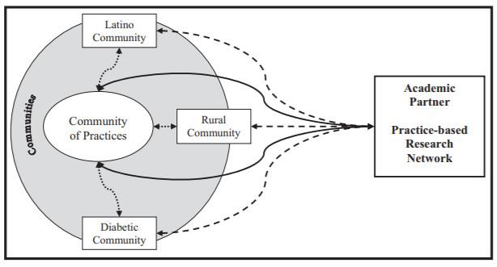
Practice-Based Research is Community Engagement
Westfall, Fagnan, Handley, et al. J Am Board Fam Med 2009;22(4):423-427

Slide 17
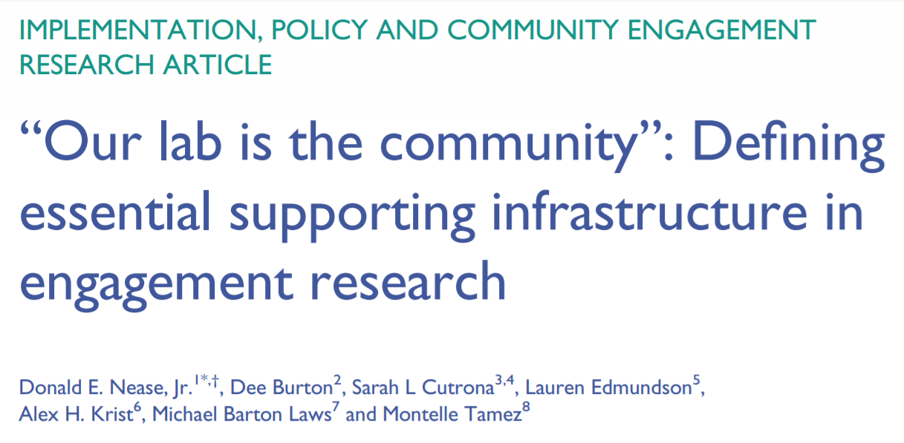
Nease, et al. J Clin Transl Sci Aug 2018;2(4):228-233

Slide 18
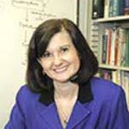
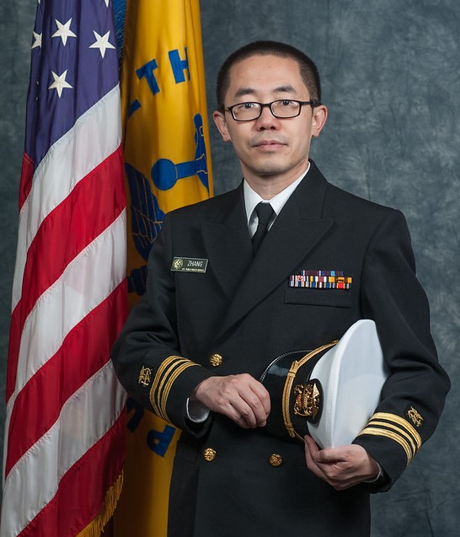
Key NHLBI Contacts for Community-Engaged Research to Address Diversity, Equity, and Inclusion in Healthcare
Dr. Catherine Stoney
Deputy Director, Center for Translation Research and Implementation Science (CTRIS), NHLBI, NIH
Dr. Xinzhi Zhang
Branch Chief, Health Inequities and Global Health Branch
CTRIS, NHLBI, NIH
Point of Contact: Dr. Xinzhi Zhang; email: xinzhi.zhang@nih.gov

Slide 19



