Slide 1
NIMHD Perspectives on Primary Care Research Funding
June 25, 2021
NAPCRG Practice Based Research Network Conference
Embracing Diversity, Equity and Inclusion
Eliseo J. Pérez-Stable, M.D.
Director, National Institute on
Minority Health and Health Disparities
eliseo.perez-stable@nih.gov

Slide 2
What Can Science Do to Reduce Inequities?
Standardized measurement of factors that affect health
Facilitate discovery science with big data
Be an engine for promoting diversity of the scientific and clinical workforce
Cultivate community engagement and build trust for sustainable relationships
Implement what we know can work to promote health equity

Slide 3
Populations with Health Disparities
•Racial/ethnic minority populations defined by Census
•Less privileged socio-economic status
•Underserved rural residents
•Sexual and gender minorities
•Social disadvantage that results in part from being subject to discrimination or racism, and being underserved in health care
•A health outcome that is worse in these populations compared to a reference group defines a health disparity

Slide 4
Race/Ethnicity and Socioeconomic Status are Fundamental in Determining Health
Race/ethnicity and SES predict life expectancy and mortality that are not fully explained
African Americans have more strokes when compared to Whites for same level of SBP
Most chronic diseases are more common in persons of less privileged SES
Among persons with diabetes, all race/ethnic minority populations have less heart disease and more ESRD, compared to Whites

Slide 5
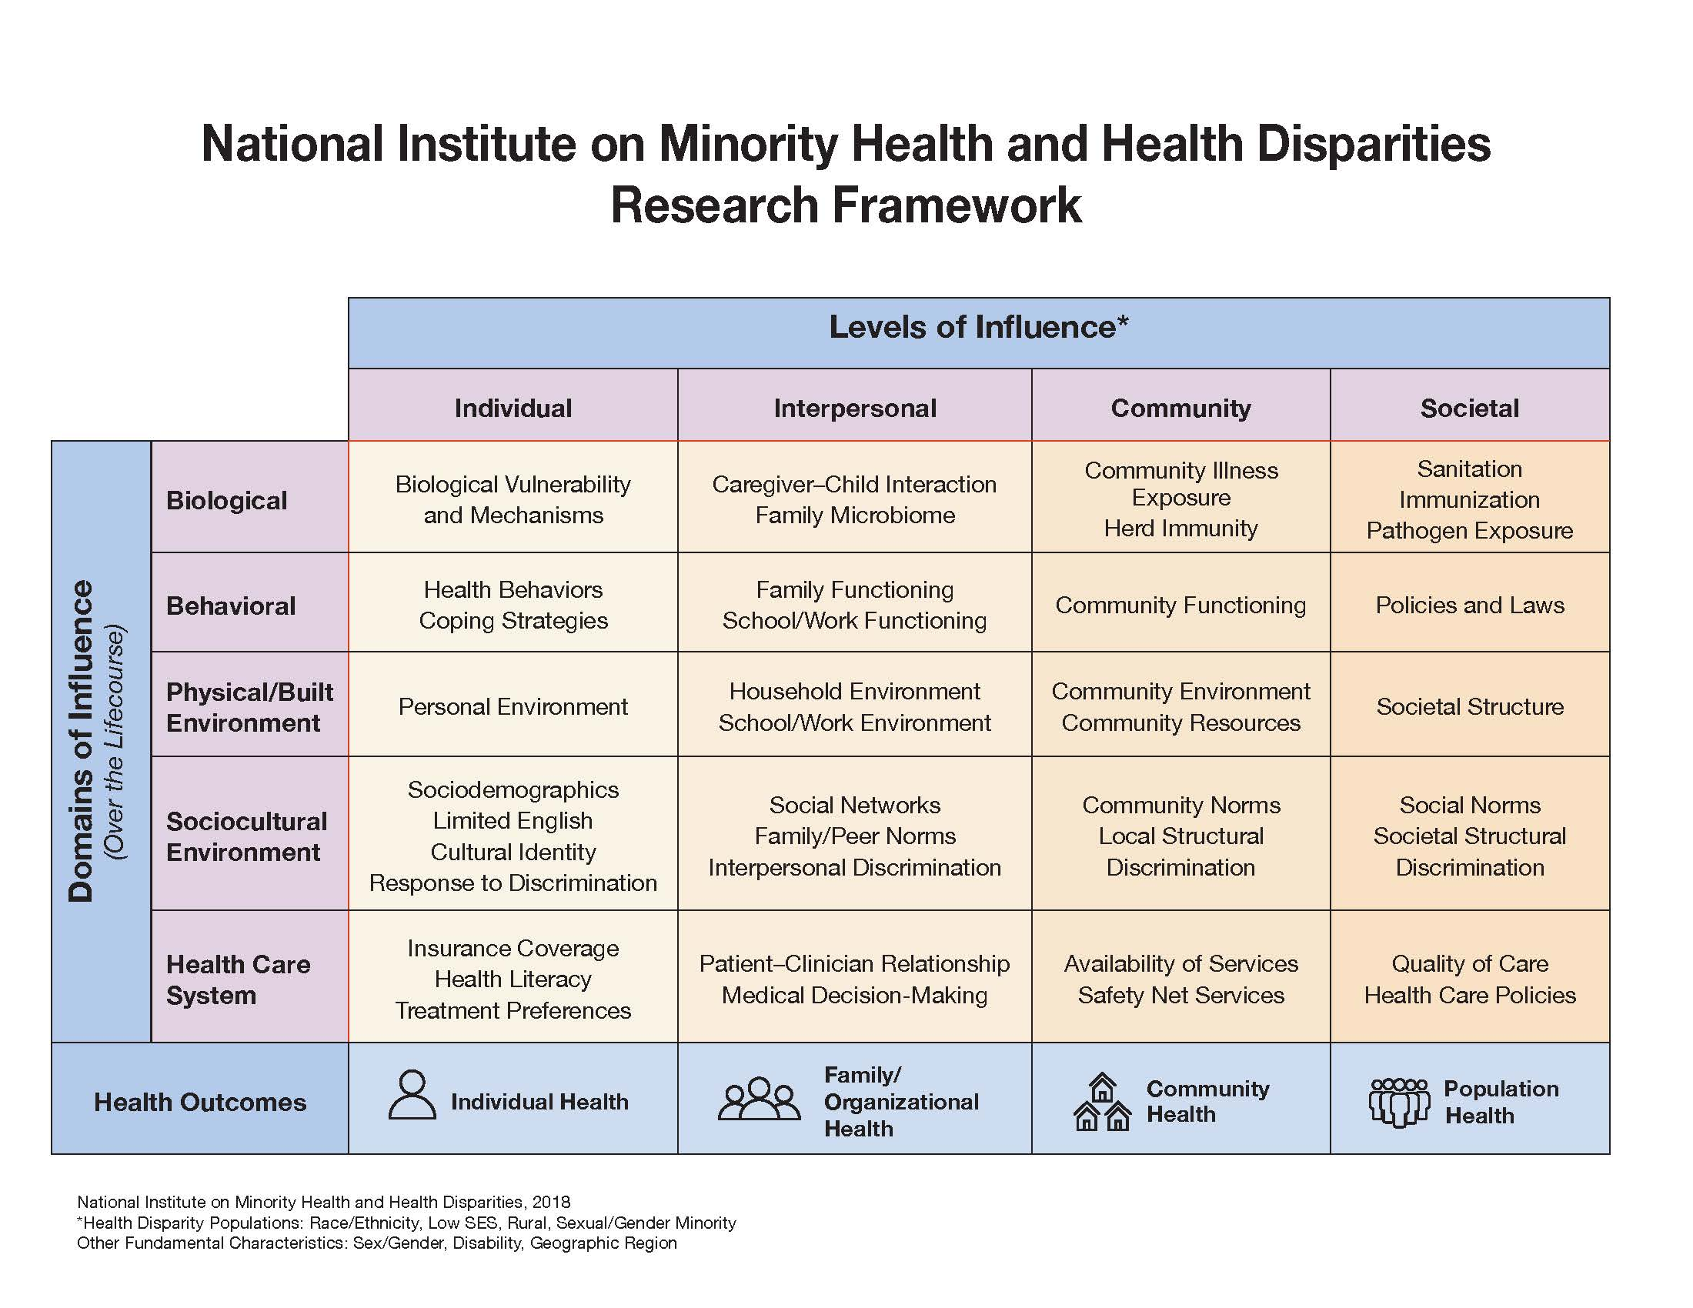

Slide 6
Social Determinants of Health
• Demographics including family background
• Urban or rural residence or geographic region
• Cultural identity, religiosity, spirituality
• Language proficiency, Literacy, numeracy
• Structural determinants: housing, green space, broadband, economic opportunity, transportation, schools, healthy food access, public safety
• PhenX Toolkit on Social Determinants of Health: https://www.phenxtoolkit.org/collections/view/6
Notes:
2

Slide 7

New Research on Health Disparities, Minority Health and Health Equity
N Committee—Co-Chair, Anna M. Nápoles, PhD
Common Fund Development
  FY21 FOAs: Transformative R01 Research projects to Address Health Disparities and Advance Health Equity stratified by Institutional resources
  FY23 strategic planning in process
  New Research/Collaborative Opportunities
  Create robust support for MH/HD/HE research extramurally/intramurally
  Collaborations w/ ODP, THRO, SGMRO, All of Us, and more
  Intramural Affairs
  Create robust CC patient Social Determinants of Health profile data
  NIH-wide intramural health disparity, minority health, and health equity funding opportunities and infrastructure for community-based participatory research

Slide 8
Perception of Unfair Treatment: 2015
In past 30 days were you treated unfairly because of racial or ethnic background in store, work, entertainment place, dealing with police, or getting healthcare?
 | Percent Agree
 | All | Health
Latinos | 36% | 14%
African Americans | 53% | 12%
Whites | 15% | 5%
Trust in clinician/institution? Role of Unconscious Bias?
Kaiser Family Foundation Survey of Americans on Race, November 2015.

Slide 9
Racism as Research Construct
Interpersonal: Most work done, good measures developed, associations established
Internalized: How discrimination effects individuals who are not aware or sublimate; accept cultural or biological inferiority
Perceived societal discrimination: What does an individual perceive happens in society
Second-hand effects of racism: How does a victim of discrimination/racism impact their loved ones or colleagues

Slide 10
Research on Structural Racism
History, culture, institutions, policies and codified practices that perpetuate inequity by promoting an ideology of inferiority
Organized system that categorizes, ranks, devalues, disempowers, and differentially allocates resources
Residential segregation as cornerstone of the system
NIMHD 2017 Workshop: Structural Racism and Discrimination: Impact on Minority Health and Health Disparities (https://www.nimhd.nih.gov/.../structural-racism.html)
NIMHD structural racism and discrimination RFA has been published: https://grants.nih.gov/grants/guide/rfa-files/RFA-MD-21-004.html with wide support among all ICOs; >$30 M; due 8/24/21
Notes:
Synergistic effects
Have been talking about income and education as major SDOH
Racial inequality is another powerful SDOH
Racial inequality, like socioeconomic deprivation, shapes exposures, vulnerability, & consequences
At a given income or educational level, African Americans and Latinos on average have:
Less wealth, poorer neighborhoods, poorer childhoods
Race often captures unmeasured socioeconomic factors
More hardship with fewer resources to cope
Studies often conclude that a given health difference must be genetic f it persists after (inadequate) “control for SES”
under-resourced & needier social networks
Overt incidents still occur
But considerable stress even without overt incidents
Pervasive subtle incidents. Chronic, pervasive concern about being judged or treated unfairly based on race
Internalized racism could harm health by undermining self-esteem and sense of control
Discrimination could affect health through pathways involved in stress; chronic stress is particularly toxic, even in absence of dramatic events

Slide 11
Multiple Chronic Diseases Health Disparities Centers –– P50 and U24 Coordinating Center
More comprehensive and holistic effort is needed to address health disparities and co-morbidity
$45 million funding in FY 2021 budget for NIMHD to establish centers; $3.0 M direct cost
Regional multi-institutional consortiums that produce collaboration, research and translational science
Cardiovascular disease, cancer, obesity, diabetes, CKD, stroke, chronic liver disease and osteoarthritis
NCI, NHLBI, NCATS, and NIDDK plus NIAMS
Single U24 Coordinating Center

Slide 12
Patient-Clinician Communication Matters
Directly linked to higher patient satisfaction scores, better adherence and improved health outcomes
Race concordant visits for African American patients are longer and more patient-centered
In MEPS, African American and Latino physicians care for >50% of minorities, >70% LEP, and more Medicaid/uninsured patients
In 2020, only 14% of medical school graduates and 12% of practicing physicians were URM

Slide 13
Concept for FOA on Patient-Clinician Communication Research at NIMHD
•Formative, retrospective or prospective analyses, and interventions in primary care settings
•Understanding patient-clinician concordance and communication
•Impact on quality of care such as Medication safety, Adverse events, patient satisfaction, shared decisions
•Effect on health outcomes––Intermediate outcomes, Emergency care visits, hospitalizations and readmissions
• Lessons learned (Best practices, sustainability, cost effectiveness) How the patient-clinician communication and relationship will be influenced? Effectiveness?

Slide 14
Practice-based Research to Reduce Health Disparities: What is Needed?
Shift models of care to population health with standardized measurement of social determinants of health
Implement evidence-based interventions in populations with health disparities
Performance measurement: need Equity Quality Measure with incentives
Leverage health IT and EHR to reduce disparities and promote health equity
Recognize and manage structural and interpersonal discrimination

Slide 15
NIMHD Grants in Primary Care Research
Health Information Technology to improve hypertension control, cancer screening
Incorporation of SDOH in clinical care
National health service corps impact
FQHCs, dual eligible patients and preventable hospitalizations
mHealth interventions to improve CV health in African Americans
14 research grants or K-awards funded

Slide 16
Future Research Directions
Multi-level interventions needed to address health disparities and improve minority health
Discovery science: biological pathways, social determinants, individual behavior, environment, health system….
Assess specific communication strategies between patients-clinicians to maximize trust
Implement structural change to modify individual and group behaviors

Slide 17
The Science of Health Disparities Research
NIMHD scientists and national experts have written this 26-chapter book on health disparities research methods
Defines the field of health disparities science
Explains basic definitions, principles, and concepts for identifying, understanding, and addressing health disparities
New directions in scholarship and research
Discusses population health training, capacity building, and multidisciplinary tools needed to advance health equity

Slide 18

Connect With NIMHD

