Slide 1


Patient Preferences in Addressing Health Needs in Primary Care
Jennifer Gilbert, PsyD, Ben Webel, BA, Jacqueline Britz, MD, MSPH, Adam Funk, Cameron Kelly, Jong Hyung Lee, PhD, MS, & Alex Krist, MD, MPH
Practice-Based Research Network Conference
June 18, 2024

Slide 2
No disclosures
No conflicts of interest

Slide 3





Background
Unhealthy behaviors
Mental health risks
Unmet social needs
Multiple chronic conditions
Notes:
Health, well-being, and mortality are largely impacted by the root causes of poor health. Individuals with chronic conditions commonly experience unhealthy behaviors including poor nutrition, lack of physical activity, and unhealthy alcohol use. Mental health challenges including depression, anxiety, loneliness, and poor sleep. Unmet social needs such as poverty, lack of transportation, housing instability and safety risks. They can potentially benefit from treating root causes of poor health. However, this is difficult to do in primary care and it is unclear how clinicians can integrate treating these needs into routine practice. Little is also known about how patients prioritize seeking help to address the root causes of poor health.

Slide 4
Study overview
Five-year R01 funded by the Agency for Healthcare Research and Quality (AHRQ), award # 1R01HS02622-01A1
Intervention to test whether care planning (including patient navigation and access to community health worker / resources) helps patients to manage multiple chronic conditions
This presentation/analysis focuses on identified patient health risks and the care plan topics they choose to create
Notes:
This analysis is part of an RO1 clinician level randomized control trial to test whether care planning to address root causes of poor health helps to improve uncontrolled chronic conditions more than conventional medical care. We assessed the health behavior, mental health, and social risks of participants; how often they created a care plans to address risks; the strategies they selected as part of their care plan; and any variation based on sociodemographic factors

Slide 5

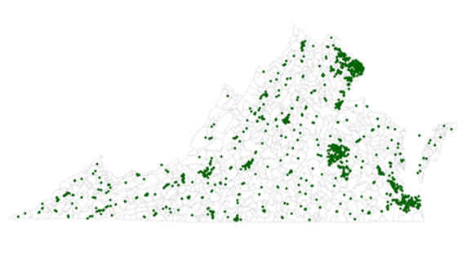
Setting and participants
Patients 18-75 years old with two or more chronic conditions (diabetes, hypertension, hyperlipidemia, cardiovascular disease, obesity, depression) seen in the last year by participating clinicians in Virginia Ambulatory Care Outcomes Research Network (ACORN) practices
Notes:
We recruited clinicians from the Virginia Ambulatory Care Outcomes Research Network (ACORN) primary care practices located in the Greater Richmond region and Northern Virginia areas. Clinicians were matched by age and sex and randomized to usual care (control condition) or care planning with patient navigation (intervention). From the electronic health record (EHR) and patient survey screener, we identified all patients age 18 and older with two or more chronic conditions, with at least one that is uncontrolled, This analysis only included intervention patients, as control patients did not complete a health risk assessment (HRA) and create care plans.

Slide 6





Methods
Patient completes Health Risk Assessment and is presented with identified risk areas
Quantitative analysis using the MOHR site, care plans, and HRA questions completed at baseline, six months, and 12 months
Patient decides what they want to work on and creates personal care goal
Patient receives support from patient navigator and community health worker
Notes:
The intervention includes two components. First, patients were connected with a patient navigator to help patients throughout the process. Navigators were nurses, medical students, patient access representatives, social workers, and community program managers supported by the research team Second, patients completed an enhanced care planning tool called My Own Health Report (MOHR) either on their own or with the help of the patient navigator. MOHR screens patients for unhealthy behaviors (fruit and vegetable intake, fast food, soda consumption, weekly exercise, tobacco use, alcohol use, and illegal drug use), mental health risks (depression, anxiety, loneliness, poor sleep), and social needs (financial needs, employment status, food security, access to transportation, housing stability, dental care, home and neighborhood safety). Once risks were identified patients could select one or two for creating a care plan. Once a risk was selected, MOHR asked them why they selected the topic, if they tried to address it prior and what happened, and what they think will help them most to succeed; MOHR walked them through creating SMART goals with a video guide on setting SMART goals; it presented a list of about a dozen actionable evidence-based strategies they could select to improve the risk; and it reviewed the information with the patient and asked patient’s to rank their confidence with their plan.

Slide 7



Results
Unhealthy behaviors
100% 1 or more
Health behavior care plans
92.5%
Mental health risks
66.8% 1 or more
Mental health care plans
23.2%
Social needs
51.3% 1 or more
Social care plans
12.5%
*Health Behavior vs. Mental Health p <0.001
*Health Behavior vs. Social Need p <0.001
*Mental health vs Social Needs p=0.048
Notes:
The overall analytic sample included 187 patients that created one or more care plan. All patients included in the study had at least one unhealthy behavior, mental health risk, or social need. 100% of patients had one or more unhealthy behavior and 92.5% created a health behavior care plan; 66.8% of patients had one or more mental health risk and 23.2% created a mental health care plan; and 51.3% of patients had at least one social need and 12.5% created a social needs care plan. The difference in the likelihood of creating a health behavior versus mental health care plan if a risk was present was statistically significant (p <0.001). Similarly for creating a health behavior versus social need care plan (p<0.001 ), and a mental health versus social needs care plans (p=0.048).

Slide 8
Results
Unhealthy behaviors
98.9% nutrition
81.7% exercise
64.7% obesity
Unhealthy behavior care plans
92.8% nutrition
36.2% exercise
Mental health risks
44.9% anxiety/depression
43.9% loneliness
39.6% sleep
Mental health care plans
11.9% anxiety/depression
9.8% loneliness
14.9% sleep
Social needs
33.7% financial 23.0%transportation
18.2% food insecurity
Social care plans
7.9% financial
0.5% transportation
0% food insecurity
Notes:
The most common unhealthy behaviors were poor nutrition (98.9% ), insufficient exercise (81.7%), obesity (64.7%), smoking (14.4%), unhealthy alcohol use (44.4%), and drug use (6.4%). Patients most commonly selected nutrition for creating care plans and at least one patient picked a care plan for every risk except drug use

Slide 9
Results: Number of Health Risks and Care Plans
Notes:
Of patients with unhealthy behaviors, 3.2% had one risk, 18.2% had two risks, 49.7% had three risks, 23.1% had four risks, 3.7% had five risks, and 1.1% had six risks. Among patients with mental health risks, 33.2% had zero risks, 22.5% had one risk, 27.3% had two risks, and 17.1% had three risks. For patients with social needs, 48.0% had zero risks, 22.5% had one risk, 10.2% had two risks, 10.2% had >3 risks, 6.4% had four risks, and 2.1% had five risks.

Slide 10
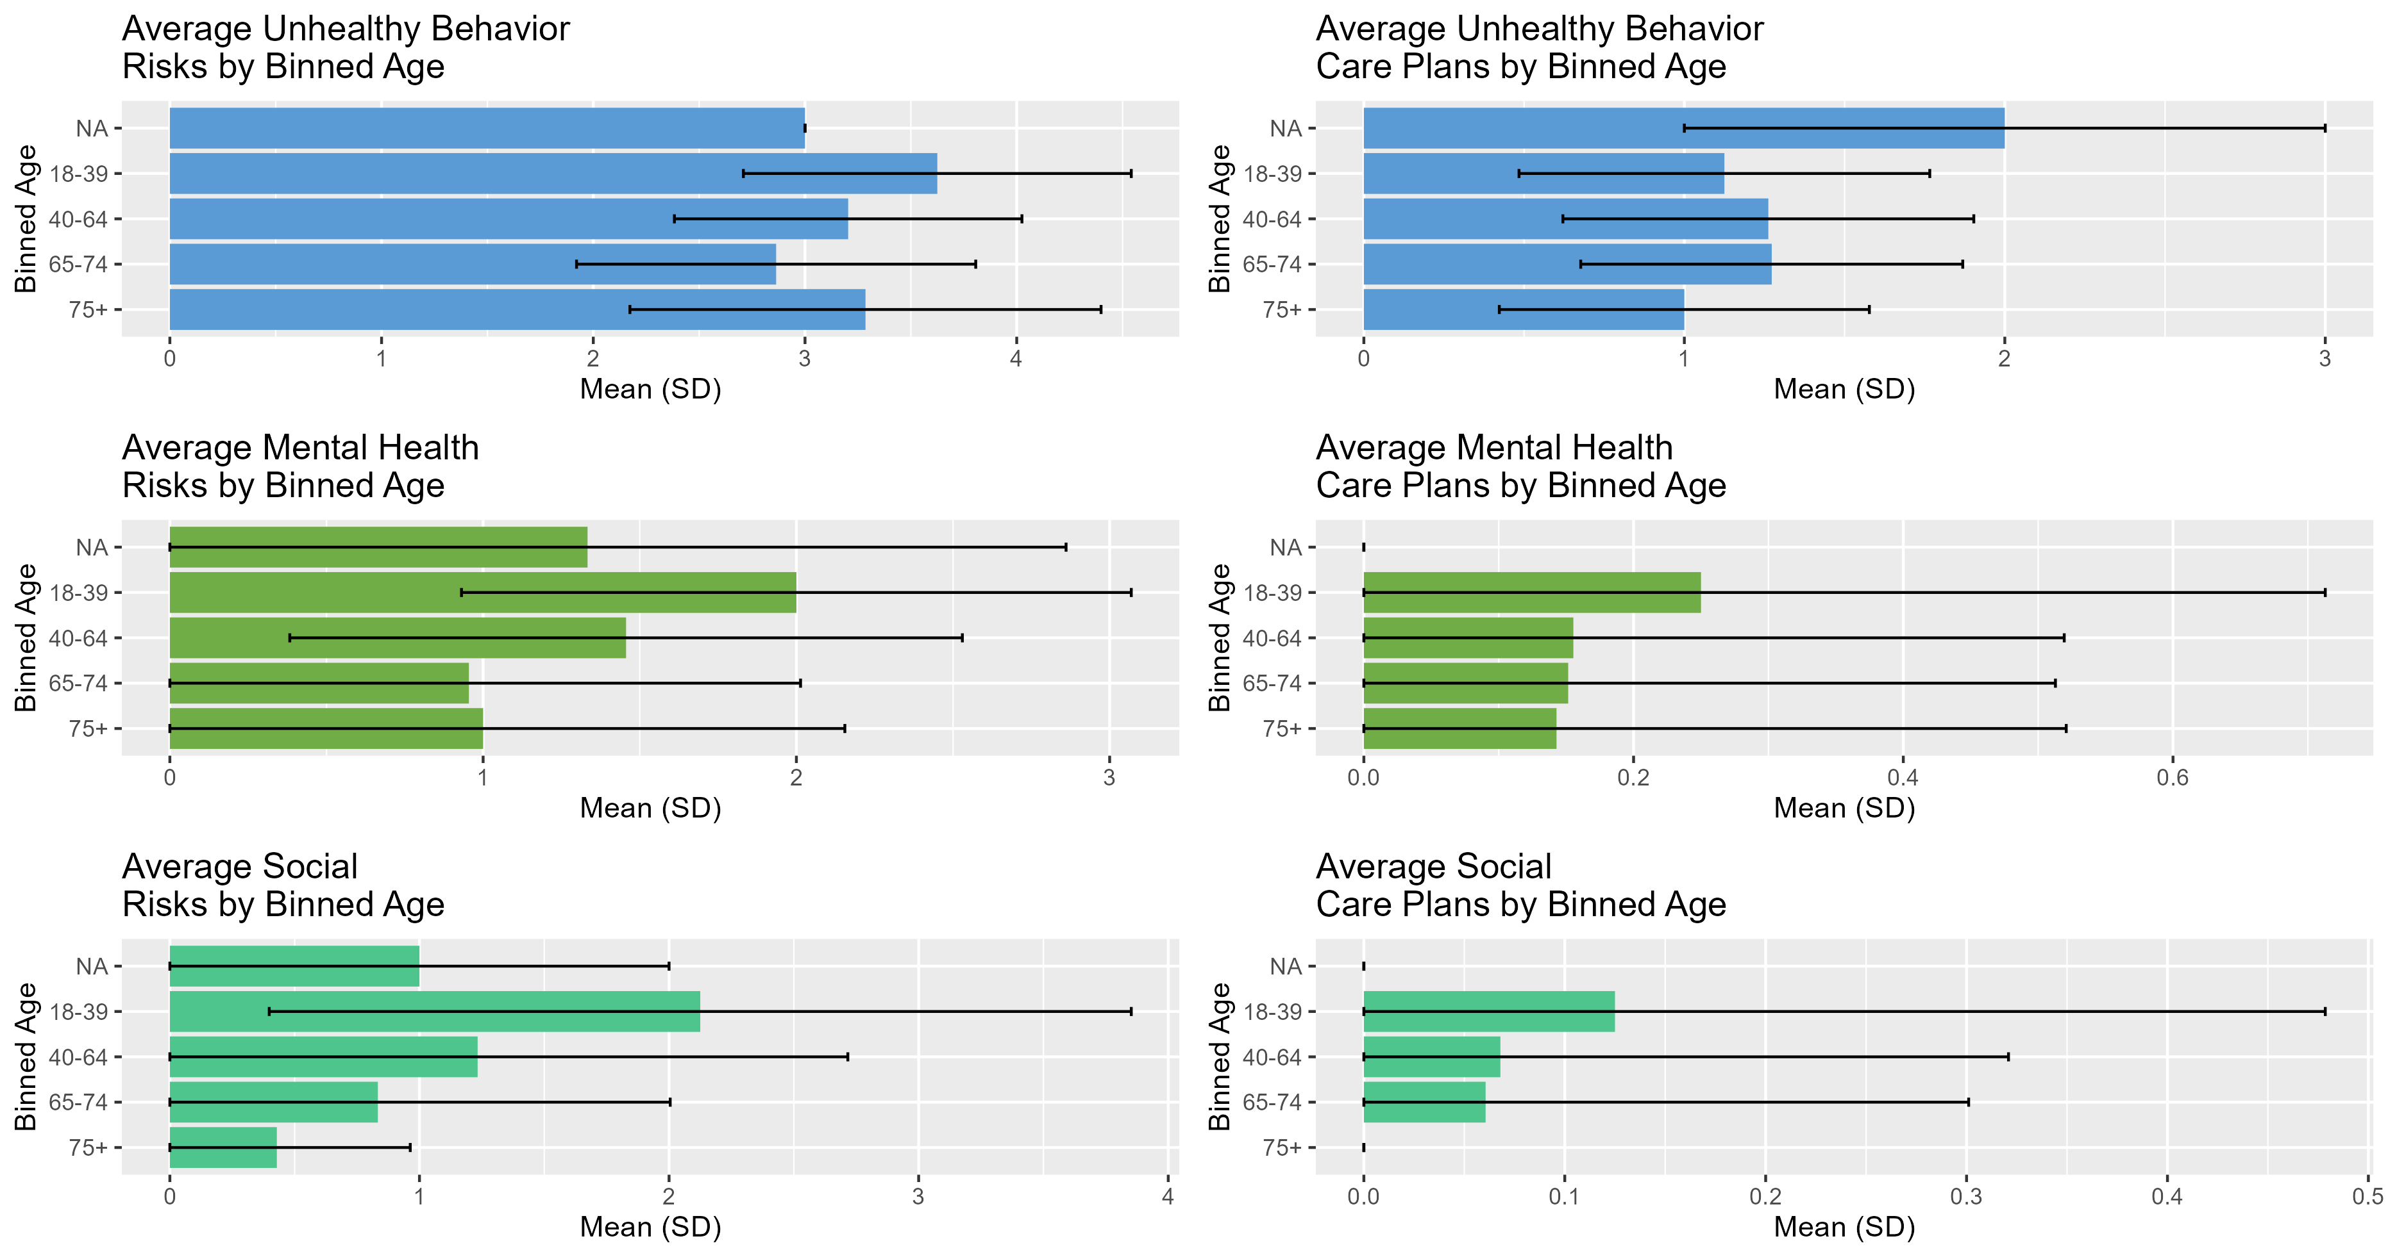
Results: Health Risks and Care Plans by Age
Notes:
While there were differences in the frequency of risks or likelihood of creating care plans by age, gender, race, ethnicity, and education, none were statistically significant. However, we did not have an adequate sample size and prospectively did not intend to have power to detect differences

Slide 11
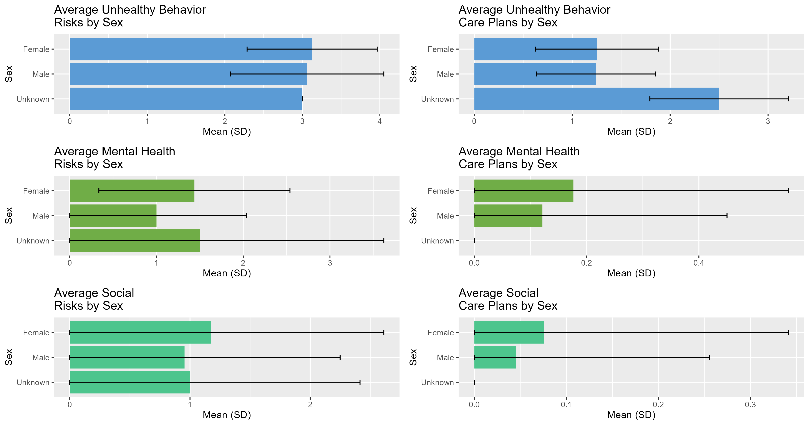
Results: Health Risks and Care Plans by Sex

Slide 12
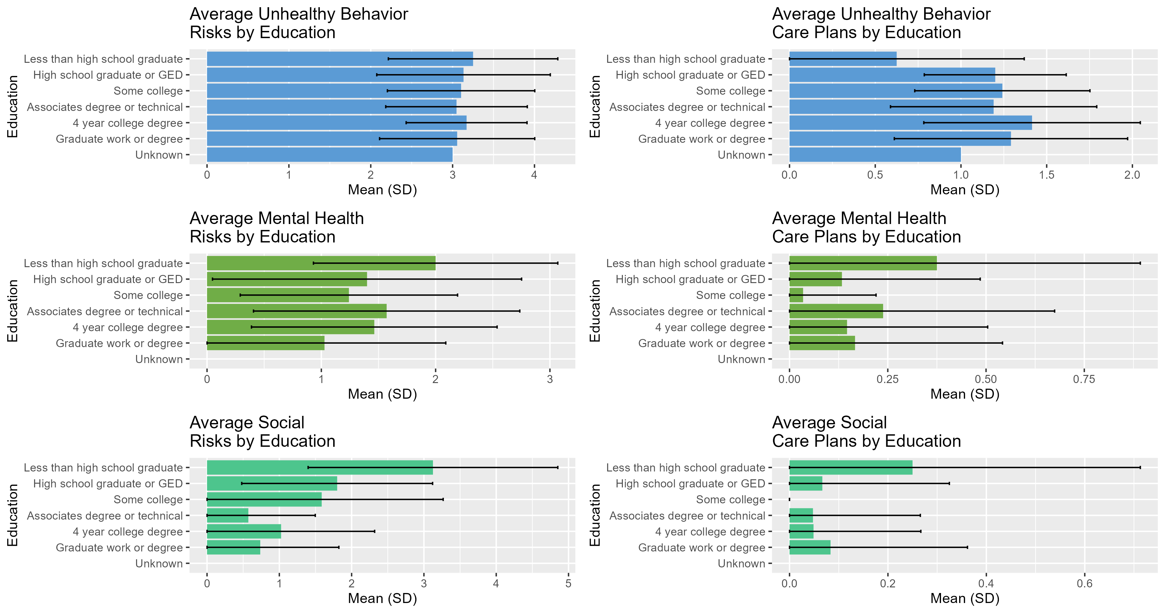
Results: Health Risks and Care Plans by Education

Slide 13
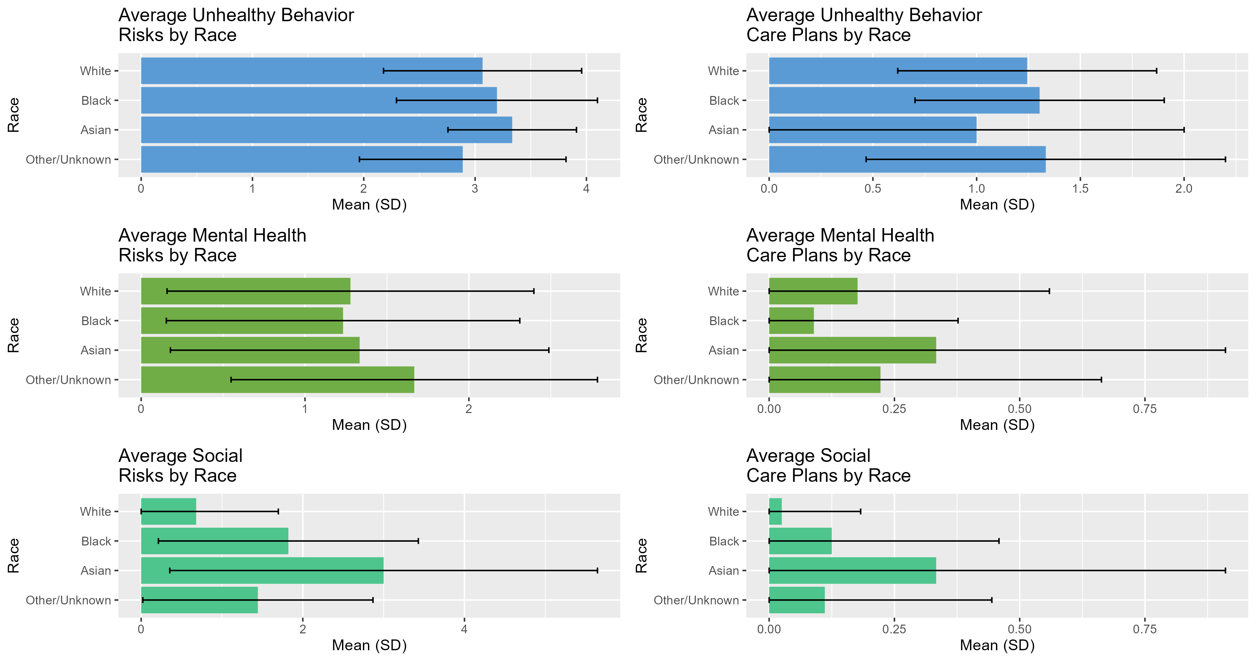
Results: Health Risks and Care Plans by Race

Slide 14
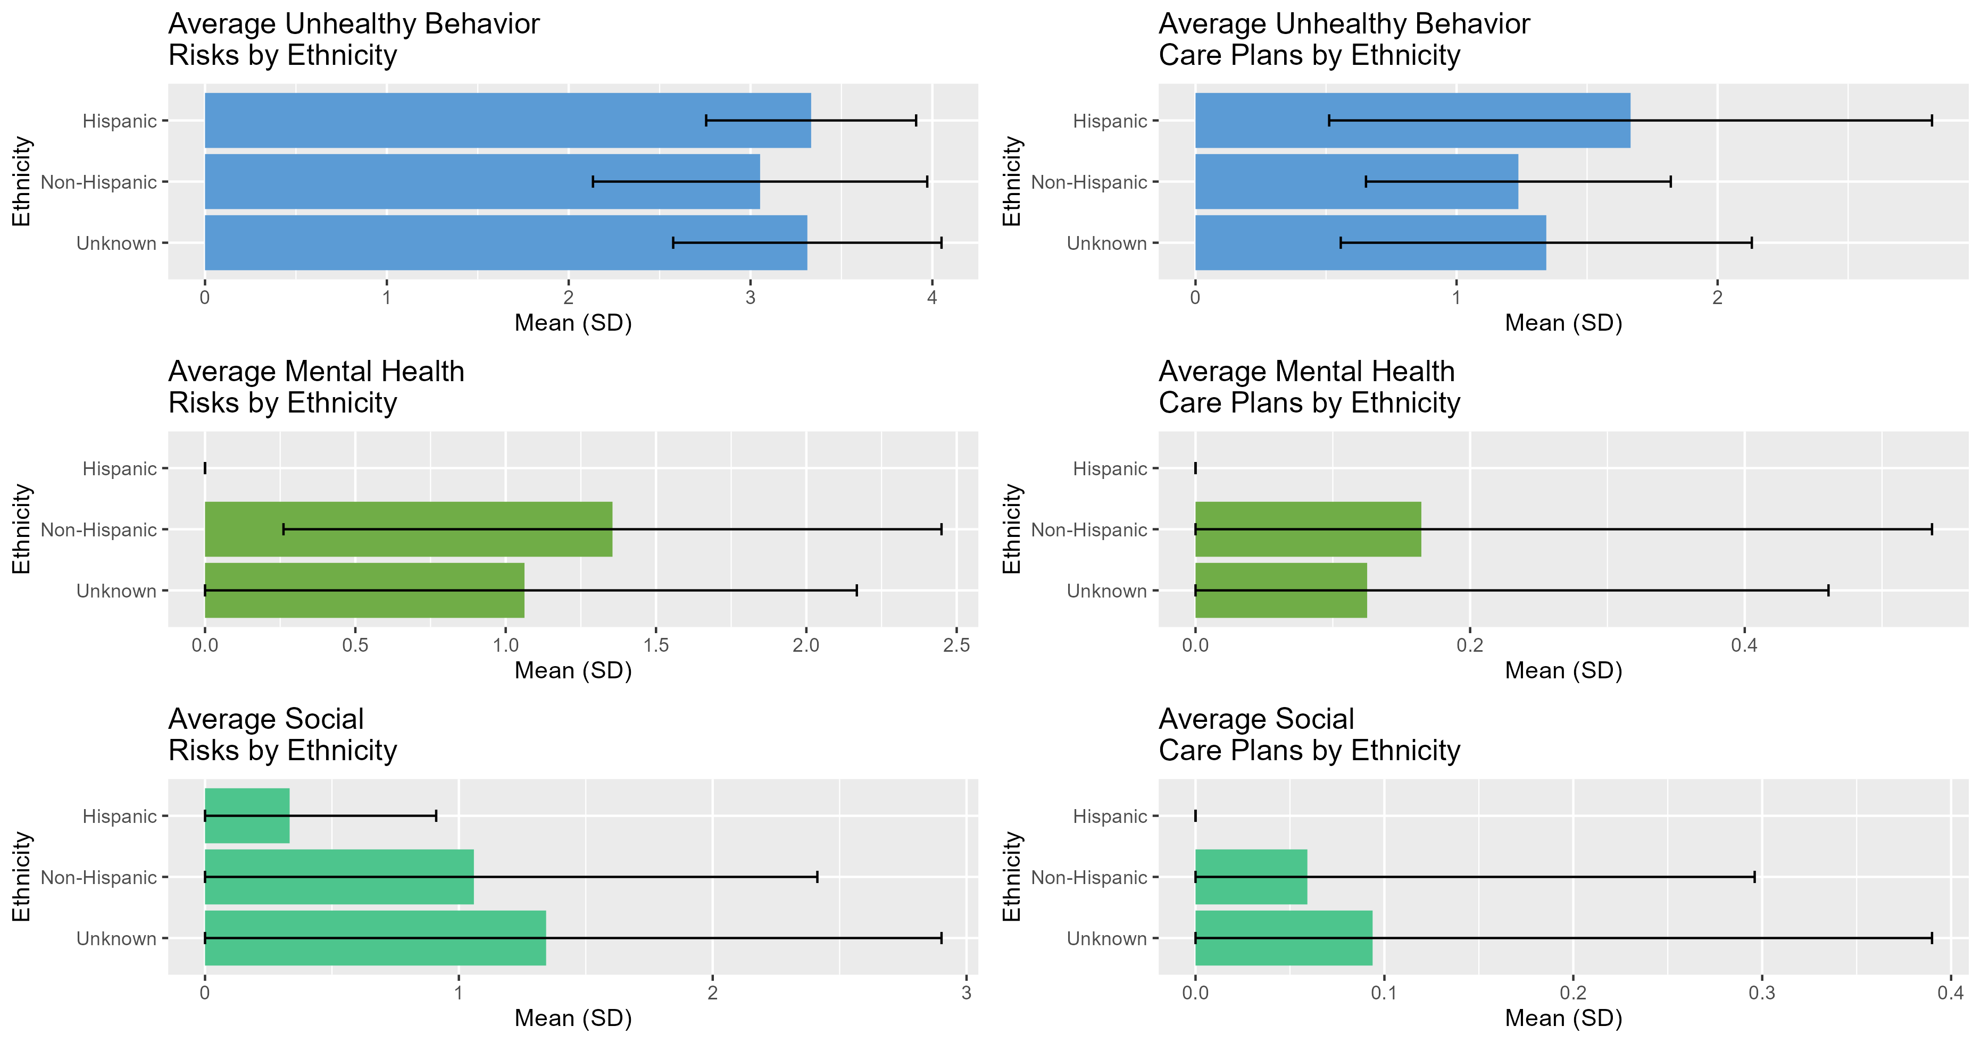
Results: Health Risks and Care Plans by Ethnicity

Slide 15
Conclusions
In primary care, the majority of patients have health risks in relation to unhealthy behaviors, mental health, and social needs.
Patients were more likely to create care plans to improve unhealthy behaviors and less likely to create care plans about mental health and social needs.
We need to understand the modifiable factors associated with patient reluctance in addressing mental health and social needs in primary care.

Slide 16
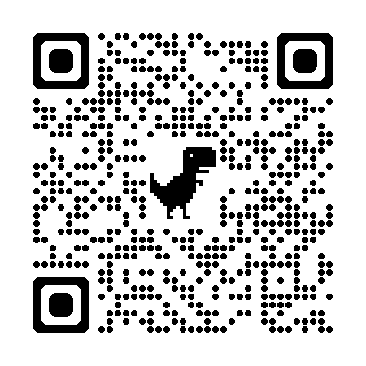
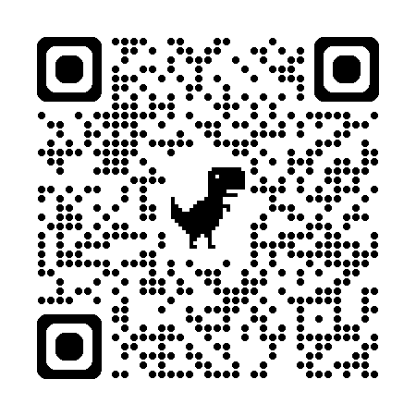
Thank you!
If you have questions and/or would like to talk more, please email me at jennifer.gilbert2@vcuhealth.org
Study website
PBRN website
https://ecpvirginia.squarespace.com/
https://www.acornvirginia.org/

