Slide 1

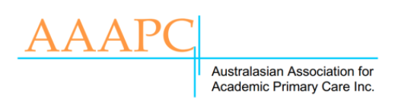

General practitioners' perspectives and experiences when screening for primary aldosteronism
Mr Abhir Nainani, Dr Sanne Peters, Dr Jun Yang, Prof. Grant Russell

Slide 2
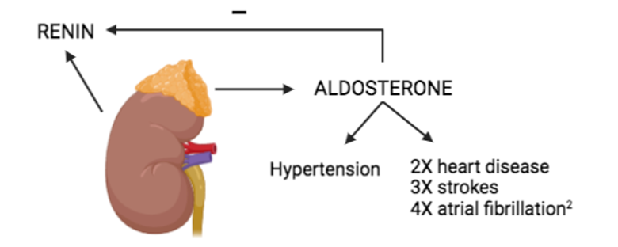
The Research Question
Primary aldosteronism (PA) is the commonest treatable cause of secondary hypertension
  4-16% of primary care patients with hypertension
PA is easy to detect by screening with an aldosterone-renin ratio
  But frequently overlooked
We taught a group of family physicians (FPs) how best to screen for PA
  But still found highly variable screening rates…
So… are there other factors that may impact on screening?
Our research question was:
  What factors influence a FP’s decision to screen for PA?

Slide 3
Research Design and Method
Design: Qualitative study using a phenomenological approach
Participants: Purposeful sample of FPs working in Melbourne, Australia who had received a 30-minute educational session on PA within the last 12 months
  FPs varied by practice location, experience and the number of patients screened for PA
Data collection: Semi-structured interviews
  Face-to-face or online lasting 30-45 minutes
  Participants received a summary of their interview (member checking)
Analysis: Coded inductively using NVivo 12.0
  2 independent coders (investigator triangulation)

Slide 4
What the Research Found
We interviewed16 FPs – their screening decisions were influenced by their knowledge of the screening process, perceptions about the cost & convenience of screening, conceptualization of risk related to PA, and a desire to improve clinical care.
Most were positive to the concept of screening once it was introduced to them
However, many found it challenging to follow guidelines to alter antihypertensives prior to performing the aldosterone-renin ratio
  Hence, they overwhelmingly preferred screening newly diagnosed hypertensive patients
Most were also reluctant to screen patients who fitted a “clinical picture of essential hypertension”
  These were hypertensive patients with metabolic syndrome and/or cardiovascular disease

Slide 5
What this means for Clinical Practice
FPs require:
Clear and concise guidelines on PA screening
  Including information on how to safely replace antihypertensives before screening for PA
FPs should understand that:
Metabolic syndrome and cardiovascular complications are more common in PA than essential hypertension
  PA is generally clinically indistinguishable from essential hypertension
Future research should:
Evaluate simpler methods of PA screening that do not require replacing antihypertensives
Explore system-based strategies to increase screening rates in primary care

