Slide 1
Lower Dementia Risk in Patients Vaccinated Against Herpes Zoster
Jeffrey F. Scherrer, PhD; Joanne Salas, MPH;
Christine Jacobs, MD; Daniel Hoft, MD; John Morley, MBBCh
Funder: Benter Foundation
Affiliation: Saint Louis University School of Medicine.
St. Louis MO. USA

Slide 2
The Research Question
Are patients, 65 years of age and older, less likely to develop dementia if they receive herpes zoster vaccination?

Slide 3
Research Design and Method
Retrospective Cohort Study 2009-2019
Hypotheses tested in Veterans Health Administration medical record data
Analyses replicated in MarketScan medical claims
Confounding controlled using propensity scores and inverse probability of treatment weighting
Variables created from ICD-9 and ICD-10 diagnostic codes, vaccinations, prescriptions, lab results, vital signs, provider type, geographic location in the United States and demographics

Slide 4
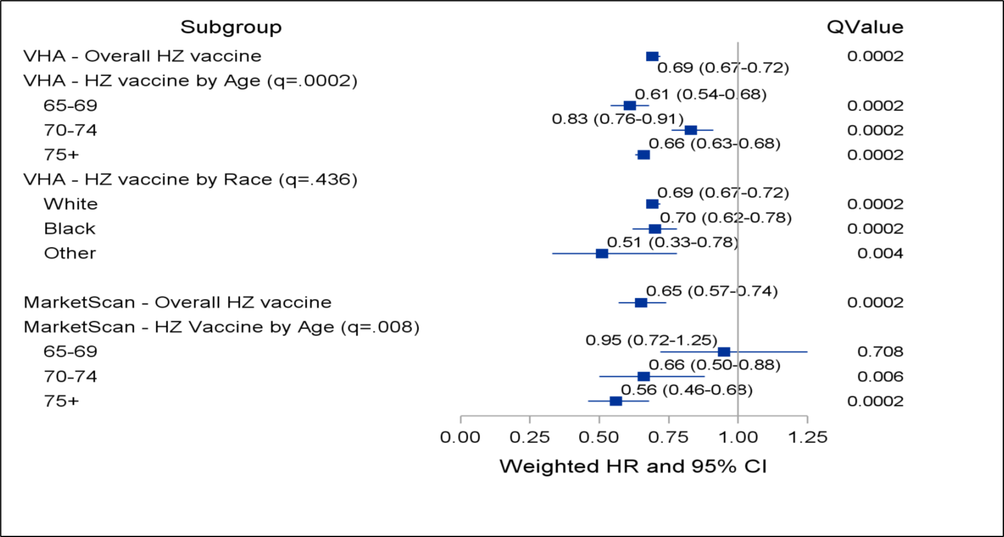
What the Research Found
Survival modeling results estimating association between HZ vaccination and incident dementia

Slide 5
What this means for Clinical Practice
Secondary benefits of vaccination may encourage some patients to obtain appropriate herpes zoster vaccination.
If confirmed as a causal association, vaccination could offer an inexpensive, readily accessible means to reduce risk for, or prevent dementia?

Slide 6
citation
Scherrer JF, Salas J, Wiemken TL, Hoft DF, Jacobs C, Morley JE. Impact of Herpes Zoster Vaccination on Incident Dementia: A Retrospective Study in Two Patient Cohorts. PLoS One. 2021;16(11):e0257405. PMID: 34788293

