Slide 1
Does De-implementation of Low-Value Care Impact the Patient-Clinician Relationship? A Mixed Methods Study
Michelle S. Rockwell, PhD, RD
Kenan C. Michaels, BA
John W. Epling, MD, MSEd
Department of Family & Community Medicine
Virginia Tech Carilion School of Medicine
Roanoke, Virginia

Slide 2
The Research Question
Low-value care is a health service that offers no patient benefit in specific clinical scenarios.
  It is prevalent, costly, and causes harm.
  De-implementation has proven to be very difficult.
One barrier to low-value care de-implementation is clinicians’ fear of negatively impacting the patient-clinician relationship.
Thus, our mixed-methods study aimed to answer:
Does de-implementation of low-value care impact the patient-clinician relationship?

Slide 3
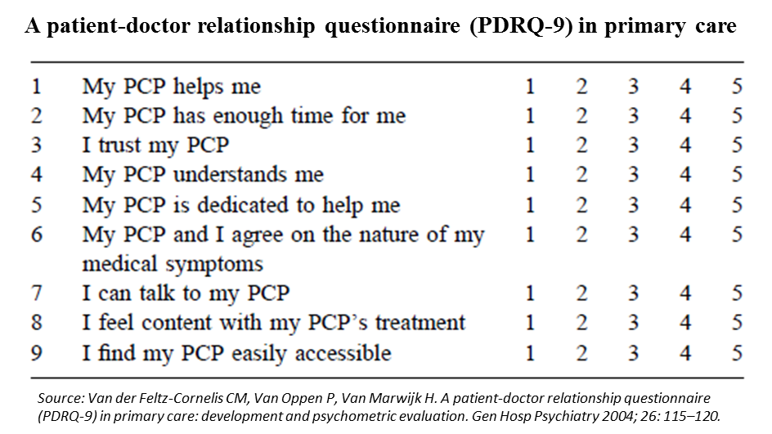
Research Design and Method
Participants
  Primary care patients from a large health system in southwest Virginia
Qualitative (interviews)
  After hearing a vignette about a patient who desired low-value 1)antibiotics for viral URI or 2)EKG screening, participants responded to semi-structured interview questions.
  Transcripts were coded and themed using open-coding and directed content analyses.
Quantitative (survey)
  After reading a vignette about a patient who desired low-value 1)antibiotics for viral URI, 2)EKG screening, 3)vitamin D screening, OR a 4) control vignette, participants responded to the PDRQ-9.
Data integration
  At the interpretation/reporting level

Slide 4
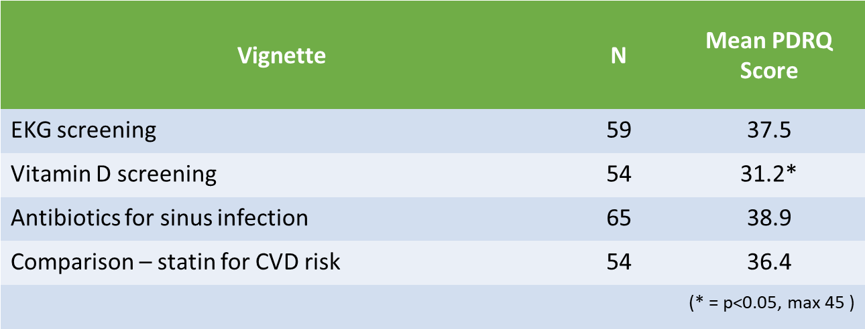
What the Research Found
Impact of de-implementation on the patient-clinician relationship
 | Understand? | Agree? | Impact Relationship?
Low-value antibiotics | 100% yes | 100% yes | 8% yes
Low-value EKG | 100% yes | 42% yes | 8% yes
Interview
Survey
Although there was some variation by service, we observed minimal evidence that the patient-clinician relationship would be negatively impacted by de-implementation.
* Higher PDRQ-9 score = greater relationship integrity

Slide 5
What the Research Found
Several participants expressed that if their clinician withheld low-value care, it would increase their trust in them.
Other themes:
  The majority of participants demonstrated incomplete understanding of the concept of low-value care.
  The low-value care topic consistently elicited memories of poor quality care and other negative experiences with healthcare.
  Participants repeatedly expressed their trust in their primary care clinician and the value they place in that relationship.

Slide 6
What this means for Clinical Practice
In the presence of a trusting, communicative patient-clinician relationship, patients stand ready to play a role in de-implementing low-value care.
But it’s important to keep in mind that the concept is very difficult for many patients to understand and service-specific differences may exist.

Slide 7
Rockwell, M.S., Michaels, K.C. & Epling, J.W. Does de-implementation of low-value care impact the patient-clinician relationship? A mixed methods study. BMC Health Serv Res 22, 37 (2022). https://doi.org/10.1186/s12913-021-07345-9

