Slide 1
Electronically-delivered push notifications improve patient adherence to preventive care: a cohort study
Lenard Lesser, MD, MSHS
Esha Datta, PhD
One Medical

Slide 2
The Research Question
Will push notifications via a mobile application increase adherence to preventive services?

Slide 3
Research Design and Method
Using EHR data, we developed lists of patients who were due for annual preventive examinations, cervical cancer screening, and diabetes follow-up labs
We used the One Medical mobile application (iOS and Android) to send push notifications to patients
We compared the rate of appointment bookings/labs in the intervention group to a matched control group that did not receive the push notifications
The outcome was booking an appointment for an annual preventive exam, a cervical cancer screening, or diabetes labs (A1c and Urine protein)

Slide 4
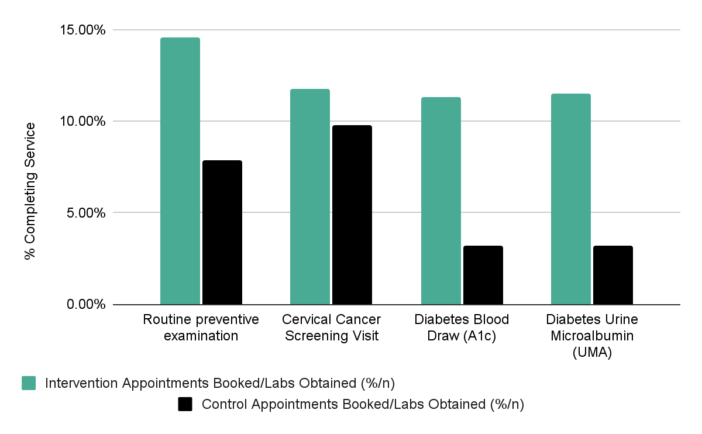
What the Research Found
Those who received the push notifications had a statistically higher rate of preventive visits and labs, than those who did not.

Slide 5
What this means for Clinical Practice
Medical organizations can use informatics to define eligible populations for care reminders
Care reminders, delivered via push notifications on mobile devices, with direct booking links, can improve engagement in care

