Slide 1
Rapid Detection of Influenza Outbreaks in Long Term Care Facilities Reduces Emergency Room Visits and Hospitalization
Jonathan Temte MD, PhD, MS¹; Mary Checovich MS, CCRC¹;
Marlon Mundt PhD¹; Shari Barlow BA¹;
Irene Hamrick MD, FAAFP, AGSF, CMD^{1α} ; Erik Reisdorf MPH^{2β}
¹Department of Family Medicine and Community Health, University of Wisconsin, Madison, WI ;
²Wisconsin State Laboratory of Hygiene, Madison, WI;
^{α}Current appointment - University of Cincinnati College of Medicine, Cincinnati, OH
^{β}Current appointment - ICF International, Infectious Disease Detection and Surveillance (IDDS) Rockville, MD;

Slide 2
The Research Question
Is there a role for rapid diagnostics to detect
influenza in long-term care facilities?
  Population: For individuals living in long-term care facilities
  Intervention: does the use of a broadened surveillance definition of an influenza-like illness (ILI) coupled with the use of rapid influenza diagnostic tests (RIDT) in which anonymous results are transmitted wirelessly to public health and result in infection control guidance for LTCF residents
  Comparator: compared to usual care
  Outcome: result in increased early antiviral treatment of influenza, increased use of antiviral prophylaxis for other at-risk residents, and fewer hospitalizations, reduced mortality, and lower healthcare-associated costs during the influenza season.

Slide 3
Research Design and Method
Study Design and Analysis: Non-blinded, pragmatic, randomized controlled trial - https://clinicaltrials.gov/ct2/show/NCT02964871
Setting: Wisconsin long-term care facilities (LTCFs).
Population Studied: Residents of 20 LTCFs matched by bed capacity and geographic location.
Intervention: (1) modified case identification criteria and (2) nursing staff-initiated collection of nasal swab specimens for on-site RIDT (rapid influenza diagnostic test).
Outcome Measures: Primary outcome measures, expressed as events per 1000 resident-weeks, included antiviral treatment courses, antiviral prophylaxis courses, total emergency department (ED) visits, ED visits for respiratory illness, total hospitalization, hospitalization for respiratory illness, hospital length of stay, total deaths, and deaths due to respiratory illness over three influenza seasons.

Slide 4
What the Research Found
Oseltamivir use for prophylaxis was higher at intervention LTCFs
Rates of oseltamivir use for treatment were not different
Rates of total ED visits total hospitalizations hospital length of stay were lower at intervention as compared to control LTCFs
No significant differences were noted for respiratory-related ED visits or hospitalizations or in rates for all-cause or respiratory-associated mortality
Outcome | Events per 1000 person-weeks |  | Rate Ratio | 95% CI | P-value
 | Intervention | Control
AV-T: Antiviral Treatment Courses | 3.0 | 3.8 | 0.78 | 0.59-1.03 | 0.077
AV-P: Antiviral Prophylaxis Courses | 2.6 | 1.9 | 1.38 | 1.24-1.54 | <0.001
ED-T: Emergency department visits for any reason | 7.6 | 9.8 | 0.78 | 0.64-0.92 | 0.004
ED-R: Emergency department visits for respiratory illness | 2.1 | 2.0 | 1.02 | 0.72-1.45 | 0.903
H-T: Hospitalization for any cause | 8.6 | 11.0 | 0.79 | 0.67-0.93 | 0.004
H-R: Hospitalization for respiratory illness | 2.6 | 3.0 | 0.89 | 0.66-1.20 | 0.426
H-LOS: Hospital length of stay (days) | 35.6 | 55.5 | 0.64 | 0.59-0.69 | <0.001
D-T: Deaths due to any cause | 7.9 | 8.2 | 0.96 | 0.80-1.15 | 0.645
D-R: Deaths due to respiratory illness | 0.8 | 1.0 | 0.81 | 0.47-1.39 | 0.451

Slide 5
What this means for Clinical Practice
Low-threshold criteria—such as the presence of new, acute respiratory infection symptoms—for initiating specimen collection coupled with nursing staff-initiated, on-site RIDT results in higher use of antiviral prophylaxis for influenza, lower numbers of ED visits and hospitalizations, and shorter hospital lengths of stay.
Using low threshold ARI criteria and on-site testing is likely to facilitate early influenza outbreak detection and response.
This feasible, and low-cost intervention may provide significant benefits and should be further tested in other settings.

Slide 6

Background Information is available at:
  Checovich M, Barlow S, Shult P, Reisdorf E, Temte JL. Evaluation of viruses associated with acute respiratory infections in long-term care facilities using a novel method: Wisconsin 2016-2019. JAMDA 2019 https://doi.org/10.1016/j.jamda.2019.09.003

Slide 7
Factors predicting poor weight gain in newborns to guide weight monitoring: retrospective unmatched case-control study
Bryce Ringwald, MD and Emily Gorman, DO
OhioHealth Riverside Methodist Hospital Family Medicine Residency Program

Slide 8
The Research Question
Our study aimed to:
1) Identify characteristics (neonatal, maternal, social, or nutrition) related to not regaining birth weight by DOL 14
2) Determine criteria to guide recommendations for weight monitoring.
Hypothesis: We hypothesize that newborns with significant weight loss on initial weight check, prolonged fasting times, nulliparous birthing persons, documented feeding difficulties, and those negatively affected by social determinants of health are at increased risk of not regaining birth weight by DOL 14.

Slide 9
Research Design and Method
Exploratory retrospective unmatched case-control study
  Inclusion:
    Initial patient visit date range (07/01/201921 through 06/30/2022)
    Patient cared for by the Riverside Family Practice Center residency team in the well-baby nursery and established care at Riverside Family Practice Center
    ICD-10 codes: Z00.110 or Z00.111
    Completion of recommended follow-up
  Exclusion:
    Initial visit outside of the date range
    Initial visit performed after DOL 14
    Family members of practice staff or physicians
    Gestational age <35 weeks at birth
    Infants requiring care in the NICU

Slide 10
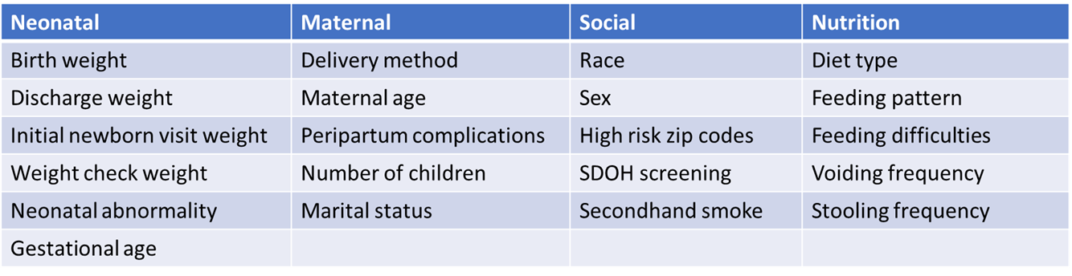
Research Design and Method
Characteristics Assessed

Slide 11
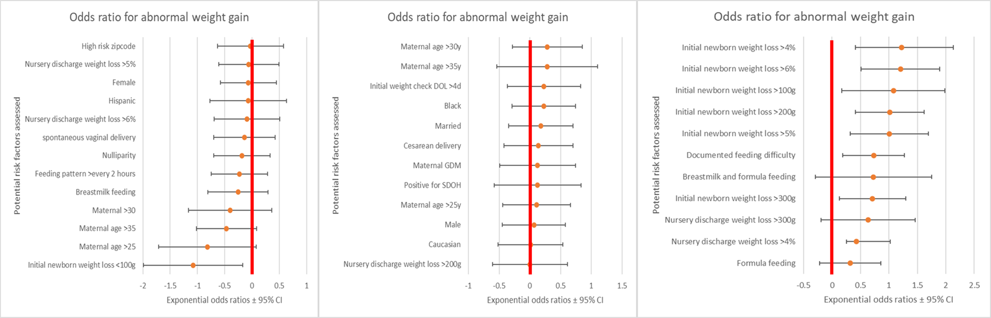
What the Research Found

Slide 12
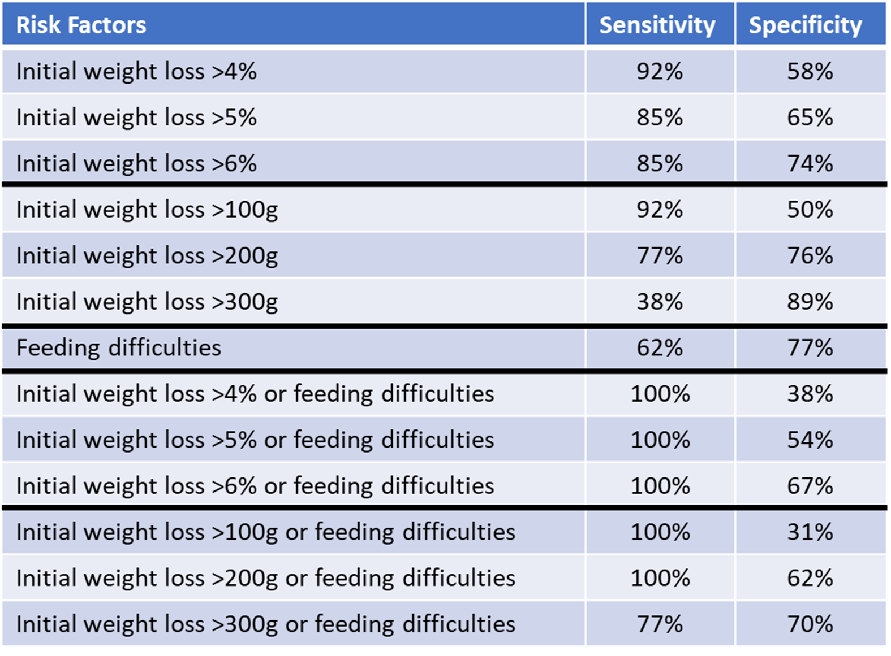
What the Research Found

Slide 13
What this means for Clinical Practice
Significant weight changes at initial newborn exam and documented feeding difficulties can predict newborns at risk of not regaining birth weight at DOL 14.
Utilization of these characteristics can decrease needed appointments on providers schedules, decrease travel time and costs for families.

Slide 14
The Economic Impact of a Hospital at Home in a COVID19 Pandemic
Thad Wilkins, MD, MBA¹ ; David Walsh, MD²; Christy Ledford, PhD¹; Stephen Looney, PhD³; Stephen Shiver, MD⁴; Matthew Lyon, MD⁴; Megan Furno, MPH⁵
1 - Department of Medicine, Division of Hospital Medicine, Medical College of Georgia at Augusta University
2 - Department of Family Medicine, Medical College of Georgia at Augusta University
3 - Department of Biostatistics and Data Science, Medical College of Georgia at Augusta University
4 - Department of Emergency Medicine, Medical College of Georgia at Augusta University
5 - Operational Excellence, Augusta University Medical Center
This research was funded by a grant from the Curtis G. Hames Research Grants Program (MCGFD01044)

Slide 15
The Research Question
What is the economic impact of a Hospital at Home (HAH) program in COVID19 patients?

Slide 16
Research Design and Method
Objective: To evaluate the economic impact of HAH versus usual hospital care for patients requiring admission for COVID19
Study Design: Matched case-control retrospective study (100 HAH and 100 control)
Setting: Academic medical center
Population studied: Patients admitted with COVID19 and, subsequently enrolled into the HAH program. Patients age <18 were excluded from consideration for enrollment. A Case-control sample was matched on age, gender, and severity of illness. 200 patients were included
Outcome Measures: Inpatient length of stay (iLOS), rate of 30-day readmissions, fixed, variable, and total costs

Slide 17
What the Research Found
This retrospective analysis included 200 patients (mean age 50.4, SD 14.2)
Most patients (55%) were female, 48.5% were African American, 43.5% were white, and 8% were other races
There was no significant difference in 30-day readmissions (11% vs. 14%, p = 0.670).
For HAH patients, the total LOS = iLOS (5.7 days) + Home LOS (7.2 days) = 12.9 days
 | HAH Cohort | Control Cohort | p-value
Inpatient LOS (days) | 5.7 | 9.4 | 0.055
Total LOS (days) | 12.9 | 9.4 | 0.015

Slide 18
What the Research Found
 | HAH Cohort | Control Cohort | p-value
Inpatient fixed costs | $675,668 | $1,439,719 | 0.019
Inpatient variable costs | $593,277 | $1,495,887 | 0.011
Inpatient total costs | $1,268,944 | $2,935,601 | 0.013
The HAH group had an additional at home cost of $536,250 (715 days at $750 per day) representing a lower total cost of care ($1,805,194 vs $2,935,601)

Slide 19
What this means for Clinical Practice
Our findings support a favorable economic impact of implementing a HAH program ($1.1 million)
There are many advantages of a HAH program during a pandemic including decreasing nosocomial spread and reducing the strain on inpatient capacity
A major potential advantage of HAH programs is reducing healthcare spending by reducing the cost of care, but the true effect depends on how the program is implemented and other factors, e.g., rates of readmissions

Slide 20
What this means for Clinical Practice
Our results do not reflect the total economic impact because we did not include the impact of back filling beds vacated 3.7 days sooner in the HAH group compared to usual care
Future studies should prospectively study the fixed and variable costs of a fully developed HAH program

Slide 21
Self-sampling tools for cancer screening in primary care:
Evidence from a randomized trial with underserved patients
Jennifer Moss, PhD*; Paul Reiter, PhD; Lisa Klesges, PhD;
Tracy Onega, PhD; Mack Ruffin, MD, MPH
*Penn State College of Medicine
Funding: K22 CA225705; PI: Moss

Slide 22
The Research Question
What is the impact of an intervention delivering self-sampling cancer screening tools among underserved, unscreened patients in primary care?
  Cancer screenings:
    Cervical cancer (Self-sampled HPV DNA test)
    Colorectal cancer (Self-sampled FIT)
  Outcomes:
    Preliminary effectiveness
    Acceptability

Slide 23
Research Design and Method
Setting: 9 federally-qualified health centers (FQHCs)
Participants: patients eligible but out-of-date for both CRC and cervical cancer screening
  Female with intact cervix, ages 50-65
  Average risk for CRC, cervical cancer
  Living in rural, racially-segregated Pennsylvania county

Slide 24
What the Research Found
OR = 31.3
(95% CI=5.2-289.3)
OR = 72.0
(95% CI=9.2-1141.4)

Slide 25
What this means for Clinical Practice
Self-sampling tools are effective and acceptable for increasing screening for CRC and cervical cancer among unscreened, underserved patients in the primary care setting
Abnormal screening results were common, suggesting need for linkages to follow-up services and care
Long-term, self-sampling tools could increase screening and reduce cancer disparities in the US

Slide 26
Optional: Add citation if work is published
Moss JL, Entenman J, Stoltzfus K, Liao J, Onega T, Reiter PL, Klesges LM, Garrow G, Ruffin MT. (in preparation). Self-sampling tools to increase cancer screening behaviors among underserved patients: Results from a pilot randomized controlled trial.

Slide 27




SaFETy score as a predictor of gun violence in adolescent / young adult patients in a primary care setting
Sanjay Batish¹, MD; Anna Gilbert²; Cory Lutgen³; Elisabeth Callen³, PhD
¹Batish Family Medicine; ²MedServe; ³AAFP National Research Network
This research was made possible through an award from the American Academy of Family Physicians Foundation and the support of the American Academy of Family Physicians National Research Network

Slide 28
The Research Question
Primary Research Question
Is the SaFETy questionnaire a valid predictor of gun violence in a non-urban primary care setting?
Secondary Research Questions
Can adolescents be screened for gun violence exposure in a non-urban primary care setting?
Can PCP’s have an active role in reducing the gun violence epidemic?

Slide 29






Research Design and Method I
Figure 1: Location of Participating Clinics
Roanoke Chowan Community Health Center
Study Design: 6-month longitudinal, quantitative, survey-based study
Setting: four non-urban primary care clinics Participants: adolescent patients ages 14-24 Variables: SaFETy score and other assessments/survey questions and demographics, gun violence exposure Analysis: Mann-Whitney U, Wilcoxon Signed Rank
Limitations : small sample size, limited time frame (6-months vs. 24-months)
Piedmont Adult & Pediatric Medicine Associates
Cabarrus Rowan Community Health Centers
Batish Family Medicine

Slide 30

Research Design and Method II
Figure 2: SaFETy Score
Single Survey, issued at baseline and follow-up (6-months)
Measures:
SaFETy Score (4-item predictor of gun violence exposure)
ACEs: Adverse Childhood Experiences (physical and emotional abuse, neglect, and household dysfunction experienced in childhood)
6-month Violence Exposure
Lifetime Community Exposures
Parental Support
Conflict resolution beliefs (retaliatory attitudes)
Peer influence
Firearm Behavior
Resilience
Demographics
SaFETy Acronym | Question | Scale | Contribution
 |  | 0 (never) | 0
 | In the past 6 months, including | 1 (once) | 1
Serious Fighting | today, how often did you get | 2 (twice) | 1
 | into a serious physical fight? | 3 (3-5 times) | 1
 |  | 4+ (6 or more times) | 4
Friend Weapon Carrying | How many of your friends have carried a knife, razor, or gun? | 1 (none) 2 (some) 3+ (many, most, or all) | 0 0 1
Community Environment | In the past 6 months, how often have you heard guns being shot? | 0 (never) 1 (one or twice) 2 (a few times) 3 (many times) | 0 0 0 1
 | How often, in the past 6 | 0 (never) | 0
Firearm Threats | months, including today, has | 1 (once) | 3
 | someone pulled a gun on you? | 2 (twice or more) | 4

Slide 31
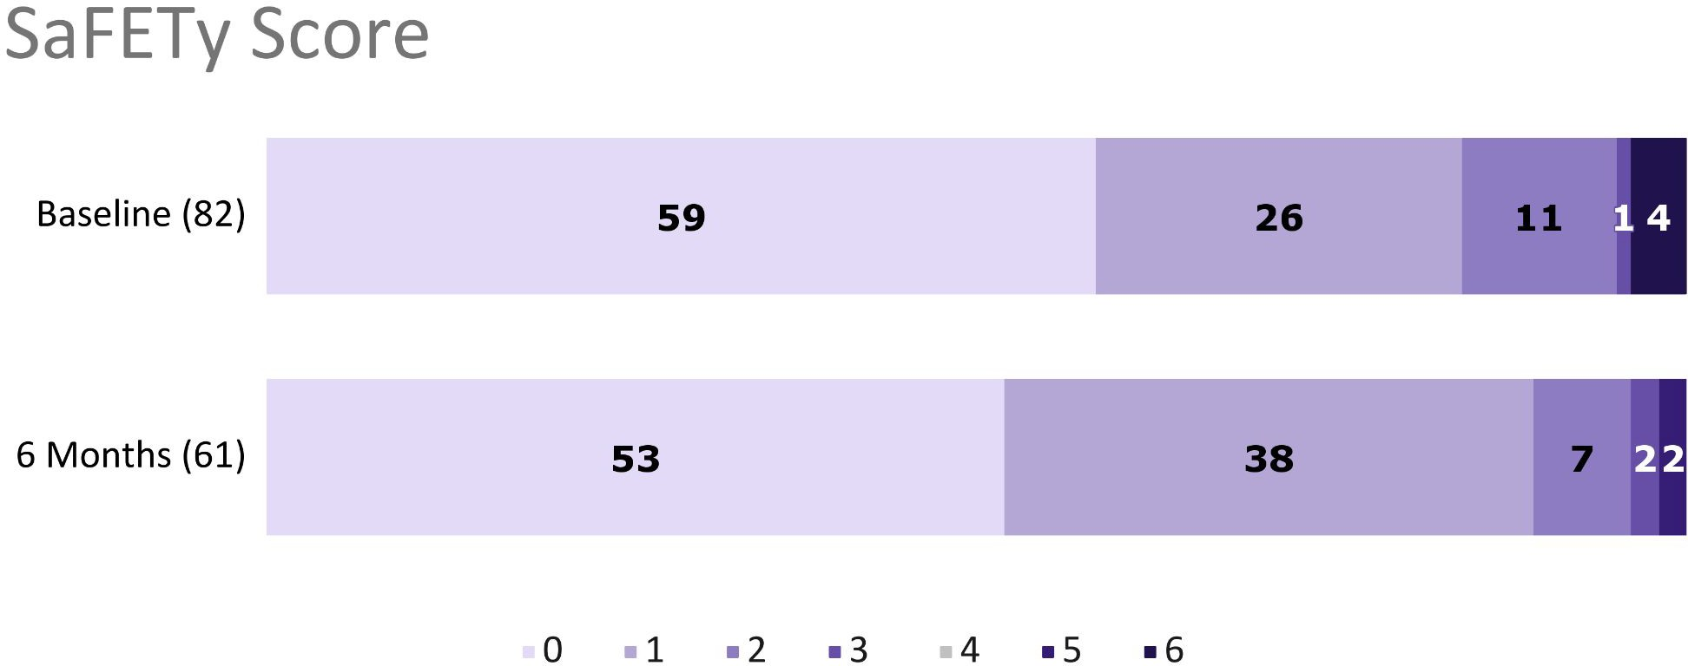
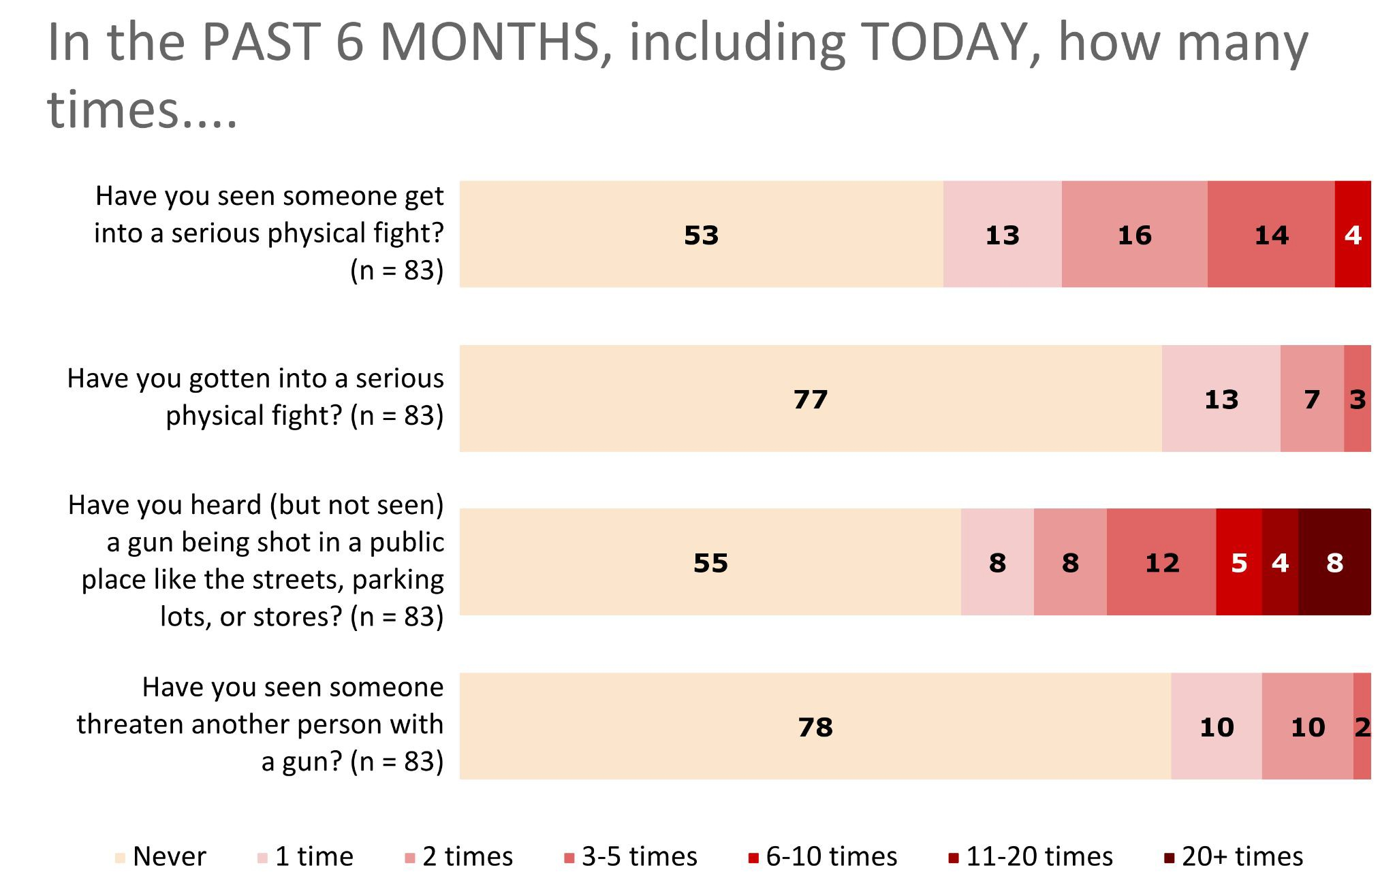
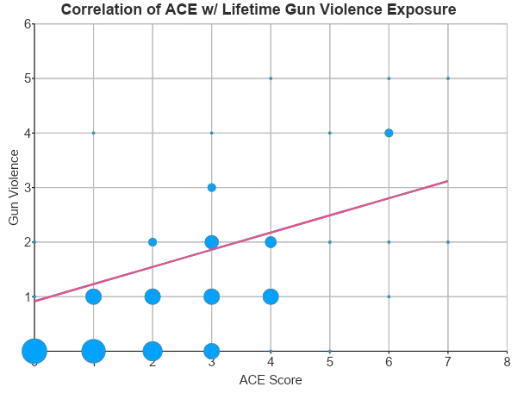
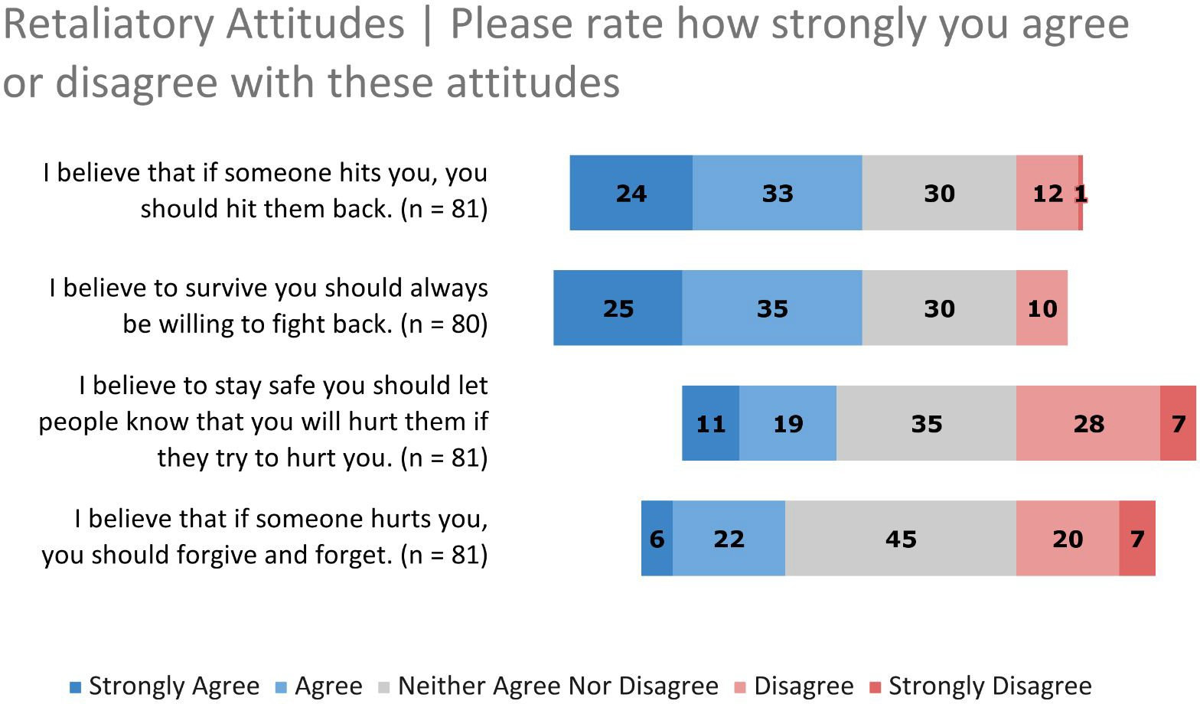
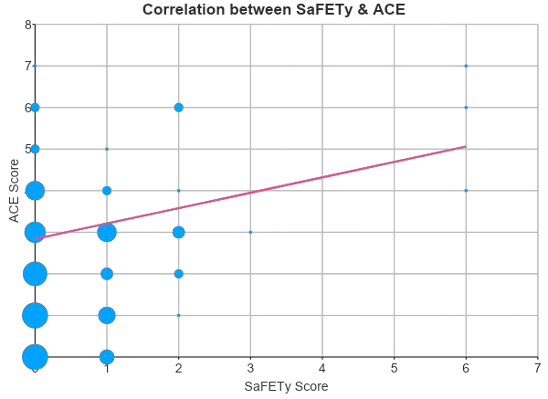
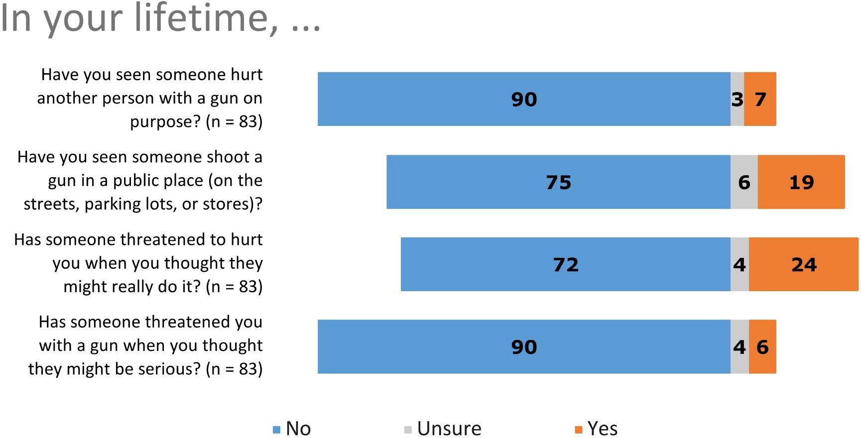
What the Research Found
Rates of violence exposure were similar in our population and the original SaFETy study which was conducted in an urban ED setting
Positive correlation between ACEs, the SaFETy Score, and Lifetime Gun Violence Exposure
No significant change in an individual’s level of gun exposure over 6 months
The belief in retaliating vs forgiving a perceived transgression ratio is 2:1 in our study population

Slide 32

What this means for Clinical Practice
Family Physicians have a role to play in the gun violence epidemic
This pilot study shows that screening adolescents for gun violence exposures or other related determinants is possible in a primary care setting
Further research with a larger sample size and longer study duration is needed to validate the SaFETy score in this population and setting

Slide 33
Management of pigmented lesions in primary care: effects of electrical impedance spectroscopy use
Shayan Owji, BS¹, Joseph Han, BS¹, Margaret Glausser, MD², Daniel Napolitano, MD, AAHIVS³, Jonathan Ungar, MD¹
¹Department of Dermatology, Icahn School of Medicine at Mount Sinai
²The Institute for Family Health
³Community Healthcare Network

Slide 34
The Research Question
What effect does electrical impedance spectroscopy (EIS) use have on primary care providers’ management decisions for pigmented skin lesions?

Slide 35
Research Design and Method
Online survey elicited biopsy/referral decisions for 12 melanocytic lesions (incl. melanomas, severely dysplastic nevi, mild-moderate dysplastic nevi) from primary care physicians and nurse practitioners
Lesions first presented as clinical image (with biopsy/referral selection) and again as clinical image + EIS score (with biopsy/referral selection)
Sensitivity/specificity of biopsy/referral decisions for melanoma & severely dysplastic nevi were compared for visual examination alone vs. concurrent visual + EIS evaluation

Slide 36
What the Research Found
1354 clinical decisions made in total by 61 participants (44 physicians, 17 NPs)
  Overall sensitivity: Visual inspection + EIS > visual inspection (90% vs. 69%; P < 0.001)
  Overall specificity: Visual inspection + EIS > visual evaluation (73% vs. 44%; P < 0.001)
Demographic | Visual Inspection |  |  |  |  |  | Visual Inspection and EIS |  |  |  |  |  | P-value, Sens | P-value, Spec
 | TP (n) | FN (n) | Sens (%) | TN (n) | FP (n) | Spec (%) | TP (n) | FN (n) | Sens (%) | TN (n) | FP (n) | Spec (%) | P-value, Sens | P-value, Spec
Occupation
Physicians | 147 | 50 | 74.6 | 131 | 151 | 46.5 | 181 | 16 | 91.9 | 209 | 73 | 74.1 | <.001 | <.001
Nurse practitioners | 46 | 36 | 56.1 | 44 | 72 | 37.9 | 70 | 12 | 85.4 | 80 | 36 | 69.0 | <.001 | <.001
Years in practice
0-5 | 64 | 33 | 66.0 | 63 | 77 | 45.0 | 89 | 8 | 91.8 | 102 | 38 | 72.9 | <.001 | <.001
6-14 | 82 | 40 | 67.2 | 74 | 100 | 42.5 | 106 | 16 | 86.9 | 123 | 51 | 70.7 | <.001 | <.001
15+ | 48 | 12 | 80.0 | 38 | 46 | 45.2 | 56 | 4 | 93.3 | 64 | 20 | 76.2 | .011 | <.001
Overall | 193 | 86 | 69.2 | 175 | 223 | 44.0 | 251 | 28 | 90.0 | 289 | 109 | 72.6 | <.001 | <.001

Slide 37
What this means for Clinical Practice
Overall, this study suggests that diagnostic accuracy for pigmented skin lesions by primary care providers may be improved with adjunctive use of EIS with visual inspection
This would ultimately improve patient care and reduce the morbidity and mortality of a melanoma diagnosis

Slide 38
Retrospective Evaluation of a Pragmatic Deprescribing Initiative in a
Skilled Nursing Facility System
Christopher P. Morley, PhD, Laura Schad, MPH; Martha Wojtowycz, PhD; Halle Cerio, MPH;
John Noviasky, PharmD, BCPS; Kelly Ulen, PharmD, BCGP, FASCP;
Sarah McNamara, MS; Nancy Smith, MA; Kimberly Townsend, CPA, EdD, JD, MBA, MPA; Sharon Brangman, MD
Funding for this project was provided by the New York State Health Foundation to the Research Foundation of SUNY, o.b.o. Upstate Medical University, Syracuse, NY. (S. Brangman, PI; C Morley, Co-PI).
Affiliations: Morley, Schad, Wojtowycz, and Cerio did this work through the Department of Public Health & Preventive Medicine, Norton College of Medicine, Upstate Medical University. Brangman and McNamara are affiliated with the Department of Geriatrics, Upstate Medical University, where Smith is a consultant. Noviasky and Ulen are Pharmacists at Upstate University Hospital. Townsend is affiliated with Lorretto.

Slide 39
The Research Question
Polypharmacy, referring to multiple medications or the use of more drugs than are medically necessary, increases risk of adverse drug effects.
Polypharmacy is a particular issue in older populations who have accumulated years of prescriptions from multiple clinical interactions and relationships.
Entry into a Skilled Nursing Facility (SNF) presents an opportunity to intervene.
Deprescribing refers to “the planned and supervised process of dose reduction or stopping of medication that might be causing harm, or no longer be of benefit.” (from Deprescribing.org)
Our Objective: to retrospectively determine whether a pragmatic deprescribing protocol reduced 8 common classes of medications in two skilled nursing facilities (SNFs) in a single system.
Pragmatic Deprescribing Protocol: Multi-faceted, pragmatic interdisciplinary deprescribing effort to reduce medications in SNF residence including
  clinician education
  guideline development
  individual chart reviews
  Intervention further described in a prior publication

Slide 40
Research Design and Method
Project Design and Analysis:
  Retrospective, longitudinal pre/post evaluation.
  A preliminary analysis was published using data from 2017- first half of 2020.
  For this follow-up, data from before and during the implementation of a deprescribing effort (2017-2019) were compared with post-intervention years (2020-2021).
Data: annual comprehensive minimum data set (MDS) reviews conducted at two SNFs located in central New York State between 2017 and 2021 (N=11,862).
Analysis: Comparison of 8 classes of medications: Diuretic, Opioid, Antipsychotic, Anticoagulant, Antianxiety, Antibiotic, Hypnotic, Antidepressant
  measured as Y/N (1/0) on MDS annual comprehensive
  total classes of meds (0-8).
  Regression models (logistic or OLS as appropriate) were used to calculate
  odds ratios and beta coefficients of post vs pre period,
  controlling for African Descent (AD) race, Female gender, and Age in years.

Slide 41
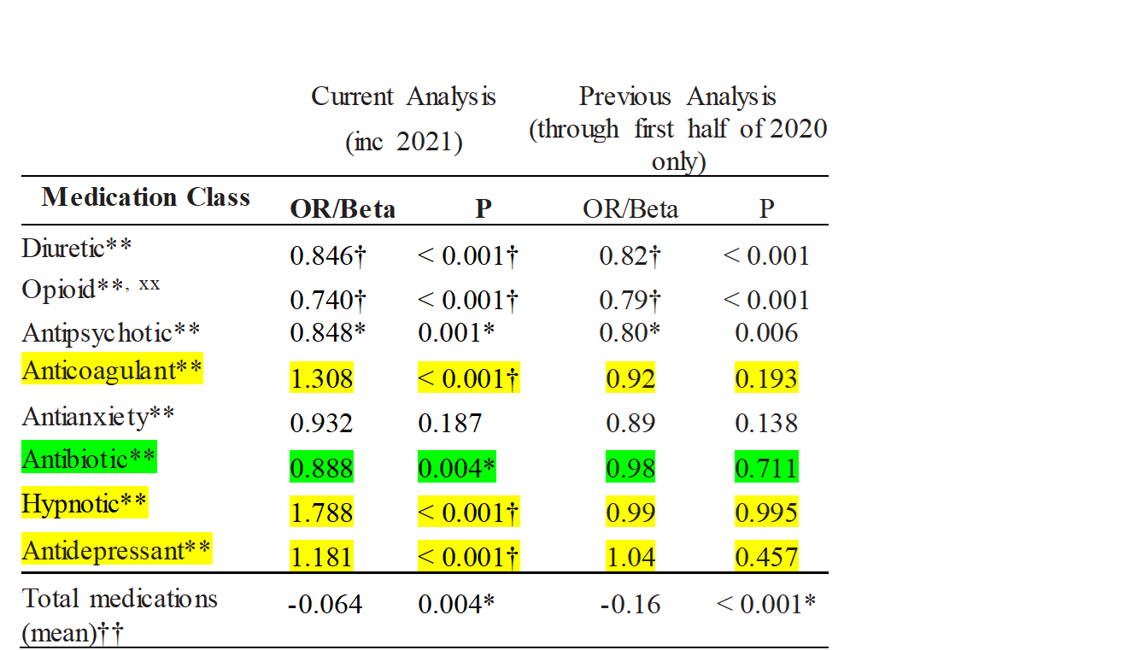
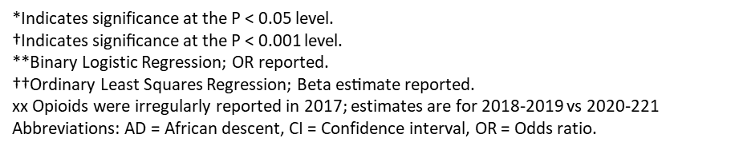
What the Research Found
Coefficients presented are adjusted for AD, Gender, and Age.
Slight change in overall medications, significant after covariate adjustment.
Significant Reductions in Diuretics, Opioids, Antipsychotics & Antibiotics; non-sig reduction in Antianxiety
Increases in Anticoagulants (likely tied to male patients, data not shown) and Hypnotics (very small overall numbers, likely not clinically significant)
Statistically significant increase in Antidepressants, used to offset other medication reductions.
Limitations
Non-experimental – evaluation began when pragmatic DeRx was underway
Single system – may or may not generalize
Opioids not yet included in 2017 (analysis accounted for that issue)
Reliance on MDS, which focuses on billing and reporting vs. clinical utility
Inability to closely analyze impact on adverse events due to limits on data

Slide 42
What this means for Clinical Practice
Pragmatic, real-time deprescribing efforts can have a gradual, but major and sustainable impact
Additional research needed/underway on cost-effectiveness
Research on outcomes needed, but MDS (which focuses on billing issues) may not be most appropriate data source to measure clinical outcomes
Bottom Line: guideline/protocol development, chart review, and an intentional focus on deprescribing efforts can help meaningfully address polypharmacy in a SNF population

Slide 43
Optional: Add citation if work is published
A paper has been published from this project, describing the intervention in more detail, and INITIAL results. The work presented in these slides offers a longer-term follow up in the post-intervention period:
Morley CP, Schad LA, Cerio H, McNamara SE, Wojtowycz MA, Smith NH, Noviasky JA, Ulen KR, Townsend K, Amidon J, Brangman SA. Longitudinal Evaluation of a Deprescribing Protocol in Skilled Nursing Facilities. Sr Care Pharm. 2022 Oct 1;37(10):523-531. doi: 10.4140/TCP.n.2022.523. PMID: 3617167
https://www.ingentaconnect.com/content/ascp/tscp/2022/00000037/00000010/art000101.

Slide 44
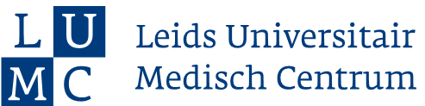

Antibiotic resistance of
Helicobacter pylori in primary care: an observational cohort study
G. van den Brink*¹, L.M. Koggel*², J.J.H. Hendriks², P.D. Siersema², M.G.J. de Boer³, M.E. Numans ¹
¹Dept. of Public Health and Primary Care, Leiden University Medical Center, Leiden & Health Campus The Hague, the Netherlands
²Dept. of Gastroenterology and Hepatology, Radboud University Medical Center, Nijmegen, the Netherlands
³Dept. of Internal Medicine and infectious diseases, Leiden University Medical Center, Leiden, the Netherlands
* Shared first authorship
Supported by a grant from the Antibiotic Resistance Care Network Holland West

Slide 45
The Research Question
To determine Helicobacter pylori eradication success over the years in primary care
as a proxy measure of the development of antibiotic resistance

Slide 46
Research Design and Methods
Observational cohort study in primary care
Based on anonymized and coded routine EMR data
Domain patients 18-80 years old found 2010-2020 with
ICPC-code gastric symptoms or
ATC-code acid inhibition
Treated with triple eradication therapy
Outcome
Antibiotic resistance =>
second eradication treatment <12 months registered

Slide 47
What the Research Found
Overall 8% of first H pylori eradication treatments leads to a second treatment within 12 months
Slowly increasing trend of H. pylori treatment failure
Initial treatment clarithromycin and/or metronidazole

Slide 48
What this means for Clinical Practice
Rapidly increasing antibiotic resistance of H pylori reported from secondary care, is partly confirmed in primary care data
Consequence might be the need to change guidelines for the first treatment to eradicate H pylori
Targeting the guideline change towards subgroups at specific risk for failure of H pylori eradication might be needed (additional risks, pretreatment testing, context factors, therapy compliance)

Slide 49
Add citation if work is published
In process

Slide 50
Electronically-delivered push notifications improve patient adherence to preventive care: a cohort study
Lenard Lesser, MD, MSHS
Esha Datta, PhD
One Medical

Slide 51
The Research Question
Will push notifications via a mobile application increase adherence to preventive services?

Slide 52
Research Design and Method
Using EHR data, we developed lists of patients who were due for annual preventive examinations, cervical cancer screening, and diabetes follow-up labs
We used the One Medical mobile application (iOS and Android) to send push notifications to patients
We compared the rate of appointment bookings/labs in the intervention group to a matched control group that did not receive the push notifications
The outcome was booking an appointment for an annual preventive exam, a cervical cancer screening, or diabetes labs (A1c and Urine protein)

Slide 53
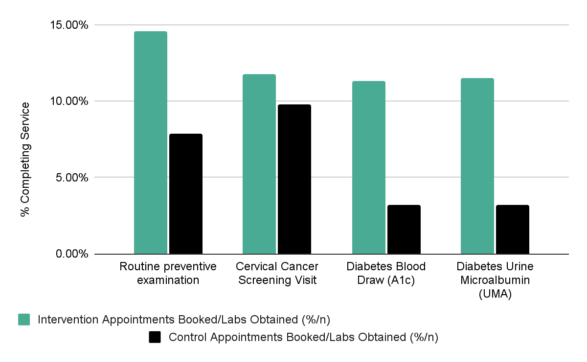
What the Research Found
Those who received the push notifications had a statistically higher rate of preventive visits and labs, than those who did not.

Slide 54
What this means for Clinical Practice
Medical organizations can use informatics to define eligible populations for care reminders
Care reminders, delivered via push notifications on mobile devices, with direct booking links, can improve engagement in care

Slide 55



Patient Function as a Health Indicator of Team-Based Primary Care:
Perspectives from Patient and Primary Care Teams
Greg Cutforth, Catherine Donnelly, Deanne Taylor, Jordan Miller

Slide 56
The Research Question
From the perspectives of patients and primary care teams, what is the understanding of the concept of patient function?
From the perspectives of patients and primary care teams, what is the utility of measuring patient function as a health indicator of team-based primary care for adult patients?

Slide 57
Research Design and Method
We employed a qualitative description study using semi-structured interviews with patients and providers conducted through videoconferencing.
Patients were recruited from within the Interior Health region of British Columbia through the Primary Care Patient Reference Group and primary care networks. Primary care providers were recruited from two primary care networks also operating in the Interior Health region.
Interviews were transcribed verbatim, and the data analyzed by reflexive thematic analysis.
To establish trustworthiness of the analysis findings, the study team used reflexive team meetings, independent coding, member checking, and maintained an audit trail.
The research was approved by the Health Sciences and Affiliated Teaching Hospitals Research Ethics Board at Queen’s University in Kingston, Ontario, Canada and the Interior Health Research Ethics Board. ​

Slide 58
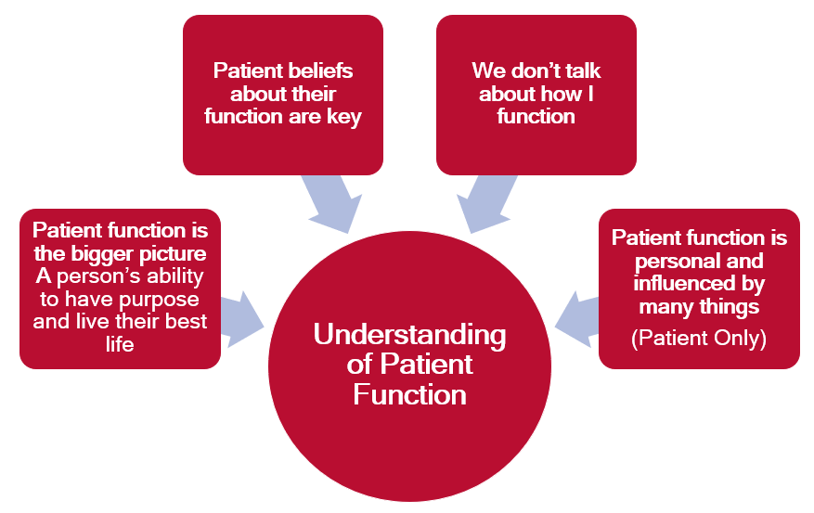
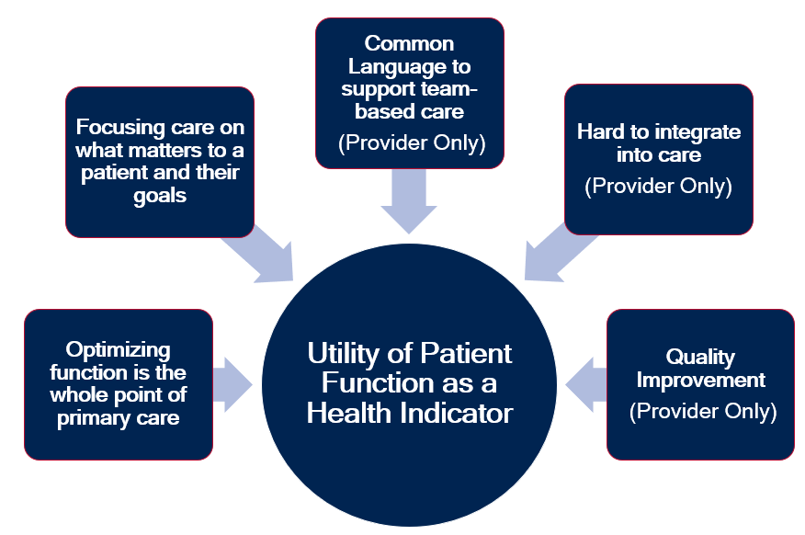
What the Research Found

Slide 59
What the Research Found
The study findings suggest:
Patients and providers generally understand the concept of patient function and recognized the importance of patient perceptions in determining functional status; although patients and providers may not specifically use the term “function” to describe what can be a complex and personal topic.
Patients and providers perceived patient function as an important and useful health indicator for team-based primary care that supports better patient-centred primary care, provides a common language amongst primary care teams, and supports quality improvement; although it may be challenging to implement measures of function into practice.

Slide 60
What this means for Clinical Practice
Patients:
Should ensure their ability to do the things that are important to them in their daily life is part of their clinical interaction with primary care teams (e.g. goal setting, decision-making, measuring outcomes of care).
Clinicians:
Should make a patient’s function part of their clinical interactions with patients and families (e.g. goal setting, decision-making, measuring outcomes of care).
Use patient function to communicate with members of the primary care team.

Slide 61
What this means for Clinical Practice
Primary Care Teams and Managers
Use a patient’s function to inform how the team mobilizes around the patient and their care needs (e.g. care conferences, team member involvement).
Use patient function data to inform quality improvement efforts (e.g. patient education, team training, clinical processes, and service design)
Health Systems and Administrators:
Identify and implement a valid and reliable measure of patient function that is a feasible and useful health indicator for primary care teams.
Utilize patient function data to inform and measure quality improvement initiatives to optimize team-based primary care (e.g. resource allocation, team composition, training and education, and measuring health outcomes for patients).

