Slide 1
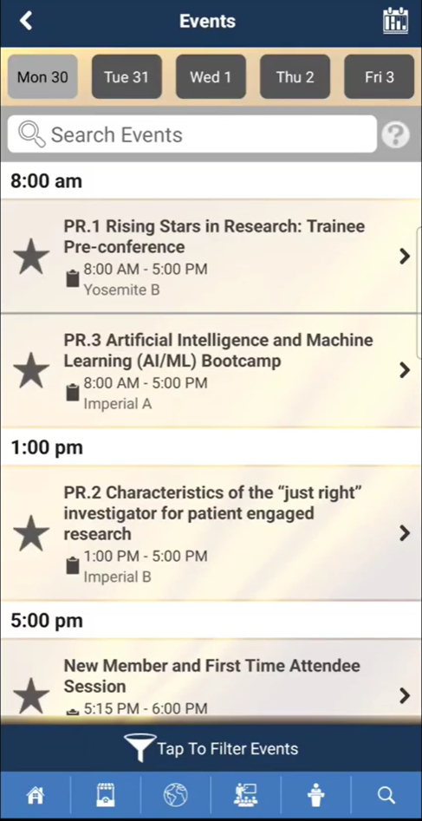
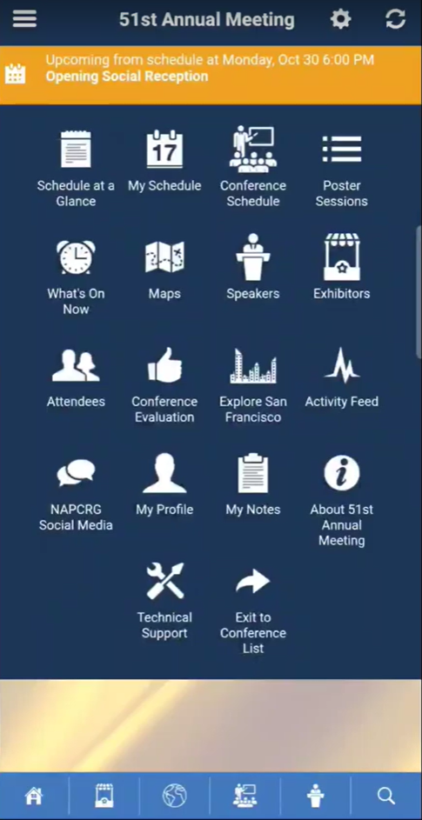
NAPCRG ANNUAL MEETING MOBILE APP
NAPCRG ANNUAL MEETING MOBILE APP
How to search the conference schedule
Once you download the app, it will ask you what conference you want.
Select the upcoming conference for “NAPCRG 51st Annual Meeting.”
It might ask you to “download” the meeting. This is normal and is for downloading any updates that have been made to the meeting.
After downloading / updating the meeting to the latest version you will then be taken to the home screen.
Search by keyword, title, or session code
Filter by event type, research priority, or room name

Slide 2
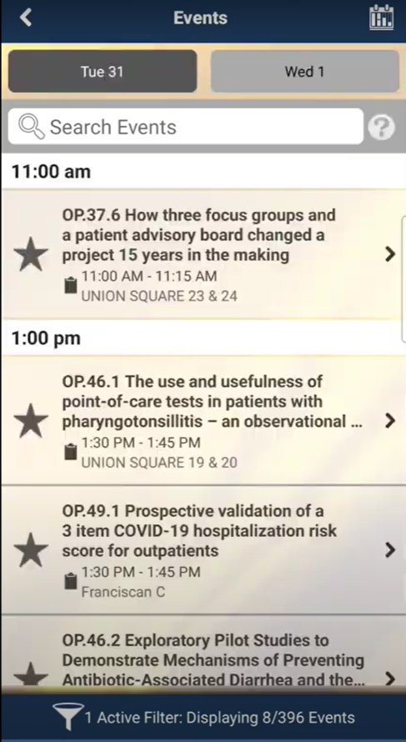
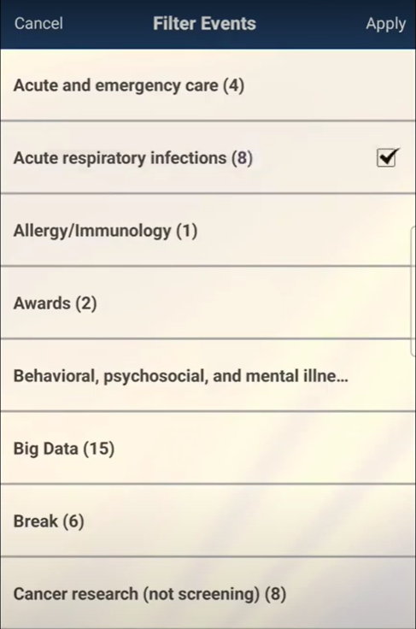
Filtering the Schedule
NAPCRG ANNUAL MEETING MOBILE APP
NAPCRG ANNUAL MEETING MOBILE APP
The results will be filterable by date
Filter page example:
Select the filter category or categories, then press Apply

Slide 3
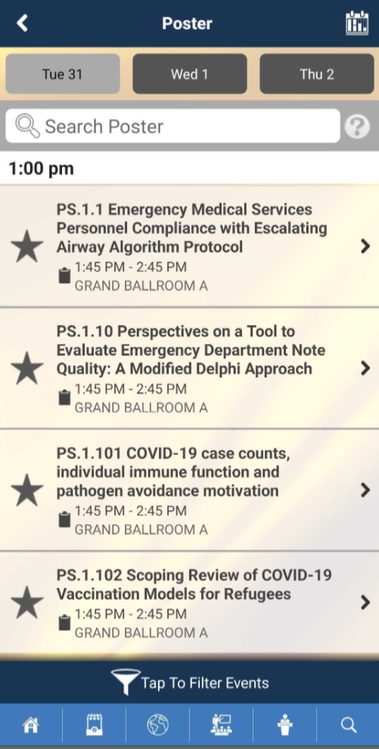
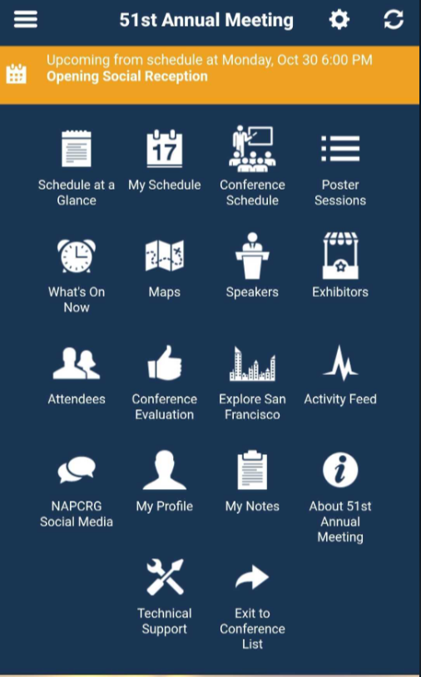
Poster Sessions
NAPCRG ANNUAL MEETING MOBILE APP
All posters are contained within the Poster Session tab
These can be filtered and searched the same ways as the full conference agenda

Slide 4
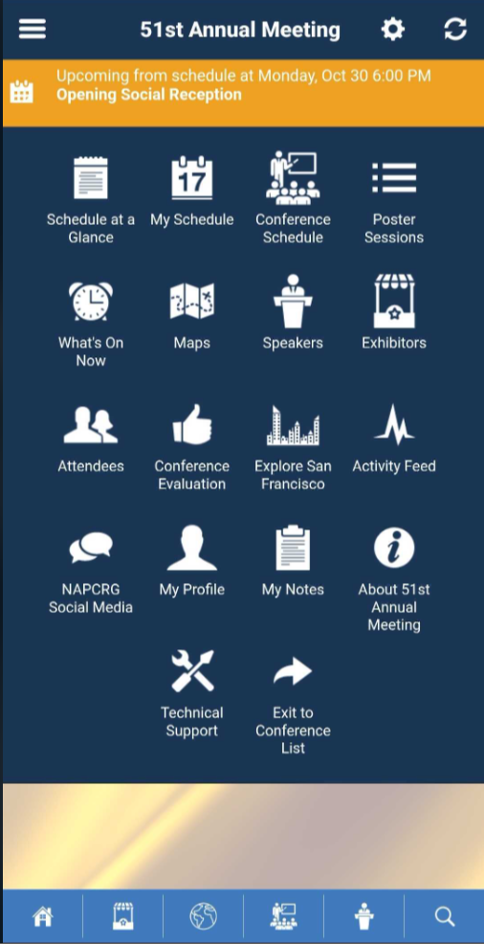
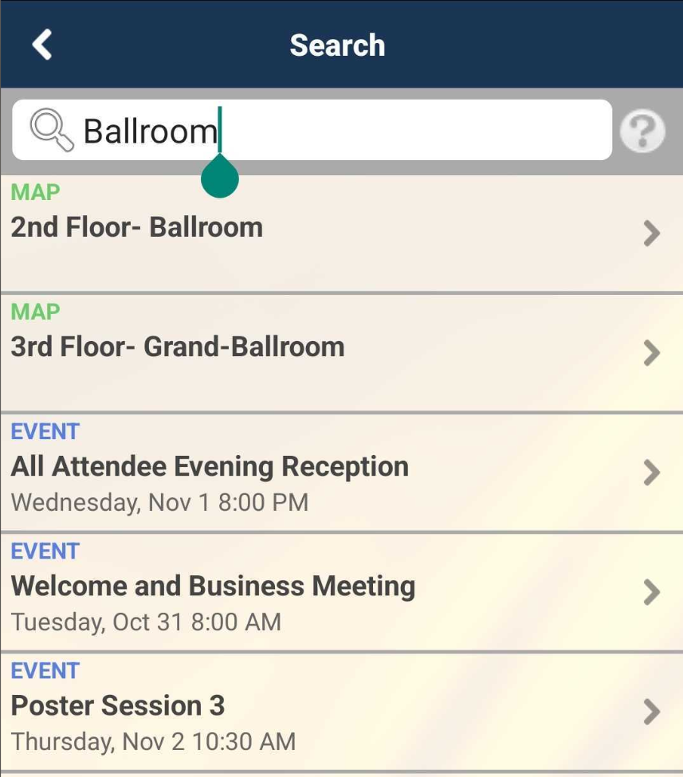
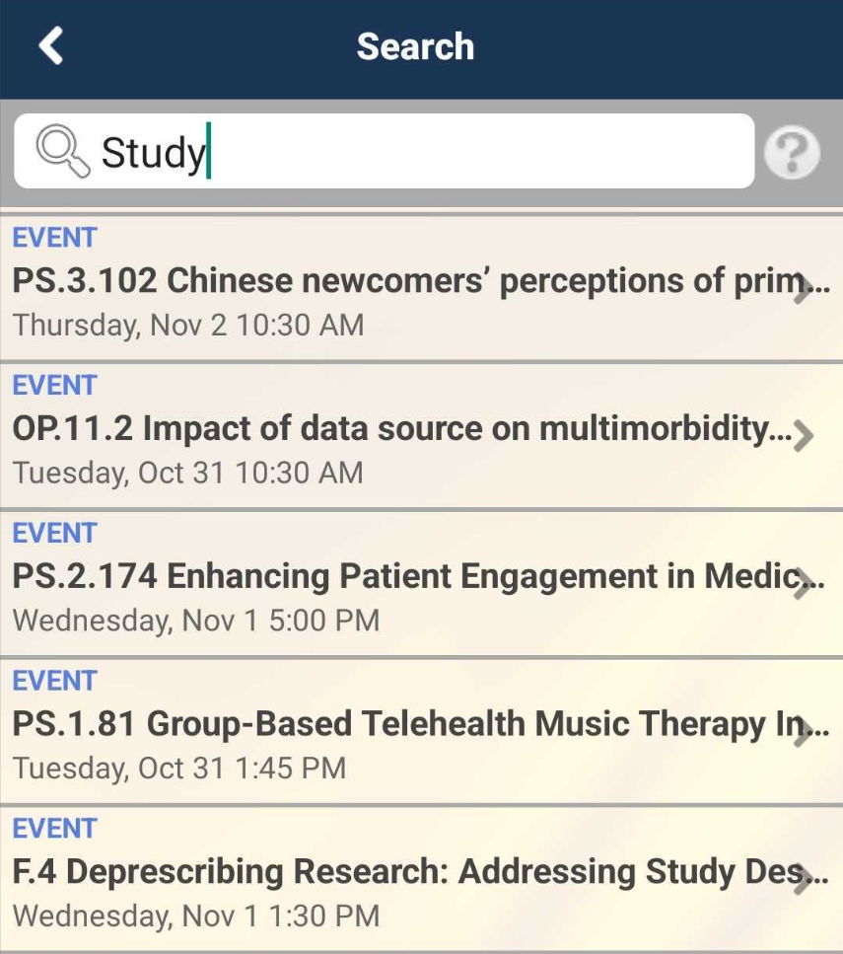
Searching the entire app
NAPCRG ANNUAL MEETING MOBILE APP
Search by any keyword, room, title or name
Select the magnifying glass

Slide 5
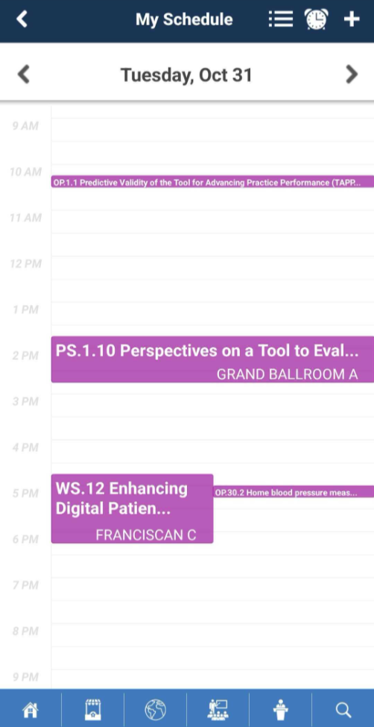
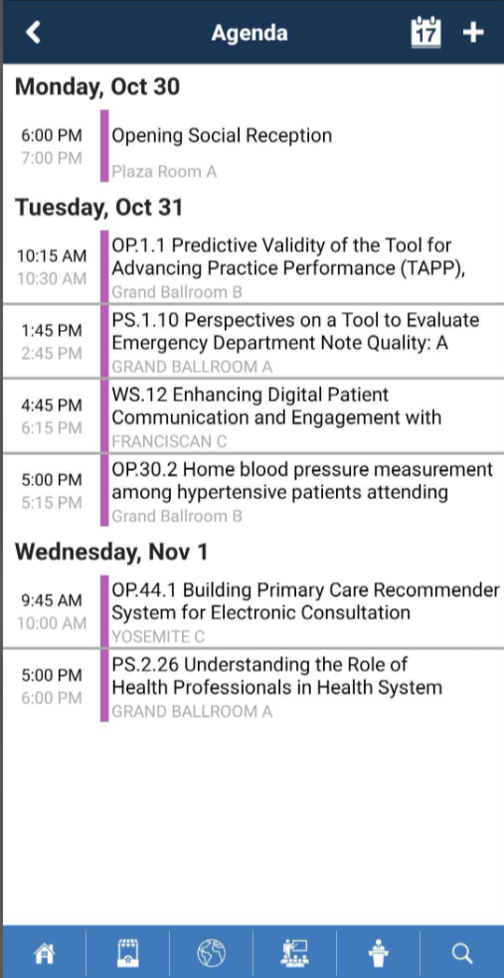
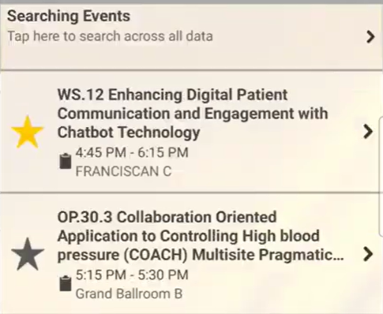
My Schedule
NAPCRG ANNUAL MEETING MOBILE APP
View by Day-at-a-glance
View Full Schedule
Add items to My Schedule using the stars on the Conference and Poster Schedules

Slide 6
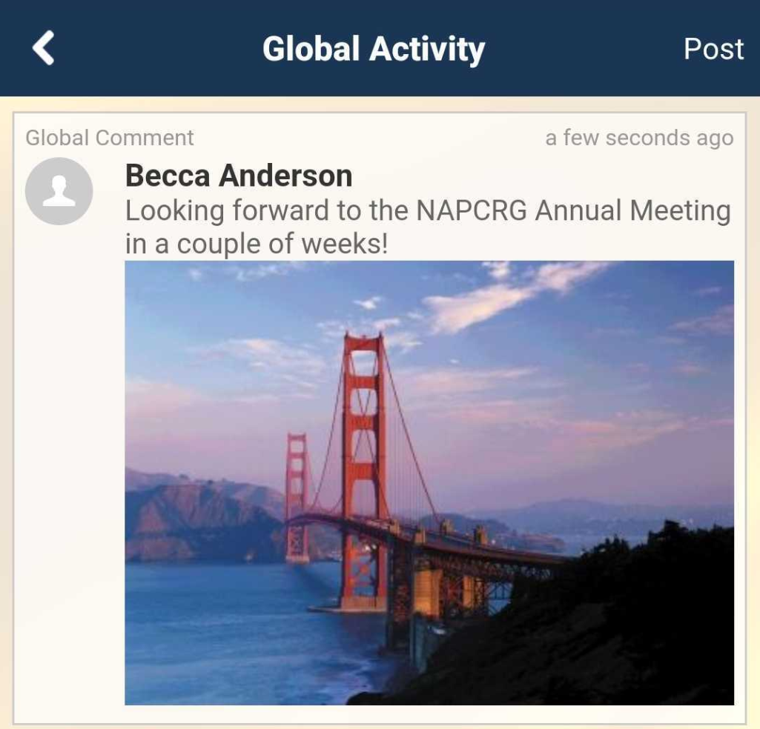
Activity Feed
NAPCRG ANNUAL MEETING MOBILE APP
Use the activity feed as an internal social media network to connect with your fellow attendees!
Please note that by posting photos in the event activity feed, you are releasing NAPCRG to use these in future marketing

