Slide 1
Patient Partners Research Council:
How a Check-In Question Led to Over Five Years of Inquiry
Presenting on behalf of the entire CaReNet Patient Partners Research Council (PPRC)
Kathy Chaten – PPRC Member
Linda Bates Leali – PPRC Member
Mary Fisher – SNOCAP Associate Director/CaReNet PPRC Co-Lead
NAPCRG PBRN Conference, 2024
Notes:
Mary
Thank you for staying until the end of the conference to hear these 4 presentations, and thank you to the NAPCRG PBRN planning committee for setting aside time to have a plenary of this sort. We are looking forward to sharing more about our work in Colorado.

Slide 2
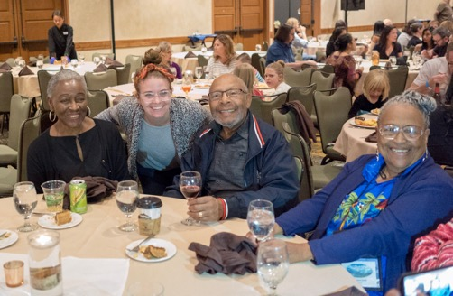
Conflicts of Interest
None (just that we like to have FUN together!)
Notes:
Mary
We have no COI to disclose

Slide 3


Learning Objectives
Demonstrate the value of bi-directional relationships between patients and researchers for long-term engagement.
Share an example of how a patient advisory group went from topic inception to engagement in research with multiple project teams.
Notes:
Mary
3-5 things to get across to the group
Need
Process
Story
Outcome

Slide 4

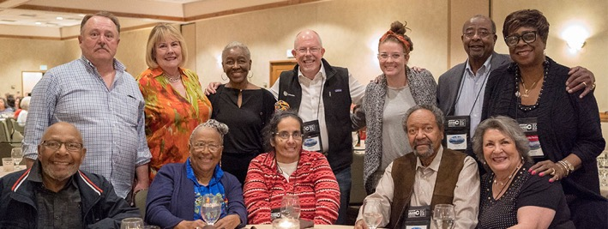
CaReNet PPRC (Patient Partners Research Council)
11 members with varied backgrounds meet bimonthly
Notes:
Mary
Formed in 2005, the CaReNet Patient Partners Research Council (PPRC) gathers regularly (every other month) to serve as patient experts, fully involved in research processes from topic inception to project/product dissemination.
The CaReNet PPRC consists currently of 11 patient partners, mainly retired professionals from a variety of fields, including engineering, education, sales, nursing, accounting, real estate, and government, who live, work, and play in the Denver/Aurora metro area of Colorado. This group is staffed out of the University of Colorado Anschutz Medical Campus in the Department of Family Medicine.

Slide 5
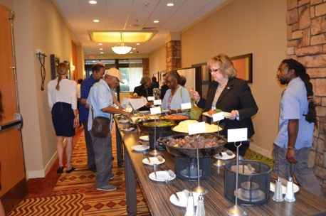
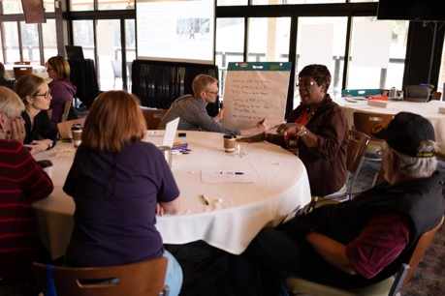
Why work with patient groups?
Ensures that research is informed and balanced
Bi-directional value
Work often leads to more successful long-term engagement
Notes:
Linda
Working with patient groups is highly beneficial from the perspective of both academic researchers as well as community members themselves.
When patient groups are fully brought into the fold of research, the work can be done in a more informed and balanced way, and ultimately lead to work with more meaning and value.
True bi-directional engagement can often look like a coworker, friendship, and family relationship. The PPRC has been able to see much success from the long-term nature of our relationships.

Slide 6
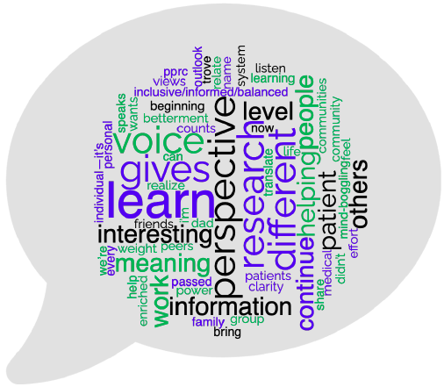
Why does the PPRC keep coming back?
Notes:
Linda
Recently during a meeting with the PPRC, we invited the new chair of the department of family medicine at the University of Colorado. She was invited to learn more about patient groups in our PBRNs.
During the meeting check-in, the PPRC was asked why they have continued to participate for as long as they have (most for 8-15 years). You can see responses to this check in question depicted in this “Word Cloud.”
PPRC members shared that they learn a lot and find the research interesting, they see that their presence gives voice to those who may not be able to, this work allows them to bring more meaning to the work and also gives their lives meaning, but most importantly they want patients to have a voice and for researchers/clinicians to see a different perspective that includes an inclusive, informed, and balanced lens for the research.
It is important to note that in the beginning, the PPRC generally worked on topics that researchers could get funding on, and not much more.
While we still often do that to to keep the work going, we have been able to shift to ensuring we’re working on topics of interest to the PPRC while the CaReNet staff seeks out investigators that have funding or will work to find funding.
This structure helps emphasizes the partnership between patients and research team—there’s a needs-based common thread; but either PPRC member or research team partner can bring topics or research to the table.

Slide 7
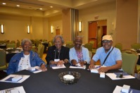
Timeline
January 2020
3 guest presenters:
Drs. Hillary Lum,
David Bekelman,
And Sean Oser
October 2022
End of 2018
Annual convening, SDoH discussions, Mental Health/ COMET training
Check-In Question leading to memory loss conversation
Early 2021
Dementia Caregivers Proposal Development:
Dr. Hillary Lum
2023/2024
March-May 2019
Continued interest in caregiver support and challenges, older adults, and loneliness
Group discussions and invited guest Dr. Dave Nowels
September 2021
“Memory Tech” Project Kickoff
Notes:
Linda
Through the years, the PPRC has worked on topics such as diabetes, chronic pain, patient-centered medical home, and shared decision making, but we have also always been interested in topics around the health and care of older adults.
Towards the end of 2018 at a PPRC meeting, a former member started a conversation during our check-in time. In the world of microwaves and crockpots, she definitely wasn’t a microwave – she didn’t speak often so when she did, we all listened. Her message went far because of who she is and how she came to the table.
She began sharing some recent personal struggles with memory loss and confusion. After she spoke, the PPRC began internally discussing struggles they had experienced with themselves or loved ones who were experiencing memory loss as well.
Others chimed in sharing those they knew with Alzheimers or dementia, as many in the group have served in this caregiver role or have had close loved ones that they have seen struggle with these diseases for years.
In early 2019, the group began discussing the care of people living with memory loss, and wanted to learn more about dementia and Alzheimer’s and specifically their caregivers. This conversation led the group to understand terms such as “cognitive impairment,” “dementia,” and “Alzheimer’s disease,” and ask to seek further information from medical experts.
That conversation has since turned to over 5 years of learning about and understanding the burdens this type of care places on the caregivers; subsequently the group has reached out to several researchers at the University of Colorado to help provide education and background knowledge on this topic.
Let’s look at this timeline to learn more!
Between March 2019-mid-2020, we invited different guests to help our group learn more about topics ranging from basic memory loss to Alzheimer’s disease and dementias to the basics of older adult care and geriatrics.
In early 2021, a newer investigator came along and helped that snowball grow and grow. We advised on a proposal that went in, and then within months were notified that it had been funded and we’d be working on the project with her and her team.
As of September 2021, we were officially partners in this work!
We had never met virtually before the days of COVID, but quickly figured out virtual methods that worked for us to continue the engagement. If we had not continued to meet and talk, this would have been lost due to COVID issues.
We went slightly off the rails late in 2022, but figured out quickly where we wanted to get to. We have followed many different roads, but they all tie in to continued progress down the path toward funding and new learning.
COMET = Changing Our Mental and Emotional Trajectory, a conversation-based approach to discussing mental health in community
Now, over the past 5 years, the PPRC has advised on various project proposals, participated in an advisory group for a caregiver project, and continued to learn more about linkages between other topic areas such as mental health, loneliness, and social isolation.
The PPRC is working hard to continue to learn about topics and share their perspectives in work that is ongoing, as well as provide insight into upcoming proposals for furthering this work. We hope to show how asking a question and then listening for the intent of learning has progressed into a years-long process of inquiry.

Slide 8
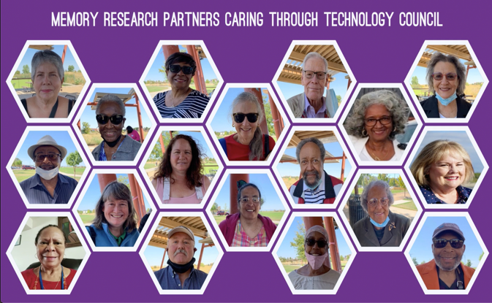
Memory Tech – Dr. Lum
Notes:
Linda
We wanted to highlight a bit more of the work that we partnered with Dr. Lum on, called “Memory Tech.” The photos shown here were a pivotal day for so many. This was in September 2021, when there were still so many questions and concerns surrounding the future of COVID and how best to show up in-person. This day was the official project kickoff, where we got to learn from doctors, researchers, and each other. We added in multiple non-PPRC voices to this work to round out the perspectives. Our voices were truly heard, considered, and brought forward in all of the phases of this project and the resulting work.
One thing we learned from this project was that what we discuss may not be what the other is experiencing at the same time, but a broader group helps to expand the experiences. We understand and experience the topics at different levels and at different times, but We all share this interest and experience. We can’t run from the fact that we’re all aging, but we have the opportunity to give voice to those who can’t.

Slide 9
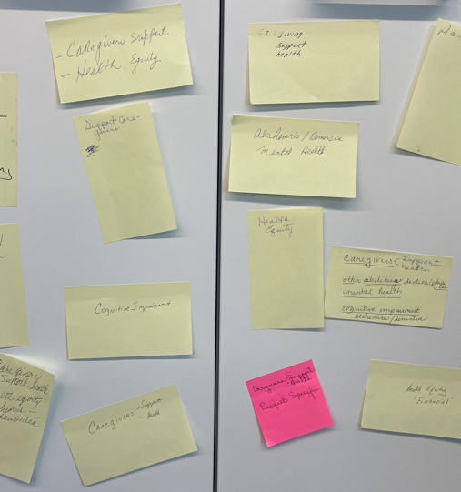
Next steps and Conclusion:
Work toward tangible outcome(s) – project work or otherwise
Group-based work
Topics:
  Caregiver support & health
  Health Equity
  Cognitive impairment
Continue working with Dr. Lum on memory care work
Notes:
Mary
The PPRC’s engagement in the Memory Tech project with Dr. Lum has led to much ongoing work, including that the research team has:
Implemented an adaptation of a pre-visit questionnaire in a geriatrics clinic, based on user-design input from Memory Tech members. The pilot has been active since May 2022. A study manuscript is under review.
A team of researchers have formed the “GeriTech lab”. The goal of this group is to involve persons with lived experience of dementia and/or caregiving as design consultants to help with the co-design of health information technology interventions. The group is submitting grant proposals to fund the next steps of this work.
As we move forward into this next phase, we realized the importance of honing in on what is most important within the umbrella of topics the PPRC has engaged in or learned about over the past 5 years. Moving forward, the PPRC hopes to: continue to learn, learn, learn, as well as engage in projects and other work to come, specifically those with tangible outcomes to share with their community. We also asked if they would like to break off into smaller groups to do more consulting, have a smaller group partner with other researchers, etc, and there was a resounding desire to continue along with their larger group-based work.
Specific topics that the group is choosing to hone in on in the coming months/year:
Caregiver Support & health - 7
Health Equity - 4
Specific note: financial - 1
Alzheimer's/dementia/cognitive impairment – 4
Additional interests that we are keeping on the table but not currently putting focus toward include the overlay with:
Mental health - 2
Ability Declines/Physical - 2
Loneliness and Social Isolation - 1
Next steps: The PPRC continues to engage topic experts and hopes to continue to be a voice in the spaces of dementia/Alzheimer’s disease and older adult and caregiver research.
Conclusion: Engaging patients in the long-term inquiry process has helped to inform a variety of funded projects and has shaped the way patients and researchers see various aspects of the work.

Slide 10
Acknowledgements
CaReNet PPRC
Doug Fernald
Allison Lee
Don Nease
Hillary Lum and the Memory Tech team
Dave Nowels, David Bekelman, Sean Oser, and others
Notes:
Mary
Past and present PPRC

Slide 11

Mary.Fisher@cuanschutz.edu
SNOCAP@cuanschutz.edu
Notes:
Kathy

