Slide 1
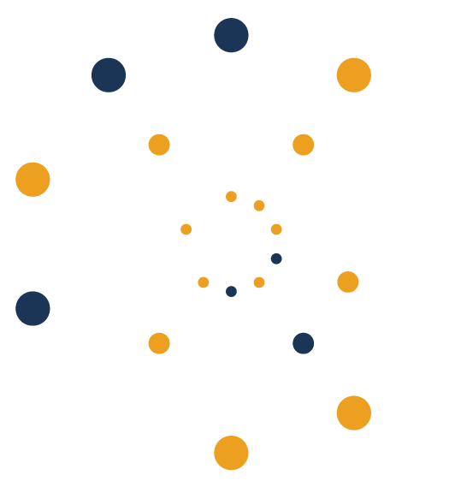

November 20 - November 24, 2024
Québec City Convention Center

Slide 2


Slide 3
Disclosures
Financial Relationships
Unapproved or Investigational Uses
Speakers’ Bureau.

