Slide 1
Reston, Virginia
June 17-18, 2024
2024

Slide 2


SPIDER: A structured approach to quality improvement and deprescribing in older patients; preliminary results of the RCT
Alexander Singer, Michelle Greiver, Simone Darrouge, Donna Manca

Slide 3
Acknowledgement
This study has received funding from the Canadian Institute for Health Research (CIHR) Strategy for Patient Oriented Research (SPOR), CIHR funded Primary Care Research Network as well as in kind and matched funding from the participating universities
Conflict of interest: None to declare for this study.

Slide 4
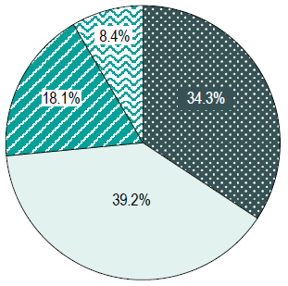
Background
Polypharmacy amongst seniors is prevalent, and may harm patients
    1 out of 4 Canadian seniors (26.5%) fill prescriptions for 10⁺ different meds each year¹
    # of meds prescribed to a patient is the single most reliable index of persistent complexity after age²
      10⁺ meds prescribed for seniors is strongly associated with high care needs for 3 consecutive years: specificity = 95.3%²
Percentage of older patients by # of medication classes
Odds of ongoing high healthcare costs
# of meds
1. Canadian Institute for Health Information. Drug Use Among Seniors in Canada, 2016. Ottawa, ON: CIHI; 2018.
2. Dahrouge S, Wodchis W. Identifying high users in Ontario - an algorithm for use in primary care practices. in preparation

Slide 5
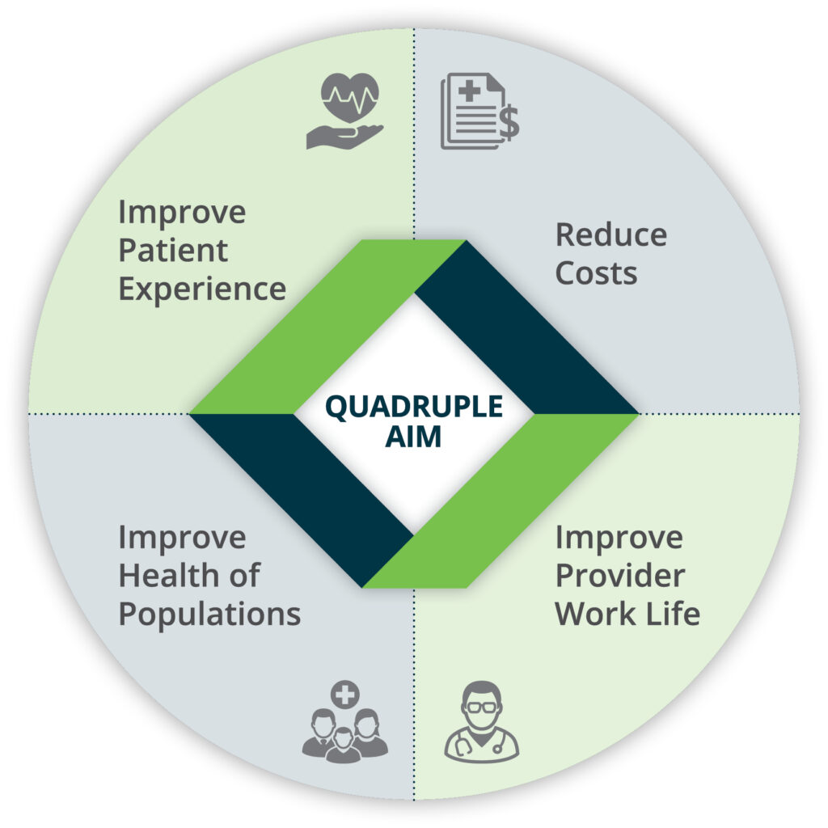
Background
What to improve?
  Medication Appropriateness:
    ↓ use of potentially inappropriate medications
      PPIs
      benzos/Z-drugs
      antipsychotics
      sulfonylureas
How could we improve?
  SPIDER*: evidence-based QI initiatives
How to measure the impact?
  Quadruple Aim
*SPIDER: Structured Process Informed by Data, Evidence and Research

Slide 6
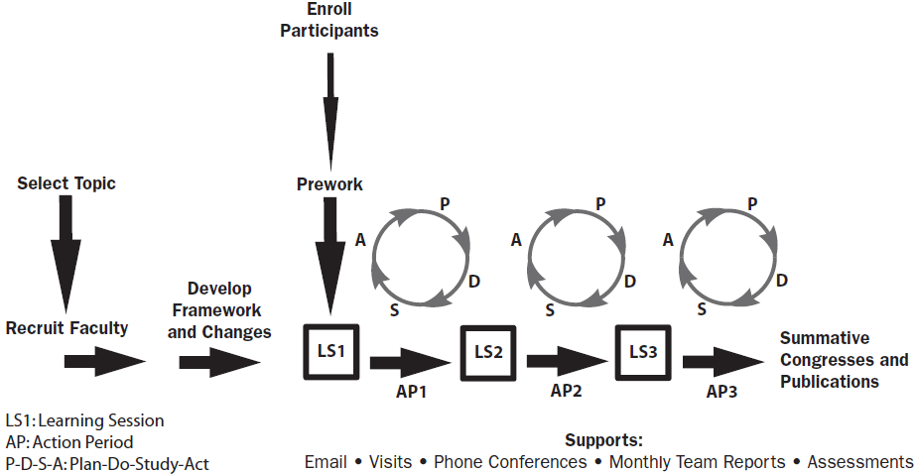
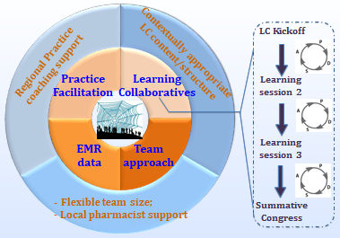
The SPIDER approach – core elements
EMR data for audit and feedback
Coaching support
Inter-professional team-based Learning Collaboratives (LCs)
Patient partners involved from the pre-funding to today

Slide 7
Standardized materials
Study implementation manual
Data collection guide that includes:
  standardized tracking sheets to facilitate recruitment tracking and data collection
  standardized tracking sheet for coaches
Provider guide – intervention arm
Notes:
Being a structured process and in order to collect data in a structured way across provinces, we developed manuals, guidelines, and standardized forms to help with tracking and support coordinators

Slide 8

SPIDER approach
SPIDER
Structured Process Informed by Data, Evidence and Research
Safer prescribing for complex older patients in community-based primary care
QI-focused interprofessional Learning Collaboratives
Practice coaching
EMR data for audit/feedback
A pan-Canadian QI-research collaboration amongst 7 provinces
Manitoba (MaPCReN)
Nova Scotia (MaRNet-FP)
Quebec (RRSPUM)
Ontario (multiple)
Alberta (SAPCReN)
Newfound-
land (APBRN)
BC (BC-CPCSSN)
https://www.spiderdeprescribing.com/
Notes:
SPIDER’s 3 key elements are:
audit and feedback from the practices’ regularly collected Electronic Medical Record (EMR) data
coaching to facilitate practice changes
interprofessional and multi-practices learning collaboratives to promote cross fertilization of ideas

Slide 9
SPIDER Progress by province
Data
presented
Completed
YT
Coming soon
Ongoing
NT
NU
Please join!
BC
Will start soon
AB
SK
NL
MB
QC
ON
PE
NB
  Primary care practices, members of CPCSSN
  2-arm pragmatic cluster RCT: intervention vs. usual care
  8 PBRLNs
  7 practice sites/arm/PBRLN (≥ 2 FPs/site)
NS

Slide 10
SPIDER Preliminary Results, 3PBRLNs
Participating practices/teams
Retention to end of trial: 83%
Survey Completion:
  Baseline: 61%
  Post-intervention: 51%
3 PBRNs: SAPCReN, MAPCReN, MaRNeT |  |  |  |  | Total# of sites: 29 | Total# of sites: 29
FPs | NPs | Nurses | Pharmacists | Admins | QIDSS | Residents | Other | Total
82 | 12 | 3 | 3 | 3 | 2 | 1 | 2 | 108
Notes:
Michelle
Colleagues leading Network right across Canada are participating

Slide 11
CPCSSN EMR “Complex Patient” Data for SPIDER analysis
Total # of patients
SAPCReN, MaRNeT, MAPCReN
Inclusion criteria
N=122,311
(100%)
Patients who are at least 65 years old at start of SPIDER
N=22,218
(18.2%)
Patients who had 2 or more visits to primary care clinic 24 months prior to baseline
N=13,350
(10.9%)
Patients who had 10+ prescriptions in 12 months prior to baseline
N=4,120
(3.4%)
Total # of complex patients
Notes:
Michelle
Colleagues leading Network right across Canada are participating

Slide 12
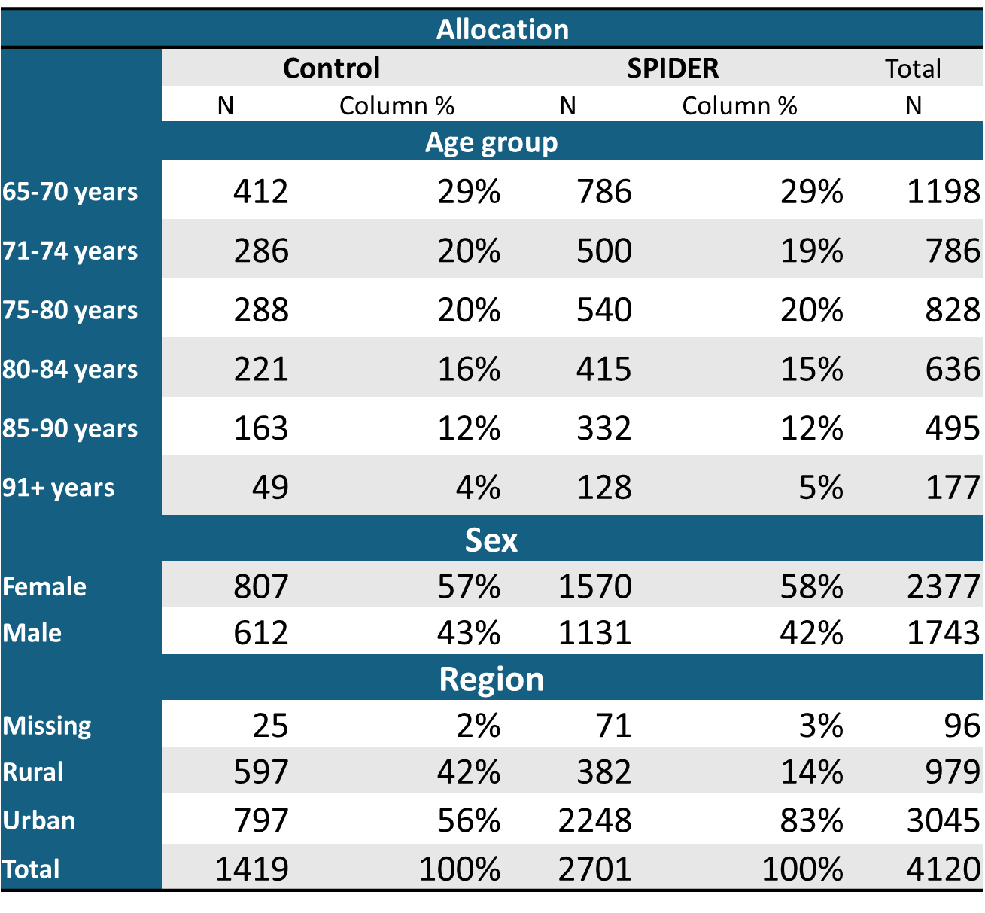
The SPIDER Table 1

Slide 13
SPIDER Preliminary Results (3 PBRLSs)
63% of patients were prescribed at least 1 PIP.
Preliminary analysis: PIPs decreased by 12% in the control arm and 13.3% in the intervention arm.
The proportion of patients not on any PIP increased by 9.5% in the control arm and 10.3% in the intervention arm.

Slide 14
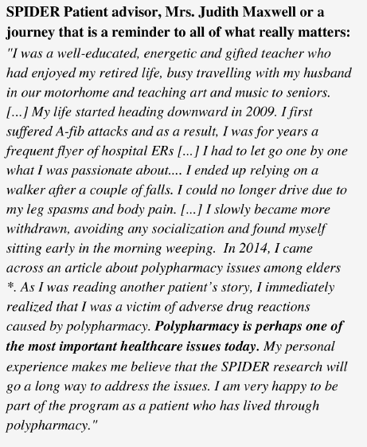

Remembrance for Juanna Ricketts, SPIDER patients partner and patient partner on Maritime Family Practice Research Network advisory committee.

Slide 15
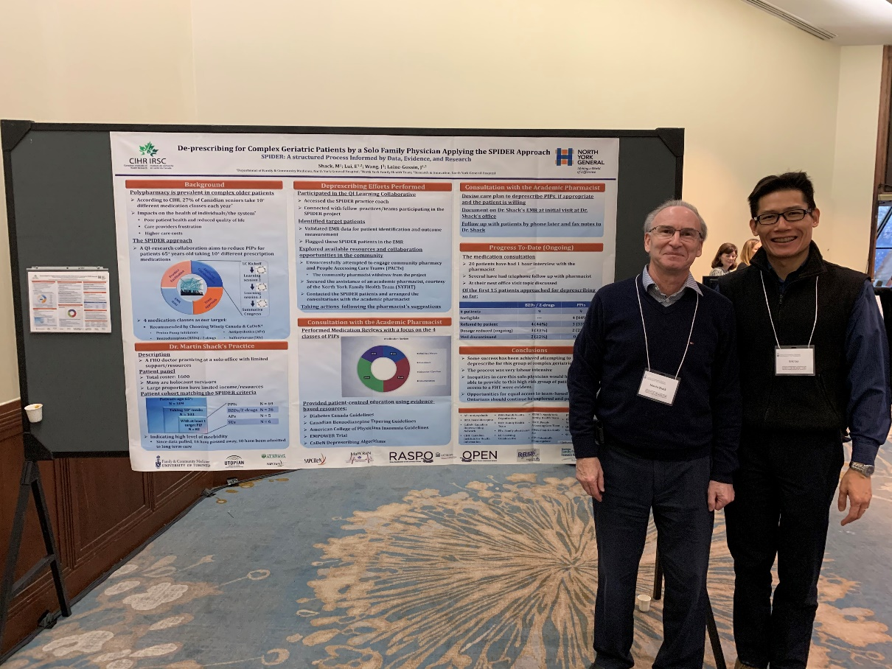
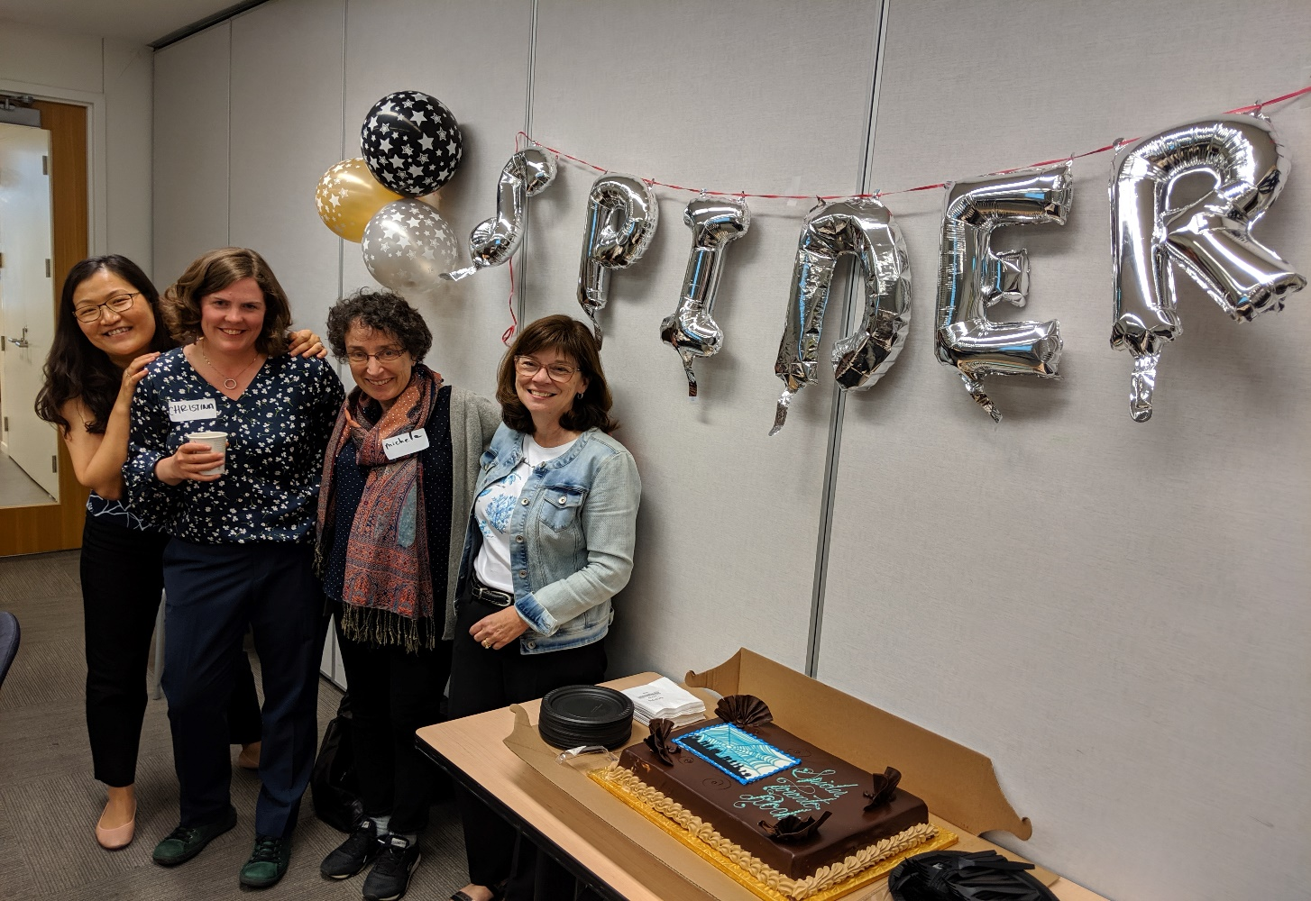

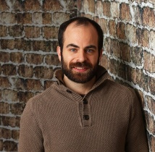











The SPIDER Team

Slide 16











For more information about the study and
deprescribing tools, please visit our study website:
www.spiderdeprescribing.com

