Slide 1
PBRNs and Data
Where Have we Been?
Where Are we Going?
Wilson D. Pace, MD, FAAFP
Chief Medical and Technology Officer
DARTNet Institute
Professor Emeritus, University of Colorado
July 18, 2024

Slide 2
Disclosures
Research Support from AstraZeneca, Boehringer Ingelheim, American Diabetes Association, Delfi Diagnostics,
Stock ownership through a trust: Novo Nordisk, Pfizer, Amgen, Lilly, Stryker, Moderna, Novartis, Johnson and Johnson
No investigational drugs will be discussed

Slide 3
Practice Population vs Study Data
Mackenzie, Pickles, Huygen, Hames, Fry – trailblazers in primary care research
While each provided different views of general practice – they ALL demonstrated the power of data collection as part of routine clinical care
“It was the family doctor who alone saw disease in its true perspective... We are in a position to supply facts from our observation(s) … it is our plain duty to make use of this unique opportunity.”
W. Pickles

Slide 4
Registries and Morbidity Reports
Curtis Hames – his practice and the county were virtually one and the same – he catalogued them both
Fry collected a “minimum data set” at every visit
  Described his practice
  Cataloged diseases
  Calculated rates of illnesses
  Described services required of the family physician

Slide 5
Ambulatory Sentinel Practice Network
Picked up the practice registry construct
Took substantial effort for most practices
  Hand audits of charts to collect information
  Age/Sex registry
  At that point they were binary

Slide 6
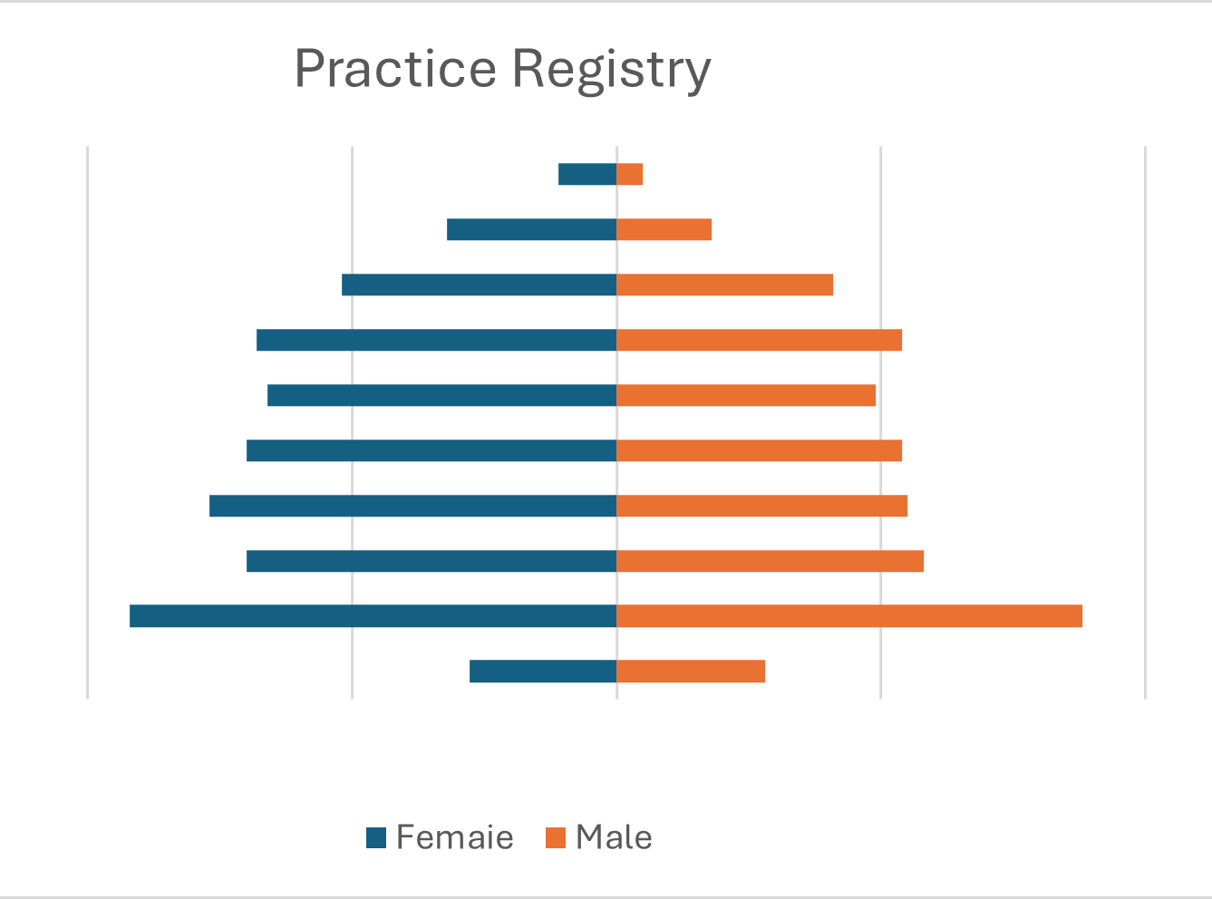
Age/Sex Registry – Continuing to Evolve
> 85
76 - 85
66 - 75
56- 65
46 - 55
36 - 45
26 - 35
16 - 25
6 - 15
0 - 5
1000
500
0
500
1000

Slide 7
Data Collected at the Point of Care
The sine qua non of a PBRN?

Slide 8
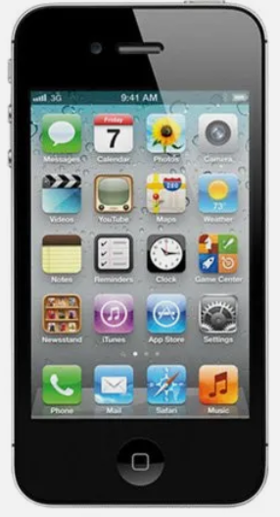

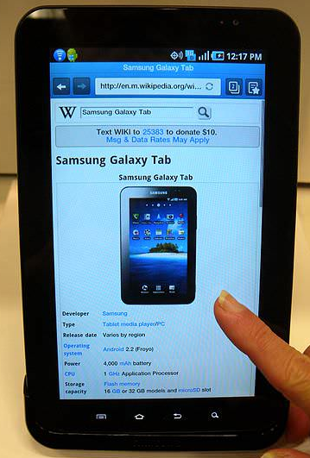
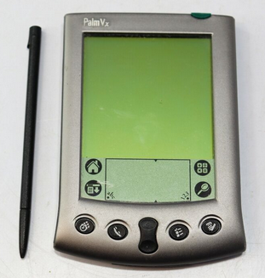
A Decade of Searching
PBRNs explored options for digital solutions for POC data collection
Palm pilots, tablets, smart phones
Add-on activities have been difficult to maintain
Notes:
Relate NDRN story about suggesting a card study when the practice population and current treatment approaches were not well delineated an impacted the study research design – re-review agreed to consider it but the process was seen as antiquated

Slide 9
PBRNs and PPACA
PPACA revolutionized health records in the US
Was this calamitous or fortuitous?
For many it was calamitous with many clinicians retiring
For a few it offered new insights and support for clinical care
For researchers it has been revolutionary
Did it/ has it cost us our “unique opportunity”?

Slide 10
Facile Data Curation and CDS -
Community Acquired MRSA
Study goal: Develop and test sustainable, guideline-consistent treatment strategies for Community Acquired-MRSA
Methods: electronic version of a “card study”
Data sources: EHR, Manual Chart Audit, Patient feedback, and Provider Evaluations – linked for analysis
Integrated a “card” study with EHR data
Incorporated the data collection into clinicians’ workflow

Slide 11
EHR Data to Research Team
EHR data for visits with Skin or Soft Tissue Infection (SSTI) diagnosis
Extracted and sent to research center nightly (no direct identifiers)
  Age of patient
  Culture Records
  Procedure Records
  Prescription Records

Slide 12
Evaluation Invitations
Automated process determined if a provider evaluation was needed
Evaluation invitation sent if:
  Provider consented to participate AND
  Provider had no other outstanding evaluations AND
  Encounter was the patient’s first with an SSTI diagnosis in the past 30 days

Slide 13
Provider Evaluation Overview
Encounters sorted into 16 different clinical scenarios
Clinicians sent a link to report on visit via “card” study specific to each scenario
  Child (yes or no)
  Culture done (yes or no)
  Procedure done (yes or no)
  Antibiotics prescribed (yes or no)

Slide 14
Invitation emails
Sent 1-3 days after the visit
Contain a link to an internal website
Link contained parameters needed to
  Look up and display patient information on internal website
  Directed provider to the correct evaluation
  Linked Provider Evaluation back to the EHR data
157 invitation email messages sent
111 completed evaluations (70.7% response rate)
On average, clinicians completed the evaluations in 3.5 days.

Slide 15
Advantages and Limitations
Advantages over traditional card study
  All cases captured
  Does not require provider initiation, resulting in better response rates
  “Cards” can be tailored
Limitations
  Accuracy of Data Capture
    Culture results slow to appear in EHR
    Some antibiotics handwritten, not captured in EHR
    Procedures not captured reliably in EHR
    Had to incorporate backup questions into evaluation to account for inaccurate EHR data
  More up-front set up time

Slide 16
Bigger Systems, Higher Tech, Less Flexible
In many/most large systems an electronic card study would be difficult administratively
Real-time access to data in smaller systems can be difficult
How many people have conducted or been involved in a card study of any kind in the last 3 years?
How many have conducted an electronic version of a card study ever?

Slide 17

Where Does the Data Go?
Early on EHRs were generally data sinks – some still are
Converting data into useful information can be difficult
Despite over a decade of effort most clinical organizations
repeat the work of others (guaranteed work for Epic DBAs)
Many smaller organizations still have basic decision support at best
Some have abandoned embedded EHR tools and are struggling to find replacements
Improving point of care information presentation is needed

Slide 18
POC Information Management and PBRNs
PBRNs have been involved in implementation activities
POC decision support/information management logically invoked
  Variable impact
  Too often despised by clinicians
  Passive approaches generally ignored
Both a tool for PBRN research as well as a research topic

Slide 19
Data Driven Implementation – Depression
AHRQ Contract No. HHSA290200500371
DARTNet Depression Task Order – 16 organizations 50+ offices
Clinical Decision Support Systems prompted staff/clinicians for specific patients at specific intervals based on:
  Depression diagnoses OR
  Other diagnoses used to indicate depression AND
  Length of time since last PHQ-9 and other factors
Collected on printed forms given to patient or nurse, directly into EHR, or patient portal
15/16 organizations successfully initiated PHQ-9 data collection

Slide 20
Depression POC CDS Results
81,028 episodes of depression recognized in 61,464 patients from 14 organizations with 5 year look back plus 1 year intervention
4,900 PHQ-9s were collected from 2,969 patients over 3-6 months
25-30% of subjects had suicidal thoughts at some point in time
At one year > 15,000 PHQ-9s collected
Recognize may change visit dynamic
  Goal oriented clinicians may strongly resist
21% stopped using depression part of system at 12 months
  Primary cause – uncovering unexpected suicidality

Slide 21
Data Driven Implementation – Asthma
PCORI Contract: 129408 2023_PEA
Implementation of findings from PREPARE study – R-ICS
Four sites, four different implementation approaches
Two Epic sites using passive Best Practice Alerts (BPAs)
One Epic site using active “Care Reminders”
One site using huddle sheets and one click referrals

Slide 22
Improving Asthma Care
Passive BPA pilot
  Academic detailing to the clinicians (5) by FM champion
  First 150+ patient visits with passive BPA present
  Opened 6 times
  SMART set used 2 times and 2 referrals to pharmacist
SMART set found by pulmonary NP – used 25 times with/without BPA
Reworking system!
Active “Clinical Reminder”
  450+ provided
  200+ new Rxs for R-ICS

Slide 23
Lessons from Multiple Studies:
Don’t Assume –
That clinicians are excited about improving care
That they are comfortable with measurement-based care from PROs
That feedback of performance/missed opportunities will change care
DO:
Engage entire office and orient CDS to all parts of the team
Engage and empower other members of team to initiate action

Slide 24
Data Driven Study Development
Researchers/PBRNs without access to a sufficiently large pool of primary care practice EHR data will be/are at a disadvantage
Drive number of clinical sites from actual data
Use your estimates applied to practice size, not the gestalt of a practice clinician
Develop power from historical outcomes when possible
Consider alternative designs when EHR can provide study outcomes

Slide 25
Data Driven Recruitment
Can you remember waiting for a potentially eligible study participant to show up to be recruited?
Performed my first pharma supported study at the end of residency – I learned quickly that as soon as you study something it disappears
Existing data has replaced that approach – mostly
  CDS can help remind clinicians or the research team at POC
  Automated alerts when an appointment is scheduled
  Outreach to existing patients

Slide 26
Population Based Outcomes
Collected as part of routine care
Powers “QI” based projects
Works well for cluster randomized trials
Allows true stepped wedge designs
Feedback reports can guide implementation projects
Missed opportunities reports can be harder to ignore
But anything is possible, “when you don’t want to do something one reason is a good as another” J Stalin

Slide 27
Understanding the Marshmallow Effect
In an under resourced environment focusing on anything will typically improve that item
Often at the expense of something else
EHR data allows you to track this marshmallow effect
  Implement CDS to increase pneumococcal immunization
  Track herpes zoster, tetanus, COVID background rates

Slide 28
Leveling the Playing Field
My practice is different
My patients are:
  Sicker
  Older
  Have fewer resources
  Etc.

Slide 29
Complex Drug Risk Mitigation
US spends more on drug adverse events than on the drugs themselves
EHR simple drug/drug or drug/disease interactions cannot handle multi-drug regimens
Nuances of drug-metabolic and drug distribution interactions add complexity
Advanced systems able to highlight multiple types of risk along with combined score

Slide 30
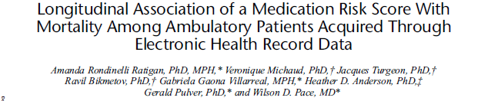
Impact of a High Score
Results of Age-Stratified Cox Proportional Hazards Regression Models Examining the Multivariable Associations of Medication Risk Score with Mortality while Controlling for Covariates among Ambulatory Patients in the United States, 2011-2017
 | All Patients HR (95% CI) | Ages 30-49 years HR (95% CI) | Ages 50-64 years HR (95% CI) | Ages ≥65 years HR (95% CI)
Medication Risk Score
<10 | 1.00 | 1.00 | 1.00 | 1.00
10-14 | 1.65 (1.52 – 1.79) | 2.09 (1.27 – 3.44) | 1.76 (1.41 – 2.20) | 1.50 (1.37 – 1.64)
15-19 | 1.81 (1.65 – 2.00) | 3.35 (1.86 – 6.06) | 2.28 (1.77 – 2.95) | 1.57 (1.41 – 1.74)
20-30 | 2.25 (2.03 – 2.49) | 7.04 (3.86 – 12.85) | 3.54 (2.71 – 4.63) | 1.87 (1.67 – 2.09)
>30 | 2.58 (2.06 – 3.25) | 7.83 (1.07 – 57.21) | 4.95 (2.60 – 9.41) | 2.42 (1.89 – 3.09)
Classic Pharmacist Supported Medication Management Increases overall Risk Scores!!!
Higher scores associated with higher health care costs
Lower score through timing and med changes lowers costs
BUT – only 50% of recommendations are acted upon
Still have a ways to go with implementation of new approaches to care
J Patient Saf • Volume 17, Number 4, June 2021

Slide 31
Beyond the Obvious – AI/ML/Advanced IT
Risk predictions
  Who is at the highest risk of a fall resulting in injuries?
  Who will develop Acute Kidney Injury when using NSAIDs?
  Who will lose function rapidly?
Unexpected relationships
  Which practice characteristics predict BP control?
Office/medicine of the future
  Pre-visit data collection
  Note creation
  Diagnostic checks

Slide 32
% Patients > 18 BP Not at Goal

Slide 33
% Pts BP Not at Goal Adjusted

Slide 34
54 Variables Significantly Linked BP Control
Two of the variables listed below were in top 6: (90% of all variance associated with the top 6)
Presence of a care manager
Percent of patients treated for BPH
Use of combination drugs for hypertension
Frequency of office visits for people with HTN
Percent of office visits for URI

Slide 35
54 Variables Significantly Linked BP Control
The two variables in the top 6:
Presence of a care manager
Percent of patients treated for PBH
Use of combination drugs for hypertension
Frequency of office visits for people with HTN
Percent of office visits for URI

Slide 36
AI/ML Growth
Most large health systems experimenting with AI/ML algorithms
Economist estimates over 1500 health care oriented AI companies worldwide – 50% started in last 60 months
New algorithms released daily
Validation and testing can be minimal
What to do with systems that return different answers each time the same data is presented to the system?
Exciting/game changing/concerning/scary – take your pick

Slide 37
FDA Recently Proposed Guidelines
Developers must evaluate impact of modifications on use, safety and effectiveness
Developers must develop a Predetermined Change Control Plan including potential modifications, modification assessments and impact of changes
Modification protocol must account for: data management, re-training, performance evaluation and update procedures
Modifications will not require re-approval if all phases followed
Seems to expect a totally predictable process

Slide 38
AI/ML Where is it working?
Radiology – long history of use for over reads
Hospital “command” centers – report using up to 20 AI algorithms with a focus on patient flow – 25% reduction in ED wait times, 40% reduction in admit from ED times, 70% reduction in pre-surgical bed time
Drug discovery – 5 in the pipeline report
Direct to consumer company offering full body MRI for cancer screening AI read for $1350

Slide 39
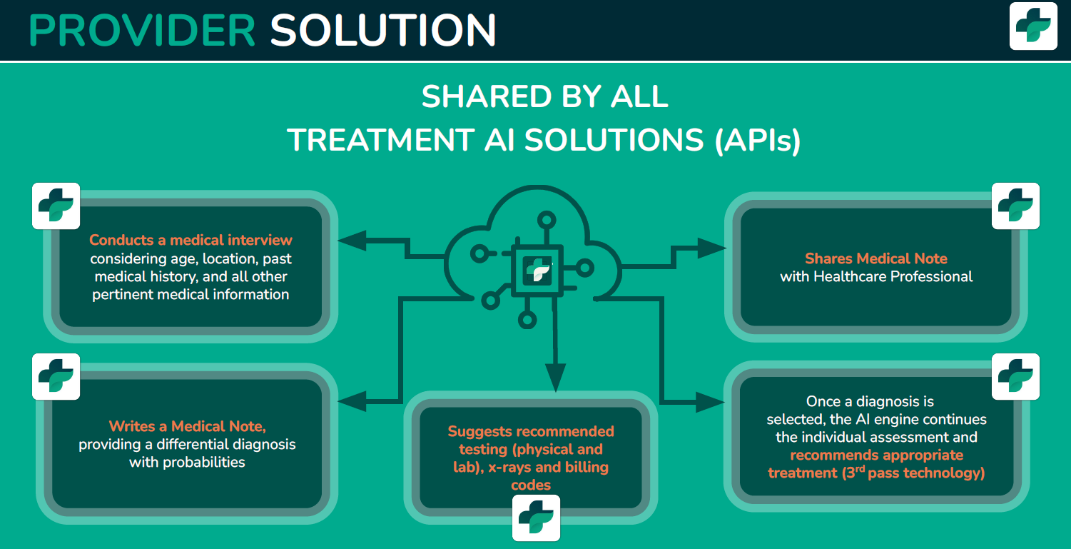
AI/ML Where is it headed?
Courtesy of Treatment AI

Slide 40
AI/ML Concerns
Validation of many algorithms is spotty at best
Hard to “certify” a “device” that can give different responses using the same input data over time
As more people/data are included in the models they will change – this doesn’t compute with our current constructs of medical devices
No standards exist anywhere in the world to deal with an evolving non-human recommendation system

Slide 41
AI/ML Concerns
Many algorithms will be marked directly to the public
Most systems still have obvious confabulations from time to time
Even if only available through a medical professional how do you deal with a novel recommendation that has never been seen before?
Many applications are for screening
USPSTF says there are 7 things that can happen when screening asymptomatic individuals and 6 of them are bad
Will we get the GOOD, the BAD or even the UGLY?

Slide 42
AI/ML and PBRNs
Embrace it as a new technology that requires rigorous assessment in the correct place with the correct population
Consider how it can change office workflow and practices
Further erodes any knowledge differences between primary care and specialists
Consider how it will empower patients
If you thought Google searches were annoying!

Slide 43
PBRNs and Data
We started by exploring practice/community level data
We focused on understanding the processes of care and the natural history of presenting concerns
We have evolved with the world of “BIG DATA”
  Which used correctly strengthens us
We need to embrace what machine learning will bring
We need to push ML, mold ML, evaluate ML and make sure it supports and empowers doctor-patient relationships – not by-pass them.
It will be a challenge
  But may further flatten the differences between specialties

