Slide 1
Development and external validation of the FluScoreVax risk score for influenza that incorporates vaccine status
Mark H. Ebell, Yewen Chen, Fangzhi Luo, Ye Shen, Samuel Coenen, Paul Little, Bruce Barrett, Daniel Merenstein, and Margareta Ieven

Slide 2
The Research Question
The original FluScore was developed and internally validated for the diagnosis of influenza in primary care patients.
The goal was to develop and externally validate a simple risk score for use by clinicians that could identify patients at low, moderate, and high risk of influenza using clinically relevant cutoffs for testing and treatment.

Slide 3
Research Design and Method
GRACE study: 12 European countries from 2007 to 2010. Cough as main symptom < 28 days or suspected of having lower RTI, during flu season.
EAST-PC study in 3 US sites from 2019 to 2023. Acute cough < 14 days + at least 1 chest or systemic symptom, during flu season
GRACE Population (n=1526):
Random assignment 65:35
GRACE derivation (n=992): create several candidate models using logistic regression
GRACE internal validation (n=532): evaluate models for accuracy and choose best one, convert to point score
EAST-PC external validation (n=535): evaluate accuracy, discrimination (AUC) and calibration of final model in a new contemporary US population

Slide 4
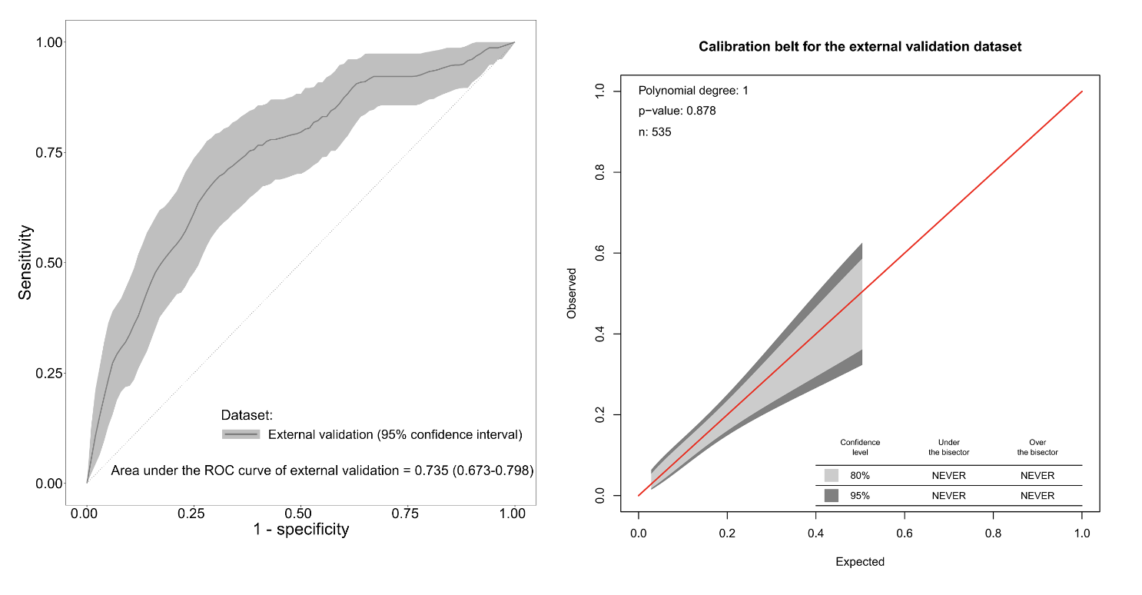
What the Research Found
Predictor | Points
Fever (subjective) | 4
Interfered with usual activity | 1
Headache | 1
Wheeze | -1
Phlegm production | -2
Received flu vaccine this year | -2
Total (range -5 to 6):
AUC 0.735
Very good discrimination (AUC) and calibration of observed: expected in external validation

Slide 5
What this means for Clinical Practice
The risk score has been externally validated in a contemporary US population with very good discrimination, accuracy and calibration
It is especially useful for ruling out influenza: 61% of patients are classified in the low-risk group with only a 6.8% chance of influenza (well below the 10% test threshold)
All of the predictors can be obtained by phone so it is useful for triage
External validation (US EAST-PC population) | Influenza/Total (%) | % classified into this group | Likelihood ratio
Low risk (-5 to 0) | 22/325 (6.8%) | 60.7% | 0.41
Moderate risk (1 to 3) | 31/142 (21.8%) | 26.5% | 1.57
High risk (4 to 6) | 24/68 (35.3%) | 12.7% | 3.06

